Slide 1
Cognitive Model Timing
Retrievals vs Reasoning
Bryan Stearns
University of Michigan
Soar Workshop - May 2019

Slide 2
Cognitive modeling
Test theory of cognition with computational model
Design agent to reflect theoretical processes
Compare agent performance with human performance
Two main ways of testing performance:
Agent achieves same results as humans
Agent takes same time as humans

Slide 3
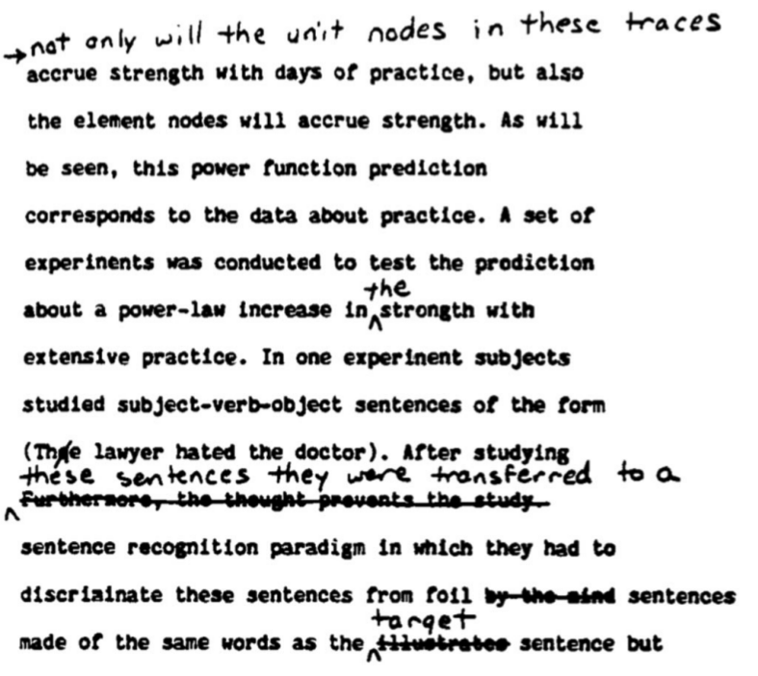
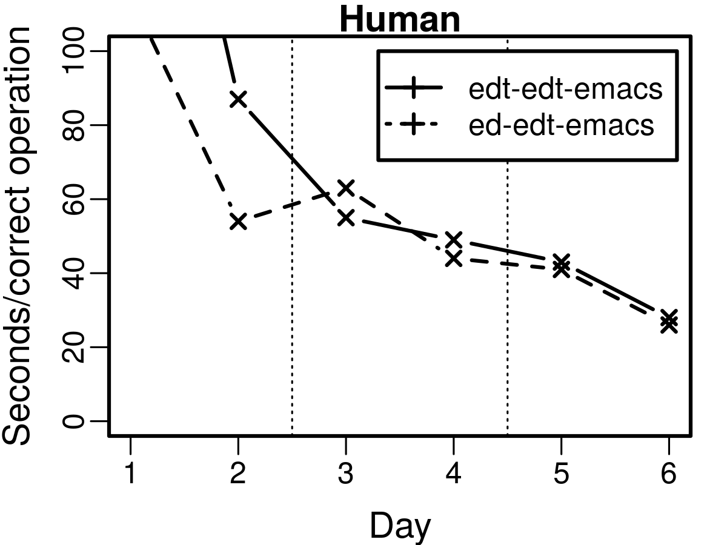
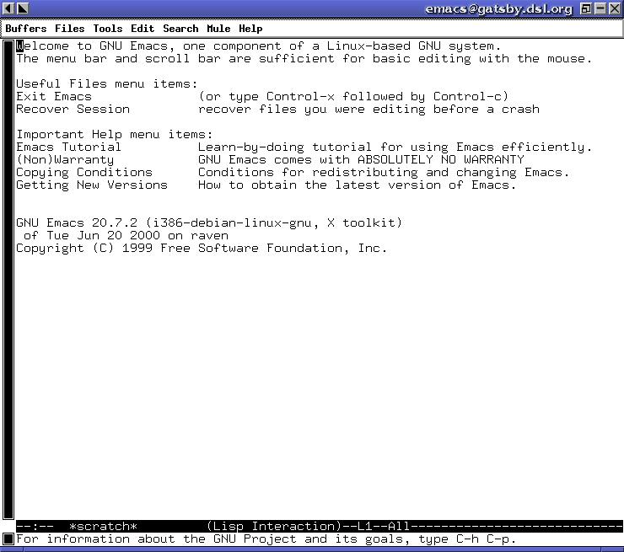
Editors task (Singley & Anderson, 1985)
Human typists
Written edit directions
3 unfamiliar text editors:
ED, EDT, EMACS
EDT w/o practice
EDT after
practice

Slide 4
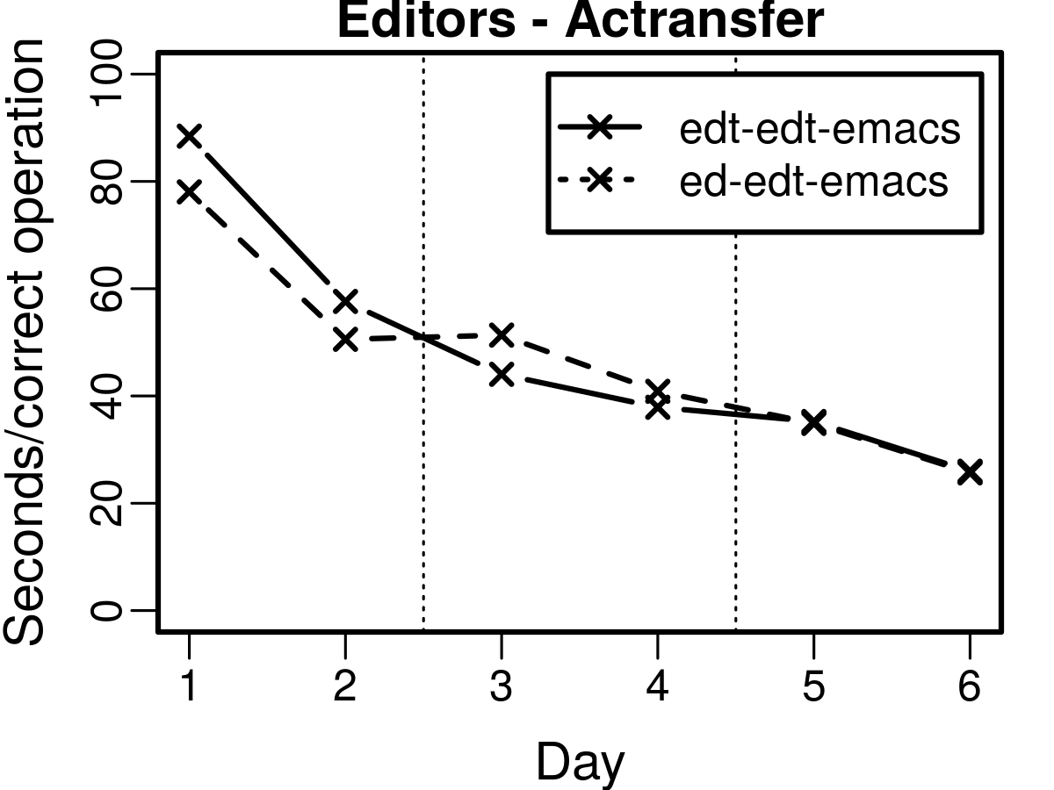
Actransfer Editors model
Actransfer architecture (Taatgen, 2013)
Based on ACT-R architecture
Learns new skills by practice, given instructions
Achieved same transfer as humans
Showed similar timing as humans

Slide 5

Retrieval timing
ACT-R approach: (Brasoveanu, 2015)
50 msec / decision
Extra time for vision/motor processing
Activation-based timing for long-term declarative retrievals:
Activation: Recency, frequency, spreading, fan-effect, etc….
T_{retrieve} : Time to retrieve memory
A : Activation of retrieved memory
F_{r} : Latency-factor (scalar multiplier)

Slide 6
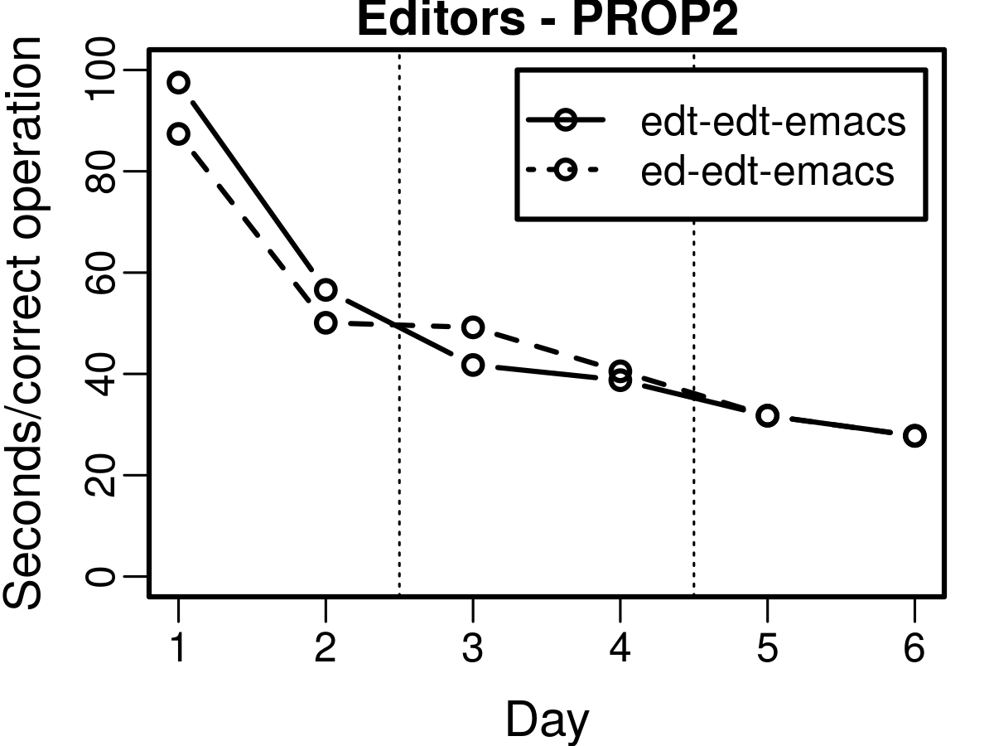
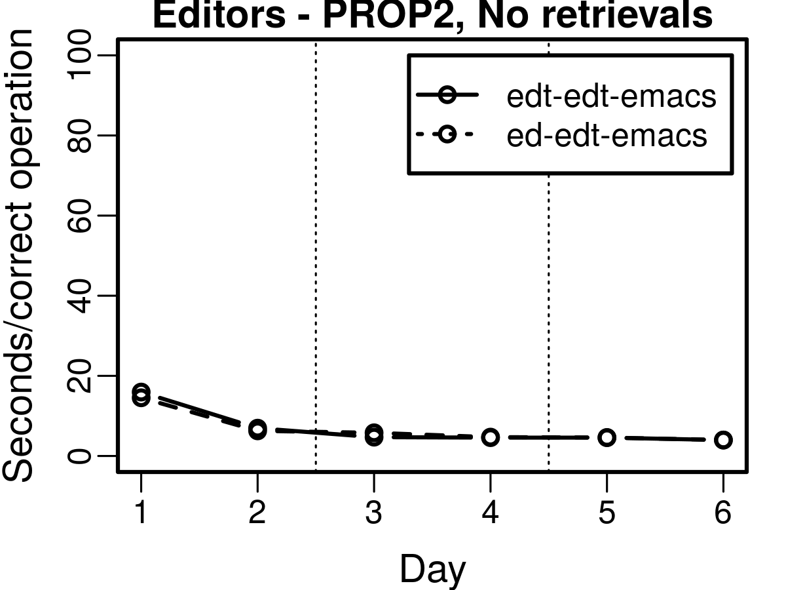
Editors model timing
Model used F_{r} = 1.5
PROP2 replication
(Stearns & Laird, 2018)
See effect of T_{retrieve}
Scale of timing highly dependent on T_{retrieve}
With T_{retrieve}
Without T_{retrieve}

Slide 7
Identifiability problem
Different model mechanics can provide same results
(Beck & Chang, 2007)
How meaningful is model’s explanation?
Editors model:
Explain timing via long-term memory activation
But isn’t a “memory” task?
Hypothesis:
Scales of latency for procedural tasks should be based on procedure complexity, not declarative memory activation.

Slide 8

Procedure contexts
S1
^procedure-context
X1
^name
emacs
^proposable
^proposable
Separate decisions for navigating goal structure
More decisions for complex goal structure
Fewer decisions for simple goal structure
(See previous talk)
New timing function:
T_{goal} : Time to navigate goals
G : Total number of goal modifications
F_{g} : Latency-factor (scalar multiplier)
Soar: F_{g} = 3 x 50ms = 150ms
^proposable
P1
P2
P3
^name
^name
^name
read-cmd
move-cursor
edit-text
S1: # TASK NAMED: Emacs
1: (query-context) # Query: Emacs
2: (collect-context)
3: (read-cmd)
4: => S2:
5: (query-context) # Query: read-cmd
6: (collect-context)
7: …

Slide 9

PROP3
Cognitive model of task learning in Soar
PRimitive OPerator agent -- version 3
Implements procedure contexts in Soar
Models T_{goal}
Doesn’t model T_{retrieve}
Composes operators from primitive memory operations
LOAD, ADD, REMOVE, etc
(Stearns, Assanie, & Laird, 2017)
Same agent rules for any task
Change declarative instructions
“Assembly-level”
LOAD const
EQUALS
ADD
REMOVE

Slide 10
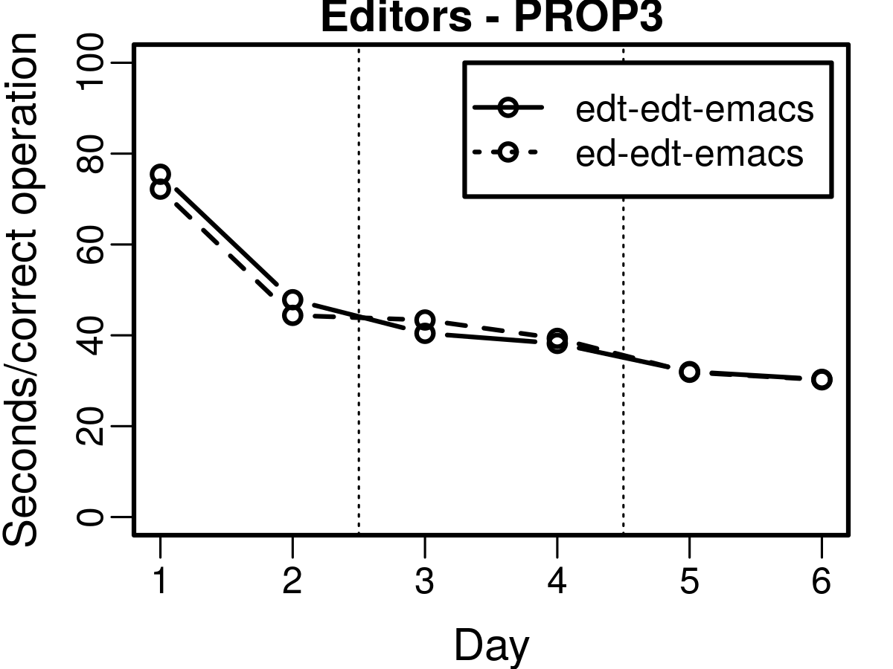
Editors model
Model Editors agent with procedure contexts
PROP3
Use same agent operations and timing
Replace T_{retrieve} with T_{goal}
Gets same temporal behavior
Explains with context switching, not memory activation

Slide 11
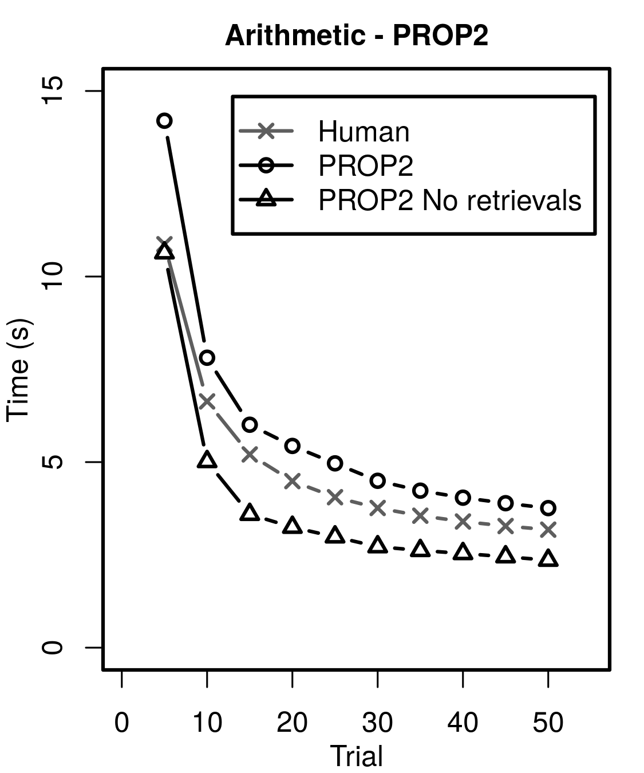
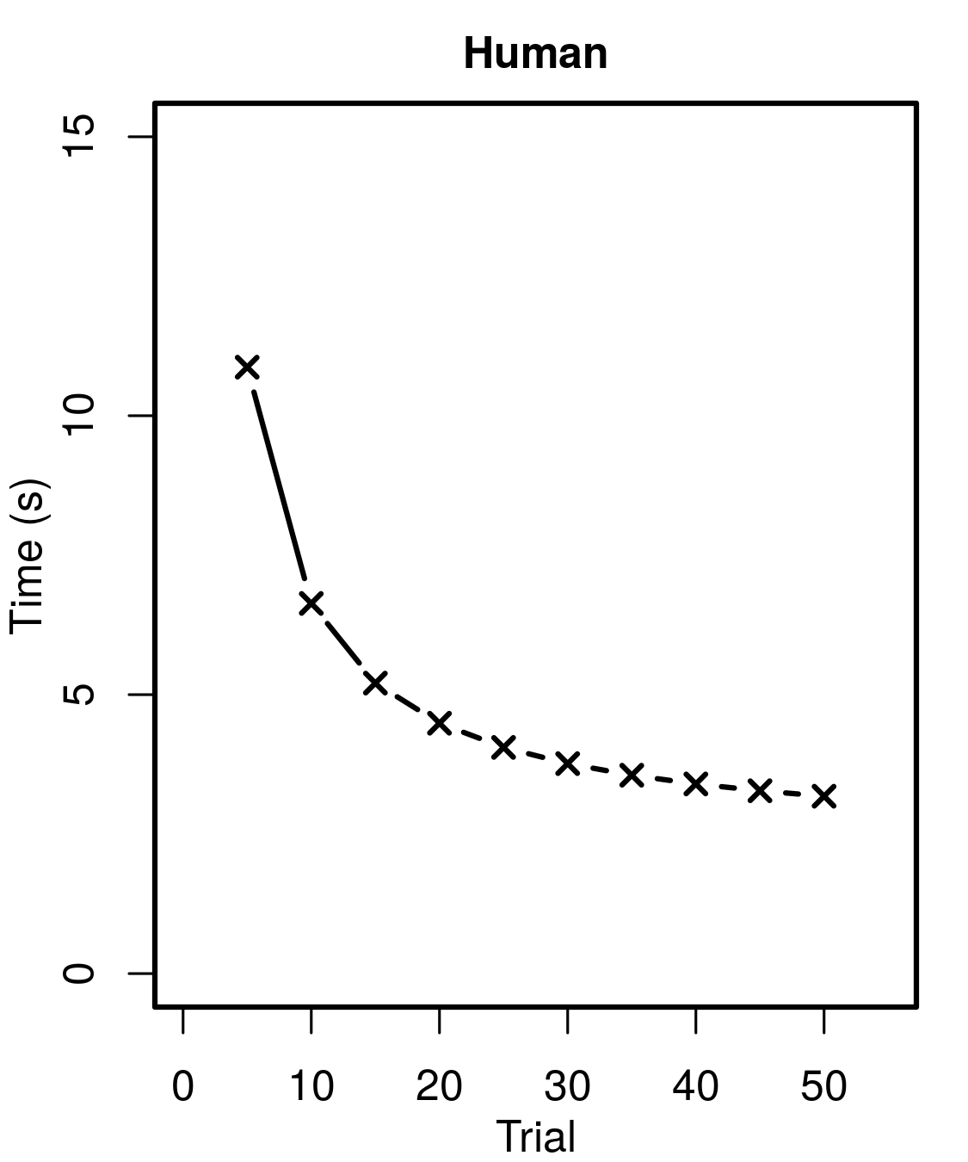
Goal complexity
Var1 <- input1 * (input2 - input3)
Var2 <- max(input4 / 2, input5 / 3)
result <- Var1 + Var2
Editors task has high goal complexity
Time scale ∼ 80-30 sec / operation
Actransfer: High T_{retrieve}. F_{r} set to 1.5
Goals reach depth 6
Human Latency
What about low goal complexity?
New task: Arithmetic (Elio, 1986)
Memorize algorithm, apply to different input
Time scale ∼ 10-3 sec / trial
Actransfer: Low T_{retrieve}. F_{r} set to 0.15
Goals reach depth 2

Slide 12
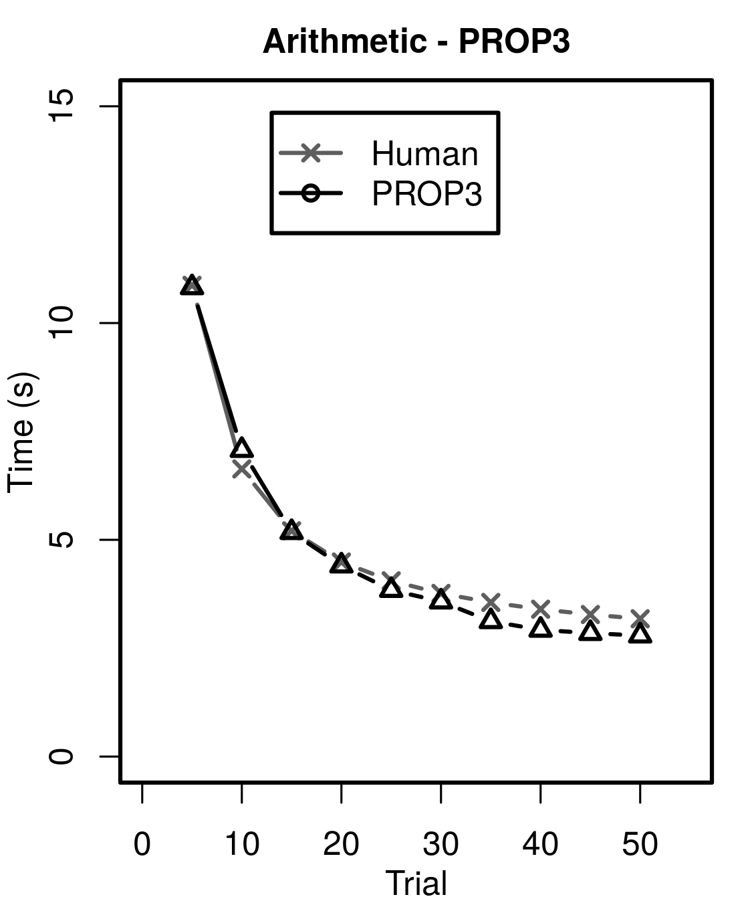
Arithmetic model
Model Arithmetic task using procedure contexts
Use same agent operations
Replace T_{retrieve} with T_{goal}
Close alignment to humans

Slide 13
Interpretation
Goal manipulation is valid model of procedural task latency
Removes retrieval time parameter fitting for specific task
Activation and retrievals still important for modeling
Claim: Just not so much for procedural tasks
Additional function to complement model timing:

Slide 14
Speculative context switching?
T_{goal} is time to bring procedures into context
Could reduce latency by loading context before needed
Model of mental preparation?

Slide 15
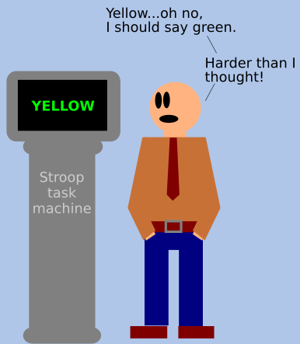
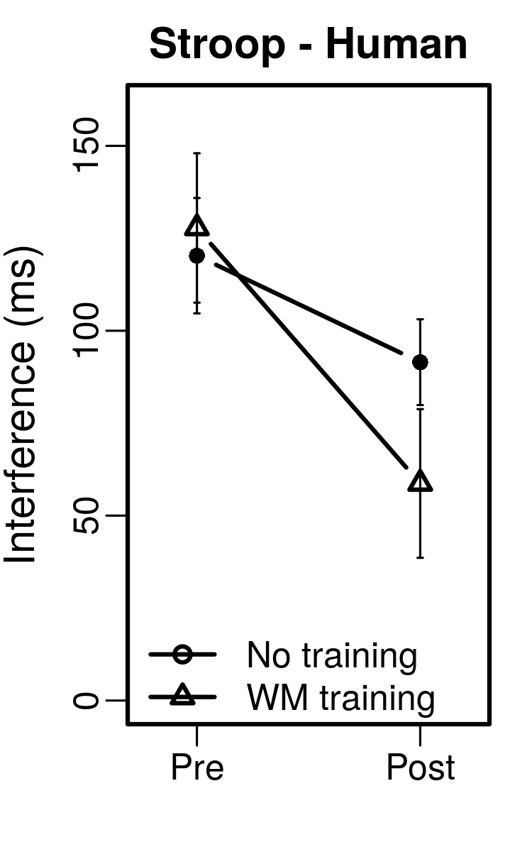
Stroop task
Say color, not the word
Stroop effect:
Longer to answer when mismatch than when match
WM Interference:
Difference in latency
Chein & Morrison (2010):
Interference reduced with WM span training

Slide 16
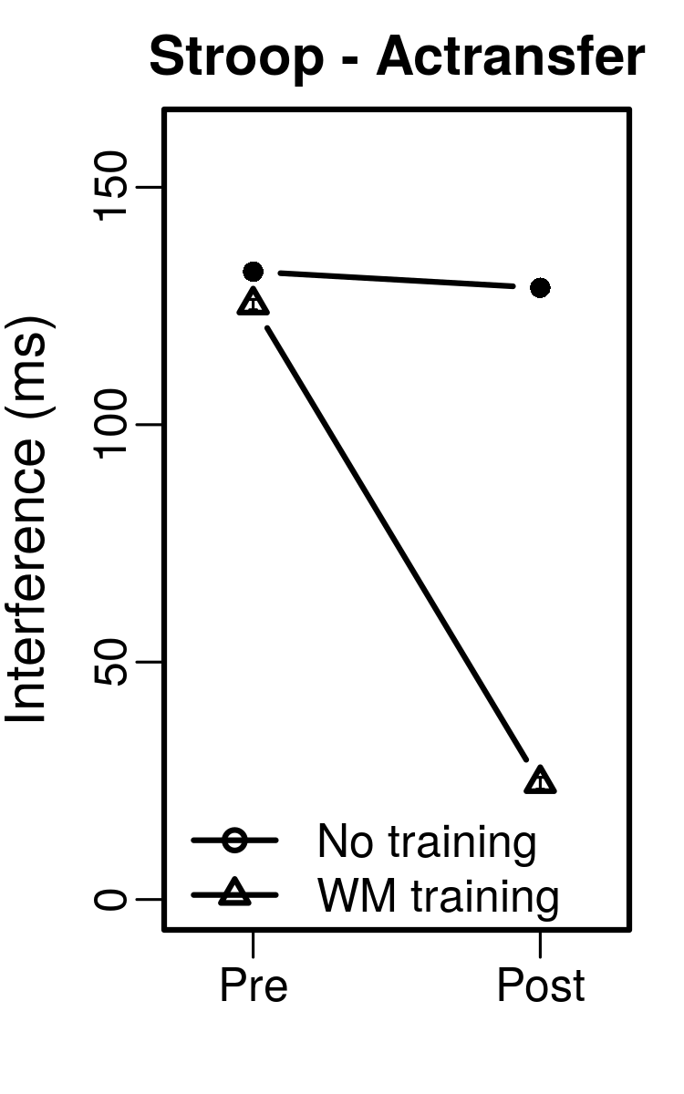
Actransfer model
Model interference via declarative activation
Mismatching stimuli --> lower activation
Model preparation via perception filtering
Train decision to block text stimulus
Practiced decision making gets utility boost
Reduces interference with training

Slide 17
PROP3 model
Stroop
Model interference via context switching
Need time to find correct procedure
Model preparation via speculative context switching
Train decision to load context before needed
Practiced decisions preferred via RL
Reduces interference with training
Prepare
Say Text
Say Non-Text
Say Color

Slide 18
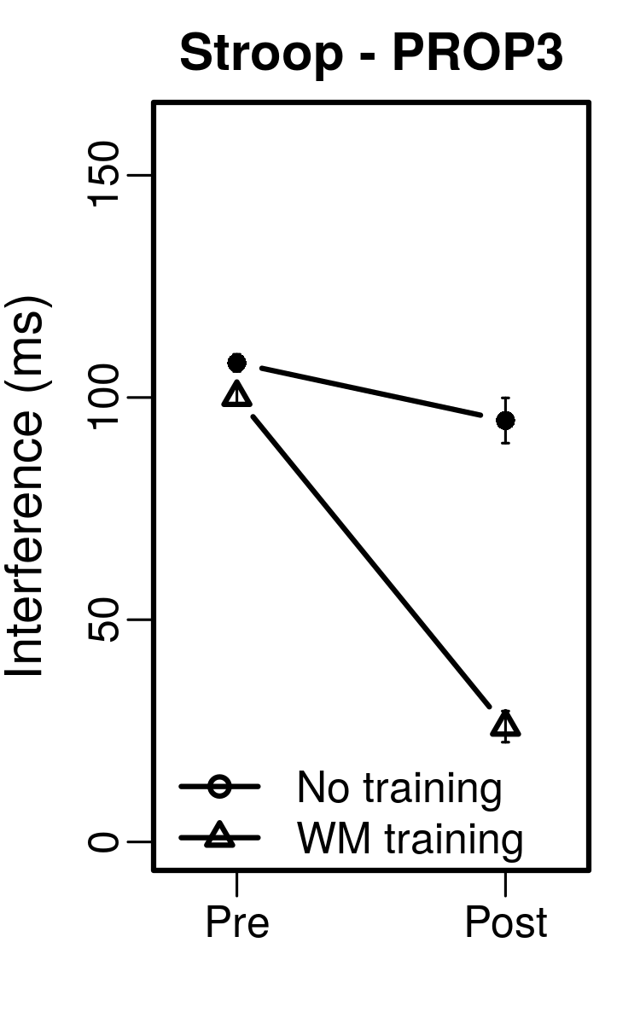
Model results
Procedure context switching can also explain WM interference

Slide 19
Summary
Declarative activation can be used to model procedural skill learning and WM interference
Procedure context switching can also model procedural skill learning and WM interference
Nuggets
Shows skill latency via skill complexity
Option for cognitive modeling in Soar
A new general modeling function - T_{goal}
Replicates human performance across tasks
Common general agent
No parameter fitting of T_{goal}
Coal
Identifiability problem still an issue
T_{retrieve} not explicitly modeled
Interaction between procedure contexts and declarative retrievals not clear
More experimentation needed

Slide 20
References
Beck, J. E., & Chang, K.-m. (2007). Identifiability: A fundamental problem of student modeling. In C. Conati, K. Mc-Coy, & G. Paliouras (Eds.), User modeling 2007 (pp. 137–146). Berlin, Heidelberg: Springer Berlin Heidelberg.
Brasoveanu, A. (2015). Intro to the act-r subsymbolic level for declarative memory. Accessed April 22, 2019. Retrieved from https://people.ucsc.edu/~abrsvn/ACT-R_subsymbolic_3.pdf
Chein, J. M., & Morrison, A. B. (2010). Expanding the mind’s workspace: Training and transfer effects with a complex working memory span task. Psychonomic Bulletin & Review, 17(2), 193–199.
Elio, R. (1986). Representation of similar well-learned cognitive procedures. Cognitive Science, 10(1), 41-73.
Singley, M. K., & Anderson, J. R. (1985). The transfer of text-editing skill. International Journal of Man-Machine Studies, 22(4), 403 - 423.
Stearns, B., Assanie, M., & Laird, J. E. (2017). Applying primitive elements theory for procedural transfer in soar. In International conference on cognitive modeling.
Stearns, B., & Laird, J. E. (2018). Modeling instruction fetch in procedural learning. In International conference on cognitive modeling.
Taatgen, N. A. (2013). The nature and transfer of cognitive skills. Psychological Review, 120(3), 439–471.

Slide 21
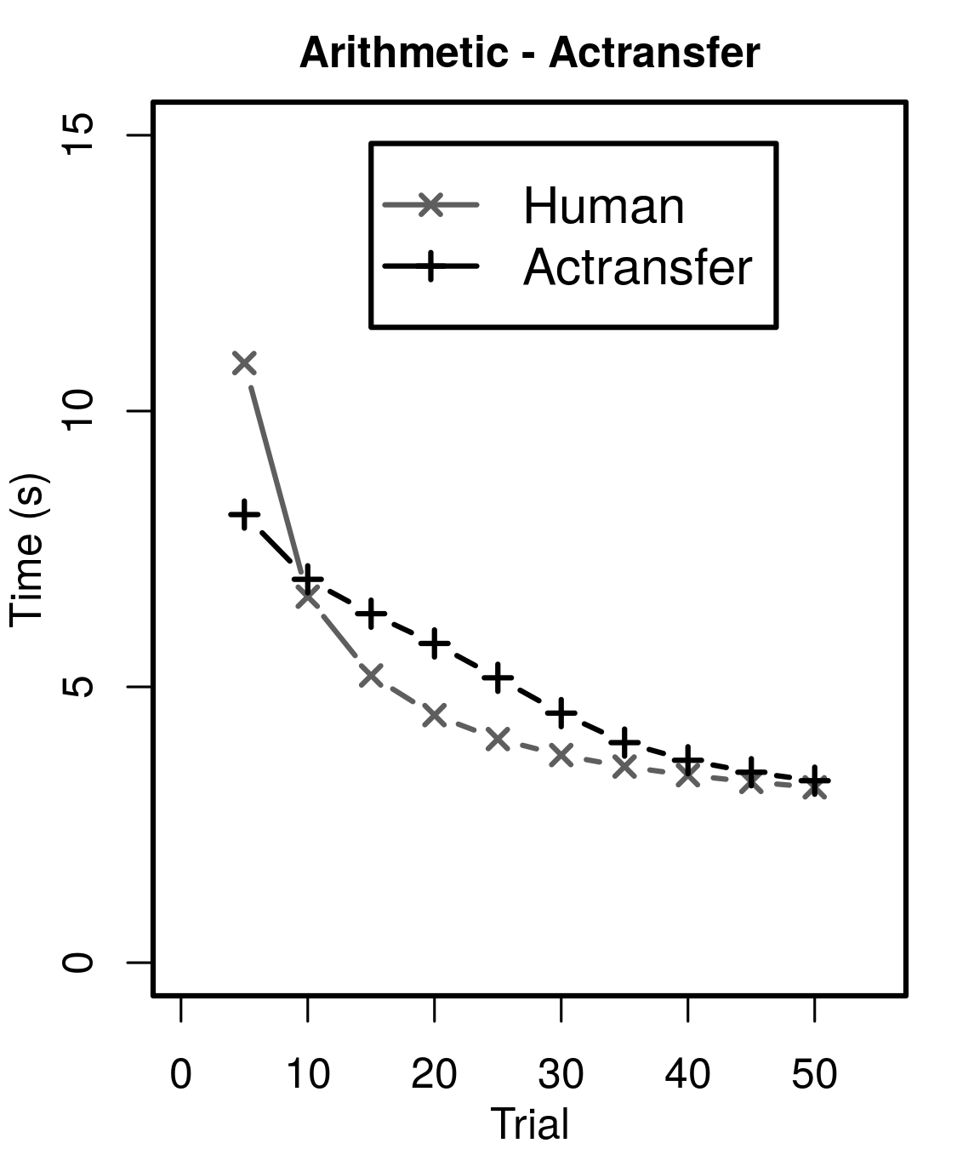
Actransfer Arithmetic model
Procedure learning less power-law effect
Primitives not as primitive (Stearns, Assanie, & Laird, 2017)

Slide 22
Convert to PROP3
IF (Goal == “set-line-strategy”)
AND (target-line-dist > 3)
THEN
((“p-cmd” target-line) --> Output)
(“read-directions” --> Goal)
Use “Goal” buffer value to cluster procedure contexts
But treat goal modifications as separate operators
Same latency calculations
50 msec / decision
Motor/vision latencies
But don’t add latency for retrievals
Decisions for switching procedure contexts
S1
^procedure-context
X1
^name
set-line-strategy
^proposable
^proposable
P1
P3
^name
^name
p-cmd
read-directions

Slide 23
RL with PROP3
sp {rl*template*condition
:template
(state <s> ^operator <o>)
(<o> ^condition.name <name>)
-->
(<s> ^operator <o> = 0.0 ) }
RL template
Per primitive condition
Per proposed operator name
Task-general
Used softmax
Learning rate 0.02
Discount 0.775
sp {rl*template*op-name
:template
(state <s> ^operator <o>)
(<o> ^name <name>)
-->
(<s> ^operator <o> = 0.0 ) }

