Slide 1
Metareasoning for Comprehensive Troubleshooting
James Kirk
james.kirk@cic.iqmri.org
45th Soar Workshop
May 5, 2025

Slide 2
Comprehensive Troubleshooting (CTS)
CTS goes beyond routine troubleshooting, replicating expert human-level skills
In “real world” troubleshooting complex, novel problems and faults occur
Requires wide range of knowledge and cognitive skills, including metareasoning
SOA limitations
Pre-planned responses (checklists, fault analysis trees) cannot address unpredicted complex issues
DL/ML strategies effective for limited TS (e.g., fault classification), but not for issues outside training data
Cognitive architectures support metareseaoning but limited in explorations to narrow domain/task specific scenarios
Requirements for CTS
Capabilities/knowledge to identify, diagnose, and address novel, complex, unseen issues/faults
Need inexpensive/reliable methods for acquiring domain-specific TS knowledge
Need metareasoning and control knowledge to guide CTS

Slide 3
Metacognition for Self-reliability
Comprehensive TS is essential for reliability autonomy
Must identify and address unanticipated problems that inevitably occur
Plan: Leverage LLMs and Cognitive Architectures
Build on cognitive capabilities to support TS steps
Develop metareasoning for control
Use LLMs to provide required knowledge
From generic system model, TS, and metareasoning knowledge: learn specialized domain-specific knowledge to achieve expert-level CTS
Generic
Knowledge
Grounded, domain- specific knowledge
Expert-level
knowledge
Systems Models
Domain-specific TS
General TS
Domain Expertise
Domain-specific MR
Meta-reasoning

Slide 4
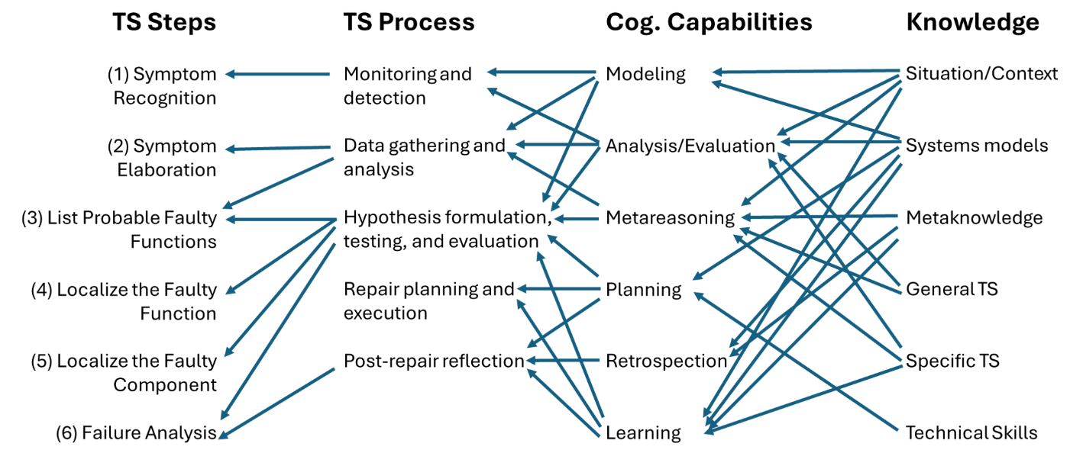
Knowledge and Processes for CTS

Slide 5
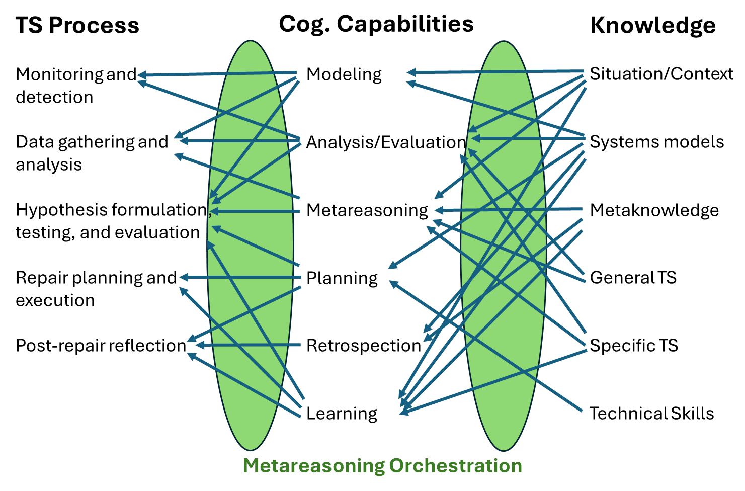
Metareasoning for CTS
Metareasoning Orchestration

Slide 6
Planned Approach
Innovations
Leverage recent LLM advancement as source of domain-specific troubleshooting and metareasoning knowledge
Leverage our prior work on accessing and verifying task knowledge from LLMs for cognitive agents and current working on orchestration with LLMs
Build on existing CA capabilities, skills orchestrated via metareasoning and LLM
Objectives
Acquire domain-specific troubleshooting knowledge for CTS
Acquire domain-specific metareasoning knowledge to orchestrate the usage of cognitive capabilities and access of knowledge during CTS
Learn expert-level CTS through the integration of knowledge and capabilities

Slide 7
Project Plan
Year 1
Develop TS processes in Soar
Explore simple CTS problems
Integrate with simulator(s)
Year 2
Exploit LLMs for specializing metareasoning and TS knowledge
Leverage ongoing working using LangGraph for Metareasoning orchestration
Explore more complex CTS problems
Year 3
Leverage Soar learning capabilities to learn long-term knowledge from specialized metareasoning and TS knowledge
Perform experiments on complex CTS problems

Slide 8
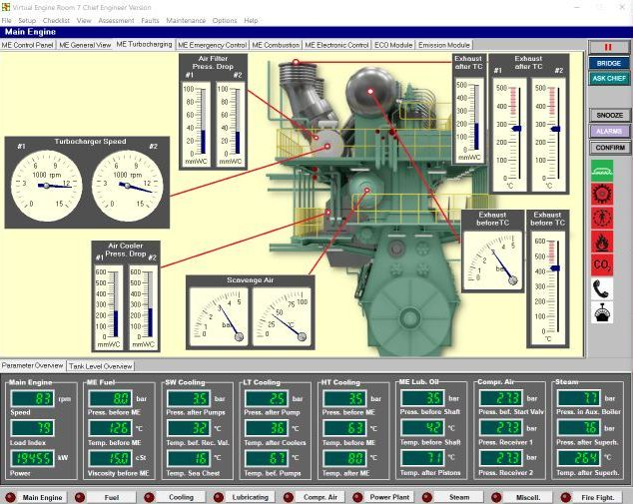
Experimentation Plan
We will evaluate the agents CTS abilities in a simulation environment
Initial investigations with simple simulation environment, possibly drawn from other work (Factorio?)
Planning to use a ship-engine simulator, such as VIRTUAL ENGINE ROOM 7 (VER7) →
Evaluation Metrics
Solution performance: percentage of problems it successfully diagnoses and solves
Efficiency: time, agent processing costs, and monetary cost of experiments (tokens)
Transfer: ability of the agent to use knowledge learned from past experiences to solve new troubleshooting problems more efficiently/directly

Slide 9


Nuggets & Coal
Nuggets
Coal
Grant awarded!
Synergy with other projects, continuing exploration of LLM usage
Haven’t started yet, waiting to receive funding, hopefully in next couple months…

Slide 10
Questions?

