Slide 1
Ongoing work on
Soar linguistic applications
Deryle Lonsdale
BYU Linguistics
lonz@byu.edu

Slide 2
The research
BYU Soar Research Group
  10 active students (many graduating this summer)
  Weekly meetings
  Lots of progress on different fronts
Two applications: NL-Soar and LG-Soar
Today: will summarize several talks (to be) given on research in both applications

Slide 3
Application 1: NL-Soar
Principal all-purpose English language engine in Soar framework
Yearly progress, updates at Soar workshops for a decade now
Gaining in visibility, functionality
Lexicon, morphology, syntax, semantics, discourse, generation, mapping
Major progress: WordNet integration

Slide 4
On-line ambiguity resolution, memory, and learning:
A cognitive modeling perspective
To be presented at the 4th International Conference on the Mental Lexicon
(Lonsdale, Bodily, Cooper-Leavitt, Manookin, Smith)

Slide 5
Lewis’ data and NL-Soar
Unproblematic ambiguity: ✓
  I know that. / I know that he left.
Acceptable embedding: ✓
  The zebra that lived in the park that had no grass died of hunger.
Garden path: ✗
  The horse raced past the barn died.
Parsing breakdown: ✗
  Rats cats dogs chase eat nibble cheese.

Slide 6
Updating Lewis
Use of WordNet greatly increases, complicates NL-Soar’s parsing coverage
Lewis’ examples did not assume all possible parts of speech for each word
We want to show NL-Soar is still a valid model in the face of massive ambiguity
Limit of x (2? 3? 4? ?), WM usage
Refine, extend Lewis’ typology

Slide 7
Approach
New sentence corpus w/ greater range of lexical/morphological/syntactic complexity
  Focus on lexical polysemy/homonymy
Quantitative and qualitative account of the effects
  Working memory
  Chunking
  Lexical aspects of sentence parsing
  Some semantics too

Slide 8
Results we’re working on
Wider array of (un)problematic constructions
Other theories of complexity (Gibson, Pritchett)
Scaling up performance (as always)
Comparative evaluations
Suggestions for follow-up psycholinguistic experiments

Slide 9
NL-Soar and Analogical Modeling
To be presented at ICCM 2004 (Lonsdale and Manookin)

Slide 10
WordNet and NL-Soar
Several previous publications (Rytting)
Works well when WordNet is the basic repository for lexical, syntactic, semantic information
  part(s) of speech, combinatory possibilities, word senses
Problem: WordNet does not cover proper nouns so no semantics (Bush? Virginia?)
Solution: integrate NL-Soar with exemplar-based language modeling system

Slide 11
Analogical Modeling (AM)
Data-driven, exemplar-based approach to modeling language (& other types of data)
  No explicit knowledge representations required, just labeled instances
  More flexible, robust than competing paradigms
  Designed to account for real-world data
Given examples, query with test case, outcome(s) is/are best match via analogy
Previous work: implemented AM algorithm in Soar (reported in Soar19)

Slide 12
Named Entity Recognition
Widely studied machine learning task
  Standardized exemplar corpora, competitions
Given text, identify and label named entities
Named entities: proper noun phrases that denote the names of persons, organizations, locations, times and quantities. Example:”
  [PER Wolff ] , currently a journalist in [LOC Argentina ] , played with [PER Del Bosque ] in the final years of the seventies in [ORG Real Madrid ].
AM does a good job at NER
Notes:
To give background information – the problem

Slide 13
NL-Soar+AM: hybrid solution
Combining the best from both approaches
AM can provide exemplar-based information on information difficult to capture in rules
Called as Tcl rhs function at necessary stages in processing (lexical access for NER)
Data instances: standard NER data sets (CoNLL: > 200K instances, 75-95% correct)
NL-Soar passes proper noun to AM, AM returns its “meaning” (person, place, organization, etc.)

Slide 14
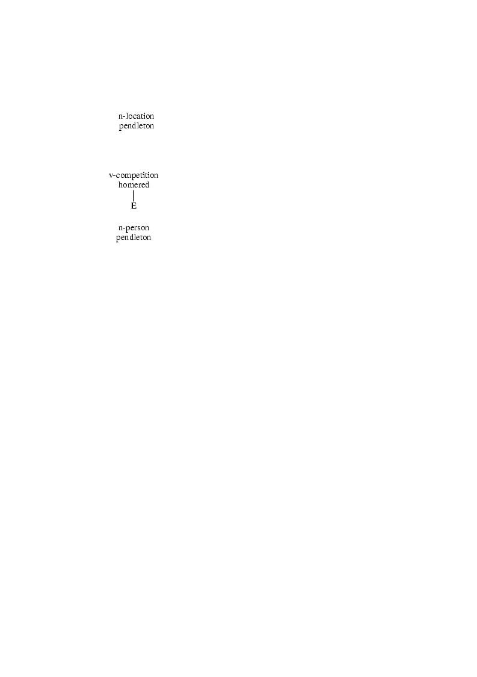
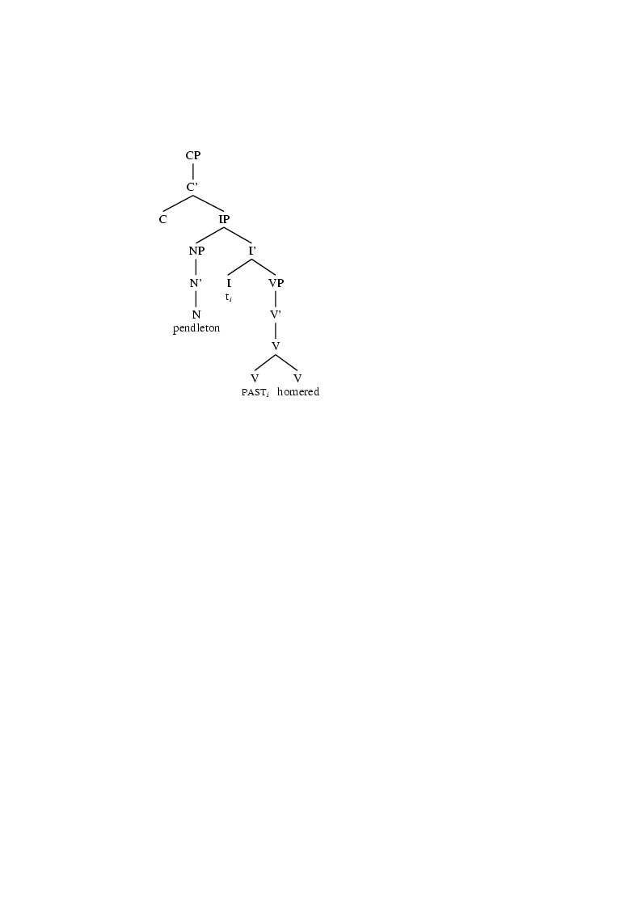
NL-Soar: NER from AM
Pendleton homered in the third...
AM: Pendleton is a person or a place

Slide 15
Another NL-Soar/AM task
PP attachment decisions, especially in incremental parsing, are difficult
  Some combination of linguistic reasoning, probabilistic inference, exemplars via analogy, guessing
  Work has been done on this problem in the ML community, too
Pure linguistic NL-Soar approaches have been documented (LACUS, Manookin & Lonsdale)
Better: let AM inform attachment decisions

Slide 16
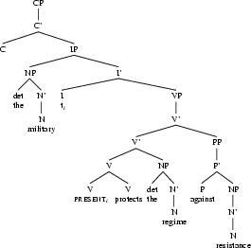
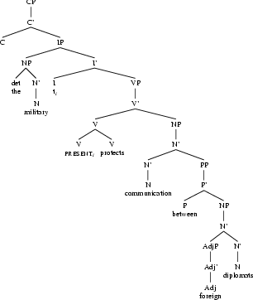
PP attachment example
Instances

Slide 17
An intelligent architecture for French language processing
Presented at DLLS 2004
(Lonsdale)

Slide 18
Not just for English...
NL-Soar has been used primarily for English
An implementation has also been done for French (Soar 17/18?)
  Comprehension, generation
  Narrow coverage, as for English at the time
Since, scaling up English with WordNet
This task: scale up French accordingly

Slide 19
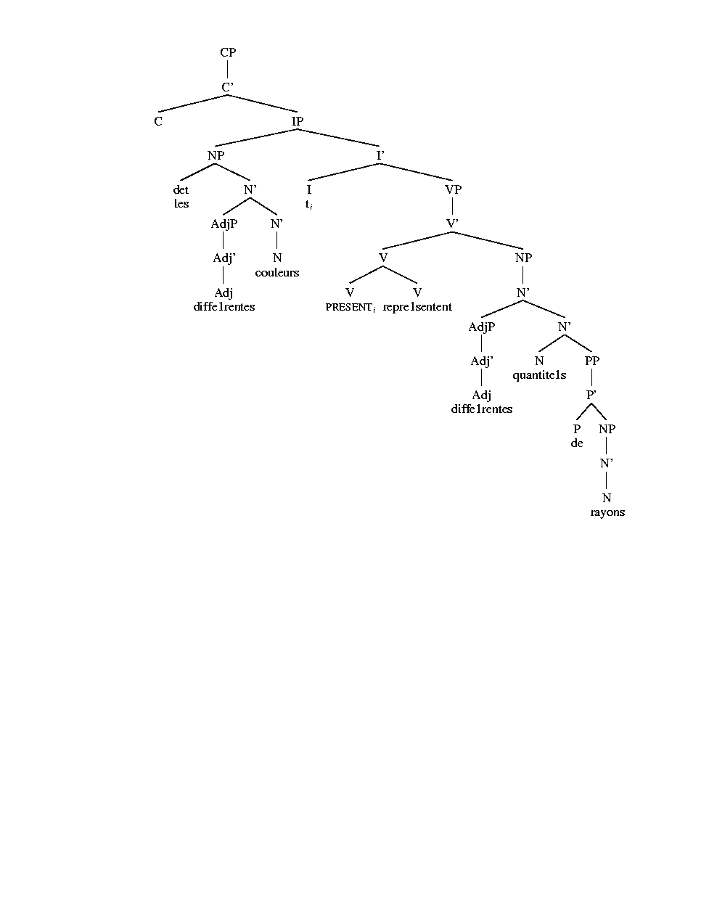
French syntax model

Slide 20
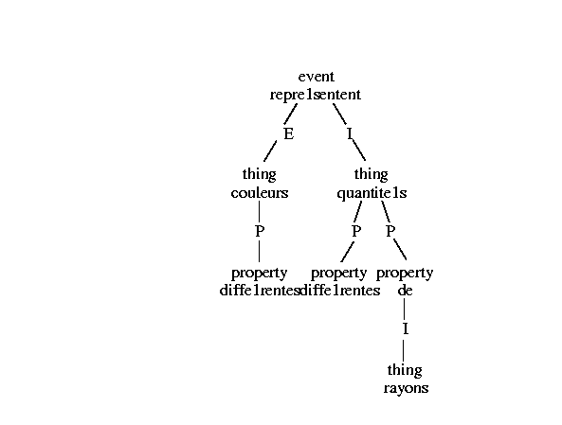
French semantics model

Slide 21
Morphosyntactic information
BDLEX: 450,000 French words with relevant phonolo/morpho/syn information
zyeuteras;V;2S;fi;-2
zyeuterez;V;2P;fi;-2
zyeuteriez;V;2P;pc;-3
zyeuterions;V;1P;pc;-4
zyeuterons;V;1P;fi;-3
zyeuteront;V;3P;fi;-3
zyeutes;V;2S;pi,ps;-1+r
zyeutez;V;2P;pI,pi;-1+r
zyeutiez;V;2P;ii,ps;-3+er
Accessed during lexical access (Tcl rhs function)

Slide 22
Lexical semantic information
French WordNet
  lexical database
  word senses, hierarchical relations
homme: 7 senses: 1-3, 5-7 n-person; 4 n-animal
travailler: 5 senses: 1 v-body; 2-5 v-social
Accessed during lexical access (Tcl rhs function)

Slide 23
S1: Ces hommes travaillent.
(straightforward)
S2: Ces hommes ont travaillé.
(more complex: snip and semsnip)
S3: Les très grands hommes plutôt pauvres ont travaillé dans cet entrepôt.
(quite involved)

Slide 24
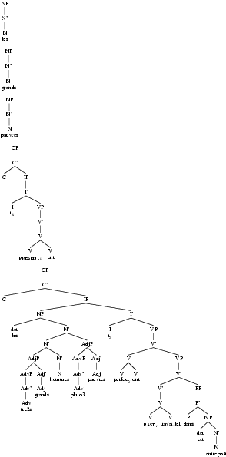

Slide 25
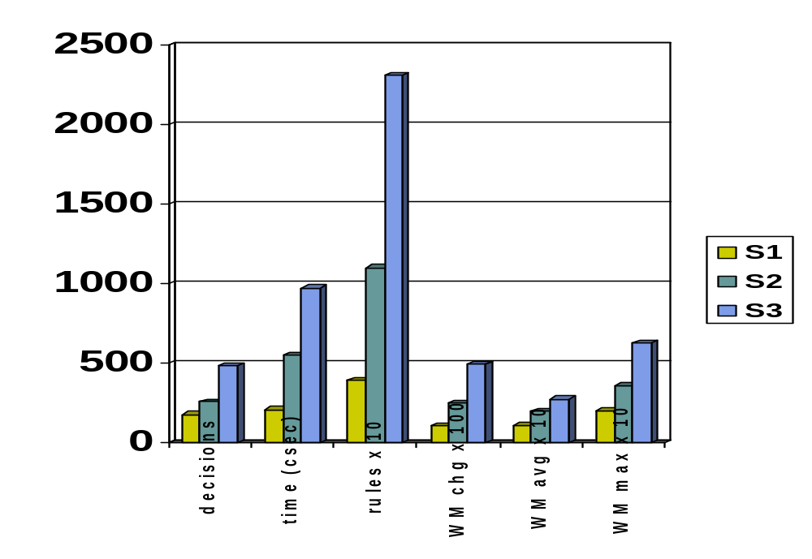
Resources required

Slide 26
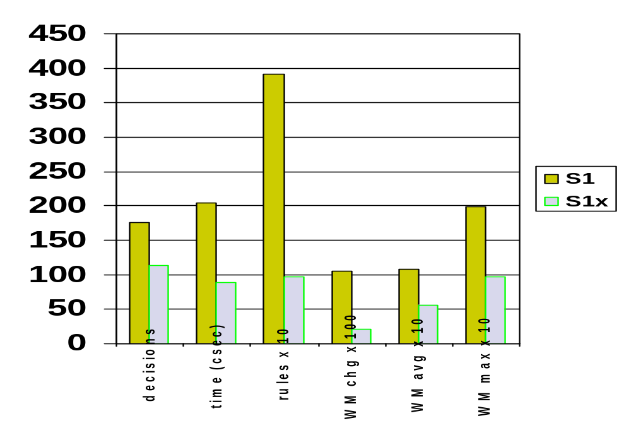
Effects of learning: S1

Slide 27
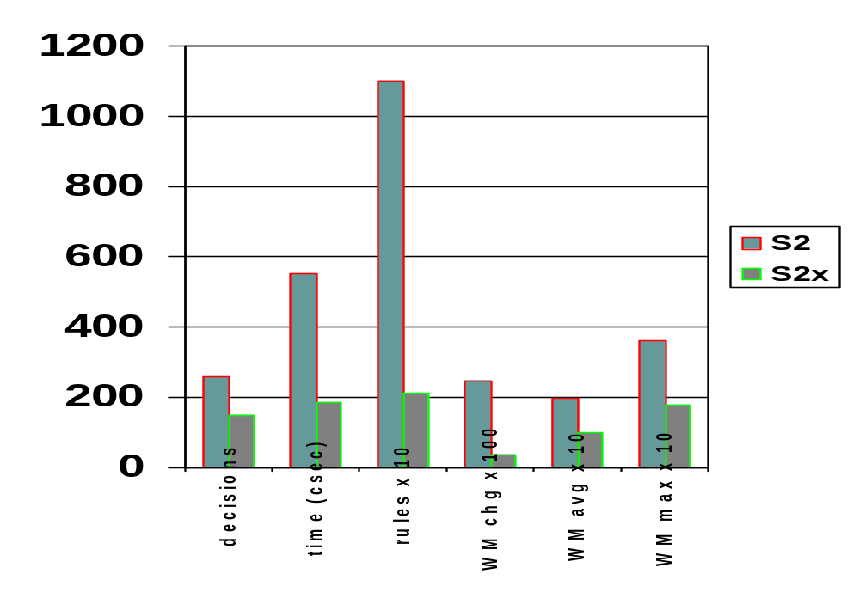
Effects of learning: S2

Slide 28
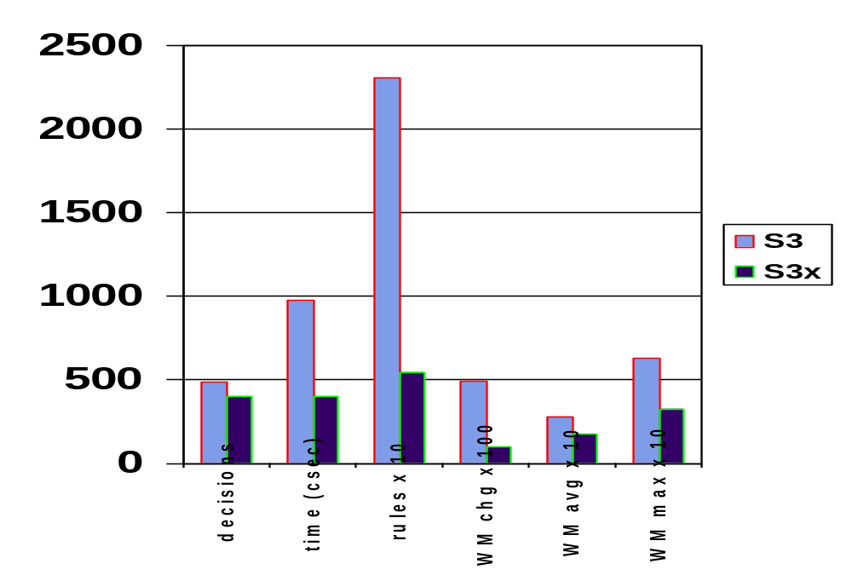
Effects of learning: S3

Slide 29
Future work
Subcategorization information
Semantics of proper nouns, adverbs
Adjunction, conjunction
Standardized evaluations (word sense disambiguation, parsing, semantic extraction)
Coverage

Slide 30
The Pace/BYU robotic language interface
To be presented at AAMAS 2004
(Paul Benjamin, Damian Lyons, Rebecca Rees, Deryle Lonsdale)

Slide 31
Discourse/Pragmatics
Language beyond individual utterances
  Sentence meaning grounded in real-world context
  Turn-taking, entailments, beliefs, plans, agendas, participants’ shared knowledge
Traditional approaches: FSA, frames, BDI
NL-Soar
  Discourse recipes (Green & Lehman 2002)
  Operator-based, learning
  Syntactic and semantic information

Slide 32
START
FSM
0
1-6: Eagle 6, this is 1-6. The situation here is growing more serious. We’ve spotted weapons in the crowd. Over.
1
Base: 1-6, this is Eagle 6. Eagle 2-6 is in the vicinity of Celic right now and enroute to your location.
2
1-6: Eagle 2-6, this is 1-6. I need your assistance here ASAP. Things are really starting to heat up here.
Lt (2-6) to 1-6
3
Lt: What happened?
sil.
4
default
Sgt: They just shot out from the side streets, sir… Our driver couldn’t see ‘em coming.
5
default
6
Lt: How bad? Is he okay?
default
Sgt: Medic, give a report.
7
8
Sgt: Sir, I suggest we contact Eagle base to request a Medevac, but permission to secure the area first.
Medic: Driver’s got a cracked rib, but the boy’s—Sir, we gotta get a Medevac here ASAP.
9
default
10
default
default
Lt: Secure area.
11
12
13
14
Lt: base
Lt: base
Sgt:
Sir, the crowd’s getting out of control. We really need to secure the area ASAP.
Lt: Base, request Medevac.
15
25
Lt: agree
Lt: agree
Base: Standby. Eagle 2-6, this is Eagle base. Medevac launching from operating base Alicia. Time: Now. ETA your location 03. Over.
Sgt: Yes Sir! Squad leaders, listen up! I want 360 degree security here. First squad 12 to 4. Second squad 4 to 8. Third squad 8 to 12. Fourth squad, secure the accident site. Follow our standard procedure.

Slide 33
GoDis
Control
Dialogue Move Engine (DME)
Input
Interpretation
Generation
Output
update
select
input
Latest speaker
Latest moves
Program state
Next moves
output
Information State
(IS)
TIS
Dialogue grammar (resource interface)
Database (resource interface)
Plan library (resource interface)

Slide 34
TacAir Sample Dialogue
Agent | Utterance | Dialogue Act Type
Agent 2 | Parrot101. | Summons
 | This is Parrot102. | Self-Introduction
 | I have a contact bearing 260. | Inform-description-of
 | Over. | End-turn
Agent 1 | Parrot102. | Summons
 | This is Parrot101. | Self-Introduction
 | Roger. | Acknowledge
 | I have a contact bearing 270. | Inform-description-of
 | Over. | End-turn
Agent 2 | Parrot101. | Summons
 | This is Parrot102. | Self-Introduction
 | Roger. | Acknowledge
 | That is your bogey. | Inform-same-object
 | Over. | End-turn

Slide 35
Dialogue: both sides
Syntactic and
Semantic features
of utterance
Hearer’s
Conversational
record
(2)
Plan Compiling
1
(3)
1
HMOS
creation
6
Discourse Recipes
Context
Private Beliefs/Desires
Conversational Record
5
2
HMOS
(Hearer’s model
of the speaker)
5
Monitor
1,(4)
3
4
5
Recipe
Matching/Application
Recipe Matching/
Application
1
5
3
Pending Dialogue Acts
Hearer’s
Acquired
Recipes

Slide 36
Robotics Sample Dialogue
Agent | Utterance | Dialogue Act Type
Human | Howdy, Alex. | Greeting
 | My name is Rebecca. | Self-Introduction
 | Open the window. | Request
 | Over. | End-turn
Robot | Hi, Rebecca. | Greeting
 | There are two windows. | Inform-Need-Clarification
 | Over. | End-turn
Human | Open the one on your left. | Inform-clarification
 | Over. | End-turn

Slide 37
Why NL-Soar?
Beyond word spotting: lexical, conceptual semantics
More roundtrip dialogues: agendas and clarification
Common ground
  Word senses, not just the word
Reactivity – interleaving processes
Conceptual primitives can be grounded in same operators as linguistic primitives
  Alex
  TacAir
Discourse recipes, task decomposition

Slide 38
Application 2: LG-Soar
Link-Grammar Soar
  Implements syntactic, shallow semantic processing
  Used for information extraction
  Components
    Soar architecture
    Link Grammar Parser
    Discourse Representation Theory
Discussed in Soar21, Soar22

Slide 39

Logical form identification for medical clinical trials
LACUS 2004; American Medical Informatics Association Symposium; to be defended soon
(Clint Tustison, Craig Parker, David Embley, Deryle Lonsdale)
Funded by:

Slide 40
Approach
Identify and extract predicate logic forms from medical clinical trials (in)eligibility criteria
  Clint Tustison, Soar 22
Match up the information with other data, i.e., patients’ medical records
  Craig Parker, MD & medical informatics at IHC
Tool for helping match subjects with trials
Use of UMLS, the NIH’s vast unified medical terminological resource

Slide 41
Process
Predicate
Calculus
Clinical
Trials
(www
input)
Text
processing
Soar
engine
Post-
Processing
(output)
LG
syntactic
parser

Slide 42
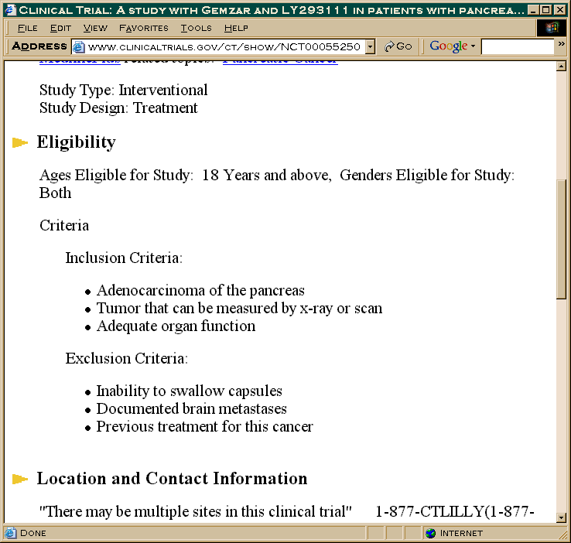
Input
ClinicalTrials.gov
Sponsored by NIH and other federal agencies, private industry
8,800 current trials online
3,000,000 page views per month
Purpose, eligibility, location, more info.

Slide 43
Process: Input
Predicate
Calculus
Clinical
Trials
(www
input)
A criterion
equals
adenocarcinoma
of the
pancreas.
Soar
engine
Post-
Processing
(output)
Syntactic
Parser

Slide 44
Process: Syntactic Parser
A criterion equals adenocarcinoma of the pancreas.
Syntactic
parser
+--------------------------------Xp--------------------------------+
+-----Wd-----+ +----Js----+ |
| +--Ds--+----Ss----+------Os-----+-----Mp----+ +---Ds--+ |
| | | | | | | | |
LEFT-WALL a criterion.n equals.v adenocarcinoma[?].n of the pancreas.n .

Slide 45
Shallow semantic processing
Soar (not NL-Soar) backend
Translates syntactic parse to logic output by reading links → shallow semantics
Identify concepts, create predicates, determine predicate arity, instantiate variables, perform anaphoric and coreference processing
Predicate logic expressions

Slide 46
Process: Logic Output
Clinical
Trials
(www
input)
Predicate
Calculus
A criterion
equals
adenocarcinoma
of the
pancreas.
Soar
engine
criterion(N2) & adenocarcinoma(N4) & pancreas(N5) & equals(N2,N4) & of(N4,N5).
Post-
Processing
(output)
Syntactic
Parser

Slide 47
Post-processing
Prolog axioms
  Remove subject/verb
  Eliminate redundancies
  Filter irrelevant information
  criterion(N2) & adenocarcinoma(N4) & pancreas(N5) & equals(N2,N4) & of(N4,N5).
  adenocarcinoma(N4) &amp; pancreas(N5) &amp; of(N4,N5).

Slide 48
XML output for downstream
<criteria trial="http://www.clinicaltrials.gov/ct/show/NCT00055250”>
<criterion>
<text>Eligibility</text>
<text>Criteria</text>
<text>Inclusion Criteria:</text>
<text val=“1”>Adenocarcinoma of the pancreas</text>
<pred val=“1”>pancreas(N5) &amp; adenocarcinoma(N4) &amp; of(N4,N5).</pred>
</criterion>
.
</criteria>

Slide 49

A Link Grammar Syntactic Parser for Persian
  A Link Grammar Syntactic Parser for Persian

Slide 50

Background
Persian (Farsi): major language, strategic
Arabic script but Indo-European
Little computational linguistic research in public domain
Much richer morphology than English, different word order

Slide 51
The approach
Preprocessing: Arabic → romanized
Morphological processing: break down complex words via finite-state techniques
Pass output to Link Grammar parser implemented for Persian language syntax
Send output to Soar engine for shallow semantics processing
Output Persian first-order logic expressions

Slide 52
Morphological preprocessing
Two-level morphological engine used (PC-Kimmo)
PC-KIMMO>recognize nmibinmC
n+mi+bin+m+C NEG+DUR+see.PRES+1S+3s.object
Top
|
Verb
_________|__________
VNEGPREFIX VNStem
n+ _________|__________
NEG+ VPREFIX VStem
mi+ _______|________
DUR+ V1Stem VOSUFFIX
____|_____ +C
V2Stem VPSUFFIX +3s.object
| +m
V3Stem +1S
|
V
bin
see.PRES

Slide 53


Persian link parse
Persian: <mn rftm> “I went”
+------Spn1------+
| +----VMP---+
| +-VMT+ +-RW+
| | | | |
mn.pn rf.v t.vmt m.vmp .

Slide 54

Persian link parse (2)
Persian: <tu midAni kh mn mirum> “you know that I am going”
+------------C-----------+
+--------Spn2-------+ | +-------Spn1-------+
| +-VMdur+-VMP-+--SUB-+ | +VMdur+-VMP-+-RW+
| | | | | | | | | |
tu.pn mi.vmd dAn.vs i.vmp kh.sub mn.pn mi.vmd ru.vp m.vmp .

Slide 55
Knowledge structures
Lexicons: ~1300 fully voweled romanized entries with POS info, multiple glosses, and etymologies
LG link specifications: (for normal verbs)
(({VMdur-} & {VMneg-}) or {VMbe-}) & {@AV-} &{( O- or CCOB-)} & {@AV-} & {PP-} & @AV-} & {VMT+} & (VMP+ or CCF+ or VMPP+ or [RW+])
Soar productions: ~800 for predicate, variable instantiation, anaphor, coreference

Slide 56

Current Status
Approximately 100 unique links in 51 categories
Achieving over 70% correct parsing of diverse sentence scenarios (newswire)
More work: lexicons, question sentences
Next: demonstrate its functionality, applicability (and reality)

Slide 57
Overall conclusions
Nuggets
  active work, fairly good acceptance and visibility on lots of fronts
  incredible insights into human language processing
  Soar 8.x
  we’re still listening to the architecture
  more adept at compiling new Soar versions
Coals
  need to bring into mainstream (competitive evaluations)
  still soar8 –off
  semantics is still being refined
  not released
  still a challenge to get others to listen to the architecture

