Slide 1

Executable Specification for Soar Theory
Bob Marinier
Devvan Stokes
University of Michigan

Slide 2
Why a theory specification?
Implementation contains many details which are not part of the theory
  RETE
  Performance tricks
Manual doesn’t always go into enough detail
Can be difficult to tell theory from implementation by looking at the code

Slide 3
Why an executable specification?
Forces correctness and completeness
Allows us to verify Soar the implementation
Ideally it is easier to modify the specification than the implementation

Slide 4
Previous specifications
Soar 4
  Written in Sceptic (Prolog)
  Executable
  Very short (28 rules)
Soar 5
  Written in Z
  Not executable (but can do syntax and type checking)
  Includes many implementation details
  Very long (200+ pages)

Slide 5
Why another specification?
Updated for newest Soar
Useful to have specifications in different languages because they have different strengths and weaknesses
  Prolog gives us unification
  AsmL gives us parallelism

Slide 6
Abstract state machine Language
Highly parallel like Soar
Object-oriented
Syntax is similar to Java, C#
Very useful high-level primitives like Sets and Maps
Can supposedly describe any system at any level of abstraction…

Slide 7
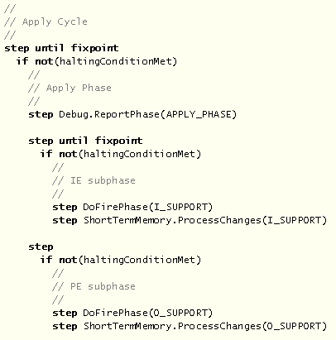

Slide 8
Knowledge-level System
Soar
Levels of Abstraction
ACT-R
Neural-level System

Slide 9
Knowledge-level System
Levels of Description
More Specific
Less Specific
Soar
Levels of Abstraction
Decision Procedure
Matching
Neural-level System

Slide 10
Specifying Soar theory is hard…
Soar is described at multiple levels of description
  Completeness is a double-edged sword
    Not possible to specify all aspects in enough detail to execute without also introducing implementation details
  One goal then is to introduce as few implementation details as possible, and to clarify which details are theoretical and which are implementational
    This is hard because sometimes both become intertwined
    Specification is still far cleaner than the implementation

Slide 11
Benefits so far…
Found bugs 356 and 357
Highlighted design decisions that may need to be reconsidered
Forced us to rethink some of the basic ideas in Soar

Slide 12
Rethinking Soar Basics
Traditionally, Soar has Working Memory and Preference Memory, which overlap slightly (acceptable preferences are in both)
Then what is a Working Memory Element?

Slide 13
What is a WME?
A basic WME has
  Identifier, Attribute, Value
A (unary) preference has
  Identifier, Attribute, Value, Preference Type
  Attribute = “operator” in Soar 8
So, structurally, a preference is a kind of WME?
  But it can’t be a WME since (except for acceptables) preferences are not in Working Memory!

Slide 14
Introducing Short Term Memory
Short Term Memory Element (STME)
  Identifier, Attribute, Value
Preference (extends STME)
  Identifier, Attribute, Value, Preference Type
Both are contained in Short Term Memory, which is a Set
So WM is the subset of STM which includes non-preferences (triples?) and acceptable preferences
And Preference Memory is the subset of STM which includes preferences

Slide 15
Short Term Memory
Working Memory
Preference Memory
STME
  Identifier
  Attribute
  Value
Preference extends STME
  Preference Type
WM = STMEs which are not preferences or are preferences with type = ACCEPTABLE

Slide 16
Status
Mostly Complete: Decision procedure, matching, preference procedure, basic conditions and actions
Current: Justifications
Future: Chunking, GDS
Currently runs single-state versions of water-jug, blocks-world with search control

Slide 17
Nuggets
  Specification is coming along well
  Helped find bugs
  Has made us aware of alternative ways of thinking about Soar
  Will be useful for future research and reimplementation
  AsmL is free for non-commercial use
  AsmL developers are very responsive to questions
Coal
  Can’t avoid specifying implementation details
  Slow
  AsmL tools are not commercial quality

