Slide 1
Reinforcement Learning and Soar
Shelley Nason

Slide 2
Reinforcement Learning
Reinforcement learning:
Learning how to act so as to maximize the expected cumulative value of a (numeric) reward signal
  Includes techniques for solving the temporal credit assignment problem
  Well-suited to trial and error search in the world
As applied to Soar, provides alternative for handling tie impasses

Slide 3
The goal for Soar-RL
Reinforcement learning should be architectural, automatic and general-purpose (like chunking)
Ultimately avoid
  Task-specific hand-coding of features
  Hand-decomposed task or reward structure
  Programmer tweaking of learning parameters
  And so on

Slide 4
Advantages to Soar from RL
Non-explanation-based, trial and error learning – RL does not require any model of operator effects to improve action choice.
Ability to handle probabilistic action effects –
  An action may lead to success sometimes & failure other times. Unless Soar can find a way to distinguish these cases, it cannot correctly decide whether to take this action.
  RL learns the expected return following an action, so can make potential utility vs. probability of success tradeoffs.

Slide 5
Representational additions to Soar:
Rewards
Learning from rewards instead of in terms of goals makes some tasks easier, especially:
  Taking into account costs and rewards along the path to a goal & thereby pursuing optimal paths.
  Non-episodic tasks – If learning in a subgoal, subgoal may never end. Or may end too early.

Slide 6
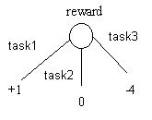
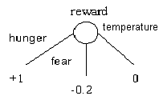
Representational additions to Soar: Rewards
Rewards are numeric values created at specified place in WM. The architecture watches this location and collects its rewards.
Source of rewards
  productions included in agent code
  written directly to io-link by environment
Notes:
Emotion – not so good for reward?

Slide 7
Representational additions to Soar:
Numeric preferences
Need the ability to associate numeric values with operator choices
Symbolic vs. Numeric preferences:
  Symbolic – Op 1 is better than Op 2
  Numeric – Op 1 is this much better than Op 2
Why is this useful? Exploration.
  Maybe top-ranked operator not actually best.
  Therefore, useful to keep track of the expected quality of the alternatives.

Slide 8
Representational additions to Soar:
Numeric preferences
Numeric preference:
Sp {avoid*monster
(state <s> ^task gridworld
^has_monster <direction>
^operator <o>)
(<o> ^name move
^direction <direction>)
→
(<s> ^operator <o> = -10)}
New decision phase:
  Process all reject/better/best/etc. preferences
  Compute value for remaining candidate operators by summing numeric preferences
  Choose operator by Boltzmann softmax

Slide 9
Fitting within RL framework
The sum over numeric preferences has a natural interpretation as an action value Q(s,a), the expected discounted sum of future rewards, given that the agent takes action a from state s.
Action a is operator
Representation of state s is working memory (including sensor values, memories, results of reasoning)

Slide 10

Q(s,a) as linear combination of Boolean features
(state <s> ^task gridworld
^current_location 5
^destination_location 14
^operator <o> +)
(<o> ^name move
^direction east)
(state <s> ^task gridworld
^has-monster east
^operator <o> +)
(<o> ^name move
^direction east)
(state <s> ^task gridworld
^previous_cell <direction>
^operator <o>)
(<o> ^name move
^direction <direction>)
(<s> ^operator <o> = -10)
(<s> ^operator <o> = 4)
(<s> ^operator <o> = -3)

Slide 11
Example:
Numeric preferences fired for O1
sp {MoveToX
(state <s> ^task gridworld
^current_location <c>
^destination_location <d>
^operator <o> +)
(<o> ^name move
^direction <dir>)
→
(<s> ^operator <o> = 0)}
sp {AvoidMonster
(state <s> ^task gridworld
^has-monster east
^operator <o> +)
(<o> ^name move
^direction east)
→
(<s> ^operator <o> = -10)}
<c> = 14
<d> = 5
<dir> = east
Q(s,O1) = 0 + -10

Slide 12
Example:
The next decision cycle
O1
reward
r = -5
sp {MoveToX
(state <s> ^task gridworld
^current_location 14
^destination_location 5
^operator <o> +)
(<o> ^name move
^direction east)
→
(<s> ^operator <o> = 0)}
sp {AvoidMonster
(state <s> ^task gridworld
^has-monster east
^operator <o> +)
(<o> ^name move
^direction east)
→
(<s> ^operator <o> = -10)}
Q(s,O1) = -10

Slide 13
Example:
The next decision cycle
O1
O2
reward
sum of numeric prefs.
Q(s’,O2) = 2
sp {MoveToX
(state <s> ^task gridworld
^current_location 14
^destination_location 5
^operator <o> +)
(<o> ^name move
^direction east)
→
(<s> ^operator <o> = 0)}
sp {AvoidMonster
(state <s> ^task gridworld
^has-monster east
^operator <o> +)
(<o> ^name move
^direction east)
→
(<s> ^operator <o> = -10)}
Q(s,O1) = -10
r = -5

Slide 14
Example:
The next decision cycle
O1
O2
reward
sum of numeric prefs.
sp {MoveToX
(state <s> ^task gridworld
^current_location 14
^destination_location 5
^operator <o> +)
(<o> ^name move
^direction east)
→
(<s> ^operator <o> = 0)}
sp {AvoidMonster
(state <s> ^task gridworld
^has-monster east
^operator <o> +)
(<o> ^name move
^direction east)
→
(<s> ^operator <o> = -10)}
Q(s,O1) = -10
r = -5
Q(s’,O2) = 2

Slide 15
Example:
Updating the value for O1
Sarsa update-
Q(s,O1) ← Q(s,O1) + α[r + λQ(s’,O2) – Q(s,O1)]
=
1.36
sp {|RL-1|
(state <s> ^task gridworld
^current_location 14
^destination_location 5
^operator <o> +)
(<o> ^name move
^direction east)
→
(<s> ^operator <o> = 0)}
sp {AvoidMonster
(state <s> ^task gridworld
^has-monster east
^operator <o> +)
(<o> ^name move
^direction east)
→
(<s> ^operator <o> = -10)}

Slide 16
Example:
Updating the value for O1
Sarsa update-
Q(s,O1) ← Q(s,O1) + α[r + λQ(s’,O2) – Q(s,O1)]
=
1.36
sp {|RL-1|
(state <s> ^task gridworld
^current_location 14
^destination_location 5
^operator <o> +)
(<o> ^name move
^direction east)
→
(<s> ^operator <o> = 0.68)}
sp {AvoidMonster
(state <s> ^task gridworld
^has-monster east
^operator <o> +)
(<o> ^name move
^direction east)
→
(<s> ^operator <o> = -9.32)}

Slide 17
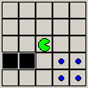
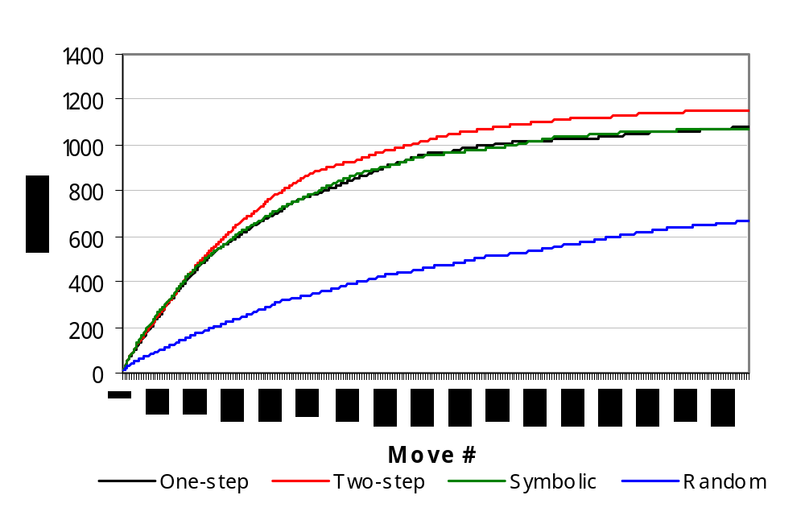
Eaters Results
Notes:
3 one-step rules
56 two-step rules
3x56 rules if not taken separately

Slide 18
Future tasks
Automatic feature generation (i.e., LHS of numeric preferences)
  Likely to start with over-general features & add conditions if rule’s value doesn’t converge
Improved exploratory behavior
  Automatically handle parameter controlling randomness in action choice
  Locally shift away from exploratory acts when confidence in numeric preferences is high
Task decomposition & more sophisticated reward functions
  Task-independent reward functions

Slide 19
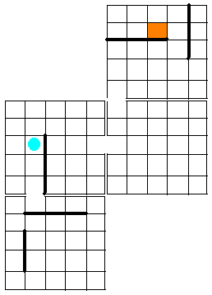
Task decomposition:
The need for hierarchy
Primitive operators: Move-west, Move-north, etc.
Higher level operators: Move-to-door(room,door)
Learning a flat policy over primitive operators is bad because
  No subgoals (agent should be looking for door)
  No knowledge reuse if goal is moved
Move-west
Move-to-door
Move-to-door
Move-to-door
Notes:
Incorrect in paper. I said that more frequent rewards make learning faster (true) and that subgoals could be seen as performing the function of providing rewards. And that this could be alternatively be done just by scattering rewards, but it was hard to know where to place the rewards (so that the agent wouldn’t end up trying to maximize these helpful rewards). That is, don’t put prior knowledge in the reward function. But, there is more than what I said, because subgoal rewards are not true rewards, they don’t influence the policies of higher-level goals.

Slide 20


Task decomposition:
Hierarchical RL with Soar impasses
Soar operator no-change impasse
Next Action
S1
S2
O1 O1 O1 O1 O5
O2 O3 O4
Rewards
Subgoal reward

Slide 21
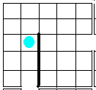
Task Decomposition:
How to define subgoals
Move-to-door(east) should terminate upon leaving room, by whichever door
How to indicate whether goal has concluded successfully?
Pseudo-reward, i.e.,
+1 if exit through east door
-1 if exit through south door

Slide 22
Task Decomposition:
Hierarchical RL and subgoal rewards
Reward may be complicated function of particular termination state, reflecting progress toward ultimate goal
But reward must be given at time of termination, to separate subtask learning from learning in higher tasks
Frequent rewards are good
But secondary rewards must be given carefully, so as to be optimal with respect to primary reward

Slide 23
Reward Structure
Action Action Action Action
Reward
Time

Slide 24
Reward Structure
Operator Action
Action Operator
Action Action
Reward
Time

Slide 25
Conclusions
As compared to last year, the programmer’s ability to construct features with which to associate operator values is much more flexible, making the RL component a more useful tool.
Much work left to be done on automating parts of the RL component.

