Slide 1
Episodic Memory for Soar Agents
Andrew Nuxoll
11 June 2004

Slide 2
What is Episodic Memory?
Memories of specific events in our past
  Example: Your last vacation

Slide 3





Soar-EpMem in Action
A simple example…
Working
Memory
Episodes
Cue
Retrieved

Slide 4
Soar-EpMem in Action
New memories are recorded periodically
Working
Memory
Episodes
Cue
Retrieved

Slide 5

Soar-EpMem in Action
The agent creates a cue
Working
Memory
Episodes
Cue
Retrieved

Slide 6
Soar-EpMem in Action
The cue is matched to episodic memory
Working
Memory
Episodes
Cue
Retrieved

Slide 7
Soar-EpMem in Action
The best match is retrieved into WM
Working
Memory
Episodes
Cue
Retrieved

Slide 8
Benefits of Episodic Memory
Aids in decision making through predicting the outcome of possible courses of action
A recorded history can be used to answer questions about the past
To help keep track of progress on long-term goals
Learn from past experience when new time/resources become available
Generalize knowledge by comparing multiple events simultaneously

Slide 9
Previous Work
Episodic Memory
  Psychology – Endel Tulving
  Cognitive Modeling – Erik Altmann
Case-Based Reasoning
  Continuous CBR – Ram and Santamaría
Notes:
CBR implementations are often domain specific in order to reduce matching complexity and simplify when episodes are recorded. There are exceptions, most notably Continuous CBR which bears a lot of resemblance to our research.

Slide 10
Key Differences:
Episodic Memory Research
  Architectural implementation
  Domain independent
Continuous Case-Based Reasoning
  Qualitative vs. quantitative episode content
  Differing scope of match and retrieval

Slide 11
Pilot Implementation: Encoding
Encoding initiation: upon significant change in activation levels
Episode determination: hand selected and domain specific
Feature selection: hand selected and domain specific
Notes:
Mention that I’ll talk more about how memory activation is used with Soar-EpMem later on.

Slide 12
Pilot Implementation: Storage
Episode structure: episodes are stored as Soar productions
Episode dynamics: none

Slide 13
Pilot Implementation: Retrieval
Retrieval initiation: deliberate retrieval in an agent-selected substate
Cue determination: agent-selected data
Retrieval: exact match
Retrieved episode representation: direct modification of the agent-selected substate
Retrieval meta-data: unique sequential id (to provide an idea of temporal order)

Slide 14
Pilot Implementation: Issues
Exact match led to encoding specificity issues
Problems from overwriting the sub-state
  Recursion
  Spurious operator proposals
  Requires that agent create a sub-state to do a retrieval
Domain dependent

Slide 15
Current Implementation: Changes
Partial match over a separate episodic memory
  Memories are no longer stored as rules
Use of an architecture-specified buffer for query and retrieval (analogous to the ^io link)
Notes:
First let me review how this affected the encoding, storage and retrieval of the current architecture and then I’ll discuss some specifics particularly in terms of the memory activation and matching.

Slide 16
Current Implementation: Encoding
Encoding initiation: one episode per agent action
Episode determination: all of working memory(!)
Feature selection: the entire episode can affect retrieval

Slide 17
Current Implementation: Storage
Episode structure: episodes are stored in an internal data structure
Episode dynamics: still none

Slide 18
Current Implementation: Retrieval
Retrieval initiation: cue is constructed in an architecture-specified buffer
Cue determination: agent selected data
Retrieval: exact match
Retrieved episode representation: the episode is recreated in an architecture-specified buffer
Retrieval meta-data: agent can retrieve the next memory in temporal sequence

Slide 19
Working Memory Activation
Extension of the memory decay work by Ron Chong
Reimplementation by Michael James:
  Includes all of working memory
  Improvements in efficiency

Slide 20
Activation & Matching
Problem: All WMEs in an episode are weighted equally
Core Idea: The activation level of WMEs indicates their relevance to current task
Implementation: Use the activation levels of the WMEs in the episode to bias the match

Slide 21
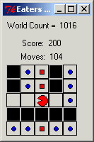
Evaluation using Eaters
Pac-Man-like
Two types of food
  Bonus food (10 pts)
  Normal food (5 pts)

Slide 22



An Episodic Memory Eater
Evaluate moving in each available direction
Create a memory cue (input-link + proposed direction)
Retrieve the best matching memory
Retrieve the next memory (in temporal order)
Use the change in score to evaluate the proposed action
East
North
Move North = 10 points
South
Episodic
Retrieval
Retrieve
Next Memory

Slide 23
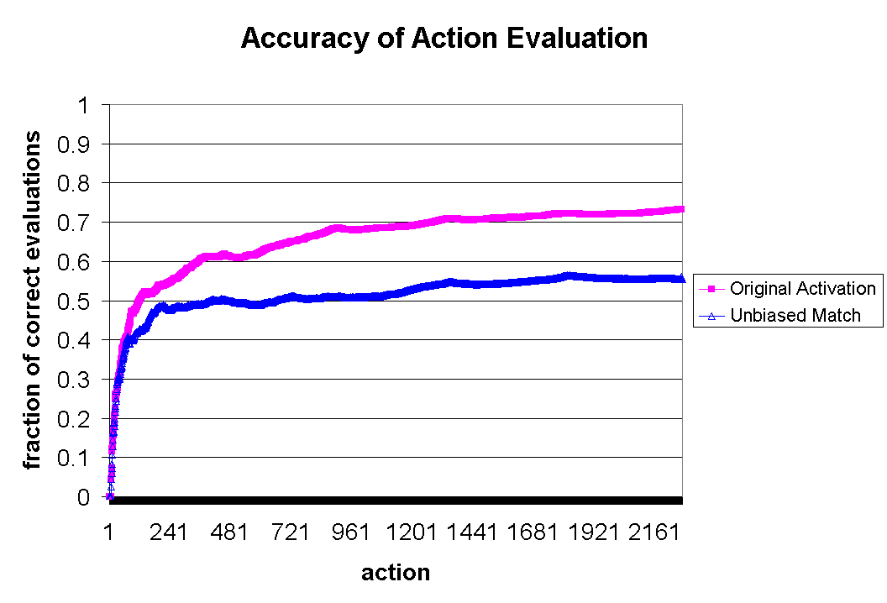
Initial Results

Slide 24
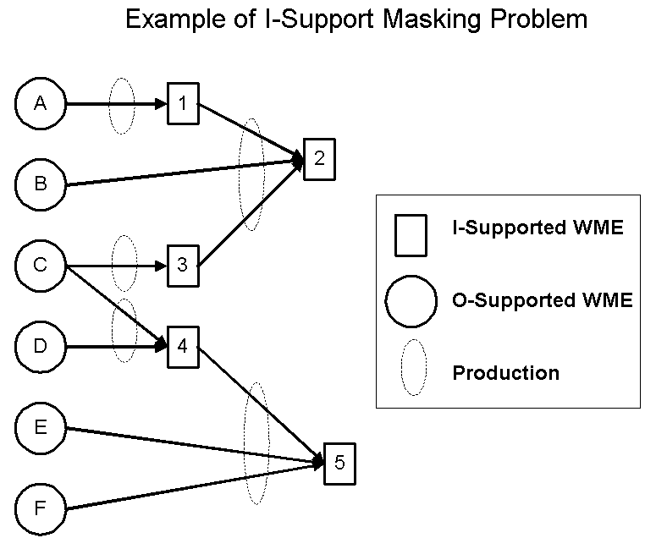
Problem #1: I-Support Masking
Problem: Testing an i-supported WME provides no activation boost
Solution = Pay it Backward: Testing an i-supported WMEs boosts the activation level of its “set of o-support”
Notes:
Begin by noting that activation is only for o-supported WMEs. Note that this is a common problem.

Slide 25
Problem #2: New WME Masking
Problem: A new WME starts at a fixed activation level
Solution = Pay it Forward: Activation of newly created WMEs is based upon those WMEs which were tested to create it

Slide 26
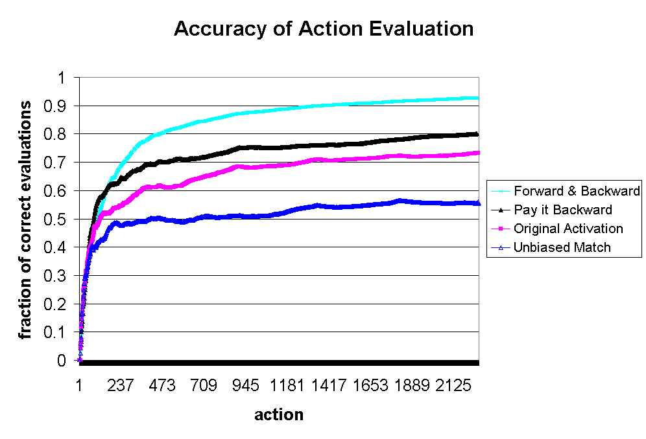
Results

Slide 27
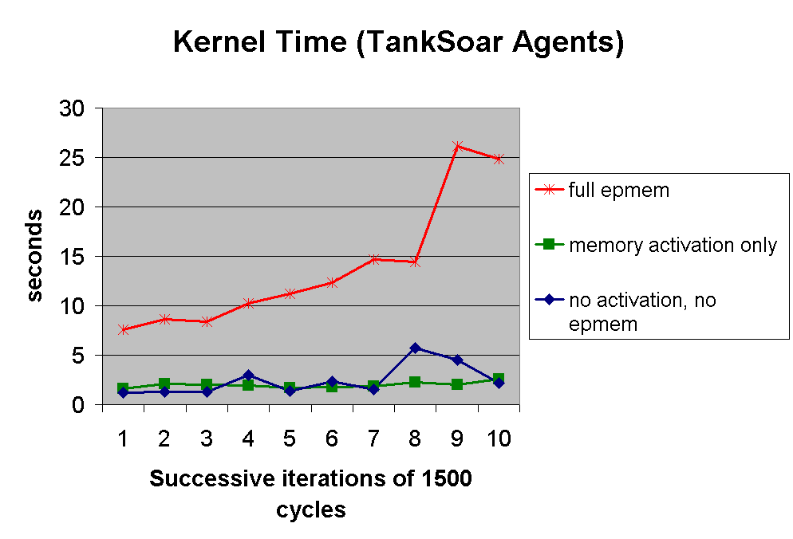
Current Challenge: Performance

Slide 28
Nuggets Coal
Domain independent, architectural implementation
Performance issues
Still only tested in a single domain

