Slide 1
VisualSoar Update
Andrew Nuxoll
09 June 2004

Slide 2
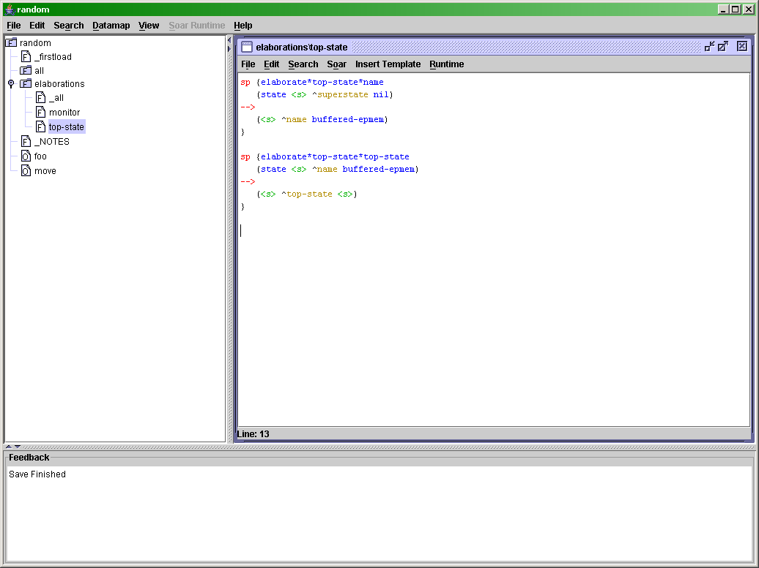
A Visual Editor for Soar Projects

Slide 3
Features of VisualSoar
Visual operator hierarchy design
Data type specification and checking (datamap)
Syntax highlighting
Auto-indent
Auto-completion (Soar complete)
On demand syntax checking
Production Templates for rapid designTested on Windows, Linux and MacOS
Supports Soar7 and Soar8

Slide 4
The last 12 months in general…
Eight months of steady bug fixes and small enhancements to improve the usability of VisualSoar
Tracking bug reports and responding to them
  https://winter.eecs.umich.edu/soar-bugzilla/

Slide 5
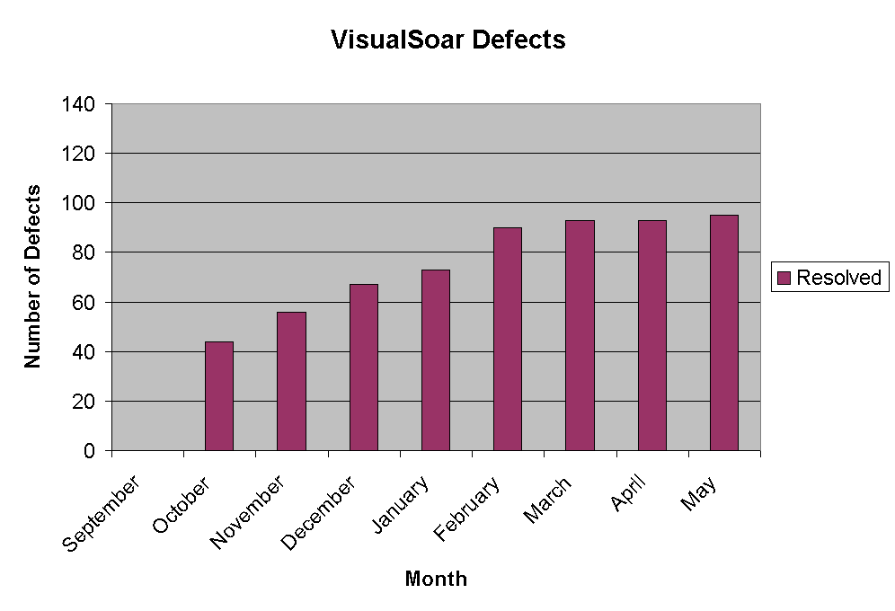
Lots of Bug Fixes…

Slide 6
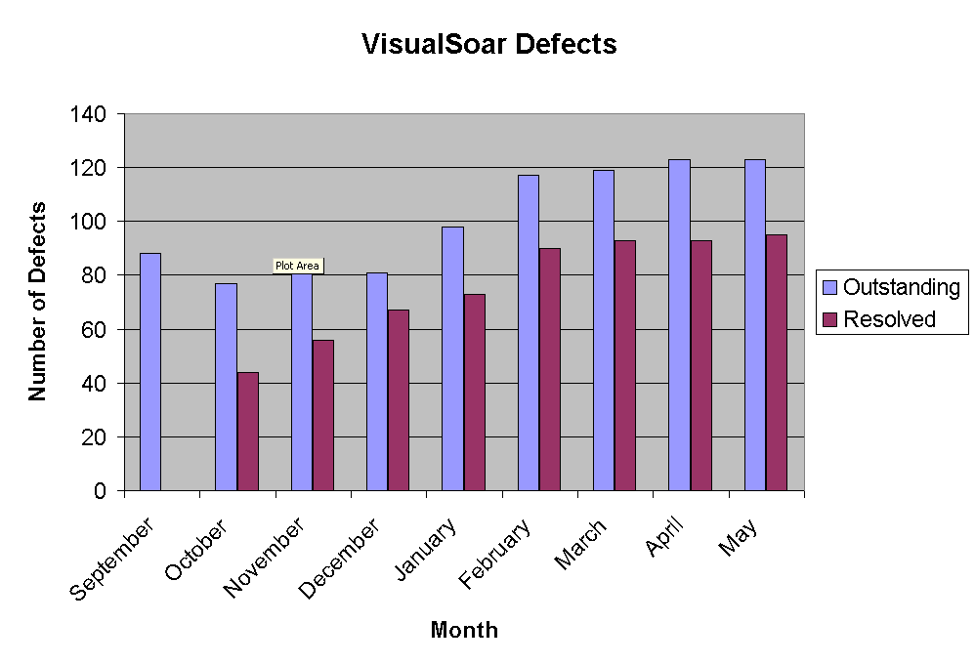
Even More Bugs…
Notes:
A total of 95 defects resolved. 123 remain outstanding. An average of 24 new bugs reported each month and 11 bugs fixed.

Slide 7
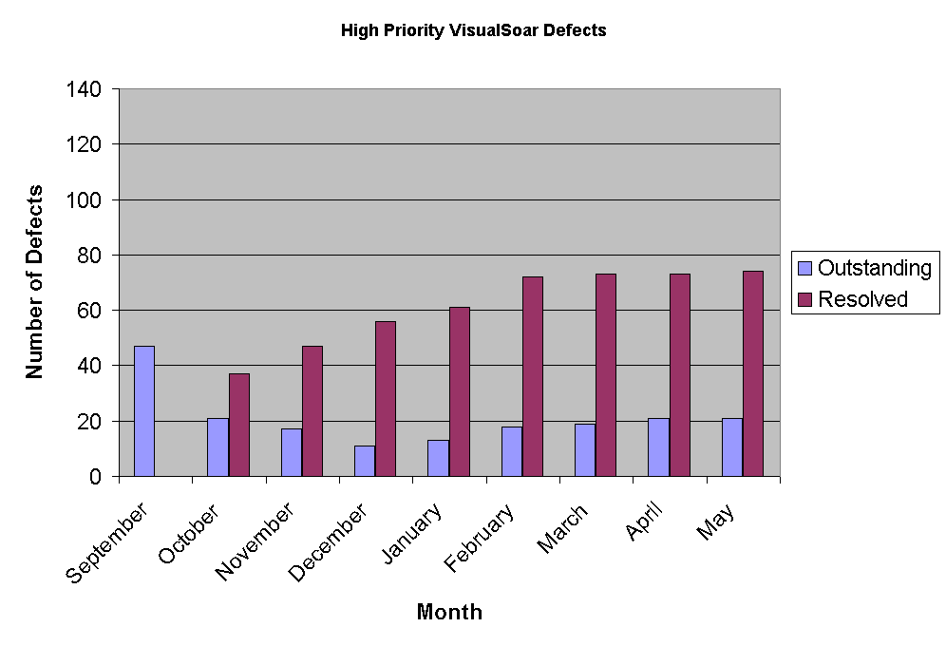
High Priority Defects

Slide 8
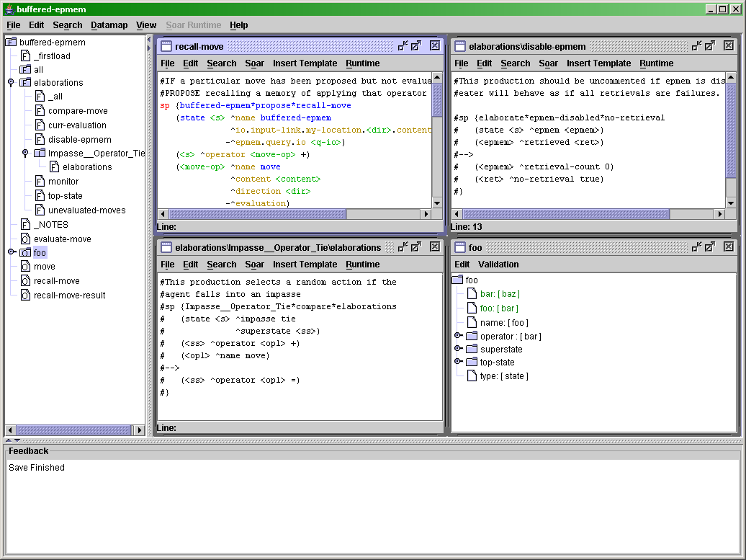
Windowing Improvements
Better response to user preference for tiled, maximized and cascaded windows
Reasonable default window sizes
Active selection of window focus

Slide 9
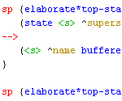
Rule Editor
All keyboard commands are documented
Multiple syntax highlighting bugs are repaired
Undo action moves cursor to the position of the undo
Better tab formatting
New templates for SoarDoc
  Thank you David Ray

Slide 10
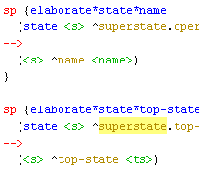
Searching
Double click now highlights the line found for search results, datamap errors, syntax errors, etc.
Find all rules that create and/or test a particular WME in the datamap
Searching within a single operator subtree

Slide 11
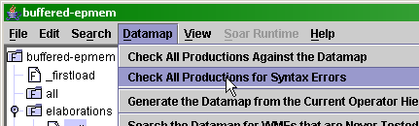
Syntax Errors
You can now make syntax error checks separately from datamap checks
Syntax errors no longer popup dialogs
Better handling for TCL commands
More robust handling of special characters

Slide 12
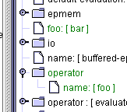
Datamap Checking
Auto-expand to show generated entries
Perform datamap checks on a single file
Better whitespace handling

Slide 13
Nuggets Coal
More robust and usable VisualSoar
A new central repository for reporting defects:
There are always more bugs to fix…
  https://winter.eecs.umich.edu/soar-bugzilla/

