Slide 1


Redux:
Rapid Model Building
Douglas Pearson, Ph.D. Professor John Laird
ThreePenny Software University of Michigan
douglas.pearson@threepenny.net laird@umich.edu
Supported by the Office of Naval Research

Slide 2
What’s Wrong with this Rule?
sp { redux*propose*shoot*proposalrule-1
(state <s> ^top-state <ts>)
(<ts> ^sel <threat-1> <friendly-1>)
(<threat-1> ^isfriend false ^isthreat true ^isa person)
(<friendly-1> ^isfriend true ^isthreat false ^isa person)
(<friendly-1> ^cansee <cansee>)
(<threat-1> ^name <name*1>)
(<cansee> ^<name*1> true)
-->
(<s> ^operator <o> +,=)
(<o> ^name shoot ^target <threat-1> ^turn <turn>)
(<turn> ^target <friendly-1> ^facing 0)
}
(<threat-1> ^alive true)
Answer #1: A condition is missing
Answer #2: It depends on what the rule is meant to do

Slide 3
Normal Debugging Cycle
Run
Model
May be hard to realize when
something goes wrong
Notice something is wrong
Easy to overshoot; may be slow to
repeat or hard to reproduce
Re-run model until just before problem
Step through rules to determine why error occurred
Easy to make the wrong correction
or not fix the whole problem
Modify the rule
Re-run and check problem is fixed
Hard to be sure this fix doesn’t break
behavior somewhere else
These sorts of problems are very common

Slide 4
Imagine a “Smart Editor”
sp { redux*propose*shoot*proposalrule-1
(state <s> ^top-state <ts>)
(<ts> ^sel <threat-1> <friendly-1>)
(<threat-1> ^isfriend false ^isthreat true ^isa person)
(<friendly-1> ^isfriend true ^isthreat false ^isa person)
(<friendly-1> ^cansee <cansee>)
(<threat-1> ^name <name*1>)
(<cansee> ^<name*1> true)
-->
(<s> ^operator <o> +,=)
(<o> ^name shoot ^target <threat-1> ^turn <turn>)
(<turn> ^target <friendly-1> ^facing 0)
}
Problem: This rule will keep firing.
Solution: Did you miss a condition?
Add (<target> ^alive true)?

Slide 5
Need to Specify What Should Happen
Formal specification / high level language?
  Problems:
    Tends to become as complex as underlying solution
    Now debugging the specification (is this easier?)
  Can be done (assembler->C++) but rare to succeed
Specify through examples
  Particular instances reduce complexity
  But may not get full coverage (or examples conflict)

Slide 6

Specification vs Exemplar
Define the category Dog
  4 Legs
  Furry
  Tail
“Spot”
  3 Legs
  No fur
  No tail
Formal specification is hard and tends to get harder as the
problem gets more complicated
Software Engineering – move to “use cases” for specification

Slide 7
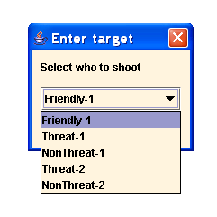
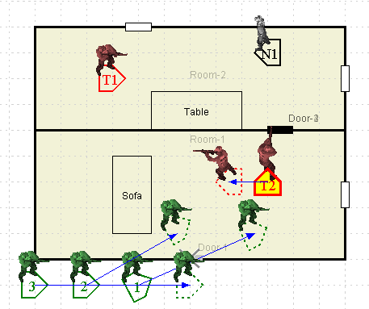
How to Define an Example of Behavior?
Need to specify a sequence of goals & operators
Text specification
  (Menus, Dialogs etc.)
  E.g. Shoot Threat-1
  Best solution sometimes
Visual specification
  E.g. Move to 6 feet west of Door-1
  In many cases easier to use
  Nice to allow this form of specification as well

Slide 8
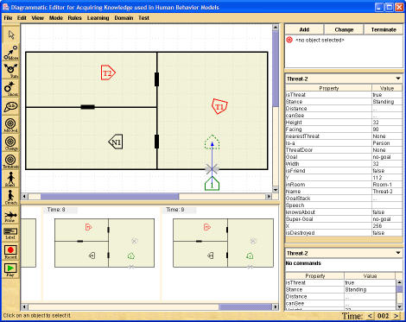
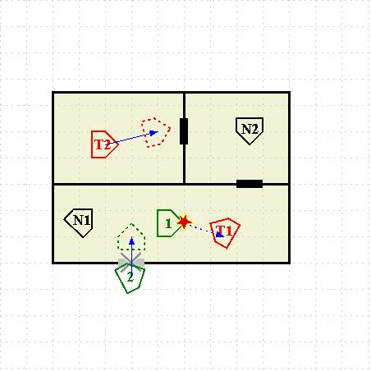

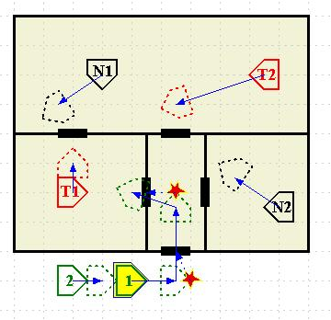
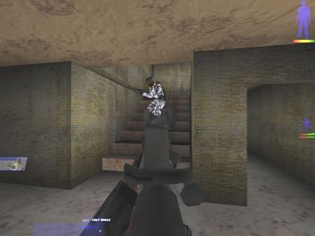
Redux: Rapid Behavior Acquisition from Diagrams Using Examples
Define behavior with
diagram-based examples
Library of validated
behavior examples
Analysis &
generation tools
Executable
Code
A -> B
C -> D
E, J -> F
G, A, C -> H
E, G -> I
J, K -> L
Detect inconsistency
Generalize
Generate
rules
Simulate execution
Expert
KE
Simulation
Environment
Notes:
Include results right up front

Slide 9
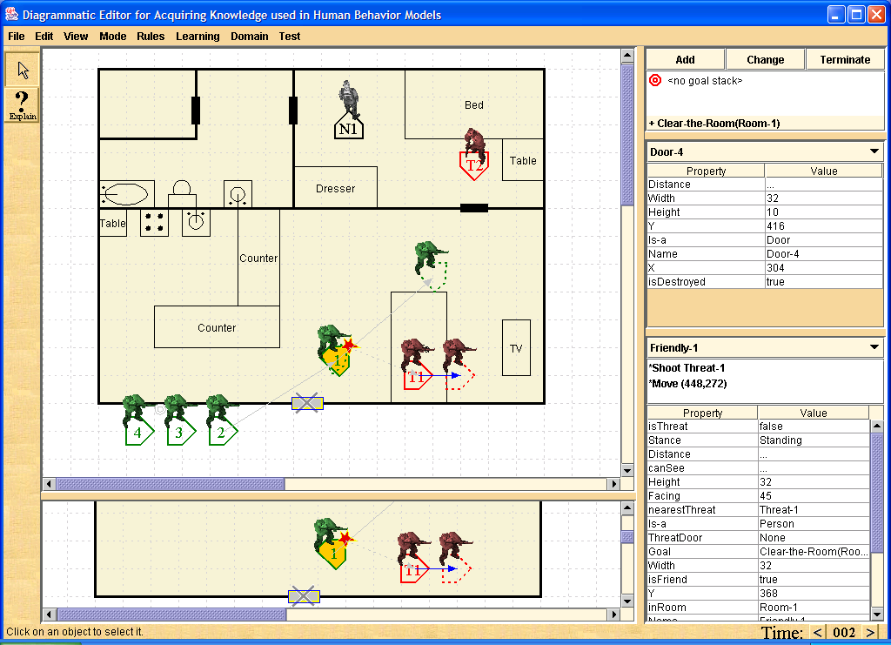
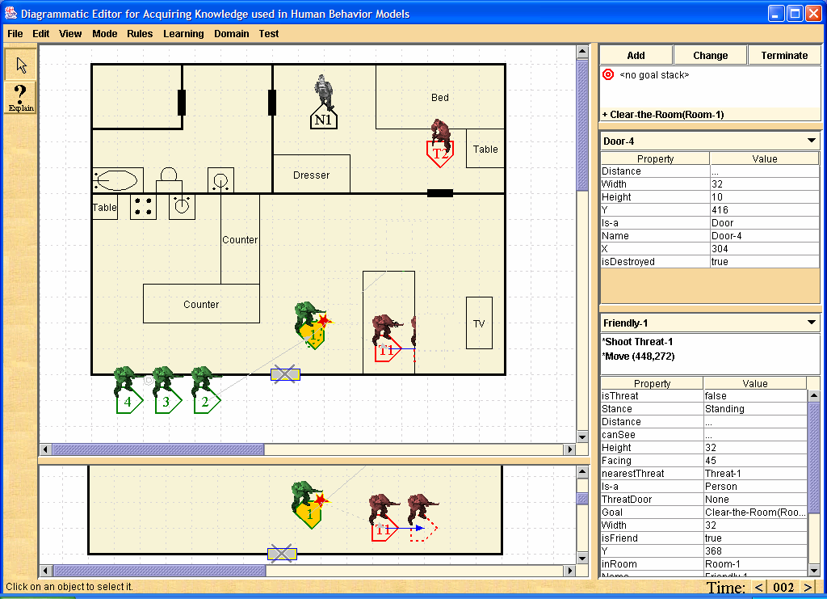
Specify Desired Behavior
Add-Goal
Clear-Room(room-1)
Move
(10ft left of sofa)
Shoot(door-1)
Shoot (threat-1)

Slide 10
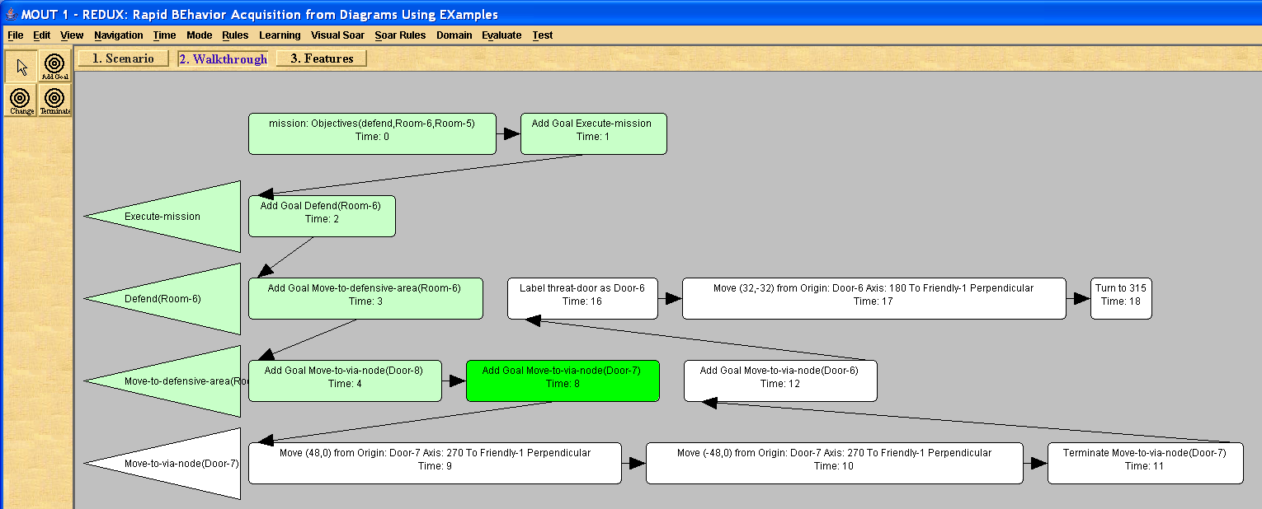
Visualization Can Take Many Forms
For some problems this view may be better
  Time and space vary differently here
  Can edit in this view too
Just assume there is some way to visualize problem

Slide 11
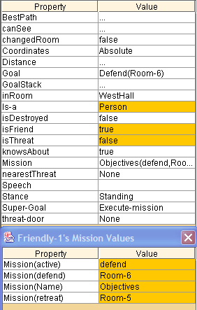
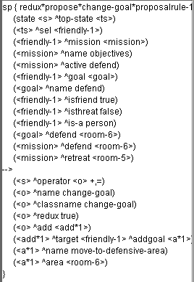
Rule Creation by Feature Picking
One way to create rules, but there are other options…

Slide 12
Faster Rule Creation
Type rule directly
Select features manually from example
Select features automatically based on example
  “Guess” based on situation (domain specific currently)
  “Guess” based on ILP from examples (Tolga)
    (Goals, State, Operator)->Yes or (Goals, State, Operator)->No
    Learn to predict when to select the operator
In each case refine the rules manually
  Better guesses just speed up rule creation
  Few features/conditions -> general rule
  More features/conditions-> specific rule

Slide 13
Close to the “Smart Editor”
sp { redux*propose*shoot*proposalrule-1
(state <s> ^top-state <ts>)
(<ts> ^sel <threat-1> <friendly-1>)
(<threat-1> ^isfriend false ^isthreat true ^isa person)
(<friendly-1> ^isfriend true ^isthreat false ^isa person)
(<friendly-1> ^cansee <cansee>)
(<threat-1> ^name <name*1>)
(<cansee> ^<name*1> true)
-->
(<s> ^operator <o> +,=)
(<o> ^name shoot ^target <threat-1> ^turn <turn>)
(<turn> ^target <friendly-1> ^facing 0)
}
Problem: This rule will keep firing.
Solution: Did you miss a condition?
Add (<target> ^alive true)?

Slide 14
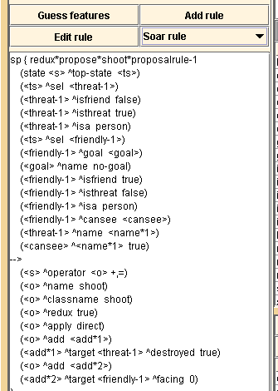
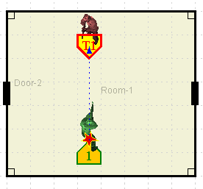
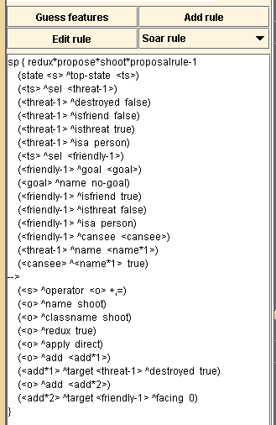
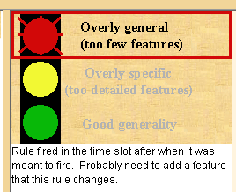
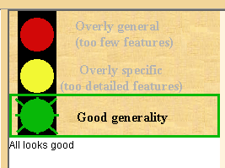
Automatic Rule Verification
  Detect missing conditions and overgeneral tests
  Detect underspecified choice points
  Detect overspecific conditions
  Will suggest solutions later (e.g. based on state deltas)

Slide 15
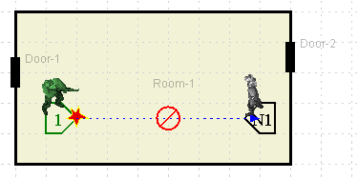
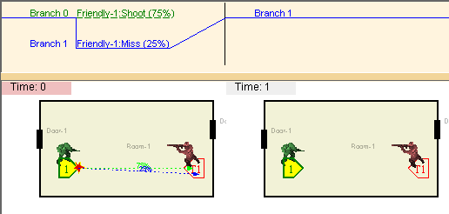
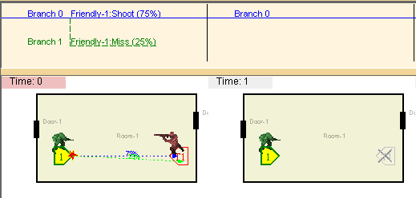
Specify Alternative Behaviors
Actions can have multiple outcomes
Can specify different choices (e.g. stand and shoot or flee)
Improves robustness
More efficient example creation
Negative examples
  What not to do
  Explicitly avoid bad choices

Slide 16
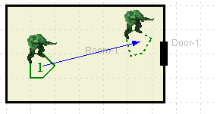
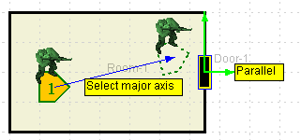
Coordinate Systems for Generalizing Spatial Actions
Move-to (240,80) doesn’t generalize.
Change coordinate system to be relative to an object.
Specified visually in one or two clicks
Allows
  Move through door
  Move to left of door
  Follow person
  Move toward person
  Move away from table
  Etc.

Slide 17
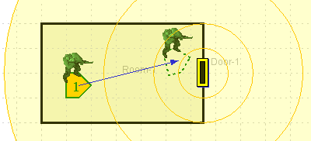
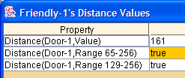
Regions for Generalizing Positional Information
Distance-to-door (161) doesn’t generalize.
Replace with series of regions (e.g. 65-256)
Create semantically meaningful regions on demand

Slide 18
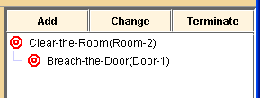
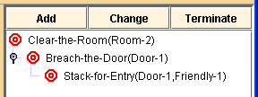

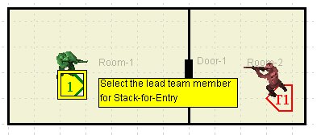
Hierarchical Goals and Goal Creation
Decompose tasks into subgoals
Decisions based on current goal are more general
Creation of new goals
  Text dialog to define class (once)
  Visual prompts for goal instance
  Added to goal stack

Slide 19
Detect Inconsistencies
Across Examples
Example
Library
Generate rules from example library
Execute rules on example scenarios
Detect when
rule behavior ≠ expert behavior
Ensures correctness
Generalization
Rule Generation
A -> B
C -> D
E, J -> F
Environment
Simulation
correct?
Notes:
Both rules as the apply to scenario and across all previous examples
Can’t do this with standard KA because don’t have examples, can’t ensure consistencies.

Slide 20
Learn Tactics for all Entities
Specify tactics for many
entities in single example
  Friendly forces
  Adversary forces
  Neutrals

Slide 21
Tool is Expressive and Efficient
Redux
Simulation
Analysis &
User Feedback
External
Rules
Internal
Rules
Jess
Jess
RETE
Matcher
Results
from
Rule Firings
RETE provides efficient rule matching
Jess inclusion allows rules to include complex conditions:
  Negations, relational tests (e.g. x closer-than y), disjunctions, etc.
(Integration with Soar still needs to become easier)

Slide 22
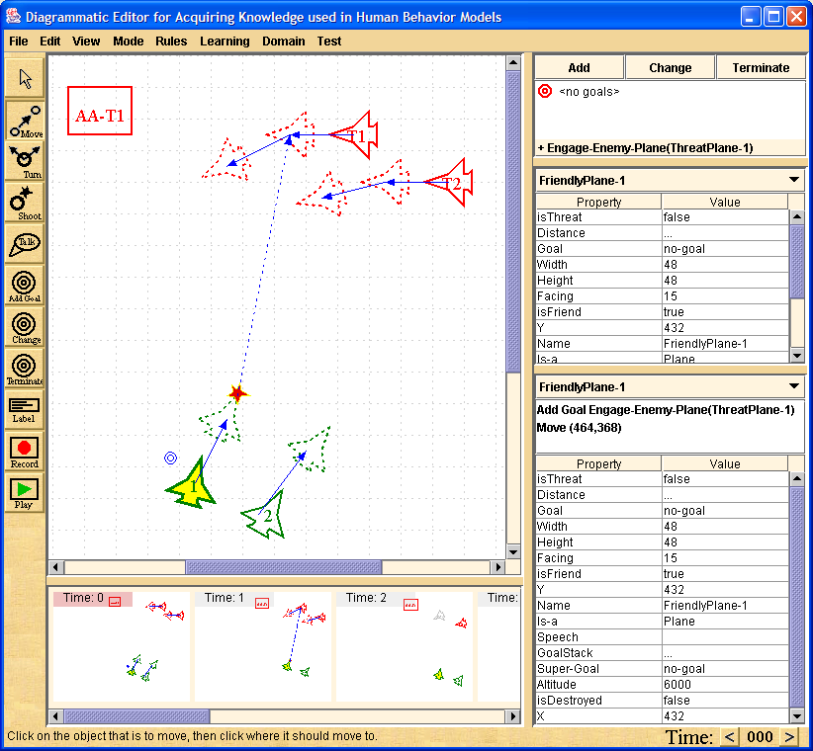
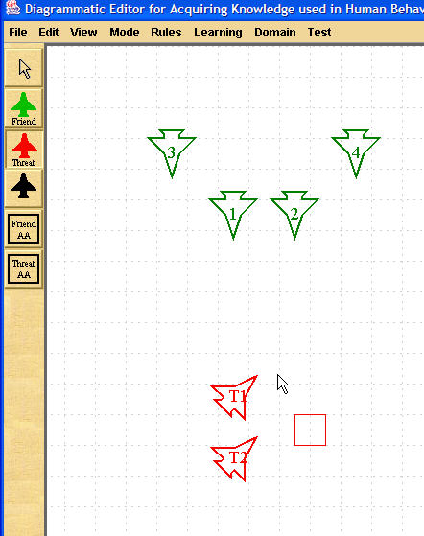
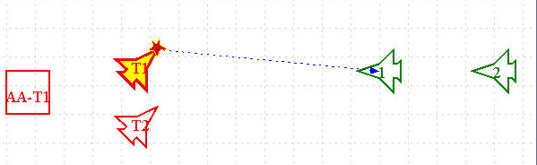

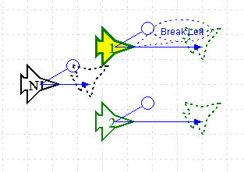

Use Tool in Multiple Domains
Define behavior with
diagram-based examples
Library of validated
behavior examples
Analysis &
generation tools
Rules
(Soar)
A -> B
C -> D
E, J -> F
G, A, C -> H
E, G -> I
J, K -> L
Detect inconsistency
Generalize
Generate
rules
Simulate execution
SME
KE
Simulation
Environment
90% of code base is domain independent
Notes:
Give Data on % that tool is domain independent

Slide 23
Use Same Tool for Air Domain

Slide 24
Nuggets
Tool with many capabilities
  Diagram specification with branches, negations etc.
  Rule generation
  Automatic verification
  Generalized spatial action
  Generalized positional information
  Hierarchical goals and dynamic goal creation
  Jess / RETE integration
Current Status
  Rapidly from diagram input to rules
  (e.g. 22 rooms+doors, 19 states and 12 rules in < 15 mins.)
  Is this fast?
Only at the mid-point of project
  Want to involve potential users now
Using Redux “feels right” so far
  Hard tasks are still hard (this is good – suggests no magic)
  Feels like Soar programming (this is also good)
  Highly constrained by examples (this is very good)
Notes:
Italics means not implemented

Slide 25
Coal
Future Work
  Extending to support a library of examples
  Extending the state representation (by the user)
  Extending to state elaboration and operator implementation rules
  Including learning component
What do we really have here?
  End-user programming tool (seems unlikely)
  End-user maintenance tool
  End-user specification tool
  Knowledge engineer tool
  Rapid prototyping tool
  Teaching tool
  Formal specification and verification tool
  Integrated specification, rule creation and environment tool (one JAR file)
Larger questions
  How expensive to tailor to a new domain / type of visualization ?
  Will Redux rules really map well to Soar rules in real environment?
  Are we focusing on the hard part of the task?

Slide 26
“The primary concern for commercialization is the ability to build and maintain the systems we want quickly and cheaply.”
- A distinguished Professor living in Maine

Slide 27
The End
Define behavior with
diagram-based examples
Library of validated
behavior examples
Analysis &
generation tools
Executable
Code
A -> B
C -> D
E, J -> F
G, A, C -> H
E, G -> I
J, K -> L
Detect inconsistency
Generalize
Generate
rules
Simulate execution
Expert
KE
Simulation
Environment
Notes:
Composibility
Validated examples give validated behavior
Because of quality positive and negative feedback – extensions and maintenance can be done by SME – just add examples

