Slide 1
gSKI, TgDI and the Updated Soar Kernel
Vini Vidi Coivi

Slide 2
The Big Picture
Soar Technology spent about a man-year developing a new interface for Soar
After over a year of in-house testing with gSKI, TgDI and a modified Soar Kernel, and further evaluation by the University of Michigan, It was decided that Soar Technology would release all of this work back to the Soar Community under an Open Source License
We are currently working with the University to integrate in all of the recent changes to the Soar Kernel and release it as Soar 8.6 when it is ready.

Slide 3
Why Any Of This Matters
These tools dramatically improve the efficiency with which you can integrate with new systems.*
  My ad hoc evaluation has shown a 5x to 10x improvement in development productivity
  Additional support libraries have added an additional 2x to 3x improvement
It makes maintaining Soar systems easier
  * This is specifically with respect to the Soar side of integration, not the end system integration

Slide 4
Some of the Systems We Have Integrated With
OneSAF Testbed (OTB)
CoABS Grid
JSAF
VR-Forces
VISTA2
Joint Battlespace Infosphere (JBI)

Slide 5
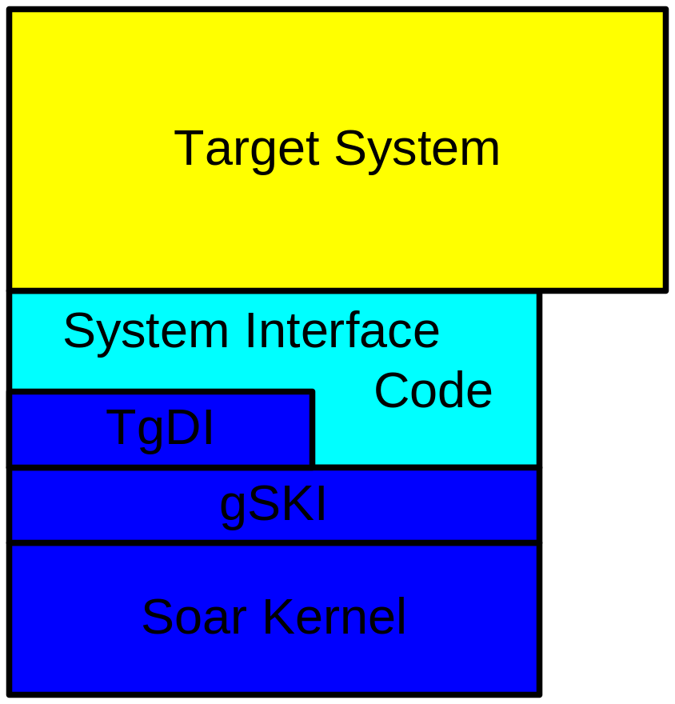
Soar System Architecture

Slide 6
(gSKI Related)
Soar Kernel Changes
The Kernel is now in C++
The Kernel is thread-safe on a per-agent basis
  No mutable global data
  No global agent pointers/data
The Kernel provides callbacks at a variety of location throughout the kernel
Refactored the kernel in to smaller more manageable pieces
  Soarkernel.h went from ≈4000 lines to 172 lines
Most macros eliminated in favor of inline CPP functions

Slide 7
What Next for the new Soar Kernel?
Improved Test Suite
Evaluation of Memory Issues
Initialization/Re-initialization
More Cleanup
New Interrupt Mechanism
Definition of Soar
Release

Slide 8
What is gSKI?
generic Soar Kernel Interface
An interface between agents and applications
A system that works on both Windows and Linux
A Much Easier interface between agents and applications
The thing that makes me look good

Slide 9
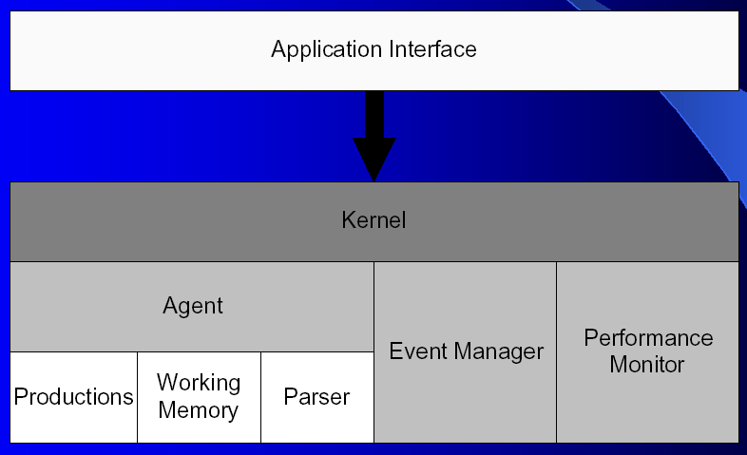
gSKI Interfaces

Slide 10
gSKI Status---Where are we?
There is sufficient functionality to accomplish all of our system integration tasks
There is insufficient functionality to provide all of the debugging tasks we would like to accomplish
New perspective on system integration

Slide 11
What next for gSKI
Improved reference counting
Finish up remaining functionality
  Primary Working Memory
  Matches
  Etc.
Test Suite

Slide 12
What is the TgDI
TCL/gSKI Debugger Interface
Integrates (most of ) the TSI functionality through gSKI
Maintains backward compatibility with earlier system developed with the TSI

Slide 13
TgDI Status---Where are we?
Implemented
  echo
  excise
  firing-counts
  gds_print
  init-soar
  learn
  matches
  new-agent
  output-strings-destination
  preferences
  print
  production-find
  rete-net
  run
  set-default-depth
  sp
  stop-soar
  waitsnc
  watch
  stats
Unimplemented
  add-wme
  ask
  attention-lapse
  attribute-preferences-mode
  capture-input
  chunk-name-format
  default-wme-depth
  explain-backtraces
  format-watch
  indifferent-selection
  input-period
  internal-symbols
  io
  log
  max-chunks
  max-elaborations
  max-nil-output-cycles
  memories
  monitor
  multi-attributes
  o-support-mode
  pwatch
  remove-wme
  replay-input
  soar8
  start-attention-lapse
  verbose
  wake-from-attention-lapse
  warnings

Slide 14
What’s Next for the TgDI?
Completed TSI interface will all relevant functionality
Upgrade to the latest version of the TSI
Peaceful death (although it will probably slow and painful)

Slide 15
Examples
Simple Example: Create one agent and run in TSI.
int main()
{
IKernelFactory* kF = gSKI_CreateKernelFactory();
IKernel* k = kF->Create();
IAgentManager* IAM = k->GetAgentManager();
IAgent* agent = IAM->AddAgent("ProductionTestAgent");
TgD::TgD* debugger = CreateTgD(agent, k, TgD::TSI25);
debugger->Init();
while(1)
{
TgD::TgD::Update(false, debugger);
TGD_SLEEP(50);
}
return 0;
}

Slide 16
Examples (continued)
Example: Create one agent and run in TSI with cycle-count on input link.
class InputProducer: public IInputProducer
{
private:
int m_count;
IWme* m_wme;
public:
// Simple constructor
InputProducer():m_count(0),m_wme(0) {}
// Virtual destructor for the usual reasons
virtual ~InputProducer()
{
// Letting go of reference to the cycle-count wme
if ( m_wme ) {
m_wme->Release();
}
}
// Update function required by IInputProducer interface
// (Responsible for updating state of working memory)
virtual void Update(IWorkingMemory* wmemory,
IWMObject* obj) {
// Getting the decision cycle count
int ccount;
ccount = wmemory->GetAgent()->
GetNumDecisionCyclesExecuted();
if ( m_wme == 0 )
{
// Possibly move this to the constructor
m_wme = wmemory->AddWmeInt(obj, "cycle-count",
ccount);
} else {
m_wme = wmemory->ReplaceIntWme(m_wme,ccount);
}
}
};
-----------------------------------------------------------
InputProducer* piprod = new InputProducer();
IInputLink* ilink = agent->GetInputLink();
IWMObject* wmobj;
ilink->GetRootObject(&wmobj);
ilink->AddInputProducer(wmobj, piprod);
wmobj->Release();

Slide 17
Examples (continued)
Example: Add the ability to write output-link commands to an XML file.
class OutputProcessor: public IOutputProcessor
{
public:
OutputProcessor() {}
virtual ~OutputProcessor() {}
virtual void ProcessOutput(IWorkingMemory* workingMemory,
IWMObject* obj){
// Iterating over children
std::set<IWMObject*> writtenObjects;
std::cout << "<Output>" << std::endl;
RecursivelyWriteXMLFromObject(obj,std::cout,writtenObjects, 1);
std::cout << "</Output>" << std::endl;
// Marking the top-level object as processed
workingMemory->AddWmeString(obj, "processed","*yes*");
}
void WriteTabs(std::ostream& ostr, unsigned int tabCount) {
for (unsigned int i = 0; i < tabCount; ++i) {
ostr << "\t";
}
}
};
void RecursivelyWriteXMLFromObject( IWMObject* obj,
std::ostream& ostr,
std::set<IWMObject*>& writtenObjects,
unsigned int tabCount = 0){
if ( obj == 0 ) return;
// If I've already written this object then don't write it again
// if not then Add the object to the set of written objects
if ( writtenObjects.find(obj) != writtenObjects.end()) return;
writtenObjects.insert(obj);
// Getting all the child wmes
tIWmeIterator* it = obj->GetWMEs();
// Iterating over the wmes associated with this object
for (; it->IsValid(); it->Next() ) {
IWme* wme = it->GetVal();
const ISymbol* attr = wme->GetAttribute();
const ISymbol* val = wme->GetValue();
IWMObject* obj = 0;

Slide 18
Examples (continued)
Example: Add the ability to write output-link commands to a file.
switch (val->GetType()) {
case gSKI_OBJECT:
// Handling these in the next iteration loop
// Write the opening tag contents and then closing tag
obj = val->GetObject();
WriteTabs(ostr, tabCount);
ostr << "<" << attr->GetString() << ">" << std::endl;
RecursivelyWriteXMLFromObject( val->GetObject(),
ostr,
writtenObjects,
tabCount+1);
WriteTabs(ostr, tabCount);
ostr << "</" << attr->GetString() << ">" << std::endl;
break;
case gSKI_STRING:
case gSKI_VARIABLE:
// Write out a simple value tag
WriteTabs(ostr, tabCount);
ostr << "<" << attr->GetString() << " value=\""
<< val->GetString() << "\"/>" << std::endl;
break;
case gSKI_DOUBLE:
// Write out a simple value tag
WriteTabs(ostr, tabCount);
ostr << "<" << attr->GetString() << " value=\""
<< val->GetDouble() << "\"/>" << std::endl;
break;
case gSKI_INT:
// Write out a simple value tag
WriteTabs(ostr, tabCount);
ostr << "<" << attr->GetString() << " value=\""
<< val->GetInt() << "\"/>" << std::endl;
break;
default:
MegaAssert(false, "Unknown symbol type in OutputProducer!");
break;
}
}
it->Release();
}
-----------------------------------------------------------
OutputProcessor oproc;
agent->GetOutputLink()->AddOutputProcessor("takeoff", &oproc);

Slide 19
Noteworthy Interfaces
IWMObject
IWorkingMemory
IWmeIterator
IWme
ISymbol
TgD
IInputProducer
IOutputProcessor

Slide 20
Other Interesting Interfaces
IKernelFactory
IKernel
IAgentManager
IAgent
IInputLink
IOutputLink
IError

Slide 21
Not So Interesting Interfaces
IProduction
IProductionManager
IProductionMatch
IAgentThreadGroup
IConditionSet
IPerformanceManager
IAgentPerformanceManager

Slide 22
Nuggets and Coal
Nuggets
  Much improved interface
  Used on many projects
  Integrated with the University
Coal
  Not Done
  Release Version note ready yet

Slide 23
Q & A
Jens Wessling
Soar Technology
wessling@soartech.com
6/8/2004

