Slide 1



Heuristic Formalism for Spatio-Temporal Qualitative Reasoning
Thinking…
…inside the box
24th North American Soar Workshop
Presented on 11 June 2004 by
Jonathan T. Beard

Slide 2
Outline
Research Team
Problem
Hypothesis
Experiment
Approach
Observations
Future Work

Slide 3
Research Team
Dr. Scott Wood – Principal Investigator
  Human-system interaction, cognitive modeling, human error
Jack Zaientz – Co-Principal Investigator & Project Manager
  User Interface Design, Human-system interaction, task analysis, information visualization
Dr. Paul Nielsen
  Soar behavior modeling, qualitative modeling
Jonathan Beard
  Soar behavior modeling, qualitative modeling, heuristic formalism design, software engineering
Jacob Crossman
  Qualitative modeling, heuristic formalism design, software engineering
Jens Wessling
  Software integration, software engineering
Laura Hamel
  Software integration, software engineering

Slide 4
Problem: Complexity
Too much data
Too many systems
Too many sources
Too many types
Not enough time
Inherent human limitations
  change-blindness
  high workload / cognitive overload
No delivery mechanisms
^
good

Slide 5
Testable Hypothesis
Hypothesis:
Intelligent agents can enhance user task performance through workload reduction by management of information presentation
Test:
Implement an intelligent agent system as described above in a real-world demonstrably high workload application and evaluate impact on user workload

Slide 6
Experimental Testbed:
Time Critical Targeting
Detection
ISR
MCC
Weapon
System
Weapon System/
Control Platform
Coordinate
With Control
Agency
Message Sent
To Weapon
System
Execute
TCT
BDA
Nominate
BCC/AOC
N
Y
Amplify Data
As Required
Y
BCC/AOC
Decision
To Control
2nd Source
Validation
BCC/AOC
N
Acknowledge
Message
ISR
WILCO
Target
Assessment
Success
N
Y
Y
Y
Weapon
System
Y
BCC/AOC
Prioritize
Elect
TP Cell
Available
Choose
Weapon
System
N
N
Intel Analyzes
Implications
Of BDA
Y
N
N
Dynamic
Target List
CANTCO
Failed
Notional TCT Process Flow (derived from JEFX 2000)

Slide 7
Experiment Features
Large number of data tracks
Multiple intelligence types
Targets of interest move over time
User tasks are monitoring and analysis
Information is presented visually and through “tipper” text chat communication
Agents must reason over all of these features to usefully assist the user

Slide 8
Approach: Qualitative Spatio-Temporal Reasoning
Agents must draw inferences on a variety of relationship types:
  Temporal relationships (Assumption1 after Assumption2)
  Spatial relationships (Friendly1 near EnemyContact1)
  Spatio-Temporal relationships (EnemyContact1 moving-toward Friendly1)
  Assertion relationships (Contact classified-as EnemyContact, Plane tagged-as Destroyed, etc)
Qualitative representations of these relationships reduce the complexity of calculation and improve explainability of the inferences (Forbus, Nielsen, et al)

Slide 9
Approach:
Heuristic Formalism
Define a formal language to provide us with a consistent format with which qualitative relationship heuristics can be encoded, compared, reviewed, and validated
Heuristic language formalism will be:
  high-level
  user maintainable
  System-independent
Satisfaction of these objectives is necessary to develop an agent with rich enough domain knowledge in an economical period of time

Slide 10
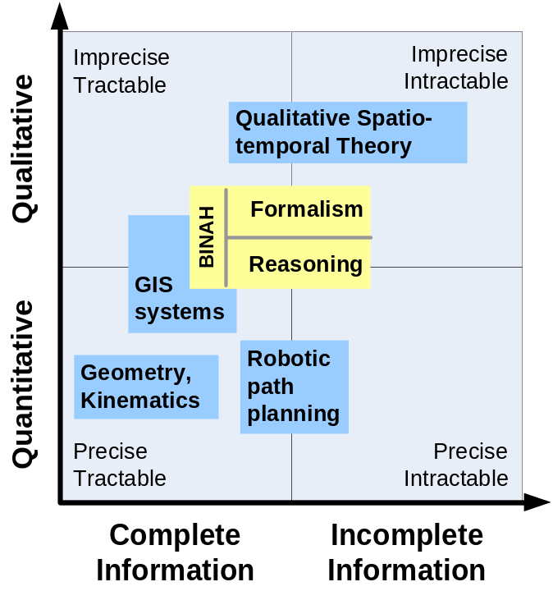
Computational Space
Formalism: purely qualitative heuristics over complete and incomplete spatio-temporal information
Reasoning: Internal and external agent processes to integrate qualitative (heuristic) and quantitative (sensed) spatial information
Overlap with GIS systems in data and needs
We need to be aware of computational difficulties

Slide 11

Temporal Properties
Projected Time
Distant-Past
Recent-
Now
Near-
Distant-Future
Past
Future
What I believed had
happened
What I believed would
happen
Distant-Past
What I believed
was happening
Past
Knowledge
Recent-Past
Real Time
Current
Now
What I believe happened
What I believe will happen
Knowledge
Near-Future
What I believe is happening
What I will believe
is happening
Future
Knowledge
Distant-Future
What I will believe
has happened
What I will believe
will happen
Historical knowledge
Projections
and Inferences (past)
and Inferences (future)

Slide 12
Spatial Properties
Necessary for quantitative computation
  Geometry: points, lines, polygons
Necessary to reason over space and time
  Velocity: fast, slow, moving toward, moving away
Useful for qualitative queries
  Topology: intersects, overlaps, disjoint
  Distance: near, far, nearer, further
  Orientation: toward, away, right/front/left/back-of
  Size: large, small
Frame of Reference (FofR): Origin and measurement system in which to define relationships and answer queries
Notes:
Separating execution into context activated slices
Preconditions, invariants
Post-conditions
Body with sequence constraints
Explicitly defining a target state (goal)
Logic defined
Slot filling
Commitment to execution path at runtime
Decision processes
Event/Interrupt handling
Knowledge level control over contexts
Defining execution as context activated slices
Explicitly defining a target state (goal)
Commitment to execution path until decision is necessary (least commitment)
Control of contexts through knowledge
Processes for blending deliberate and reactive behavior

Slide 13
Challenges
Representational Challenges
  Complete representation: research focuses on individual spatial properties, but we need a spatial model that merges these properties
  Qualitative kinematics: current research into qualitative kinematics is sparse, but we require reasoning over space and time
Computational Challenges
  Intractability: general reasoning over incomplete qualitative spatial information has been proven to be intractable
  Hybrid computation: little research in area of mixed qualitative/quantitative reasoning
Notes:
Separating execution into context activated slices
Preconditions, invariants
Post-conditions
Body with sequence constraints
Explicitly defining a target state (goal)
Logic defined
Slot filling
Commitment to execution path at runtime
Decision processes
Event/Interrupt handling
Knowledge level control over contexts
Defining execution as context activated slices
Explicitly defining a target state (goal)
Commitment to execution path until decision is necessary (least commitment)
Control of contexts through knowledge
Processes for blending deliberate and reactive behavior

Slide 14
Current Approach: Reuse and Simplifications
We will borrow established concepts from research
  RCC-8 relations: disjoint, partial overlap, etc.
  Modify qualitative distance/orientation systems
  Use key concepts from Frame of Reference research: intrinsic v. extrinsic v. deictic frames
Provide the system with sufficient sensory information to make decisions
Avoid complex projections (i.e. no “deep” planning) to avoid intractable problems
Notes:
Separating execution into context activated slices
Preconditions, invariants
Post-conditions
Body with sequence constraints
Explicitly defining a target state (goal)
Logic defined
Slot filling
Commitment to execution path at runtime
Decision processes
Event/Interrupt handling
Knowledge level control over contexts
Defining execution as context activated slices
Explicitly defining a target state (goal)
Commitment to execution path until decision is necessary (least commitment)
Control of contexts through knowledge
Processes for blending deliberate and reactive behavior

Slide 15
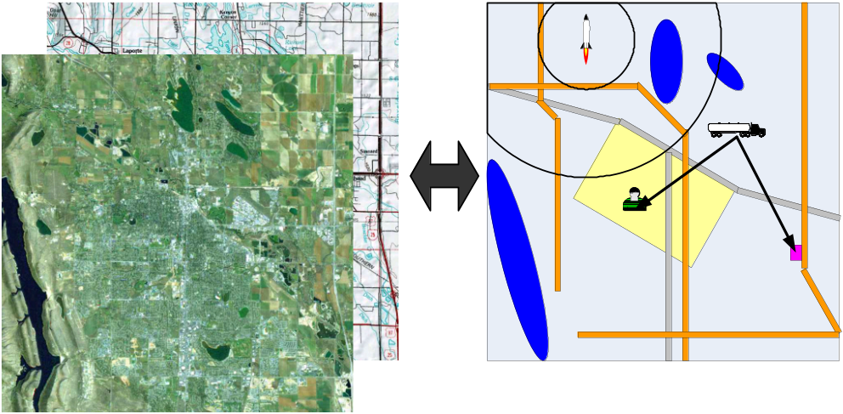
Current Approach:
Hybrid Solution
Query quantitative model
Is missile in range?
Quantitative data retained and used for computation
Is truck closer to leader or strategic site?
Is leader in city?
Detailed Quantitative Data
Simplified Qualitative Model
Path exist to missile?
Qualitative model in agent’s “head”
  Easier to specify and understand heuristics
  Reasoning is simplified through reduction of detail
Quantitative model used for computation and sensing
  Kinematics well understood at quantitative level
  Geometric computations tractable and well understood
Notes:
Separating execution into context activated slices
Preconditions, invariants
Post-conditions
Body with sequence constraints
Explicitly defining a target state (goal)
Logic defined
Slot filling
Commitment to execution path at runtime
Decision processes
Event/Interrupt handling
Knowledge level control over contexts
Defining execution as context activated slices
Explicitly defining a target state (goal)
Commitment to execution path until decision is necessary (least commitment)
Control of contexts through knowledge
Processes for blending deliberate and reactive behavior

Slide 16
Example Heuristic Statement Form
Plain English example:
  “If the system registers a new enemy contact previously undetected, the system should change the visual presentation of that contact in the warfighter’s display”
Corresponding Formal Heuristic:
IF
For Contact called Contact1
{
At Present I believe it tagged-as NewContact in Recent-Past
At Present I believe it classified-as EnemyContact in Present
}
THEN I believe Contact1 tagged-as EMPHASIZE in Present

Slide 17
Current Approach: Innovation
Existing approaches are not sufficient,
We will develop innovative solutions for:
  Representing all required spatial properties in a single representation
  Describing time and space together in a human-understandable heuristic formalism
  Integrating qualitative projections with quantitative sensing
We would also like to start to answer the question: “how much information is necessary in order to make useful decisions in our domain?”
Notes:
Separating execution into context activated slices
Preconditions, invariants
Post-conditions
Body with sequence constraints
Explicitly defining a target state (goal)
Logic defined
Slot filling
Commitment to execution path at runtime
Decision processes
Event/Interrupt handling
Knowledge level control over contexts
Defining execution as context activated slices
Explicitly defining a target state (goal)
Commitment to execution path until decision is necessary (least commitment)
Control of contexts through knowledge
Processes for blending deliberate and reactive behavior

Slide 18

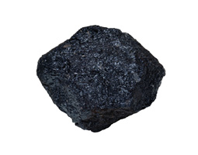
Observations
NUGGETS
Should provide a re-usable codebase for Soar-based spatio-temporal reasoning
Accessible to non-experts
Critical building block for creating more complex agent systems
System has a cool acronym: BINAH (Battlespace Information and Notification through Adaptive Heuristics)
COAL
Only scratching surface of huge research area
Implementation not finished
Not clear yet on best level(s) of abstraction for formalism

Slide 19
Future Work
Will have a finished first implementation of combined spatio-temporal reasoning system by end of August 2004
Objective is to test and evaluate agents as part of larger intelligence analysis toolset by end of year 2004
Additional research funding being sought
Investigating collaborative research and development partnerships

Slide 20
BINAH: Battlespace Information and Notification through Adaptive Heuristics
Sponsoring Organizations
Air Force Research Laboratories – Information Directorate (AFRL/IF)

Slide 21
Backup Slides

Slide 22
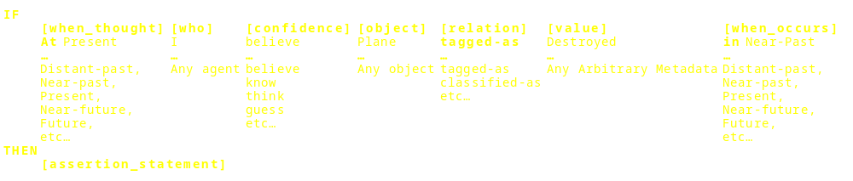
Example Heuristic Statement Options Detail

Slide 23
Fundamental Heuristic Statement Elements
object (required): object about which the inference is being made
tag (required): a text tag on an object with an arbitrary value such as “Destroyed”
relation (required): The relation of the inference
  The most common inferences are the classification or “being” inference (“is” in English) and the composition or “has” reference. The other relationships are most likely to fall under one of the following four types:
    Taxonomic
    Spatial
    Temporal
    Causal
confidence (optional): The confidence of the entity about the inference
  Default is “believe” which implies any confidence. Other confidence values:
    know (absolutely certain, usually from sensory information)
    think (fairly certain based on the evidence)
    guess (don’t know for sure, but worth considering)
value (required): A compound element composed of an object, a tag, and an atomic property relation

Slide 24
Additional Heuristic Statement Elements
who (optional): Entity making the inference
  Default is “I” or the agent making the inference
negation (optional): A field indicating if the inference is about the existence or absence of a relation
  The value can be [do/does] “not”
when_thought (required): When the inference was made as in “Now I think Plane [is] classified-as Destroyed” Valid values for when_thought are any of the following:
  The present time (Now)
  Any of the temporal bins (e.g. Awhile Ago, Recently, Soon, Eventually)
  The past: Previously
  The future: In-Future
  Any time: Anytime
when_occurs (required): The time the relation should hold as in “I think Plane [will be] classified-as Destroyed Soon”
  The range of values for this element are the same as those for when_thought

