Slide 1

The role of Confidence Factor in “Humanizing” the decision making of an AI Agent
Syed Enam-ur-Rehman¹
Mohammed Zeeshan Ozair²
¹Department of Computer Engineering, Sir Syed University of Engineering & Technology, ²The Aga Khan University & Hospital

Slide 2
Introduction
Focus of AI development
Usually the decisions of an AI agent are either too calculated or too blunt
A method is proposed for making decisions, which is simple, adaptable and endeavors to represent a more realistic humanoid behavior

Slide 3
Inspiration
Situation 1:
  Unreal Tournament 2003 (an action game)
Situation 2:
  Fifa 2002 (a soccer game)

Slide 4
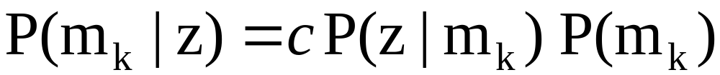
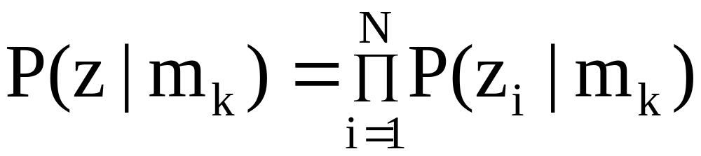
Decision Theory
K possible mastery states that take on values m_{k}
Z the response vector composed of z₁, z₂, … z_{i}

Slide 5
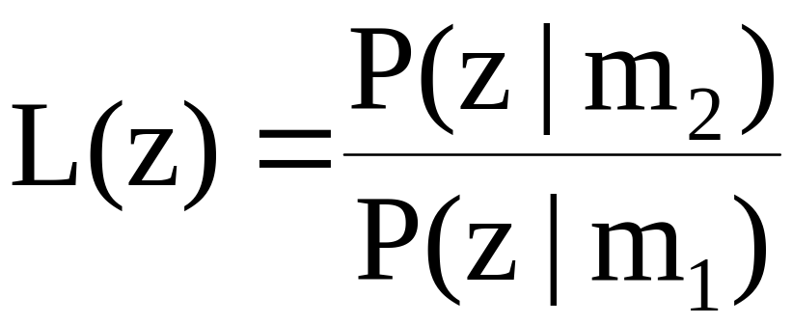
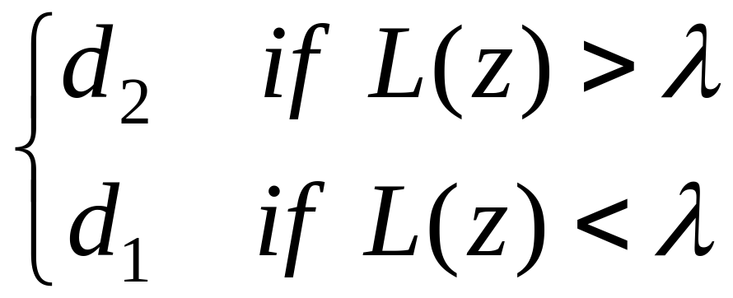
…continued
Likelihood ratio L(z) is compared with a criterion variable λ

Slide 6
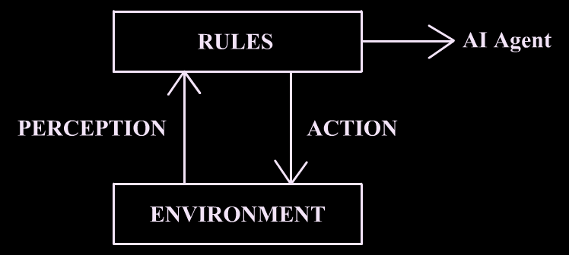
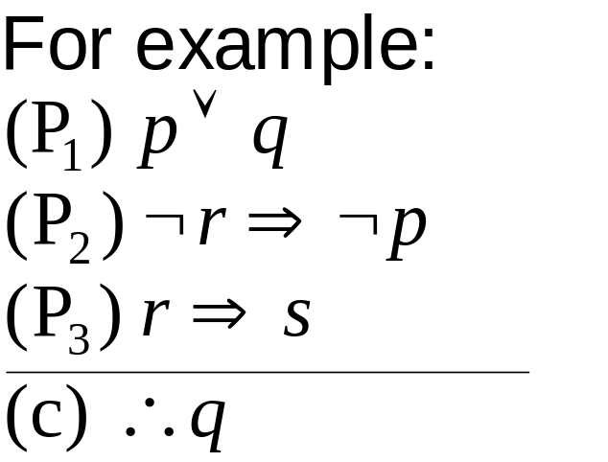
Rule-based Systems

Slide 7
Curtain Raiser
The complexity of Decision Theory makes it inaccessible to many
Rule-based systems lack the fidelity of Decision Theory and are dependant on long term knowledge
Neither of these model human behaviors accurately

Slide 8
…continued
Decision making based on confidence theory is relatively simple, flexible and reasonably adaptable, yet trying to achieve functionality
It attempts to model human behavior more accurately
Emotions such as anger, revenge, trust, mistrust, fear, pride, all an integral part of human behavior can be expressed

Slide 9
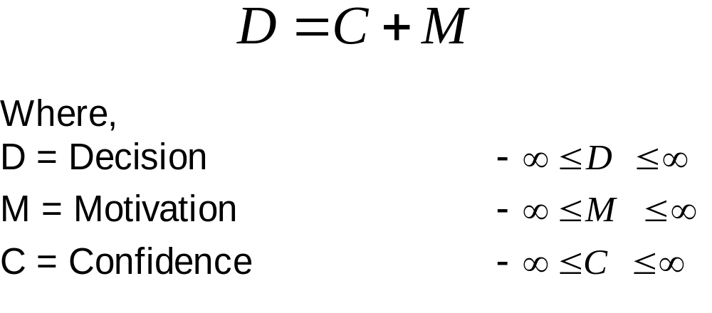
Part I: Decision, Confidence and Motivation

Slide 10
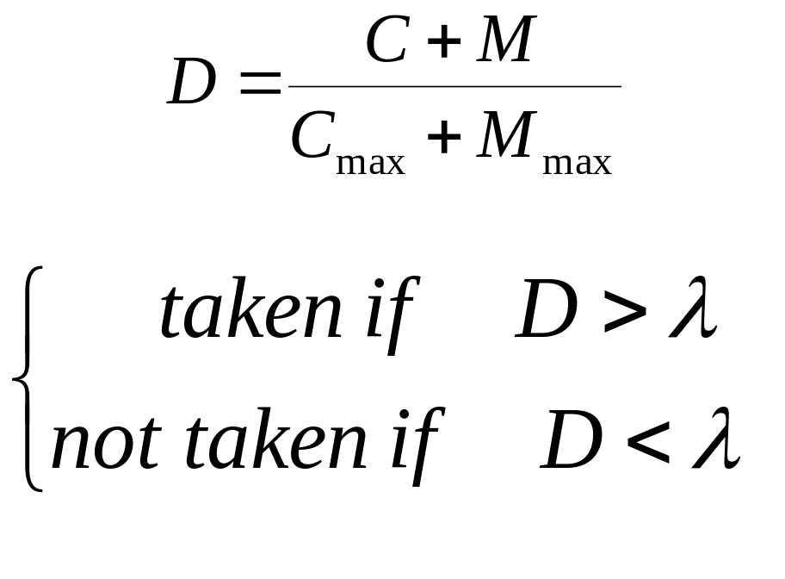
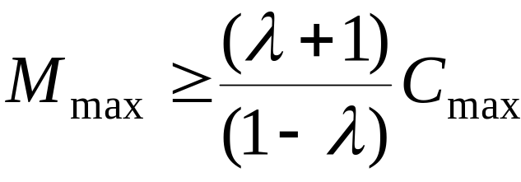
Decision Selection
For do or die situations…

Slide 11
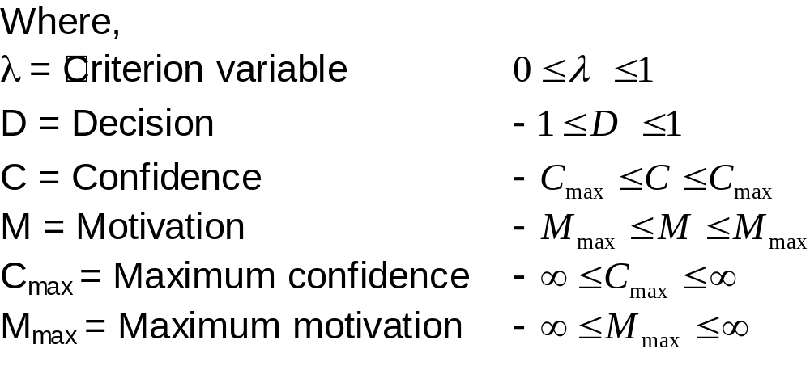
…continued

Slide 12
Part II: Motivation
Defined as the need of performing an act
Is a function of internal and external factors
Directs goal focused behavior
Modulated by learning mechanisms
For e.g., acquiring first-aid with low health, gaining revenge if provided incentive, aggression if time is running out

Slide 13
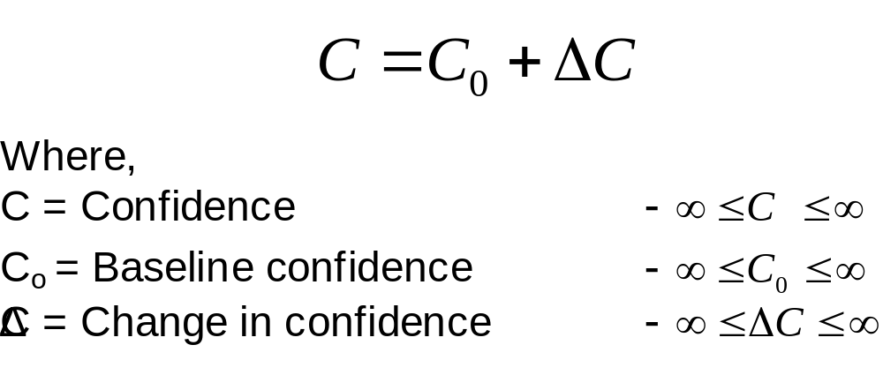
Part III: Confidence

Slide 14
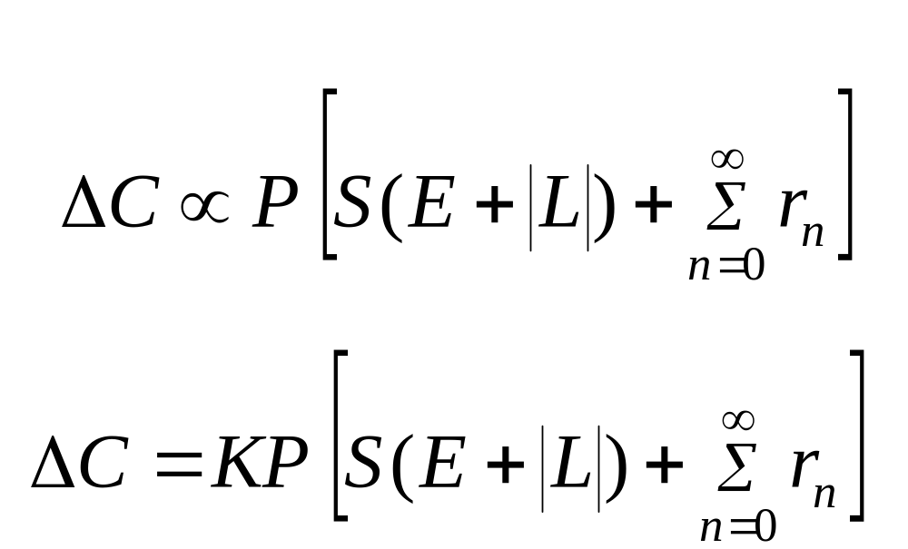
Confidence Factor

Slide 15
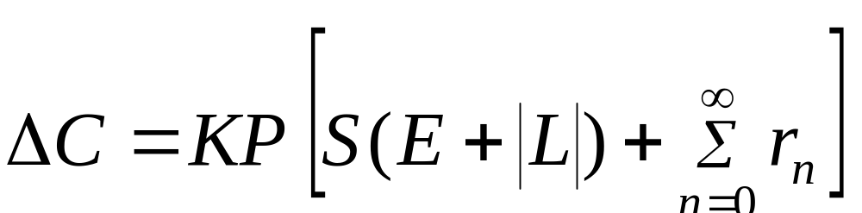
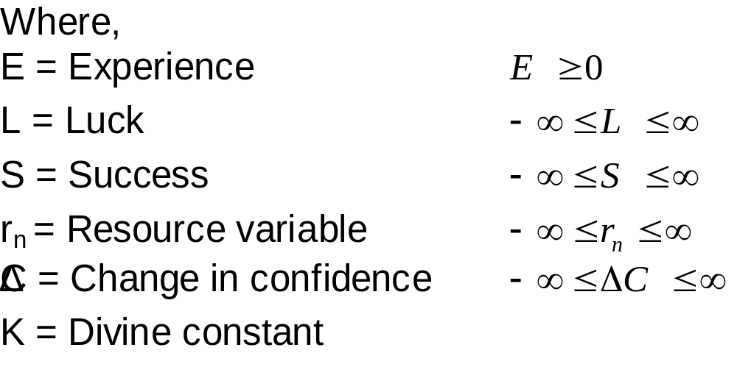

Slide 16
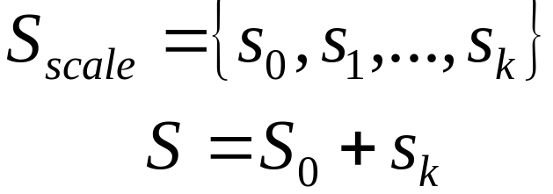
Success
A desired completion of a task or an accomplishment
Incremented on each success event with a scale proportionate to the complexity of the task

Slide 17
Experience
Number of decision cycles involved in performing an act
Its inclusion ensures,
  Ability to induce frustration
  An indirect appreciation of any learning mechanism if present

Slide 18
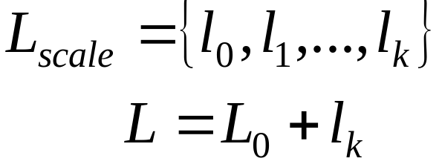
Luck
A random event which can affect the completion of a task
Consanguinity of such events affect confidence
Overall luck is updated on occurrence of each pre-defined luck event with a scale proportionate to its impact

Slide 19
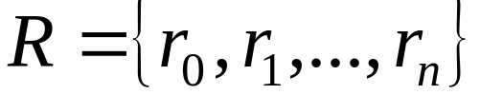
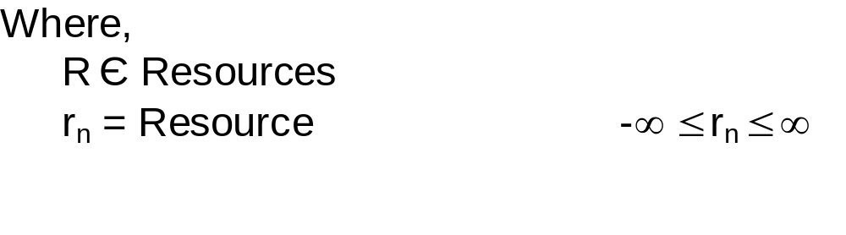
Resources
These are environmental variables whose availability or deficiency play a significant role in completing a task

Slide 20
Personality
Introduces an entropy in the interpretation of confidence
Allows a spectrum of personalities differentiating timid from aggressive

Slide 21
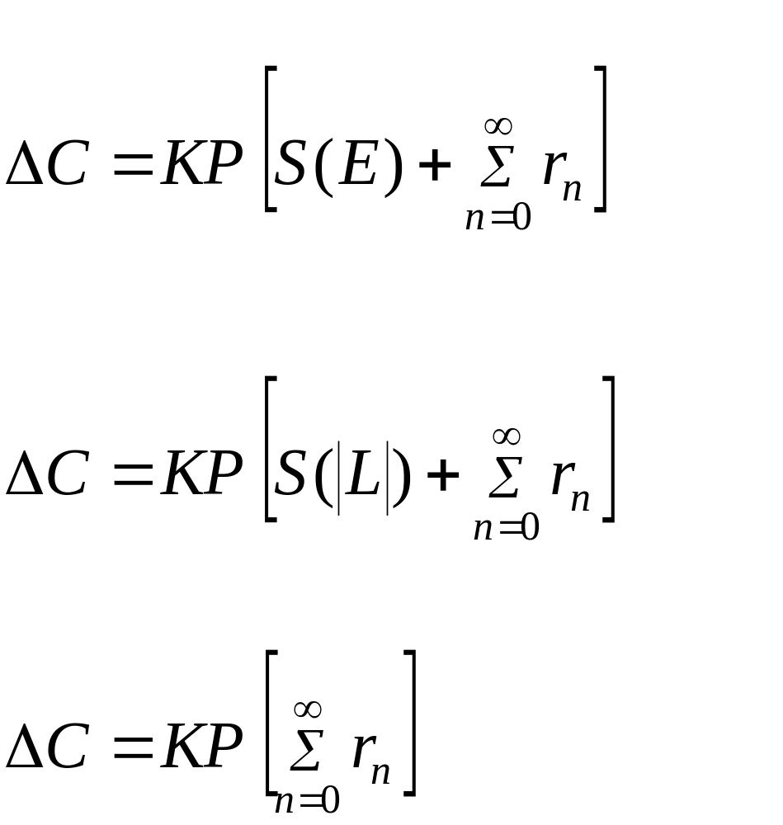
Postulates
When L = 0,
When E = 0,
When S = 0,

Slide 22
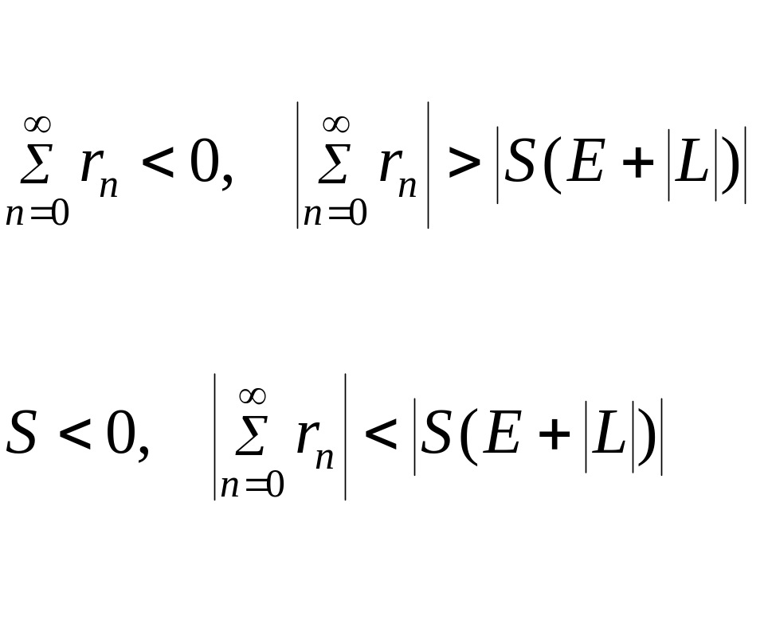
…continued
ΔC < 0 if and only if,

Slide 23
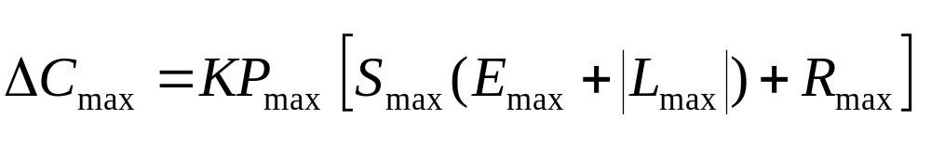
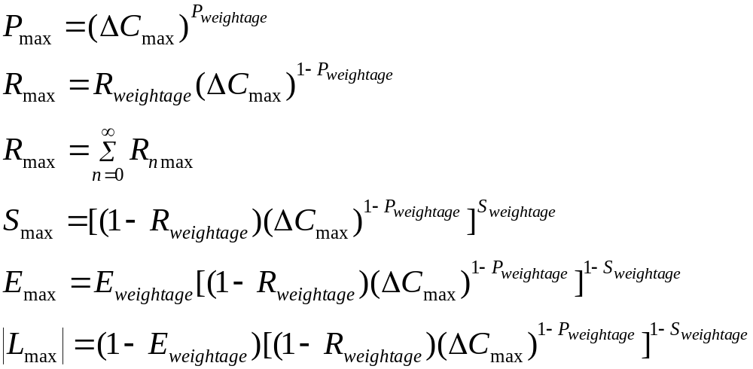

Slide 24

Decision Architecture

Slide 25
Recall
Situation 1:
  Unreal Tournament 2003 (an action game)
Situation 2:
  Fifa 2002 (a soccer game)

Slide 26
Simulation Results

Slide 27
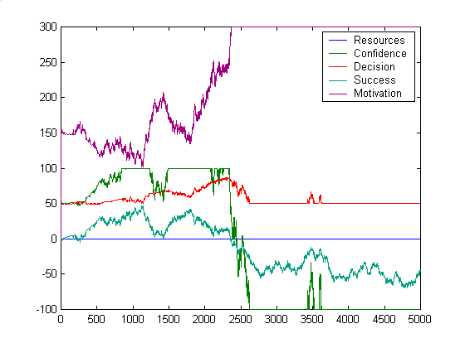

Slide 28
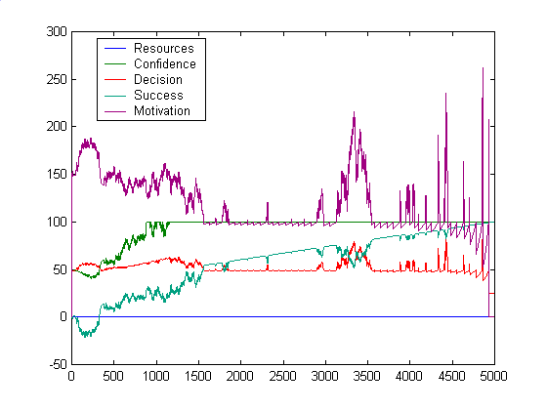

Slide 29
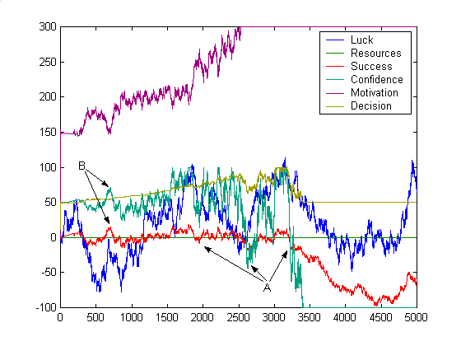

Slide 30
Future Scope / Conclusion
Based on simulation results and logical flow, we believe that this technique has a prospect in AI applications particularly those where simulation of humanoid behavior is required
Our immediate focus is the implementation of the proposed architecture into SOAR which would provide a test-bed for relatively complex applications

Slide 31

Emotion & Intellect by
Michael Bonnell

Slide 32
GAME OVER

