Slide 1
Continuing research in long-term, on-line learning in Soar
W.G. Kennedy, Ph.D.
GMU’s Krasnow Institute
wkennedy@gmu.edu

Slide 2

The Krasnow Institute seeks to expand understanding of mind, brain, and intelligence by encouraging research at the intersection of the separate fields of cognitive psychology, neurobiology, and the computer-driven study of artificial intelligence and complex adaptive systems. These separate disciplines increasingly overlap and promise progressively deeper insight into human thought processes. The Institute also examines how new insights from cognitive science research can be applied for human benefit in the areas of mental health, neurological disease, education, and computer design.

Slide 3
Research Areas
Long-term, on-line learning with Soar: exploring the behavioral changes
  Branching factor changes with learning as a function of representation and experience
Operations on rule sets to reduce their size
  Previous experiments were on rule excising based on lack of recent use
  Looking into removal of rules due to redundancies in the rule set

Slide 4
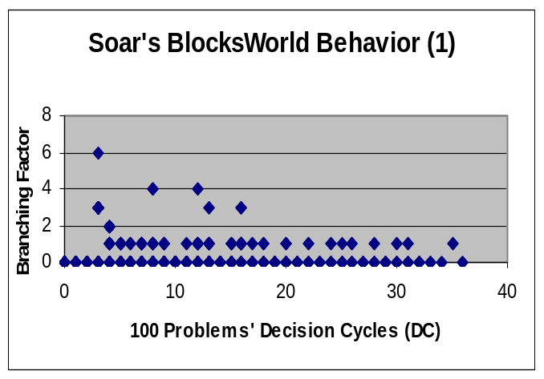
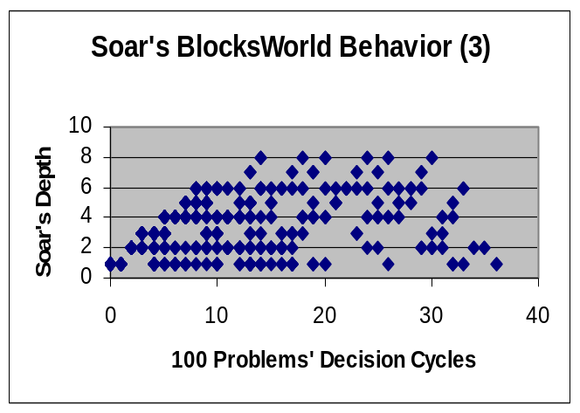
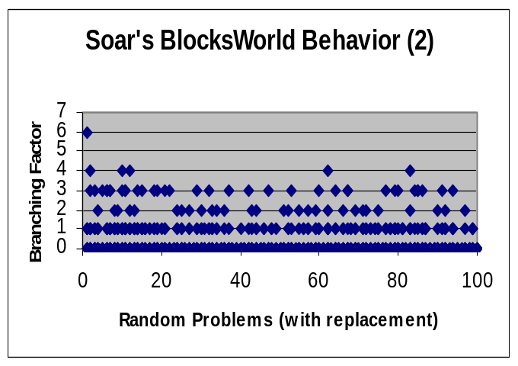
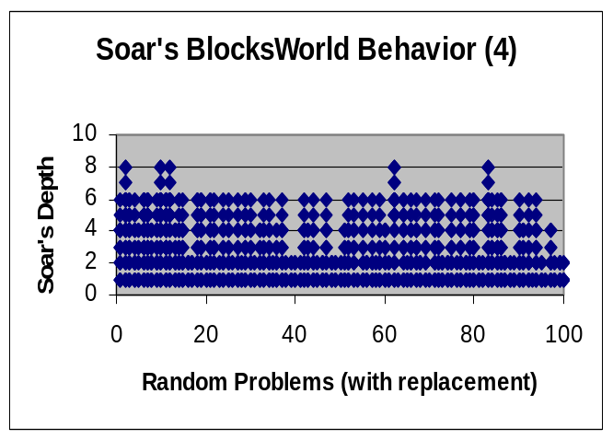
Research Examples

