Slide 1
A Query Mechanism for Inspecting Behavior History
Tolga Konik
University of Michigan

Slide 2
Goal
Storing the behavior history of an agent efficiently
Testing conditions on it efficiently

Slide 3
Where Can it Be Used?
Offline Learning:
  Hypothesis testing in learning by observation
  Other types of learning
Debugging:
  Examining the behavior history of a Soar agent
Verification:
  Testing that the agent behavior satisfy user defined constraints

Slide 4
Snapshot of Working Memory
connection
door
d1
connection
d2
in
-
room
r2
destination
door
pathdoor
1
distance
pathdoor
“room1”
p1
p2
r3
path
destination
name
path
distance
r1
r1
path
item
door
2
“health”
in
-
room
current
current
-
-
room
room
d5
type
w3
AGENT
AGENT
other sensors
other sensors

Slide 5
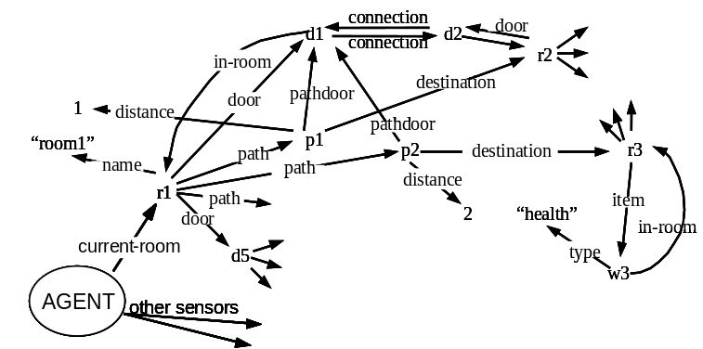
Snapshot of Working Memory
Agent Behavior History: A Set of Situations
A Situation:
  a snapshot of the working memory at a time
Notes:
Situation Timeline
In practice, a situation is a decision cycle.

Slide 6
Storing Explicit Situations
For each situation, store all WMEs
Space inefficient

Slide 7
Storing Wme Changes
Store only the changes of WMEs
Notes:
The simple way to do this to start from the initial point and apply the changes
KnoMic did this, but since it does not tried to deal with noise, it did only one pass over the behavior trace

Slide 8
Storing Indexed Wme Changes
Use an index mechanism to efficiently access situations
Notes:
The simple way to do this to start from the initial point and apply the changes
KnoMic did this, but since it does not tried to deal with noise, it did only one pass over the behavior trace

Slide 9
Testing a Condition at a Situation
Query:
  (R1, ^contains-item, ?VALUE) at S₃₀.
Given:
  R1 is an identifier representing a room
  S₃₀ is a situation
Result:
  Return all instantiations of VALUE such that
  (R1 ^contains-item, VALUE)holds at S₃₀.

Slide 10
Testing a Condition at a Situation
For each (Identifier, Attribute) store a binary search tree

Slide 11
Testing a Condition at a Situation
Search tree of (R1, contains-item)
40
20
65
15
25
50
80
i₁
i₁
i₁
i₁
i₃
i₂
i₃
i₂
i₂
i₃
i₃
i₃
start
15
20
25
40
50
65
80

Slide 12
Testing a Condition at a Situation
Query: (R1, ^contains-item, ?VALUE) at
S30
40
VALUE=
i1, i2, i3
30
20
30
65
15
25
30
50
80
i₁
i₁
i₁
i₁
i₃
i₂
i₃
i₂
i₂
i₃
i₃
i₃
start
15
20
25
40
50
65
80

Slide 13
Testing a Condition at a Situation
Using this scheme, a rule can be tested at any situation in the history of an agent.
This provides space efficiency, while keeping the access times reasonable.
We want more than that !

Slide 14
Testing a Condition over a Set of Situations
GOAL
  test a rule over a range of situations at once.
MOTIVATION
  In consecutive situations, similar conditions hold
RESULT
  More efficient than testing a rule at each situation individually

Slide 15
Testing a Condition on
Multiple Situations
Query:
  (R₁, contains-item, ?VALUE)
  at situations {1-10, 30-45}
Output:
  A Set of (VALUE, Situation-Range) pairs

Slide 16
Testing a Condition on a Set of Situations
1-10, 30-45
40
1-10, 30 – 39
40 - 45
1-10
20
30 – 39
40 - 45
65
1-10
15
25
30 – 39
40 - 45
50
80
i₁
i₁
i₁
i₁
i₃
i₂
i₃
i₂
i₂
i₃
i₃
i₃
start
15
20
25
40
50
65
80
Notes:
The query is does not depend on how many situations you test, it depends how often the tested condition change.

Slide 17
Testing a Condition on a Set of Situations
30-39, 40-45
(R₁ ^contains-item ) at
(R₁ ^contains-item ) at
(R₁ ^contains-item ) at
i₁
1-10, 30-45
i₂
30-39
40
1-10, 30 – 39
40 - 45
i₃
30-39, 40-45
1-10
20
30 – 39
40 - 45
65
1-10
15
25
30 – 39
40 - 45
50
80
i₁
i₁
i₁
i₁
i₃
i₂
i₃
i₂
i₂
i₃
i₃
i₃
start
15
20
25
40
50
65
80

Slide 18
Testing Compound Conditions
Compound Conditions
  C1 and C2
  C1 or C2
  not C1
  Macro Conditions
  Meta Conditions
  Temporal Conditions
  Prolog Programs

Slide 19
Testing Compound Conditions
P(X)
X=x₀
Input Situations
Output Situations

Slide 20
Testing Compound Conditions
AND
QUERY: P(X) and Q(X,Y) at situations D₁
P(X)
X=x₀
Q(X=x₀,Y)
X=x_{0,} Y=y₀
Situations D₁
Situations D₂
Situations D₃
D₁ ⊇ D₂ ⊇ D₃

Slide 21
Testing Compound Conditions
OR
QUERY: P(X) or Q(Y) at situations D1
P(X)
X=x₀
Situations D₂
Situations D₁
Q(Y)
Y=y₀
Situations D₃
D₁ ⊇ D₂
D₁ ⊇ D₃

Slide 22
NOT
Testing Compound Conditions
QUERY: not P(X) at situations D1
P(X)
X is not instantiated
Situations D₁
Situations D₂
D₂= D₁ – D₃ where D₃ is the set of all situations where P(X) holds

Slide 23
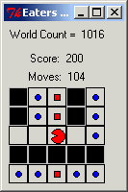
Macro Conditions
Inspect selected parameters of eaters moves.
move(Direction, Content) ←
top-state(State) and
operator(State, Op) and
name(Op, move) and
direction(Op, Direction) and
content(Op, Content)

Slide 24
Macro Conditions
QUERY: move(?Direction, ?FoodType)
Situations | Direction | Food Type
2-3 | east | bonusfood
4-5 | south | ...
6-7 | ... | ...
8-9 | ... | ...
10-11 | west | normalfood
12-13 | ... | ...
14-15 | ... | bonusfood

Slide 25
Macro Conditions
QUERY: propose-move(?Direction, ?FoodType)
Situations | Direction | Food Type
2-3 | east | bonusfood
... | north | normalfood
... | south | ...
4-5 | east | ...
... | south | bonusfood
... | west | empty

Slide 26
Meta Condition: collect
Summarize move operators by food content
collect( {X}, propose-move(?,X) )
Food Type | Situations
normalfood | 2-21, 24-27, 30-65, 70-75, 78-83, 86-109, 114-119, 152-169, …
empty | 4-5, 10-11, 16-17, 36-37, 42-43, 54-71, 76-77, 96-97, …
bonusfood | 2-9, 14-35, 40-53, 74-95, 160-165, 204-207, 214-215, 230-239, …

Slide 27
Meta Condition : sort
Temporally Reorder
sort( {X}, move(?,X) )
Situations | Food Type
2-9 | bonusfood
10-13 | normalfood
14-35 | bonusfood
36-39 | normalfood
40-53 | bonusfood
54-65 | normalfood

Slide 28
Meta Conditions : sort
sort( {X}, move-propose(?,X) )
Situations | Food Type
2-3 | bonusfood
... | normalfood
4-5 | bonusfood
... | empty
... | normalfood
6-9 | bonusfood
... | normalfood
10-11 | empty

Slide 29
Macro Conditions
Return the names of top-level operators
top-operator(Name) ←
  top-state(State) and
  operator(State, Op) and
  name(Op, Name)

Slide 30
Macro Conditions
any-operator(Name) ←
  state(State) and
  operator(State, Operator) and
  name(Operator, Name)
state(State) ← top-state(State)
state(State) ←
superstate(State, SuperState)
Notes:
A_state is inefficient because superstate is called without State instantiated.

Slide 31
Compiling Macro Conditions
Macros can be compiled to index trees for faster access
Situations
state(State)

Slide 32
Temporal Conditions
So far: return all situations where a set of conditions hold
How to match temporal conditions. I.e:
  “After I have arrived at the office, first, I had a meeting then started working”
Location= office
meeting
working

Slide 33
Temporal Meta Condition : at
Situation Intervals are represented explicitly in the representation language.
  at(C, I₁)
Conditions that compare intervals
  after(I₂, I₁)
  ( C is a condition, I₁ and I₂ are situation intervals)
I1
I2

Slide 34
Temporal Meta Condition : at
at(location(office), I₁)
at(have-meeting(Location1), I₂)
during(I₂, I₁)
at(working(Location2), I₃)
during(I₃, I₁)
after(I₃,I₂)
The query instantiates
  regular variables (i.e. Location1, Location2)
  Situation interval variables (I₁,I₂,I₃)
Location= office at I₁
meeting at I₂
working at I₃

Slide 35
Temporal Conditions
Implemented Allen Interval Algebra conditions. (ie. during, starts, meets, ...)
More complex conditions are possible:
  I₁ starts within 2 minutes after I₂ ends.

Slide 36
Visualization of the Results
Two general purpose visualization methods implemented
  Tables
  Situation Graphs
Domain specific visualization methods are also possible (not implemented)

Slide 37
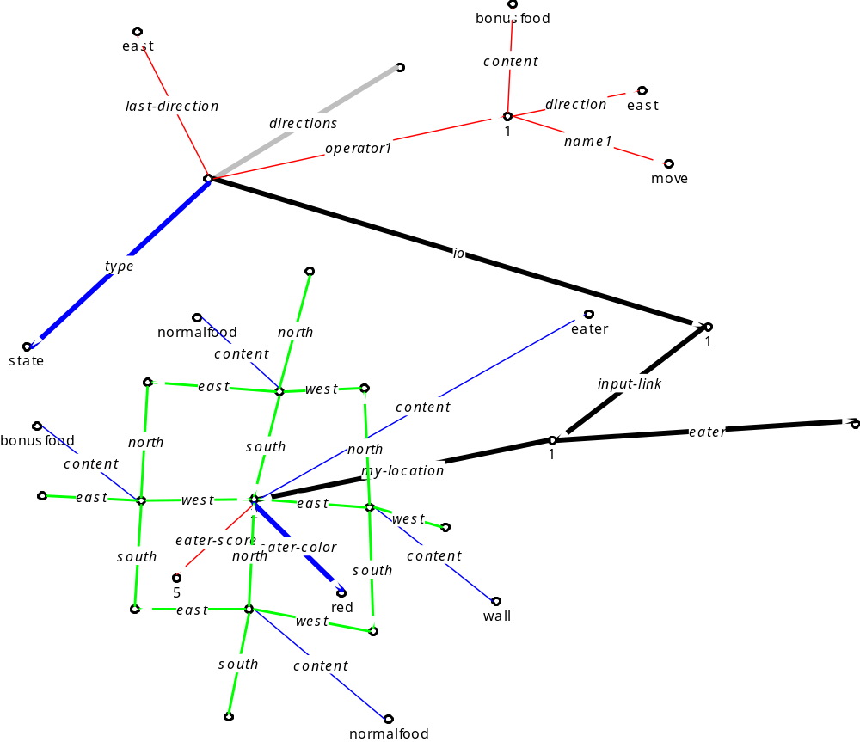
Situation Graph

Slide 38
Nuggets
A Rich query mechanism for learning, debugging, and verification
Compact Storage of Behavior Data
    Significantly better than explicit storage
    Proportional to the number of changes (not situations)
Fast Access

Slide 39
Coals
Not connected to Soar nicely: parses debug output
All database is in memory
Database is not created incrementally
Situation Grapher tool implementation is at prototypical stage

