Slide 1
Update on Learning By Observation
Learning from Positive Examples Only
Tolga Konik
University of Michigan
Notes:
RT VERSION: Using Rich Annotations and Background Knowledge

Slide 2
GOAL
Generate AI agents by observing expert task execution
Engineering Goal
  Reduce the cost of agent development
  Reduce the expertise required to develop agent development.
AI Goal
  Agents that improve themselves observing experts
Notes:
These are long term motivations, not goals I want to achieve at the end of the thesis.
We will have the engineering aspect to overcome as many problems as we can, but this is a goal towards the second goal

Slide 3
Learning Framework
Expert
Environmental Interface
Environment
Agent Architecture
Agent Program
Behavior trace
Annotations
Behavior Recorder
external
Internal
Annotated Behavior trace
Knowledge Generator
Background
Knowledge
Episodic Database
rules
Concept Learner
(ILP)
Training Set Generator
examples
Notes:
Red / Blue
Yellow: execution cycle in addition to information flow.

Slide 4
Learning with Redux
Redux
Expert
Environmental Interface
Environment
Agent Architecture
Agent Program
Behavior trace
Annotations
Behavior Recorder
external
Internal
Annotated Behavior trace
Knowledge Generator
Background
Knowledge
Episodic Database
rules
Concept Learner
(ILP)
Training Set Generator
examples
Notes:
Red / Blue
Yellow: execution cycle in addition to information flow.

Slide 5
Current Experiments
Expert Soar Agent
Expert
Environmental Interface
Environment
Agent Architecture
Agent Program
Behavior trace
Annotations
Behavior Recorder
external
Internal
Annotated Behavior trace
Knowledge Generator
Background
Knowledge
Episodic Database
rules
Concept Learner
(ILP)
Training Set Generator
examples
Notes:
Red / Blue
Yellow: execution cycle in addition to information flow.

Slide 6
Learning Framework: Mode2
Agent Architecture
Agent Program
Environmental Interface
Environment
Expert
Behavior trace
New Agent Program
Annotations
Behavior Recorder
external
Internal
Annotated Behavior trace
Knowledge Generator
Background
Knowledge
Episodic Database
rules
Concept Learner
(ILP)
Training Set Generator
examples
Notes:
I will dive this into two slides
Can I have hand-coded knowledge into two parts. Domain specific and general. (Factual, common sense, general (i.e. bias for Soar),
DISCLAIMER: we haven’t worked out all details of 2nd mode.
Neither KnoMic nor Behavior Cloning had this.

Slide 7
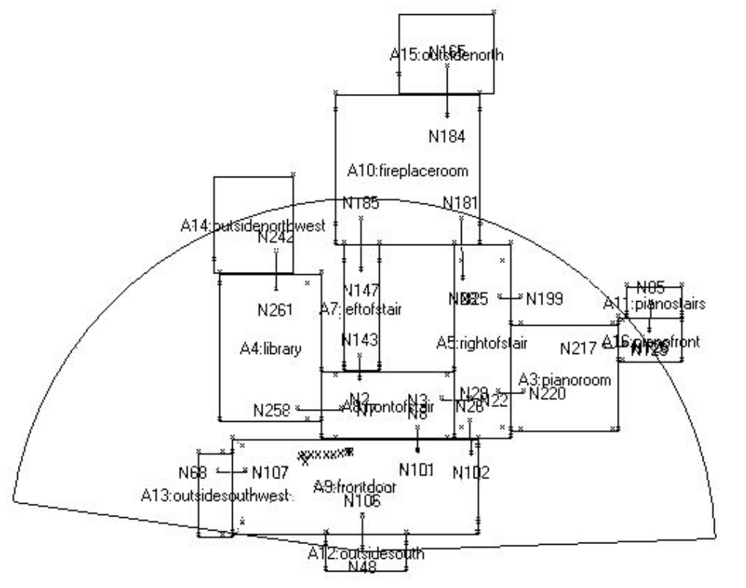
Experiments in Haunt 2 Domain

Slide 8
Move-to example
r3
d1
d2
d3
d4
i3
r2
d3
d4
r3
d2
d1
i4
move-to-area
d5
d6
r1
r4
d5b
d6b
move-to-via-node
move-to-connected-node

Slide 9
An Example in Haunt Domain
r2
d3
d4
r3
d2
d1
r1
d5
d6
r4
move-to-area(Area)
move-to-via-node(Node)
move-to-connected-node(Node)
Notes:
Also explain why we are more complex and general then KnoMic
Importance of object valued parameters.
1) More general learning results
Allow that the expert indirectly indicates complex relations that hold in context of selection of an operator

Slide 10
An Example in Haunt Domain
r2
d3
d4
r3
d2
d1
r1
d5
d6
r4
move-to-area(Area)
move-to-via-node(Node)
move-to-connected-node(Node)
Notes:
Also explain why we are more complex and general then KnoMic
Importance of object valued parameters.
1) More general learning results
Allow that the expert indirectly indicates complex relations that hold in context of selection of an operator

Slide 11
An Example in Haunt Domain
r3
d1
r1
move-to-area(Area)
move-to-via-node(Node)
move-to-connected-node(Node)
Correct selection condition for move-to-via-node
Notes:
Also explain why we are more complex and general then KnoMic
Importance of object valued parameters.
1) More general learning results
Allow that the expert indirectly indicates complex relations that hold in context of selection of an operator

Slide 12
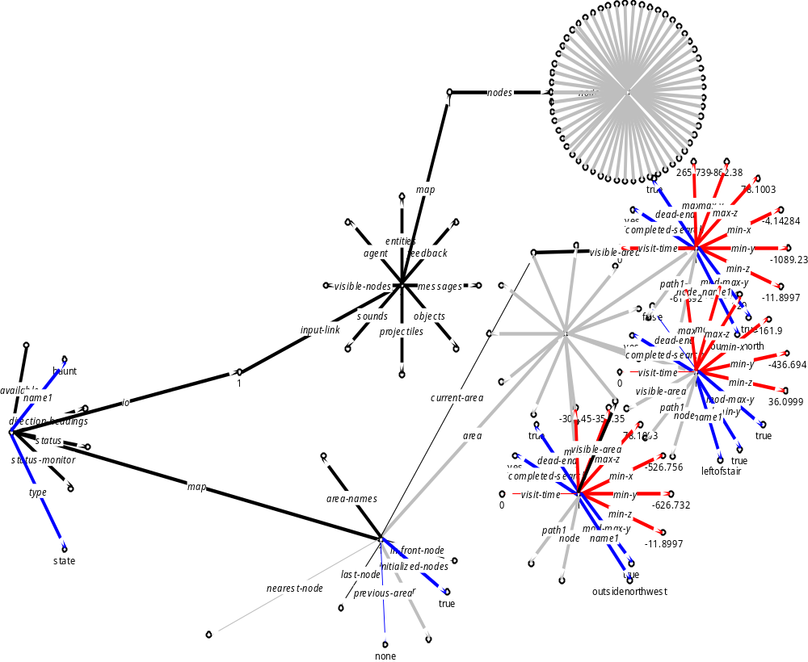

Slide 13
Example Generation
Operator Concepts
Termination(A)
A
negative
positive

Slide 14
Example Generation
Operator Concepts
Selection(A)
A
B
positive
negative

Slide 15
Learning Examples
A Positive Example:
selection(Sit₂₀, move-to-via-node(d₁) )
i3
r2
d3
d4
r3
d2
d1
i4
r1
d5
d6
r4
d5b
d6b

Slide 16
General to Special Search with positive and negative examples

Slide 17
General to Special Search with positive and negative examples

Slide 18
General to Special Search with positive and negative examples

Slide 19
General to Special Search with positive and negative examples

Slide 20
General to Special Search with positive and negative examples

Slide 21
Problem in Choosing Parameters
Selection(move-to-via-node)
i3
r2
d3
d4
r3
d2
d1
i4
r1
d5
d6
move-to-via-node
r4
d5b
d6b
move-to-connected-node

Slide 22
Problem in Choosing Parameters
Selection(move-to-via-node)
i3
r2
d3
d4
r3
d2
Positive
Negative
i4
d1
r1
d5
d6
move-to-via-node
r4
d5b
d6b
move-to-connected-node

Slide 23
Specific to General Learning with Positive Examples only
d1
Positive
Difficult to deal with inconsistent examples

Slide 24
General to Specific Learning with Positive Examples Only
Positive

Slide 25
General to Specific Learning with Positive Examples Only
d1
Positive

Slide 26
Learning Examples
A Positive Example of move-to-via-node:
i3
r2
d3
d4
r3
d2
d1
i4
r1
d5
d6
r4
d5b
d6b

Slide 27
Learning Examples
Random Examples of move-to-via-node
i3
r2
d3
d4
r3
d2
d1
i4
r1
d5
d6
r4
d5b
d6b
For each positive example, use the same situation with parameters selected in other situations

Slide 28
Nuggets
Move-to operators are learned in Haunt domain
  ~ 3 mins of trace
  ~ 35000 situations
  ~ 10 min to prepare examples
  ~20 min for learning.

Slide 29
Coals
Missing Components
It is still research not a tool

