Slide 1
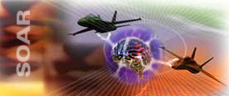
SoarTech Update 2004
Thinking…
…inside the box
Jim Rosbe

Slide 2
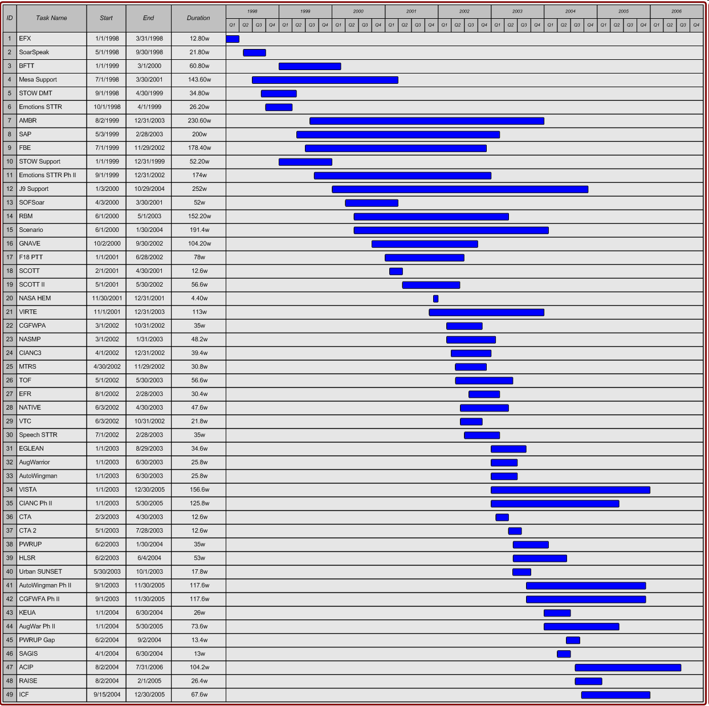
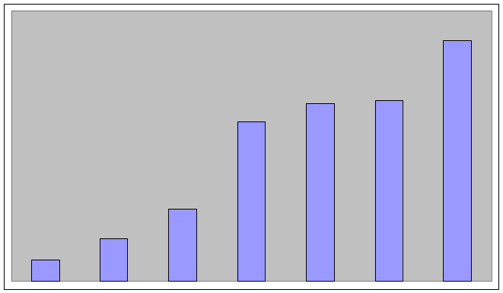
1998-2006
Revenue 98-04

Slide 3
Operations
New teaming relationships with large and small companies, universities
Growing inventory of forward contracts
Large increase in work for Army
Continuing mix of research, agent tools, HBM, training, experimentation support, command and control systems, information management/visualization

Slide 4
New Projects since Soar 23
Phase I, II and ‘II Plus’ SBIRs
  AMRDEC
  ARI
  ARL
  Natick SSC
  OSD/AFRL Rome
  DARPA
Special Operations Forces training system
Soar and OneSAF OS integration study, funded by SAIC
Upcoming:
  ACIP & RAISE
  Research on adjustable autonomy

Slide 5
The next year…
Soar Consortium
SoarTech-supported agent development tool kit
Recruiting
  AI, HCI, IUI, SW Engineering, Simulation, Test/QA
  Project Management
Diversification into bio [research/medical/ informatics] applications

Slide 6
Nuggets & Coal
Nuggets | Coal
More opportunities than we can respond to | More opportunities than we can respond to
Increased teaming Strong synergies between projects Healthy revenue outlook Contacts from new domains | Training/experimentation systems customers can’t afford or don’t perceive the need for/benefits of highly autonomous HBR

