Slide 1

Blue Bear Systems Research
Hardware Architectures for Distributed Agents
Dr Simon Willcox
24th Soar Workshop
9th – 11th June 2004
Building 32, Twinwoods Business Park, Clapham, Bedfordshire MK41 6AE
Tel: 01234 212001 Email: simon@bluebearsystems.com
✓ www.bluebearsystems.com

Slide 2
Presentation Overview
Objectives
Clustering Approaches for Multi-Agent Systems
Agent Hardware
Agent Communication Framework
Prototype Soar Implementation
Example Problem

Slide 3
Objectives
Investigate
  Multi-agent processing solutions
  Multi-agent communications
Provide pragmatic solutions featuring
  Distributed agent processing
  Small hardware footprint
  Automatic load balancing
  Fault tolerance
  Inter-agent communication between diverse agents

Slide 4
Clustering Approaches for Multi-Agent Systems
Clustering maps naturally to multi-agent processing
Two approaches considered
  Beowulf
    Designer controls parallelism
    Libraries such as PVM and MPI provide communications and parallelism
  OpenMosix
    Single-system image approach
    Provides load balancing, process migration, fault tolerance, reconfiguration
    Parallelism transparent to designer (almost)

Slide 5
Agent Hardware
Autonomous mobile applications limit space, power, etc.
Two technologies under investigation
  Field Programmable Gate Arrays (FPGA)
    Provide flexibility of software within parallel, high speed hardware
    Use as agents studied by University of Kent
  Miniature clusters
    Miniature Beowulf/OpenMosix System

Slide 6
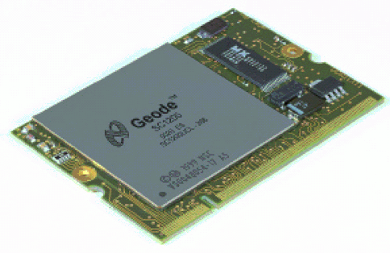
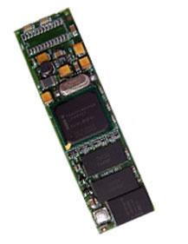
Miniature Clusters
Power of embedded processors increasing
Feasible to build a miniaturised cluster based on COTS components
Systems such as XBoard and Gumstix provide A complete system

Slide 7
Agent Communication Framework #1
Agent communication between disparate agent difficult
Agent Communication Languages (ACL) developed to address this
  Wrap internal representation of information in a agent neutral form
Little support currently within Soar
Developed communication framework and ACL wrapper for Soar

Slide 8
Agent Communication Framework #2
Marshaller
Other Marshallers
Agent Wrapper
Agent Wrapper
Other
Agent
Agent Wrapper
Java
Agent
Soar
Agent
Agent Wrapper
Agent Wrapper
Remote
Object
(CORBA)
Embedded
Script

Slide 9
Prototype Soar Implementation
Multi-agent Soar
  Send and receive complete substructures of working memory to other agents
  Locate agents in the external environment that are available for communications
  Consistent philosophy in the use of the Soar i/o link structures

Slide 10
Soar Agent Communication #1
Receiving
I6
I6
^input-link
6
^input-link
^position
I8
S2
I8
^agents
^sensor
^agents
B1
B1
^bill
^finished
^bill
I9
I9
^tom
true
^tom
T1
T1

Slide 11
Soar Agent Communication #2
Transmitting
  Similar to receiving
  New ^agents attribute under output link
  Agent adds the names of the agents it wishes to communicate to below this

Slide 12
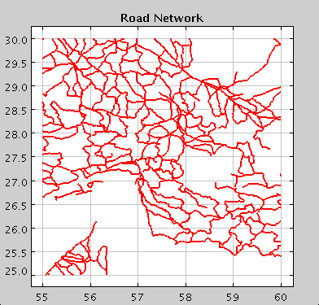
Example Problem
Road search application
  Generate a plan for searching a network of roads with a finite number of search assets (UAVs)
  Input:
    position and direction of target ground vehicle
  Output:
    guidance commands to search assets

Slide 13
Algorithm Architecture #1
Original algorithm was a single soar agent
  Large and complex
  Unverifiable
Current algorithm
  Uses work in agent hardware architectures to produce distributed solution
  Agents written in verifiable soar as defined by Malvern
  Partitions problem into a number of simple communicating agents
    Each agent individually verifiable?

Slide 14
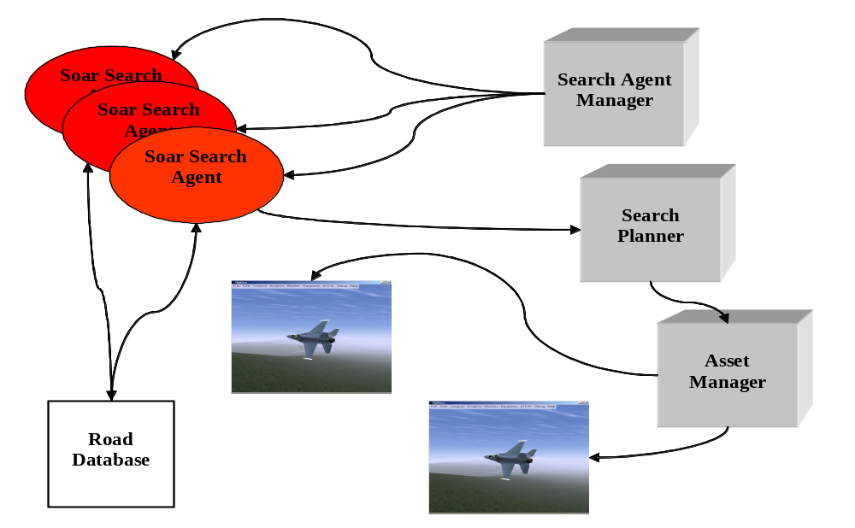
Algorithm Architecture #2

Slide 15
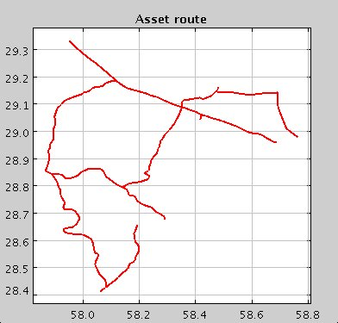
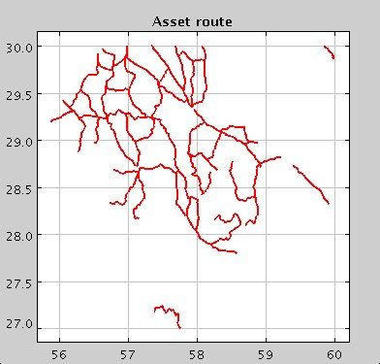
Soar Search Agent
Single agent is relatively simple written in verifiable soar
Agent knows how to perform a single task
  From an initial position and direction, define search path until next junction
At a junction, start more search agents with the junction as their initial position
Builds up road network ‘recursively’

Slide 16
Other Agents/Processes #1
Search agent manager
  Maintains search agent processes
  Monitors load balancing and fault conditions
Search planner
  Receives search segments from search agents
  Gradually builds up a complete map

Slide 17
Other Agents/Processes #2
Asset manager
  Receives connected road segments from search planner
  Allocates roads to the search assets
Asset controller
  On-board the UAV
  Maintains list of roads to search as series of waypoints
  Two modes:
    Loiter if no new roads to search
    Search roads via waypoint following

Slide 18
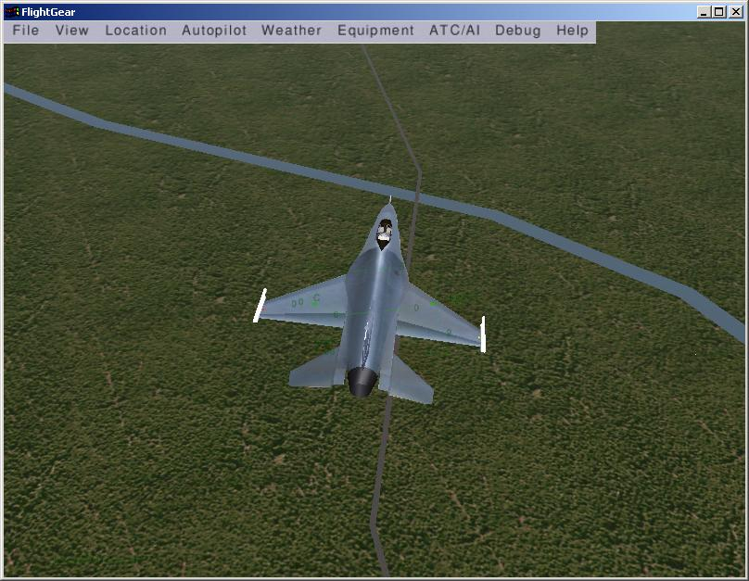
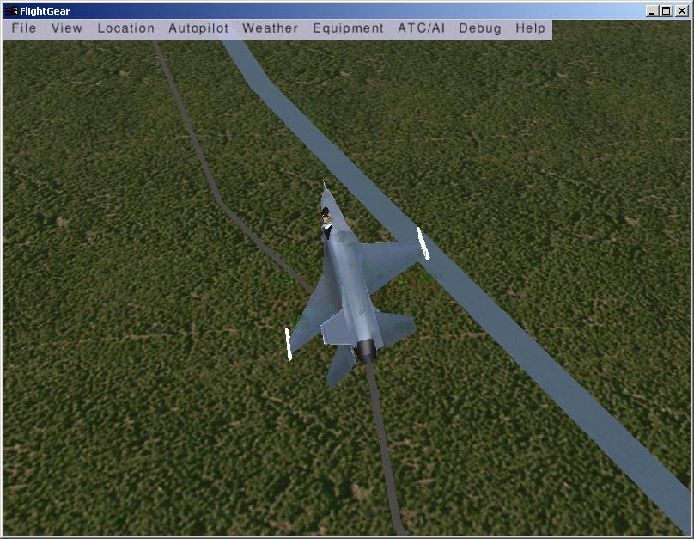
Demonstration Overview
Heterogeneous network of PCs for search agents and other processes
Search assets are two 6DOF UAV simulations
  Real time
  3D visualisation of UAV and terrain

