Slide 1

Integrating Background Knowledge and Reinforcement Learning for Action Selection
John E. Laird
Nate Derbinsky
Miller Tinkerhess

Slide 2
Goal
Provide an architectural support so that:
Agent uses (possibly heuristic) background knowledge to initially make action selections
Might be non determinism in the environment that is hard to build a good theory of.
Learning improves action selections based on experienced-based reward
Captures regularities that are hard to encode by hand.
Approach: Use chunking to learn RL rules and then use reinforcement learning to tune behavior.

Slide 3
Deliberate Background Knowledge for Action Selection
Examples:
Compute the likelihood of success of different actions using explicit probabilities.
Look-ahead internal search using an action model to predict future result from an action
Retrieve from episodic memory of similar situation
Request from instructor
Characteristics
Multiple steps of internal actions
Not easy to incorporate accumulated experienced-based reward
Soar Approach
Calculations in a substate of a tie impasse

Slide 4
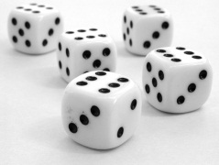
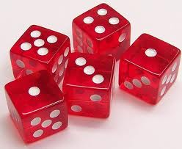
Players must increase bid or challenge.
Each player starts with five dice.
Players hide dice under cups and shake.
Players take turns making bids as to number of dice under cups.
Bid 6 6’s
Bid 4 2’s

Slide 5
Players can “push” out a subset of their dice and reroll when bidding.
Bid 7 2’s

Slide 6
Player can Challenge previous bid.
All dice are revealed
Challenge!
Challenge fails player loses die
I bid 7 2’s

Slide 7
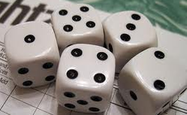
Evaluation with Probability Calculation
Tie Impasse
Bid: 6[4]
Challenge = .8
Bid: 6[4] = .3
Bid: 6[6] = .1
Challenge
Bid: 6[6]
Evaluation Substate
Selection Problem Space
Evaluation = .3
Evaluation = .8
Evaluation = .1
.1
Evaluate(bid: 6[4])
Evaluate(challenge)
Evaluate(bid: 6[6])
Evaluation = .3
compute-bid-
probability
.3
Notes:
Applies to any problem, whether blocks world, planning movement in the world, configuring a computer, …
If Failure – no way to predict future, then can still evaluate – may bias toward exploration or not.
Why is this good? Minimal internal memory – no search through memory – maintains reactivity, …
What knowledge is required?
If no model – can just punt and act in the world.

Slide 8
Using Reinforcement Learning for Operator Selection
Reinforcement Learning
Choosing best action based on expected value
Expected value updated based on received reward and expected future reward
Characteristics
Direct mapping between situation-action and expected value (value function)
Does not use any background knowledge
No theory of original of initial values (usually 0) or value-function
Soar Approach
Operator selection rules with numeric preferences
Reward received base on task performance
Update numeric preferences based on experience
Issues:
Where do RL-rules come from?
Conditions that determine the structure of the value function
Actions that initialize the value function

Slide 9
Value Function in Soar
Rules map from situation-action to expected value.
Conditions determine generality/specificity of mapping
-.43
.23
-.31
-.1
.04
.11
-.11
.51
.21
.34
-.54
.08
-.61
.43

Slide 10
Approach: Using Chunking over Substate
For each preference created in the substate, chunking (EBL) creates a new RL rule
Actions are numeric preference
Conditions based on working memory elements tested in substate
Reinforcement learning tunes rules based on experience

Slide 11
Two-Stage Learning
#
#
Processing in Substates
Deliberately evaluate alternatives
Use probabilities, heuristics, model
Uses multiple operator selections and
#
Deliberate Processing in Substates
Always available for new situations
Can expand to any number of players
#
#
#
#
?
#
#
Select action
#
#
#
#
#
#
#
#
#
#
#
RL rules updated based on agent’s experience

Slide 12
Evaluation with Probability Calculation
Tie Impasse
Bid: 6[4]
Create rule for each result
adds entry to value function
Challenge = .8
Bid: 6[4] = .3
Bid: 6[6] = .1
Challenge
Bid: 6[6]
Evaluation Substate
Selection Problem Space
Evaluation = .3
Evaluation = .8
Evaluation = .1
.1
Evaluate(bid: 6[4])
Evaluate(challenge)
Evaluate(bid: 6[6])
Evaluation = .3
compute-bid-
probability
.3
Notes:
Applies to any problem, whether blocks world, planning movement in the world, configuring a computer, …
If Failure – no way to predict future, then can still evaluate – may bias toward exploration or not.
Why is this good? Minimal internal memory – no search through memory – maintains reactivity, …
What knowledge is required?
If no model – can just punt and act in the world.

Slide 13
Learning RL-rules
Using only probability calculation
Bid: 6 4’s?
Last bid: 5 4’s
Last player:
4 unknown
Shared info
9 unknown
Pushed dice
3 3 4 4
Dice in my cup
3 4 4
2 4’s out of 9 unknown?
.3
4 4’s
Need 2 4’s
If 9 unknown dice, 2 4’s pushed and 2 4’s under my cup, and considering biding 6 4’s, expected value is .3

Slide 14
Learning RL-rules
Using probability and model
Bid: 6 4’s?
Last bid: 5 4’s
Last player:
4 unknown
Shared info
9 unknown
Pushed dice
3 3 4 4
Dice in my cup
3 4 4
7 unknown
2 4’s shared
2 4’s under his cup
Need 1 4 out of 5 unknown
.60
If 9 unknown dice, 2 4’s pushed and 2 4’s under my cup, and previous player had 4 unknown dice and bid 5 4’s, and I’m considering biding 6 4’s, the expected value is .60

Slide 15
Research Questions
Does RL help?
Do agents improve with experience?
Can learning lead to better performance than the best hand-coded agent?
Does initialization of RL rules improve performance?
How does background knowledge affect rules learned by chunking and how do they affect learning?

Slide 16
Evaluation of Learning
3-player games
Against best non learning player agent
Heuristics and opponent model
Alternate 1000 game blocks of testing and training
Metrics
Speed of learning & asymptotic performance
Agent variants:
B: baseline
H: with heuristics
M: with opponent model
MH: with opponent model and heuristics
Notes:
4-player games are slower and have much larger state space [will do in the future]

Slide 17
Learning Agent Comparison
Best agents do significantly better than hand coded.
H and M give better initial performance than B.
P alone speed learning (smaller state space).
M slows learning (much larger state space).

Slide 18
Learning Agents with Initial Values = 0

Slide 19
Number of Rules Learned

Slide 20
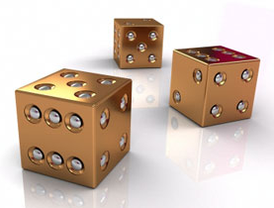
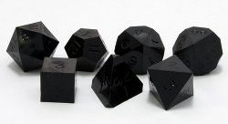
Nuggets and Coal
Nuggets:
First combination of chunking/EBL with RL
Transition from deliberate to reactive to learning
Potential story for origin of value functions for RL
Intriguing idea for creating evaluation functions for game-playing agents
Complex deliberation for novel and rare situations
Reactive RL learning for common situations
Coal
Sometimes background knowledge slows learning…
Appears we need more than RL!
How recover if learn very general RL rules?

