Slide 1
Soar 9.3.2
Mazin Assanie, John Laird, Joseph Xu

Slide 2
Key Changes
Uniform compilation procedure for all platforms compiles Soar as a single library
New forgetting mechanism + misc. kernel changes
Revamped and cleaned up Soar home page and Wiki
New project organization in Wiki and SVN repository

Slide 3
Simplified Soar Shared Library
ClientSML, ConnectionSML, ElementXML, KernelSML, SoarKernel combined into single Soar library
> g++ env.cpp -lElementXML -lClientSML -lConnectionSML -lSoarKernel
> g++ env.cpp -lSoar
Static build is actually static
No more LibraryLocation or LibraryName arguments in CreateKernelIn*Thread
The way SpawnDebugger searches for SoarJavaDebugger.jar changed

Slide 4
Unified Build System
Soar Suite now compiled via a single cross-platform SCons script
SCons is included in SoarSuite, you only need python
No longer requires Ant for Java components
No longer maintaining Visual Studio project files
SCons can generate one for debugging, etc
Still uses MSVC++ compiler
build.bat automatically sets all necessary environment variables
Defaults to clang compiler on Mac, g++ 4.2 outdated
Can compile Linux Standard Base compatible libraries

Slide 5
How To Compile
> svn co https://soar.googlecode.com/svn/trunk/SoarSuite
> cd SoarSuite
> python scons/scons.py
-- or if you have scons installed --
> scons
-- or for Windows --
> build.bat

Slide 6
Separate Compilation Targets
> scons list
Building intermediates to build
Installing targets to /home/jzxu/SoarSuite/out
C# compiler not found, not building C# SML wrappers
all
cli
debugger
debugger_api
headers
java_sml_misc
kernel
sml_java
sml_python
tests
> scons -c all
> scons kernel debugger headers

Slide 7
Kernel changes
New forgetting mechanism to automatically excise chunks via a base-level decay model (look at rl command documentation under apoptosis)
Tie-impasse substates now augmented with non-numeric and non-numeric-count attributes, analogous to item and item-count attributes.
Soar will no longer automatically change the indifference selection policy to epsilon-greedy when turning reinforcement learning on

Slide 8
New Project Organization
SoarSuite streamlined (8mb)
Contains the Soar kernel, Java debugger, VisualSoar, the Soar manual, default rules, unit tests and Soar header files
Other components moved to separate downloads
The Soar Tutorial targeted towards people learning Soar for the first time.
In addition to SoarSuite contents, contains the Soar Tutorial, Eaters, TankSoar, and all the introductory agents discussed in the tutorial and John’s new book

Slide 9
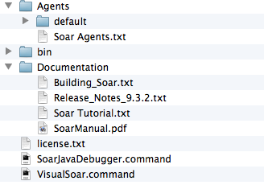
What’s in Soar Suite 9.3.2

Slide 10
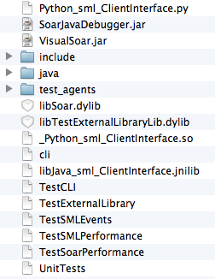
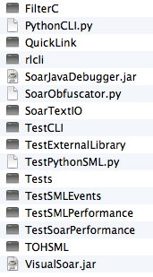
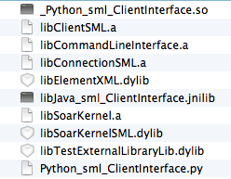
What’s in Soar Suite 9.3.2
New (Single bin folder)
Old (bin folder) (lib folder)

Slide 11
Improved Soar Web Pages and Wiki
Nearly everything has stand-alone versions to download. Each project has its own web page.
Every agent in every domain now has its own web page with thorough descriptions
We encourage you to submit your own agents, tools and domains for inclusion. We want this to very much be a community area.

Slide 12
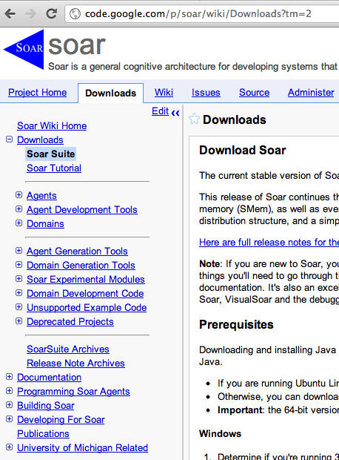
Improved Soar Web Pages and Wiki
Agents
All agents from every domain
Agent Development Tools
Soar Editor, VisualSoar, Vim plugin, UltraEdit config, Epmem-size, QuickLink, State2Dot
Domains (8 project)
Dice, Eaters, TankSoar, InfiniteMario, RoomsWorld, SoarQnA, SoarTextIO, WordNet
Generating Tools
PDDL, GGP
Unsupported & Deprecated Projects
Documentation
tutorial, manual

Slide 13
Improved Soar Web Pages and Wiki
Contacts, alumnae, Soar research groups, publications all updated and dead links removed
Please contact us if you want you or your work added to any of these pages.
Much obsolete documentation removed from Wiki
Many new documents added to wiki and re-organized to make things easier to find

Slide 14
Coal
Many older projects are no longer actively supported.
All are now under either the example development code or unsupported category.
Some minor SML API changes

Slide 15
Nuggets
Compilation is more “out-of-the-box”
Spring cleaning. Lots of obsolete things removed. People should be much more confident the information they are reading is current.
It should be much easier for people learning Soar to browse what people have put together in the past.
Consistently formatted and comprehensive pages for all projects should promote code re-use. People can see everything available quickly and how to get it.

