Slide 1
How to Use SVS
Joseph Xu
Soar Workshop 2012
Notes:
make an outline

Slide 2
History
Soar Visual Interface (SVI) – Scott Lathrop
Spatial Reasoning System (SRS) – Sam Wintermute
Soar Visual System = SVI + SRS – Sam Wintermute
SVS “lite” – What this presentation is on
Kernel & SML integration
Traded functionality for simplicity

Slide 3
Overview
SML Environment
SVS
Soar
Commands
S1
Commands
Controller
seek
generate
extract
S1 ^svs S2
S2 ^command C1
^spatial-scene S3
S3 ^child C2 C3
C2 ^id B1
C3 ^id B2
Controller
seek
generate
extract
B2
B1
Scene Graph
Scene Graph
world
on-top?
S4
S4 ^svs S5
S5 ^command C4
^spatial-scene S6
agnt->SendSVSInput()
a B1 world ...
c B2 p -0.1 12 0
d B3
B2
B1
Notes:
change variable names

Slide 4
Scene Graph
World
(<s> ^svs <svs>)
(<svs> ^spatial-scene
<scn>)
(<scn> ^id world
^child <c1>)
(<c1> ^id A
^child <c2>
^child <c3>)
(<c2> ^id B)
(<c3> ^id C)
P [ 0.1, 3.4, -12 ]
R [ 0.0, 0.0, 1.7 ]
S [ 1.0, 1.0, 1.0 ]
A
P [ ... ]
R [ ... ]
S [ ... ]
P [ ... ]
R [ ... ]
S [ ... ]
B
C

Slide 5
Scene Graph Editing Language
Environment modifies SVS scene graph with agent->SendSVSInput(“<sgel>”)
Add an object named <o> as a child of <p>
a <o> <p> v <vertices> p <position> r <rotation> s <scaling>
Change an object’s transforms or vertices
c <o> v <vertices> p <position> r <rotation> s <scaling>
Delete an object
d <o>

Slide 6
Recommended Paradigm
void output_handler(smlRunEventId id, void *env,
Agent *a, smlPhase phase)
{
int ncmds = a->GetNumberCommands();
for (int i = 0; i < ncmds; ++i) {
<handle output link commands>
}
<run environment simulation with output>
string in = <generate SGEL from environment state>;
a->SendSVSInput(in.c_str());
}
int main() {
<initialize agent and environment>
a->RegisterForRunEvent(smlEVENT_AFTER_OUTPUT_PHASE,
&output_handler, env, true);
<run>
}

Slide 7
Filters
Basic unit of computation
Multiple list inputs, single list output
Different ways to combine inputs:
Full product. Ex: N of param A, M of param B -> N * M results
Tuples. Ex. N of param A, N of param B -> N results
value1
Filter
result1
Scene Graph
value2
result2
Filter
param1
result3
result4
value1
Filter
value2
param2

Slide 8
Extract Command
on-top Filter
Scene Graph
all-nodes Filter
top
Extract
Command
node Filter
bottom
(S2 ^command.extract E1)
(E1 ^type on-top
^top T1
^bottom B1)
(T1 ^type all-nodes)
(B1 ^type node ^name block1)
Notes:
different colors for input and result

Slide 9
Extract Command
block1
on-top Filter
Scene Graph
block2
all-nodes Filter
top
Extract
Command
False
block1
node Filter
True
bottom
(S2 ^command.extract E1)
(E1 ^type on-top
^top T1
^bottom B1
^status success
^result R1)
(T1 ^type all-nodes)
(B1 ^type node ^name block1)
(R1 ^positive P1
^negative N1)
(P1 ^atom A1)
(A1 ^a block1 ^b block2)
(N1 ^atom A2)
(A2 ^a block1 ^b block1)
Notes:
different colors for input and result

Slide 10
Special Case: Intersection Filter
SVS objects are arbitrary convex polyhedrons, intersection calculations are expensive
Handle with collision detector from Bullet Physics engine
Uses cheap broad-phase calculation to rule out collisions
Precompiled libs are distributed with SVS
Caveat: All objects in scene are inserted into collision detector. If you calculate one intersection, you’ve calculated them all

Slide 11
Writing Your Own Filter
Inherit the map_filter<result type> class
Just need to code logic for calculating one result from one set of input parameters
Result caching and input combinations all taken care of for you

Slide 12
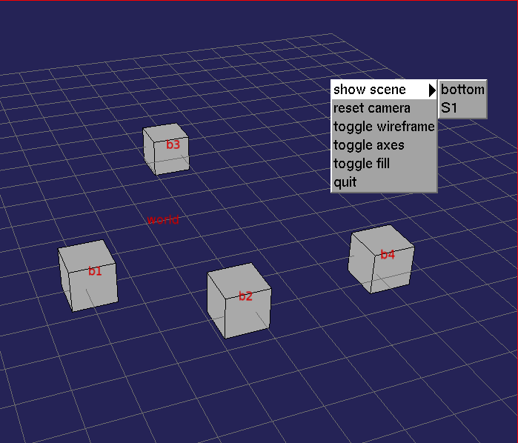
Visualization
Separate 3D viewer program to minimize SVS dependencies
OpenSceneGraph, GLUT, quickhull
SVS talks to viewer via file socket /tmp/viewer
Plain-text language very similar to SGEL
Not specific to SVS

Slide 13
How to Get It
Clone this git repo into Core/SVS
https://github.com/jzxu/SVS.git
Patch the kernel to use SVS:
$ patch -p0 < Core/SVS/patch
Compile and run Soar like normal
To run viewer:
Install OpenSceneGraph, GLUT, and quickhull (all available in most Linux package repos)
$ cd Core/SVS/vis/viewer
$ scons
$ ./viewer

Slide 14
Evaluation
Coal
Nuggets
Only works on *nix and Mac OS
Uses OS-specific BSD sockets, and I haven’t written Windows version
Works out of the box on Linux
Successfully used in Bolt project

