Slide 1
XNL-Soar: where we are and where we’re headed
Deryle Lonsdale, Jeremiah McGhee,
Nathan Glenn, and Tory Anderson

Slide 2
What is XNL-Soar?
Update of NL-Soar
Incremental language processor built on Soar
Intended to help in language modeling tasks
Language/task integrations
Interfaces, ambiguity, parsing, lexicon, etc.
More detail last year (and prior)

Slide 3
Updated how?
Soar 7.2 → Soar 9.3.1
C → Tcl → Java
Hand-coded sparse lexicon → WordNet 3.1
P&P syntax → Minimalist Program
Xwindows → Clig → GraphViz

Slide 4
Basic linguistic functionality
Lexical input: word enters IO link
Lexical access: retrieve all lexical, morphosyntactic, semantic info
Incrementally build syn structure (parse trees) and sem structure (LCS)
Snip operator when current hypothesis untenable
Subcategorization, adjunction
Empty categories, movements

Slide 5
New functionality via transition
SVN repository
Eclipse IDE
A/R set graphing
Smem, Epmem, RL (only Smem so far)
Batch tester
Various parsing strategies
Japanese syntax

Slide 6
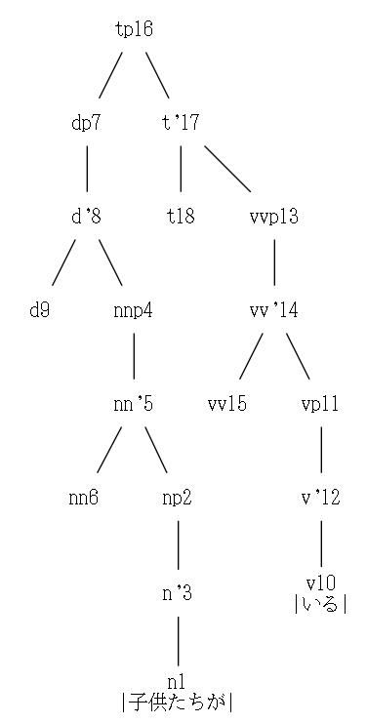
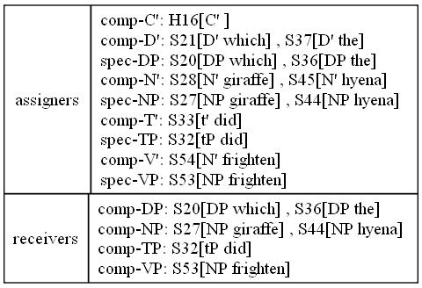
New functionality via transition

Slide 7
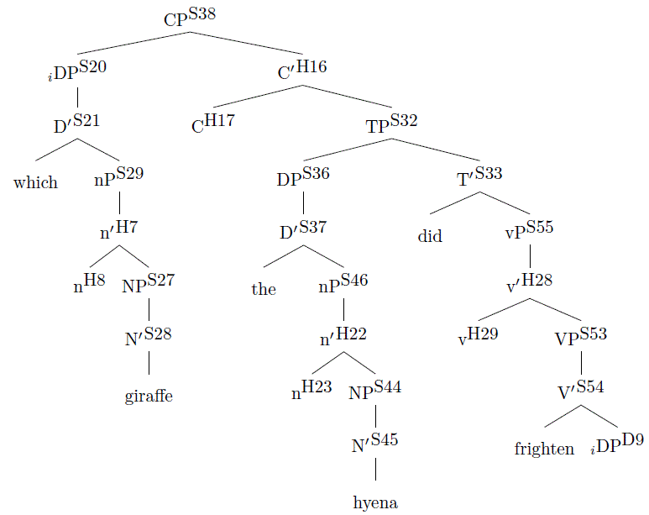

Slide 8
Noteworthy milestones
Research award lecture
45-minute-long live demo in front of whole college
English and Japanese sentences (syntax only)
Wide array of structural types, moderate complexity
Japanese parsing
Snip operators

Slide 9
Sample demo sentences
a wicked demon casts spells on disobedient children .#en
our resolution for redevelopment should not be underestimated .#en
we say a prayer of gratitude to the salmon .#en
猫が鼠を食べた。#JP
さわやかな川が流れていた。#JP
seagulls are gluttonous creatures .#en
Lushootseed tribes have been displaced .#en
revitalization is a component of our strategic direction .#en
the Salish respect matriarchal lineage .#en
ガールフレンドが新しい彼氏を見つけていた。#JP
the pebbles retain memories of important events .#en
the president has been orchestrating a political process .#en
宣教師は新しいガールフレンドを見つけなかった。#JP
they ceded their territories in the treaty of PointElliott .#en
お母さんが薬を飲んだ。#JP
revitalization is important to our community .#en
新しい彼氏は逃げた。#JP
outlandish stories frightened naughty children .#en
nobody should question our determination .#en
the reservation represents rural life .#en
she wanted to skin a deer .#en
the bureau maintains educational facilities on the reservation .#en

Slide 10
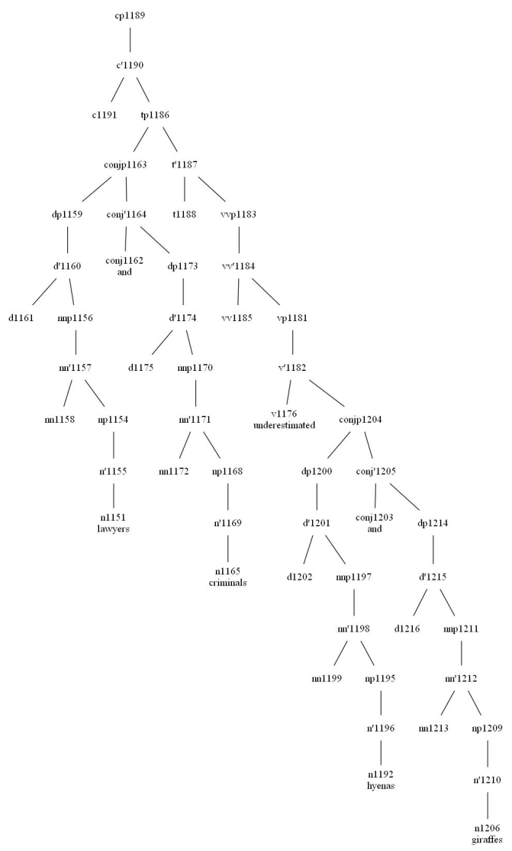
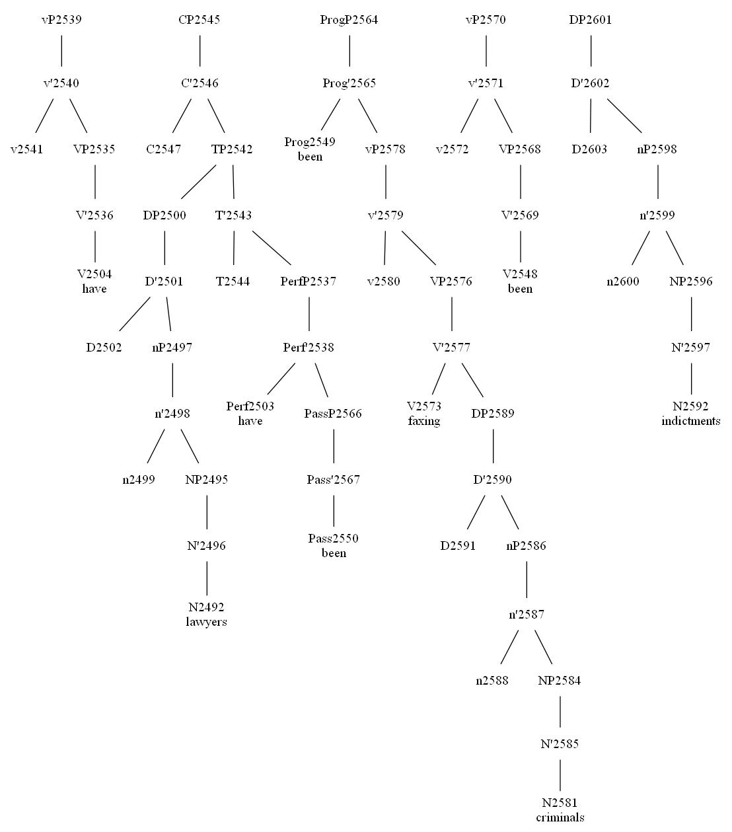
Dealing with greater complexity

Slide 11
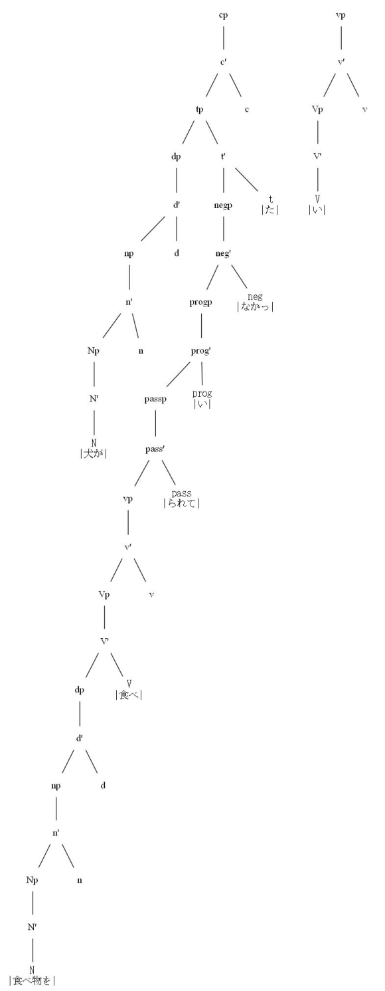
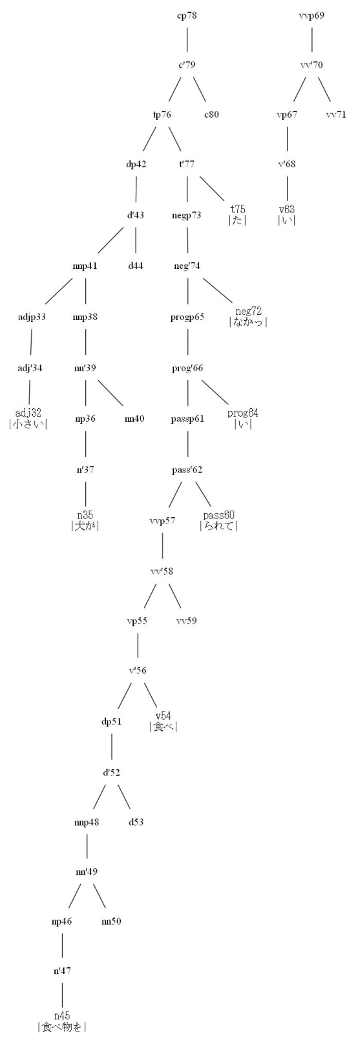
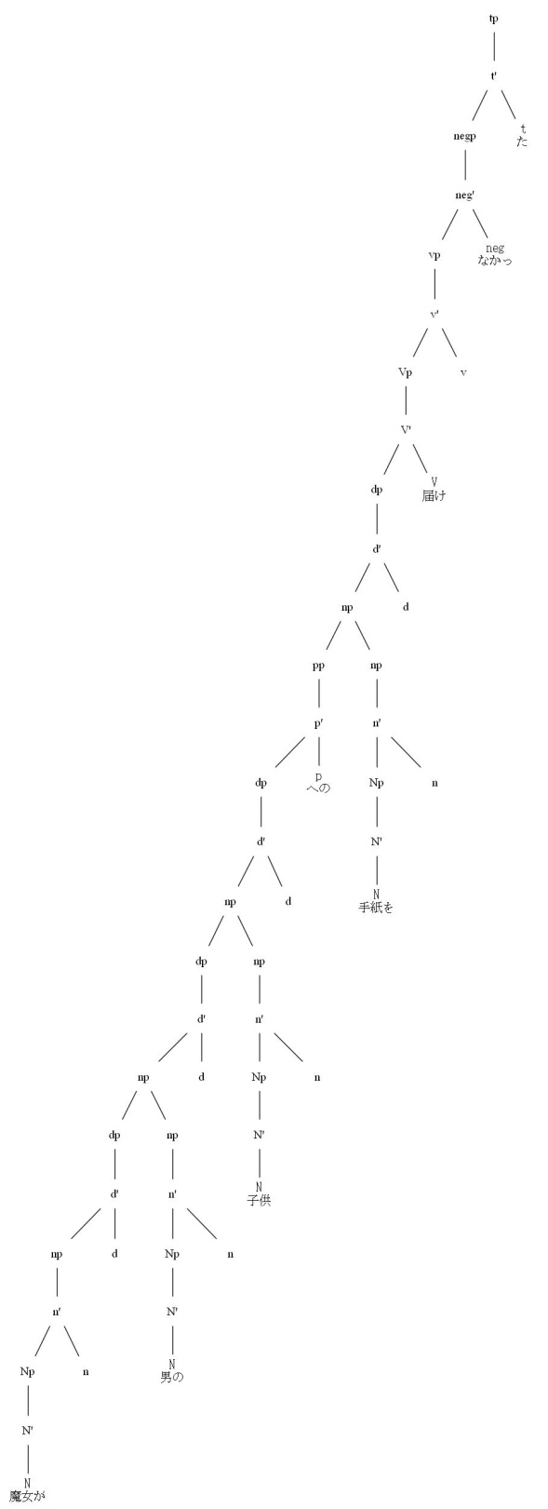

Slide 12
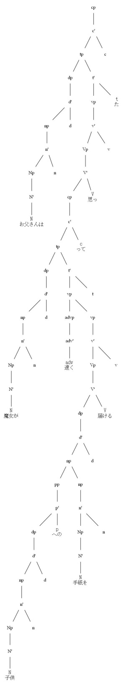
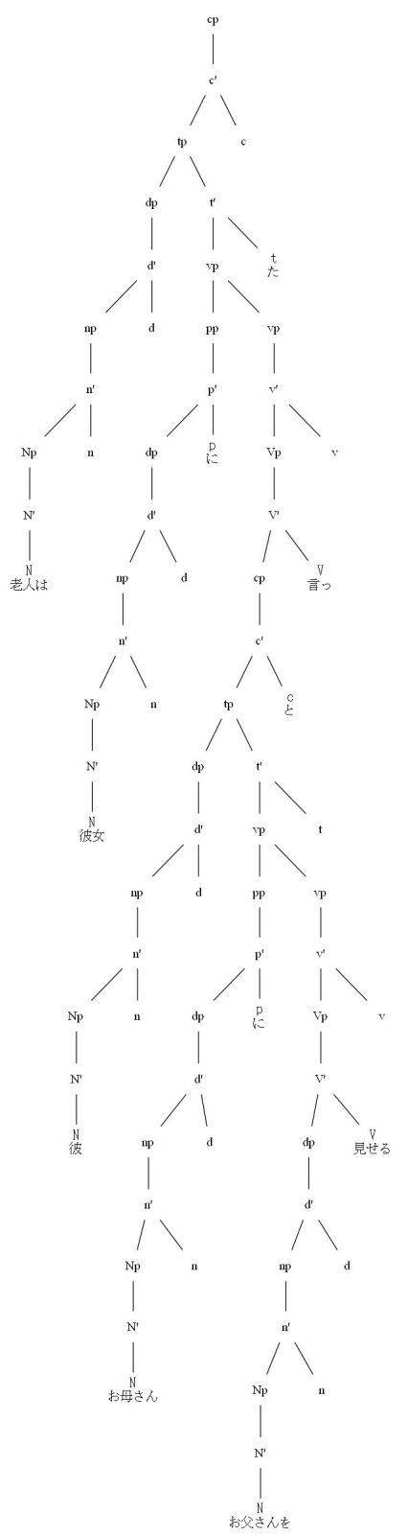
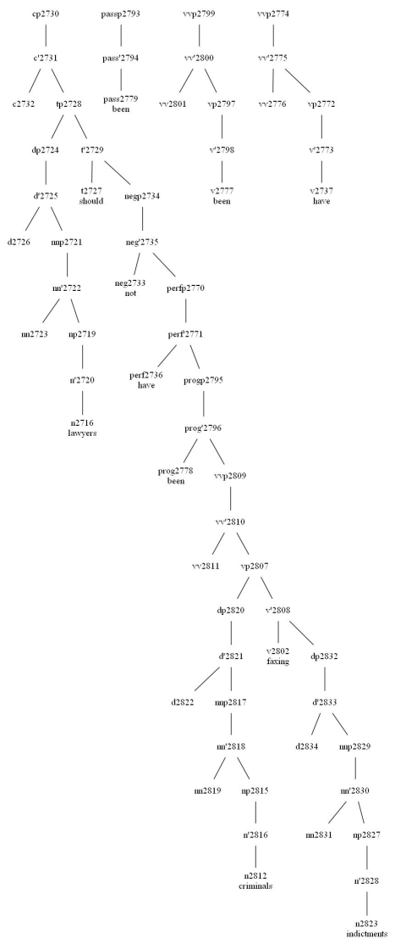

Slide 13
Haven’t yet made the transition
Nominal compounding
Chunking
“Careful mode”
Generation: sem → sentence
Mapping: lang₁ sem → lang₂ sem
Discourse/dialogue processing
SimTime: buffered input
French

Slide 14
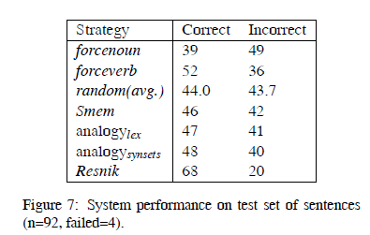
Participle/gerund ambiguity
My favorite cousin was singing. (participle)
My favorite activity was singing. (gerund)
His business is advertising. (both possible)
Corpus-based evaluation of several strategies:
Force verb or noun
Random
Use Smem
Use analogy
Use sem relatedness metric

Slide 15
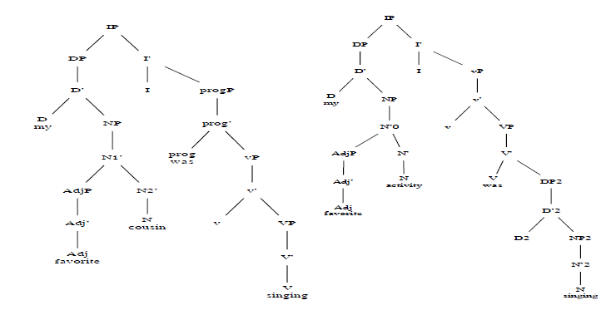

Slide 16
Sample syntactic snips
He was ugly. ok: main verb “be”
He was | singing. snip: main → prog
He was | tricked. snip: main → pass
He has a cold. ok: main verb “have”
He has | died. snip: main → perf
He had | been | singing. 2 snips
He sent the man.
He sent the man | an email.

Slide 17
Sample syntactic snips (2)
Lawyers suspected the man | was guilty.
He eats spaghetti | and meatballs.
I like green | vegetables.
She believes the man | burped.

Slide 18
Underway
Items mentioned above in “Haven’t yet…”
Massively ambiguous parses
Finish semantics
Semsnips: semantic snips
Epmem and language
Project codebase recovery ☹

Slide 19
Down the road
Better morpho-syntax-synsem know-ledge (e.g. VerbNet interface)
Interface with Sphinx
Modeling spoken language
Multilingual agent
Language control
Language acquisition modeling
Task integrations (again)
Careful reading (e.g. of web content)

Slide 20
Conclusions
Nuggets
Coal
Hundreds (more) sentences parsed
Development/testing tools, IDE
Interest despite hiatus
Quantitative evalua-tions now possible (on a small scale)
Still not public-ready
Juggling lots of func-tionality increments simultaneously
Difficulty reaching “big data”-oriented compu-tational community
Temporary repo setback

