Slide 1
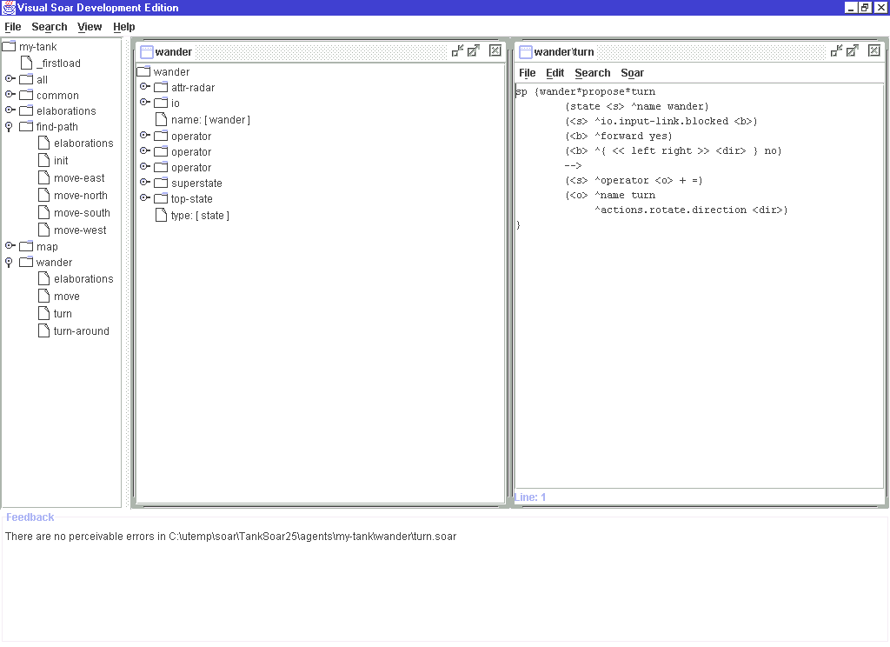
Visual Soar
Bradley L. Jones
Jonathan J. Bauman
John E. Laird
University Of Michigan

Slide 2
Motivation
It is too easy to make mistakes writing Soar programs.
  Spelling errors on attributes and values
  Attributes on wrong objects
It is too slow to write Soar programs.
  Creating operator hierarchies is cumbersome

Slide 3
Basic Design
Editor inspired by Visual C++, TAQL, ViSoar
Three editor windows
  Operator Window
    Direct support for task decomposition
  DataMap
    Add static type checking during development
  RuleEditor
    Text Editing Facilities

Slide 4
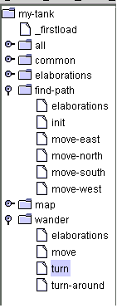
Operator Window
Displays hierarchical structure of operators
  Automatically creates underlying folders and files
Actions to operators:
  Add, Remove, Rename
  Open Corresponding Rules
  Open Corresponding DataMap

Slide 5
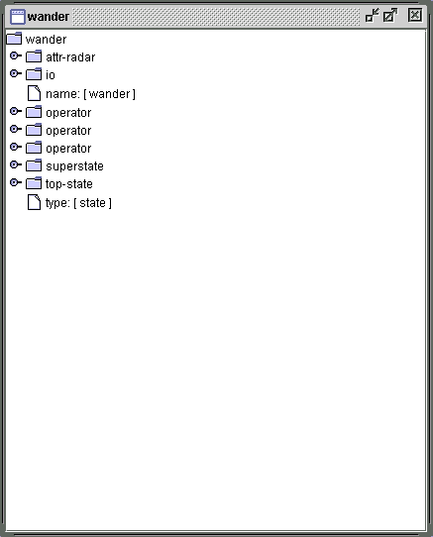
DataMap
Displays intended structure of the current state
  Provides access to superstate and top-state
  Supports static type checking
Actions in DataMap
  Add, Remove, Link
  Set value, type and range

Slide 6
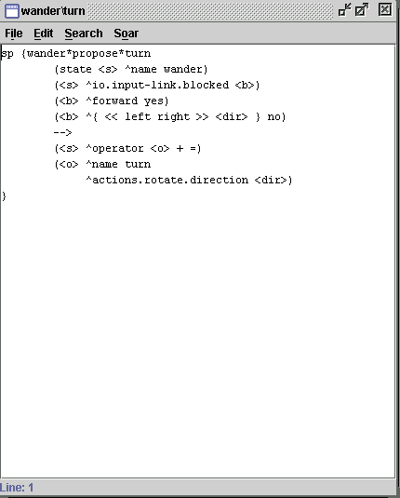
Rule Editor
Displays operator rules
Full text editing
Partially filled in templates using operator information
Syntax and semantic checks
Tab-Completion like facility
Syntax highlighting

Slide 7
New Features Since Last Year
Added a Tab-Completion like facility
Added Syntax Highlighting
Moved to J.R.E. 1.3 (it gives much better performance)
Copying and Pasting multiple selections in the DataMap

Slide 8
Visual Soar: Future Plans (this year)
More powerful text-editing facilities (more emacs or vim like or calling third-party editors to do editing see John Hawkins)
A way of building sophisticated types out of simpler ones

Slide 9
Visual Soar: Future Plans (last year)
More Comprehensive Static Analysis of Rules (being worked on actively by Sergej)
Tab-completion like facility (added)
Some Integration with the TSI, source rules from Visual Soar directly, DataMap vs. Working Memory Comparisons, Sending commands to Visual Soar through the TSI to open rule editors (hasn’t been worked on but some support is expected)
More Flexible Operator Layout (transition from tree to directed graph) (not as useful as initially thought)

Slide 10
Nuggets And Coal
Nuggets
  Static-type checking catches many errors beforehand
  Frees users from many banal tasks
  Cuts down on a lot of task switching overhead
Coal
  DataMap entry can be a clumsy process (I think the type building facility could help a lot)
  Putting old agents into Visual Soar can be cumbersome (there doesn’t seem to be around this)

