Slide 1



Collaborative multi-agent
IVUS image segmentation
Ernst Bovenkamp
Division of Image Processing, Department of Radiology
Leiden University Medical Center, The Netherlands
E.G.P.Bovenkamp@lumc.nl
Notes:
1
1
Doel is voortgang van het project te presenteren
Laat lezer zelf titel lezen
Mijn naam
LKEB noemen

Slide 2
Outline
System design
Agent design
Conflict resolution
Examples and Results
Future work.

Slide 3
Multi-agent IVUS image interpretation
Modular approach:
One or more agents for each possible image object.
Currently: lumen, vessel, shadow, calcified plaque, side-branch, and status agent.
Agents establish interrelations through communication and exchange interests and capabilities.

Slide 4
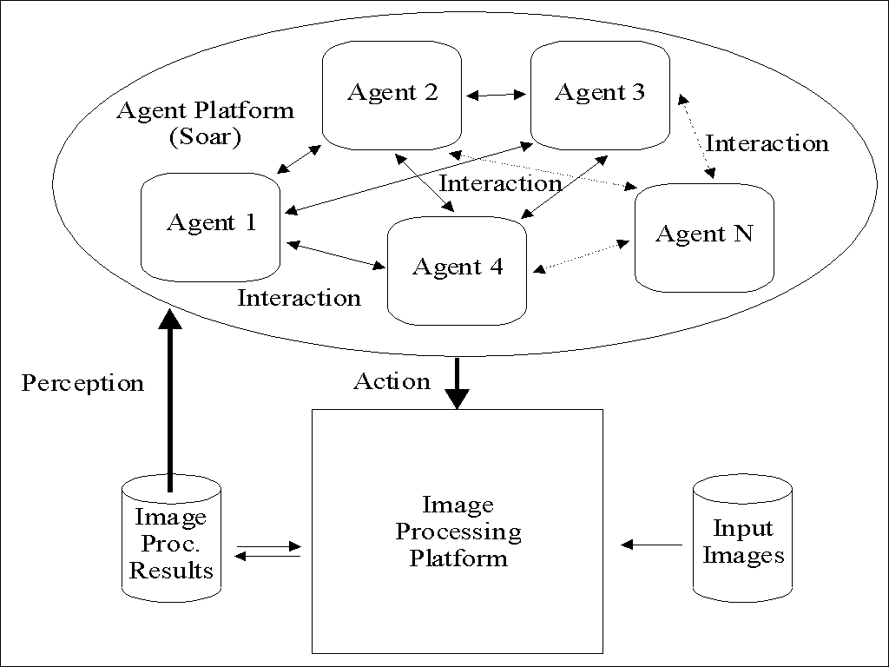
System design

Slide 5
Agent design: productions
Typical agent model:
  37 communication rules
  189 image processing rules
  112 conflict resolution rules
  26 utilities and default rules
  9 agent specific rules
  373 productions

Slide 6
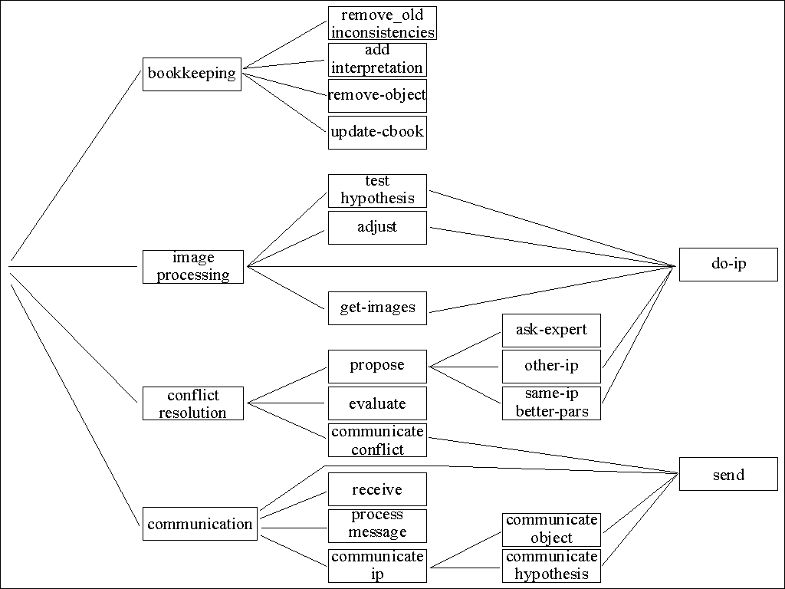
Agent design: operator relations

Slide 7
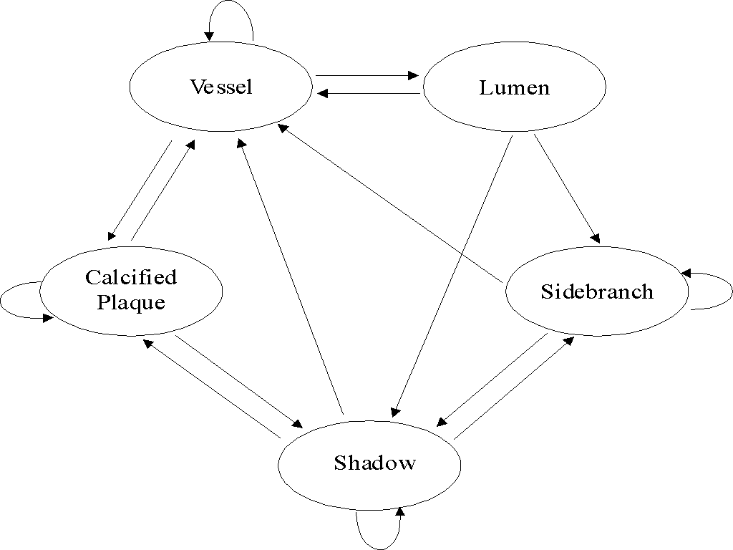
Agent design: agent relations

Slide 8
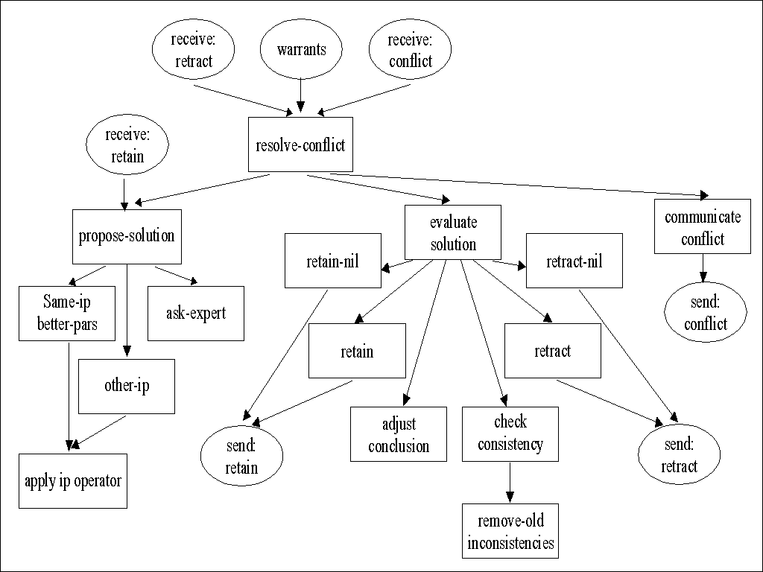
Conflict resolution: design

Slide 9
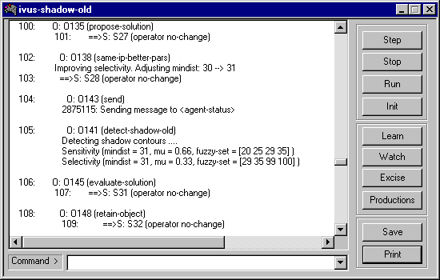
Conflict resolution: snapshot

Slide 10
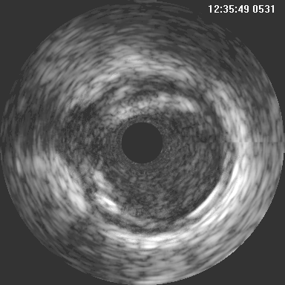
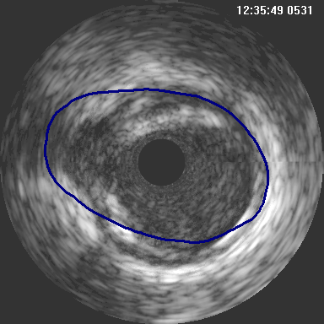
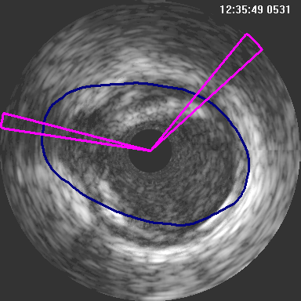
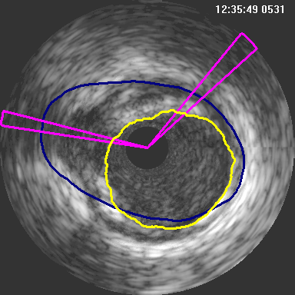
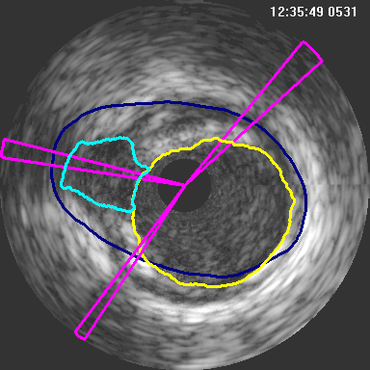
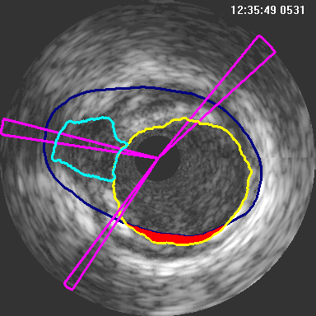
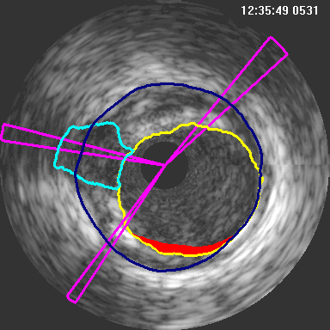
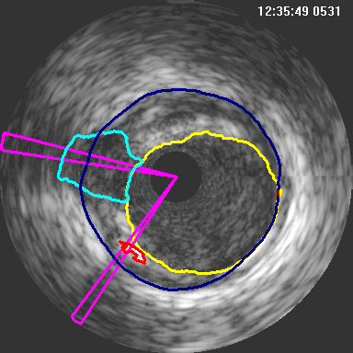
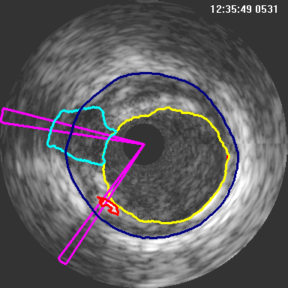
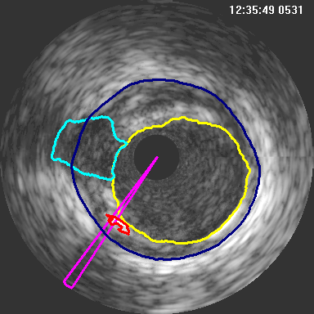
Conflict resolution: example

Slide 11
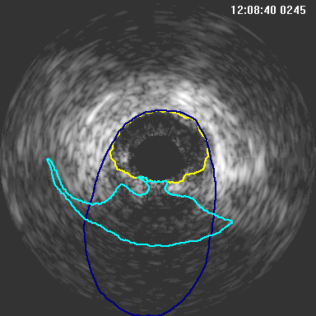
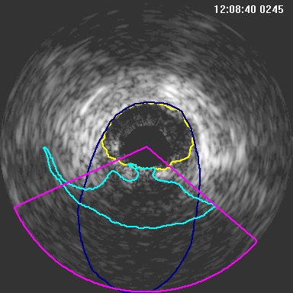
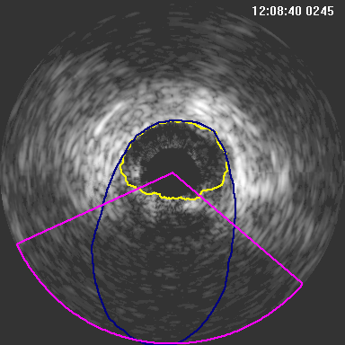

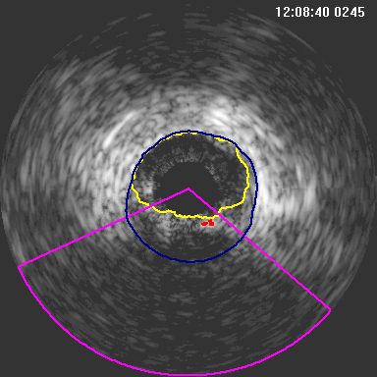
Test-hypothesis: example

Slide 12
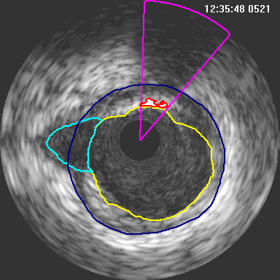
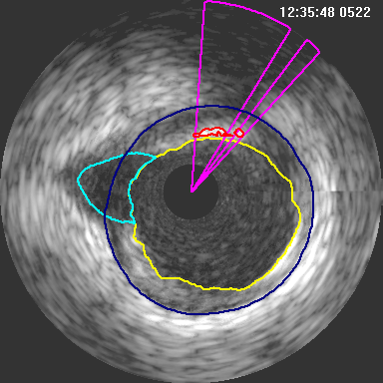
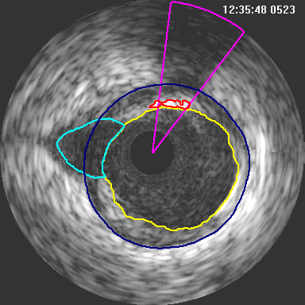
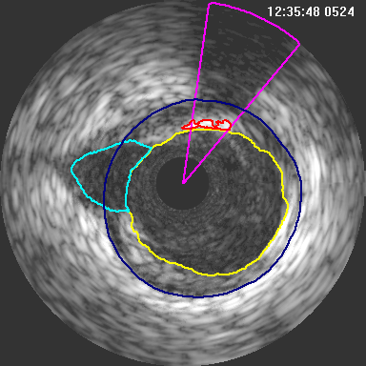
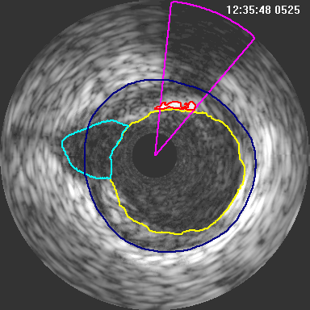
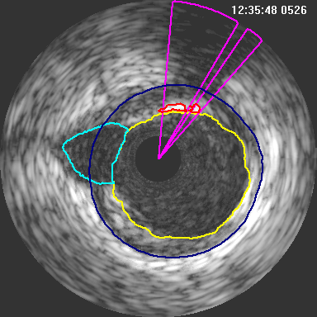
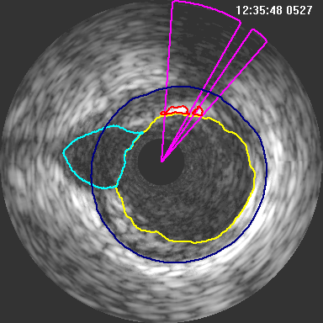
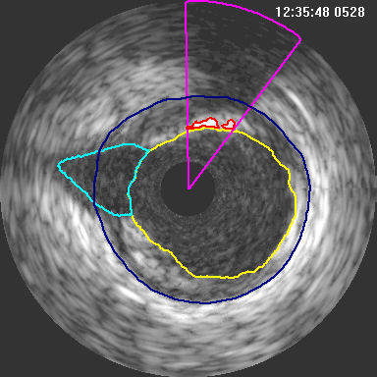
Results: patient1

Slide 13
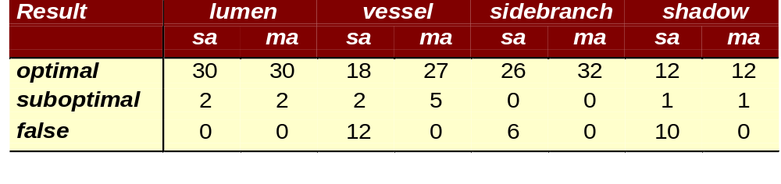
Standalone (sa) vs multi-agent (ma)
All conflicts resolved.
Considerable improvement of detectors.
Still some room for improvement.

Slide 14
Future work
Validation of complete imageruns.
Publication of results.
Inclusion of new agents (CSG, stent).
Learning image processing from the user.
This work was supported by a grand from the Dutch Innovative Research Program

