Slide 1


Testing the Situation Awareness Panel
Frank E. Ritter & Marios N. Avraamides
School of IST, Penn State
The Situation Awareness Panel (SAP) is a graphical user interface to aid in the observation, use, and development of Tac Air-Soar intelligent agents that control simulated military aircraft (Jones, 1998) within JSAF, developed by Soar Technology

Slide 2
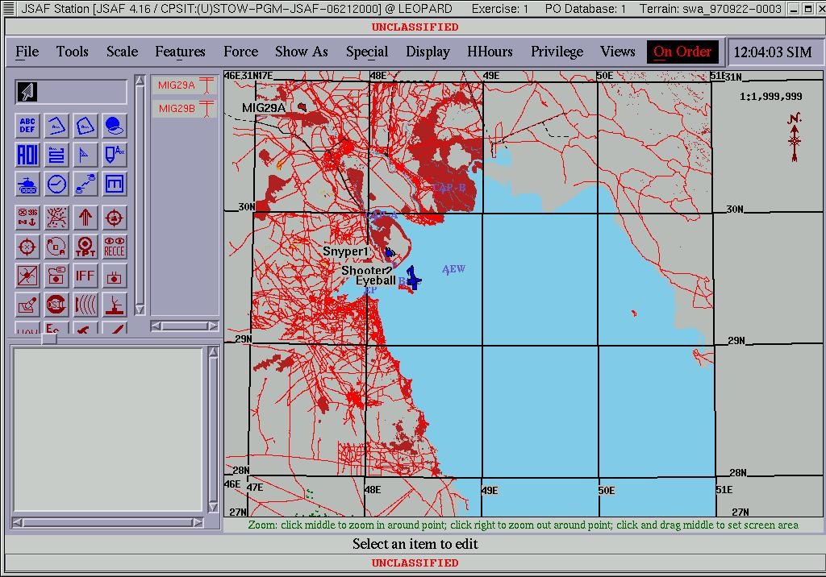
The Plan View Display

Slide 3
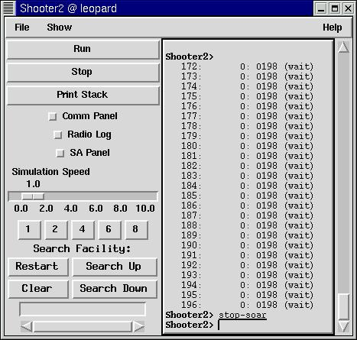
The Agent’s window

Slide 4
Parts of the SAP
Active Goal Display: Shows the agent’s stack of active goals and subgoals.
Milestone Display: Provides a quick overview of the agent’s recent history. It displays milestone events presented with a time stamp.
Aircraft Status Display: Shows cockpit-interface information that is available to the reasoning processes of the agent.
Agent Awareness Display: Provides a graphical representation of the agent’s current state of awareness

Slide 5
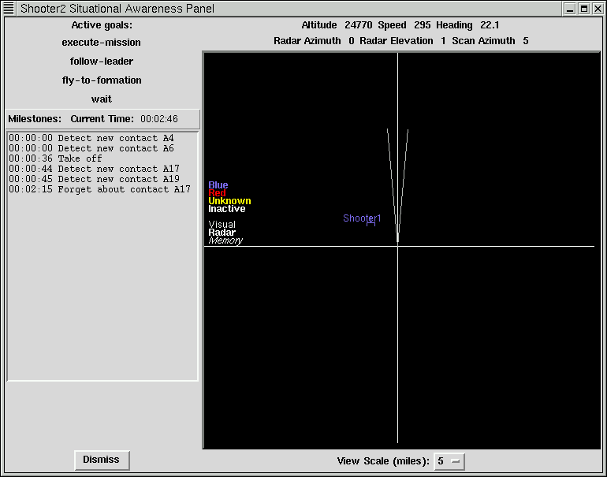
The Situation Awareness Panel

Slide 6
Approach
Scenario to guide discussions (based on TA)
HCI/Soar experts x 3
Cog modeling expert
GIS expert
Marines expert
Group HCI expert x 2
Local commerical pilot, former Navy
BMH former military pilots

Slide 7
Deliverables Now and in Sept.
Task analysis (then, does the SAP support these?)
  From HCI experts
  From Task analysis
  From military experts
Manual
  From our foibles and misteps
  From task analysis
  From expert’s use and further comments

Slide 8
Examples of Interesting Suggestions
From TA misalignment
    Radar range indicators don’t resize with scale changes,
From local experts
    show the attention of the agent, maybe as a spotlight.
    put environmental landmarks in Plan View Display.
    show what is in the environment but out of the awareness of the agent.
    Access other agents’ awareness from within the awareness of each agent
From interaction with Soar Tech
    SAP should not resize as more goals/subgoals are added on the goal stack

Slide 9
Summary
Gold
  Can positively improve interfaces
  Can educate (and be educated!) about users and use
  Proofreading an interface
Coal
  Takes effort
  They are moving so fast that interface changes during task

