Slide 1
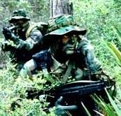

SOF-Soar :
Special Operations IFORs
Glenn Taylor
glenn@soartech.com

Slide 2
Special Operations Forces :
A completely different world
Small teams (6-16) of highly trained soldiers
Covert missions deep behind enemy lines
In the field for up to a few weeks
(“Snake eaters”)
Vastly different scales (time, space)
Emphasis on problem solving

Slide 3
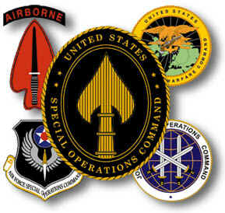
SOFs : Services
Each service has its own variety (with slight variations in tactics and deployment):
  Army Special Forces
  Army Rangers
  Navy SEALs
  Air Force Special Operations
  Marine Expeditionary Unit

Slide 4
SOFs : 9 Core Missions
Special Reconnaissance (SR) *
Direct Action (DA) *
Psychological Operations
Civil Affairs
Unconventional Warfare
Combatting Terrorism
Foreign Internal Defense
Counterproliferation of WMD

Slide 5
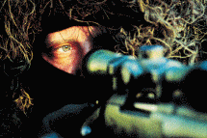
SOFs : SR/DA
Special Reconnaissance
  Area or Point reconnoitering
  Examples: specific troop movements, existence of WMD
Direct Action
  Quick strikes on specific targets to destroy, seize, or recover personnel or materiel
  Examples: SCUD launch site demolition, Raid on small C2 compound

Slide 6
SOF-Soar : Long Range Recon Patrol
Ingress
Observe-
point
Move-to-obs
Report-observations
Observe-vehicle
Correlate-reports
Listen-for-reports
Radio-base
Correlate-reports
Move-to-point
Report-observations
Egress

Slide 7
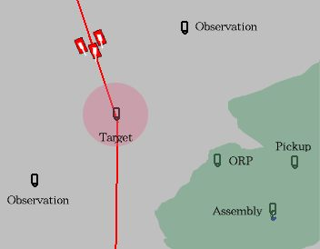
SOF-Soar : Long Range Recon Patrol

Slide 8
SOF-Soar : Reconnaissance
SOF-Soar agents’ observation criteria:
Location to look for entities (point and radius)
Entity type and subtype of vehicles (could be *any* for both)
Size of the group (numeric for now)
Direction the entities are heading
Group force (friendly, enemy, neutral)

Slide 9
SOF-Soar : Communication (1)
SALUTE reports
  S - size of group or event
  A - activity of the group
  L - location of the group
  U - unit markings
  T - time of sighting
  E - equipment

Slide 10
SOF-Soar : Communication (2)
Example:
“At 1304 observed 3 t-72s tank moving at 56 degrees 34 minutes 34 seconds by 64 degrees 43 minutes 22 seconds heading 174 at 24 miles per hour with red markings and unknown equipment”

Slide 11
SOF-Soar : Tools
SOFEE -- Java-based exercise specification tool
Comm Panel -- commands from operator to agent
Radio Log -- logs communication traffic
(Situational Awareness Panel) -- visualize agent’s decisions and situational knowledge

Slide 12
SOF-Soar : Interesting Issues
Team Behavior
Situational Awareness
Fatigue in JSAF’s DI models
Terrain is much more important
Problem Solving and Planning (more similar to RWA-Soar than TAS)

Slide 13
SOF-Soar : Progress
Initial funding for proof of concept
I/ITSEC demo won us some attention from important people (SOCOM)
  resulted in a productive KA visit to SOCOM
SOF-Soar to be used in J9’s UV01 exercise
Currently working to expand mission types and realism based on KA

Slide 14
SOF-Soar : Hazards
JSAF users not sure how to use SOFs in large exercises (so far just as “English-speaking ground sensors”)
JSAF doesn’t currently have high fidelity models of Dismounted Infantry
Competition with other simulators
  e.g., JCATS has stochastic models of SOFs for wargaming and analysis

