Slide 1

Ebonsoar:
Toward a Simulated Human Opponent
Tim Hoffman
21st Soar Workshop May 6, 2001

Slide 2
Introduction
EBONSOAR: investigations into an alternative game playing framework (FORR).
Generalize FORR to a broader class of games.
Compare FORR to the Top-down approach to agent design.

Slide 3
FORR
A plausible model of human game playing [Epstein 1994].
  avoids deep search.
  combines simple heuristics.
Employs a system of heuristics called advisors.
  Each advisor represents a specific heuristic.
  Advisors are separated into levels of order and authority, called tiers.

Slide 4
Advisor Tiers
Tier 1
  Authoritative advisors.
  Polled in a specific order.
  A recommended action is performed immediately.
  No further deliberation is done.

Slide 5
Advisor Tiers (cont’d)
Tier 1.5
  Considered only if Tier 1 makes no decision.
  Authoritative advisors.
  Polled in a specific order.
  Advisors perform weak search to arrive at recommendations.
  Recommended action performed immediately.
  No further deliberation is done.

Slide 6
Advisor Tiers (cont’d)
Tier 2
  Considered only if Tier 1.5 makes no decision.
  Non-authoritative advisors.
  Advisors recommend an action with a degree of confidence.
  A voting scheme decides which action is recommended by the most advisors.

Slide 7
Extending FORR
FORR was developed for discrete, perfect-information, turn-based games.
Question: is FORR extensible to real-time, continuous, interactive games?
  convert continuous variables to ‘buckets’ of values.
  shallow searches involving partitioned continuous variables may quickly become intractable.

Slide 8
The Subtleties of Time
When time is partitioned, different advisors can recommend actions in different time frames.
Actions may require a certain amount of time to complete themselves.
  A lower tier advisor could override a higher tier’s action while being performed.
  When time is partitioned, different advisors can recommend actions in different time frames.
Requires Persistent Justifications.

Slide 9
Persistent Justifications
Store the preconditions for an action when an advisor recommends it:
  Action name
  Advisor rank
  Conditions 1,2, … n that justify the action
Persistent Justifications remain in working memory until one or more conditions become false.
When an advisor recommends an action, it must check to see if a justification exists for that action.
  If the justification contains an advisor whose rank is equal to or greater than than the advisor recommending the action, then no action is taken.

Slide 10
Implementation
Created EBONSOAR, an Asteroids-type arcade game, as a testing environment.
Interfaced EBONSOAR and Soar with SGIO.
Designed a FORR framework in Soar.
Developed a set of basic heuristics to serve as advisors.

Slide 11
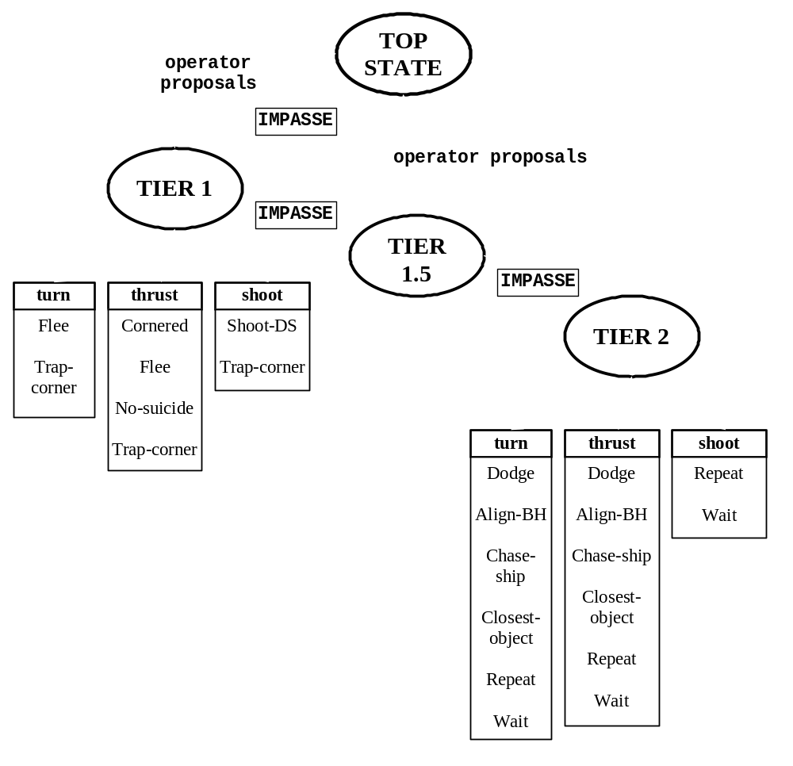
FORR in Soar

Slide 12
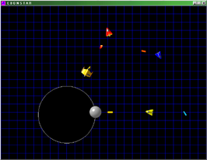
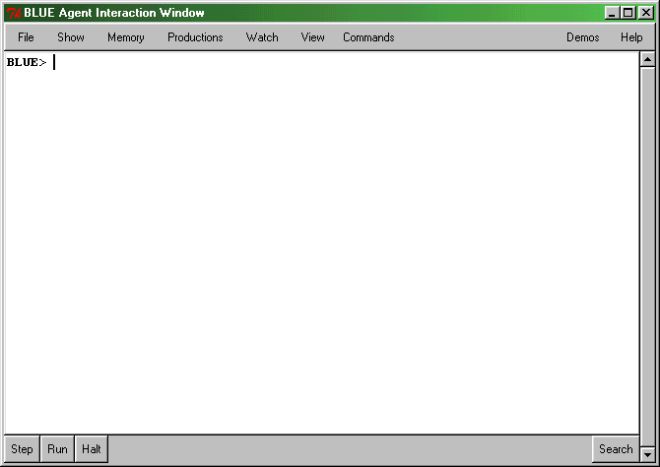
EBONSOAR Architecture
EBONSOAR
SGIO
GAME STATE
SoarAgent
C++
AGENT ACTIONS
INPUT / OUTPUT LINKS
Advisors in
Soar
AGENT ACTIONS
Soar
GAME STATE

Slide 13
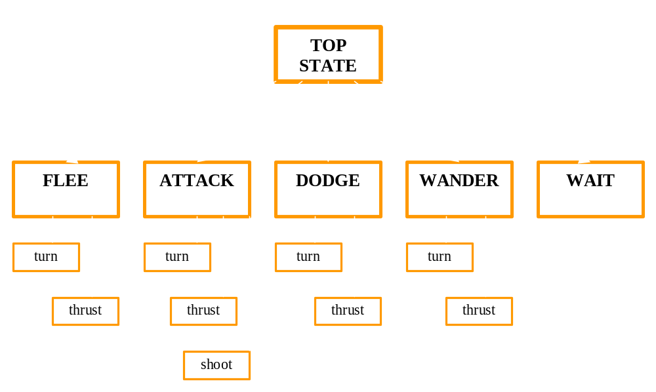
Top-down hierarchy

Slide 14
FORR vs. Top-down
FORR exhibited thrashing.
  Differing, alternating majorities in Tier 2.
  Weighting the votes of advisors can help.
  Developer must provide sufficiently many Tier 2 advisors for voting.
Advisors in FORR are “plug & play”.
Top-down ran smoothly (no thrashing.)
Top-down is potentially more complex if the number of subgoals becomes large.

Slide 15
Nuggets & Coal
Nuggets:
  FORR can be extended to more complex domains.
  Advisors easily added to and removed from the framework.
  Side effect: SoarAgent class can be reused.
Coal:
  Thrashing.
  Careful tweaking of Tier 2 voting weights required to avoid unrealistic behavior.
  Learning component in FORR not addressed yet

