Slide 1
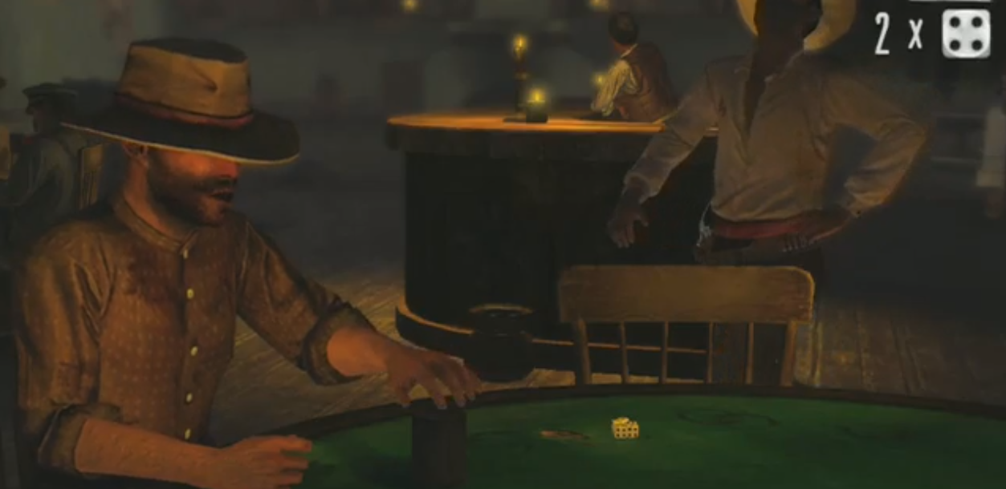
Dice Game Introduction
Miller Tinkerhess
University of Michigan

Slide 2
Dice Game
Overview
Gameplay
Example
Soar IO Link

Slide 3
Overview
Two or more players
Each player starts with five dice
Each round, one player wins or loses a die
  Usually loses
Last player with dice left wins the game

Slide 4
Why is this interesting?
Mixed symbolic / probabilistic reasoning
  Heuristic reasoning vs. precise calculations
Opponent modeling
  Gleaning information from opponent's actions
It's fun!
  We're competitive; can Soar defeat us?

Slide 5
Perception
During each player's turn, they perceive:
  The dice under their own cup
  Dice that any player has pushed
  How many dice are under each player's cup
  Move history
  Legal actions to take (affordances)

Slide 6
Actions
Bid
Bid and Push
Pass
Challenge previous bid or pass
Exact

Slide 7
Bids
A bid has a face and a count
  e.g. “Three sixes”, “Two fours”, “One one”
The first player may make any bid
Subsequent bids must increase either the face or the count
If the count increases, the face may decrease
The count may not decrease

Slide 8
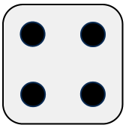
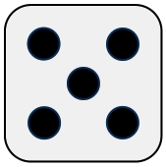
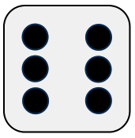
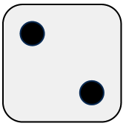
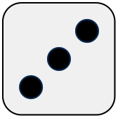
Bids
“One four”
“One five”
“One six”
“Two twos”
“Two threes”
+ face
+ face
+ count, - face
+ face

Slide 9
Ones
Ones are wild
To compensate, bids on ones may halve the current count value (rounding up)
Bids following bids on ones must double and add one to the count

Slide 10

Ones
“One two”
“Two threes”
“One one”
“Two ones”
“Five twos”
+ face; + count
½ count (ones)
+ count
2x+1 count; + face

Slide 11
Push
When a player bids, they may push some of their dice and re-roll their other dice
Pushed dice are viewable by all players
Advantage:
  Higher probability of your bid being correct
Disadvantage:
  Opponents get to see some of your dice

Slide 12
Pass
You may pass once per round
By passing, you are asserting that all your dice are showing the same face
If you bluff a pass and are challenged, you lose a die

Slide 13
Exact
Once per game, if you think the previous bid was exactly correct, you may exact
If you exact and the previous bid was exactly correct, you gain a die (limit 5)
Otherwise, you lose a die

Slide 14
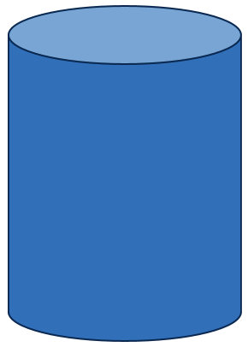
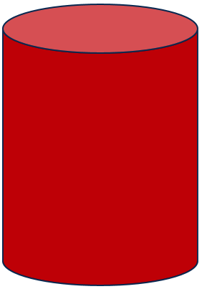

Player
Opponent
“Three sixes”
“Four fours”
“Five fours”
Round 1
“Challenge”
Result:
Three fours + two ones
(Five fours)
Opponent loses a die

Slide 15
Player
Opponent
“Three twos”
“Three threes”
Round 2
“Four twos & push”
(re-roll hidden dice)
“Challenge”
Result:
Two twos + two ones
(Four twos)
Player loses a die

Slide 16
Agent Perception
<il>.players
  ^player *
    ^id (int)
    ^cup
      ^count (int)
      ^die *
        ^face (int)
<il>.state
  ^last-bid
    ^player <player>
    ^action (string)
    ^face (int)
    ^multiplier (int)
    ^next <bid>
*multi-valued attribute

Slide 17
Agent Actions
<il>.affordances
  ^action *
    ^name (string)
    ^available (string)
    ^target <player>
<ol>
  ^bid
    ^face (int)
    ^multiplier (int)
  ^challenge
    ^target (int)
  ^exact
  ^pass
  ^push
    ^die *
      ^face (int)
  ^sleep
*multi-valued attribute

Slide 18
Questions / Comments?

