Slide 1
Soaring to New Platforms 2011 Update
Nate Derbinsky
University of Michigan

Slide 2
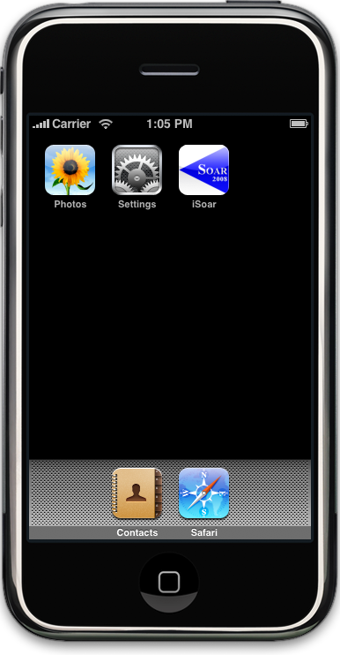
Progress: 2009
Soar on iOS
One-off compilation
Preliminary performance evaluation
Counting: ~20x slower on iPod Touch 2g
Notes:
2009: iSoar (TestSoarPerformance)

Slide 3
Progress: 2010 (Mobile)
Demonstration of mobile learning on iOS
tictactoe with RL
UI and functionality limited by foreign language (Objective-C) and tools

Slide 4

Progress: 2010 (Web)
Soar as HTTP client via Java SML
Web-based Liar’s Dice
Humans vs. Soar

Slide 5
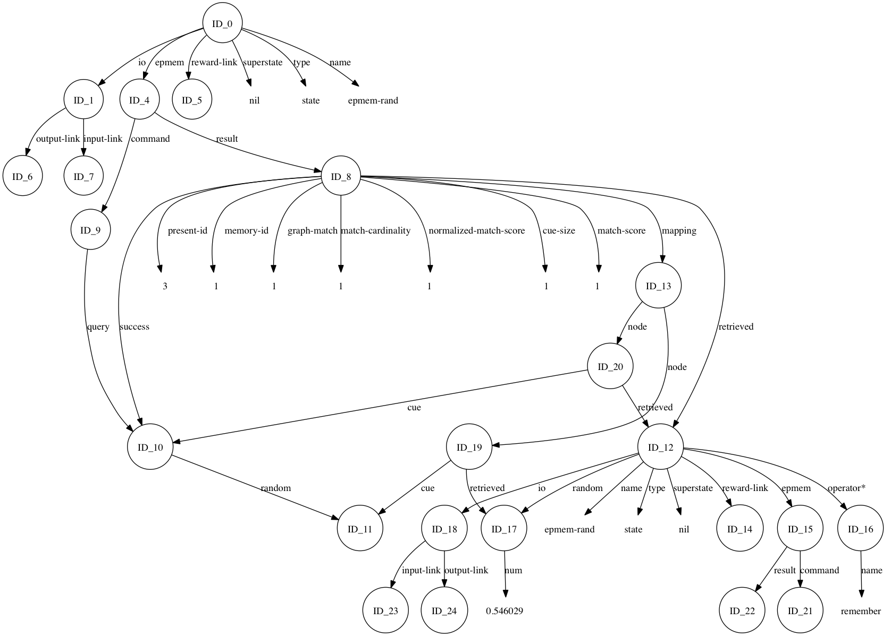

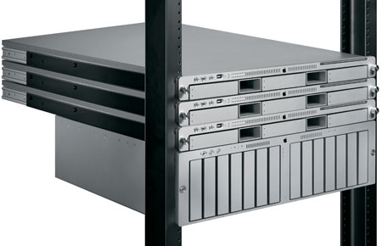
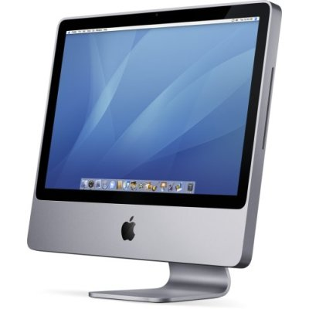
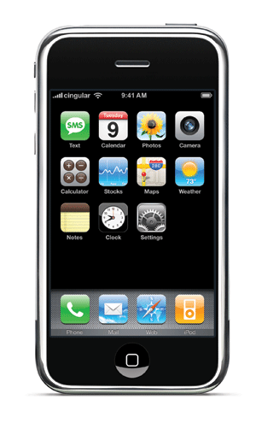
Resource (View)
Game State
HTTP REQUEST: GAME 5
Rules (Model)
Server (Controller)
Clients

Slide 6
2011 Update
Mobile
Web
Easy iOS compilation
Preliminary urMus integration + demos
(Derbinsky & Essl, 2011)
Preliminary PHP SML bindings
Server-side learning demo

Slide 7
Mobile

Slide 8
iOS Compilation
http://code.google.com/p/soar/wiki/SoarOniPhone
Preview
Checkout SoarSuite+Core
make ios-simulation ios-armv6 | ios-armv7
XCode settings

Slide 9
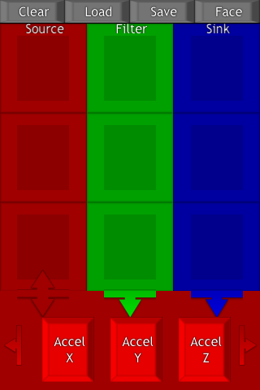
urMus (Essl, 2010) urmus.eecs.umich.edu
Open-source meta-environment for live and interactive application design and programming on and for multi-touch mobile devices
iOS, Android* support
A/V primitives
Lua front, C++ back
Interfaces decomposed into event-driven regions

Slide 10
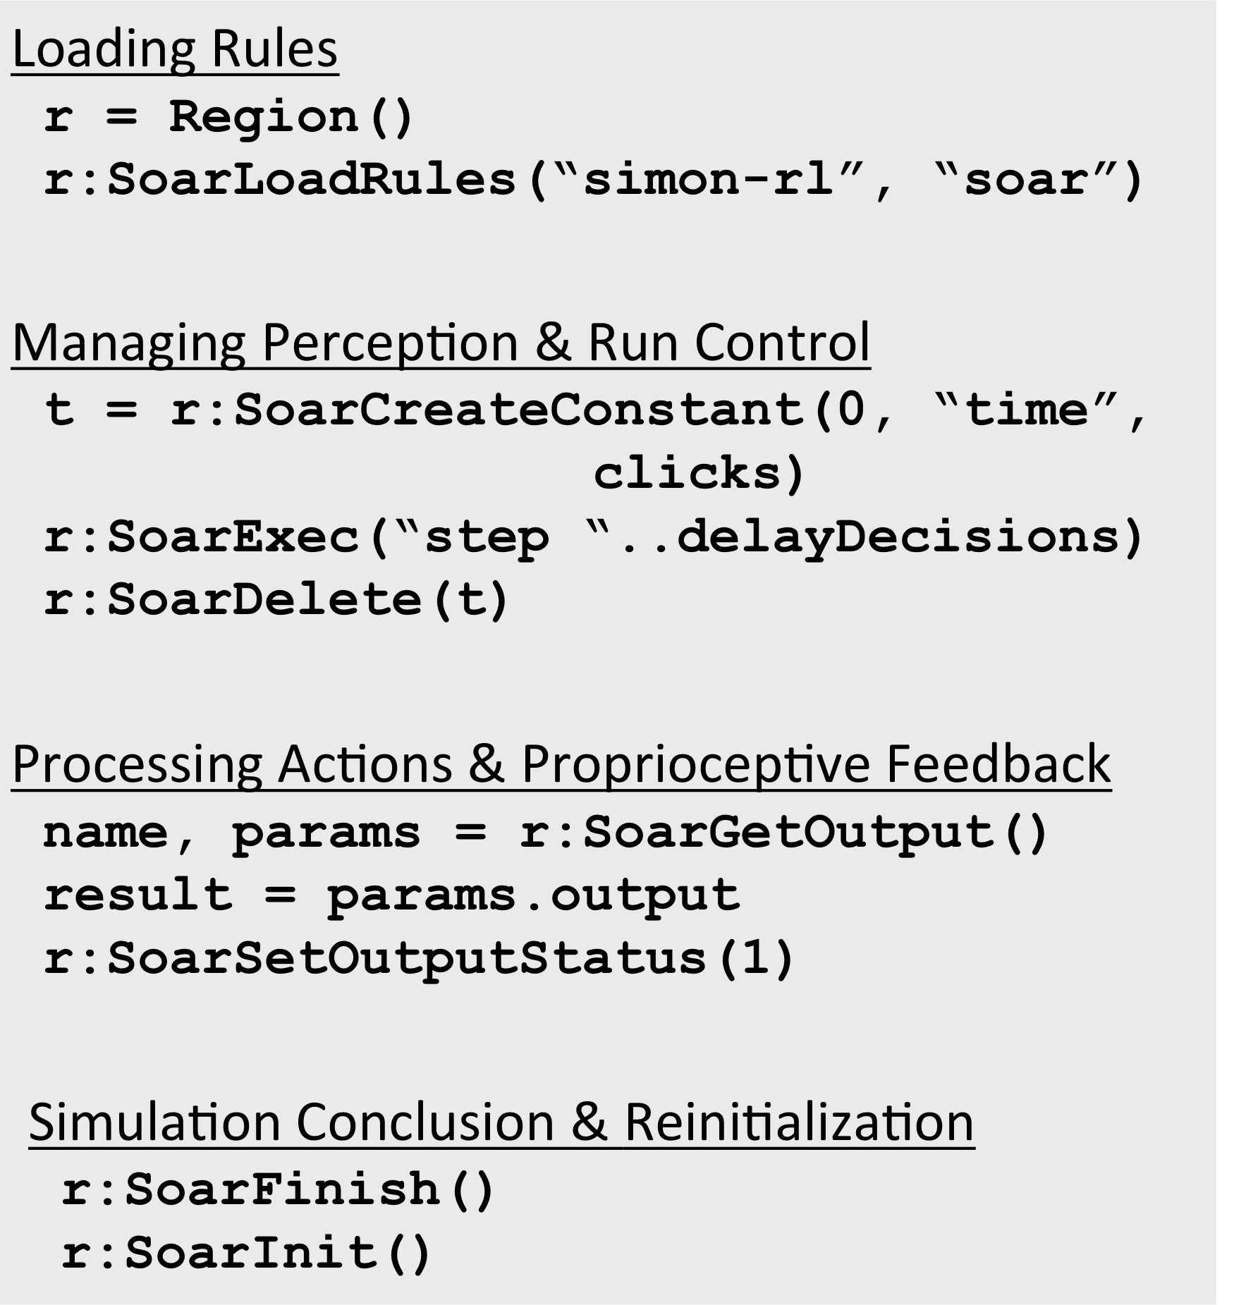
Integrating Soar & urMus
Each region can have an instance of Soar
Minimal Lua interface to C++ SML
Poor man’s callback via visual update calls

Slide 11
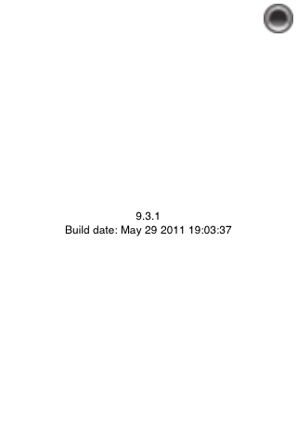
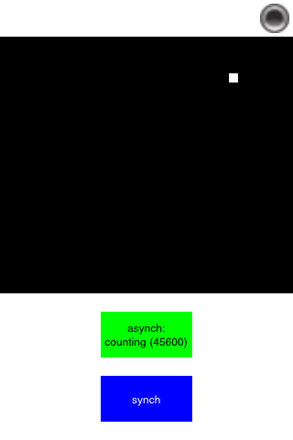
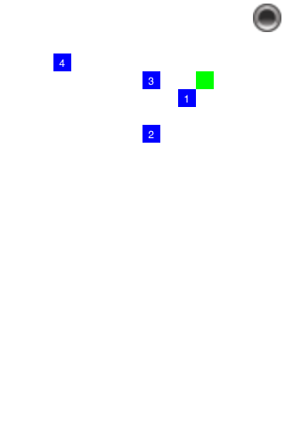
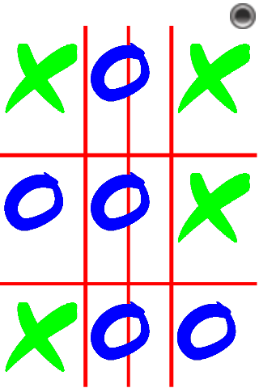
urMus Demo Applications (1)
Soar Version
26 lines
(A)Synch Counting
125 lines
Multi-Agent Food Gathering
266 lines
1/2-Player Tic-Tac-Toe
270 lines

Slide 12
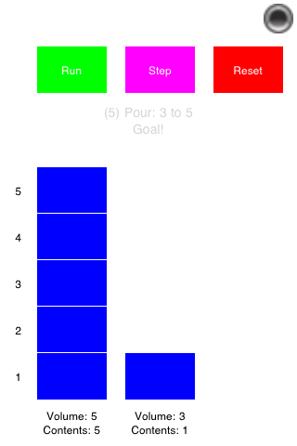
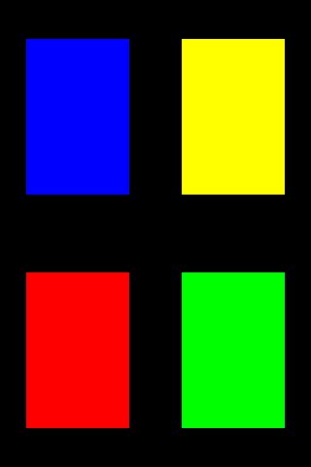
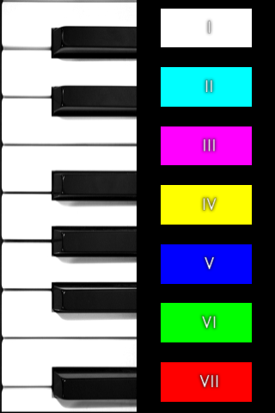
urMus Demo Applications (2)
Water-Jug RL Comparison
370 lines
Interactive Sequence Learning
370 lines
Interactive RL Music Generation
528 lines
Maximum decision 1msec, 3g iPod Touch
6 agents, 2 interfaces, Rules+RL+SMem

Slide 13

Web

Slide 14
Preliminary PHP Support
Usage
Issues
checkout, make
CLI + Apache documentation
Examples
Lightweight CLI
RL Unit Tests
Web Learning
Select callbacks implemented
Callbacks supply agent name (vs. reference)
Limited use (i.e. more issues to come)
Notes:
Mention performance via CLI

Slide 15
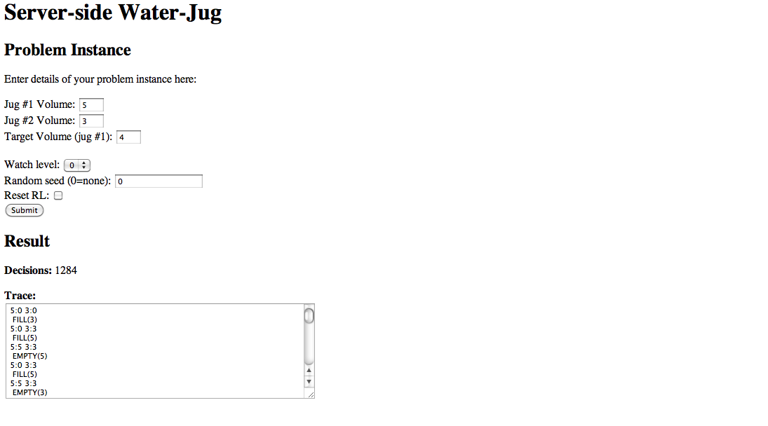
Water Jug: Server-side Learning Demo

Slide 16
Evaluation
Nuggets
Coal
Significant progress in supporting Soar on mobile and web platforms
Limited performance and efficacy evaluation

