Slide 1
SoarUnit

Slide 2
Motivation
Creating and maintaining Soar code is hard
Soar syntax/architecture does little to help (e.g., no type checking)
But partly this is what makes Soar powerful
Some existing tools provide static help
Syntax checking/highlighting finds common syntactical issues
Datamap can find many structural issues
But testing logic is still hard: need runtime testing
Some ad hoc solutions have been tried, but nothing particularly flexible or reusable
Other languages have standard tools and frameworks for creating unit tests: small scale, repeatable tests that can be run quickly to test various parts of the system

Slide 3
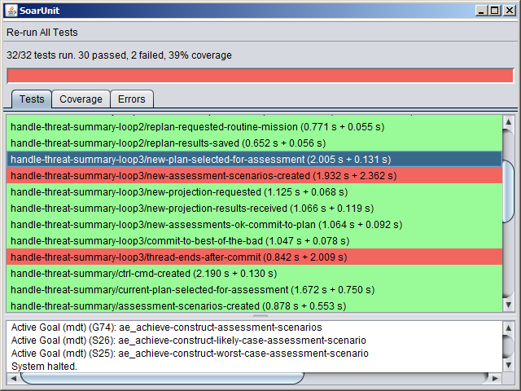
SoarUnit
Created by Dave Ray
Inspired by JUnit (a unit testing framework for Java)
Provides a way to define tests, including initial and success/failure conditions
Part of JSoar (open source, BSD), but works with CSoar, too

Slide 4
Tests
Define rules and commands to execute before the test runs
One or more rules need to call the “pass” RHS function
Can also call “fail”, but that’s uncommon
Related tests in a single .soarunit file can share common rules and commands
SoarUnit will process all .soarunit files in a given directory or directory tree
A new Soar agent is created for each test, so no state is maintained across tests

Slide 5
Example
setup {
source my-agent.soar
learn --on
sp {fake-input
(state <s> ^io.input-link <il>)
-->
(<il> ^foo bar)
}
}
test input-processing-started {
sp {check-for-input-processing-operator-selected
(state <s> ^operator <o>)
(<o> ^name process-input)
-->
(pass)
}
}
test input-processing-completed {
sp {check-for-expected-structure
(state <s> ^saw-foo-bar true)
-->
(pass)
}

Slide 6
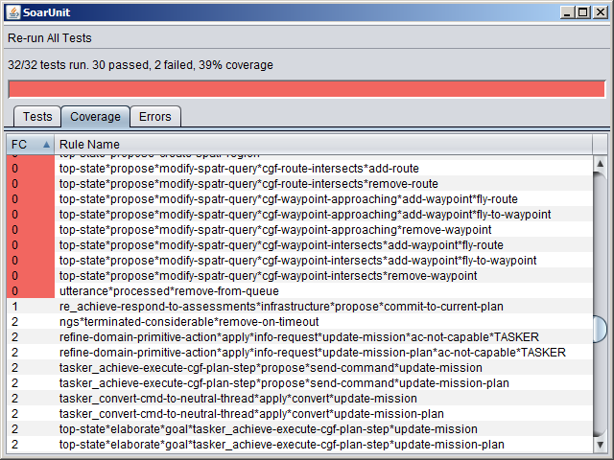
Other Features
Can right-click on any test to launch debugger with that test loaded
Coverage tab shows union of firing counts across all rules
Error tab shown when there is a problem loading/running a test (e.g., syntax errors)
In JSoar, supports Tcl and other scripting languages
Can run multithreaded (multiple tests simultaneously)

Slide 7
Demo

Slide 8
Nuggets Coal
Has really helped me write complex agents
Helps identify bugs quickly
Supports agent development even when the environment is not ready
Helps spec out what the environment connection should look like
Some missing features
Ability to re-run a single test or subset of tests
Ability to see the results of individual tests as they run
Can be slow when using Tcl, or when the tests are failing
A few minor bugs

Slide 9
More Info
https://code.google.com/p/jsoar/wiki/SoarUnit

