Slide 1
SoarQnA Standardized Access to External Knowledge
Nate Derbinsky
University of Michigan

Slide 2
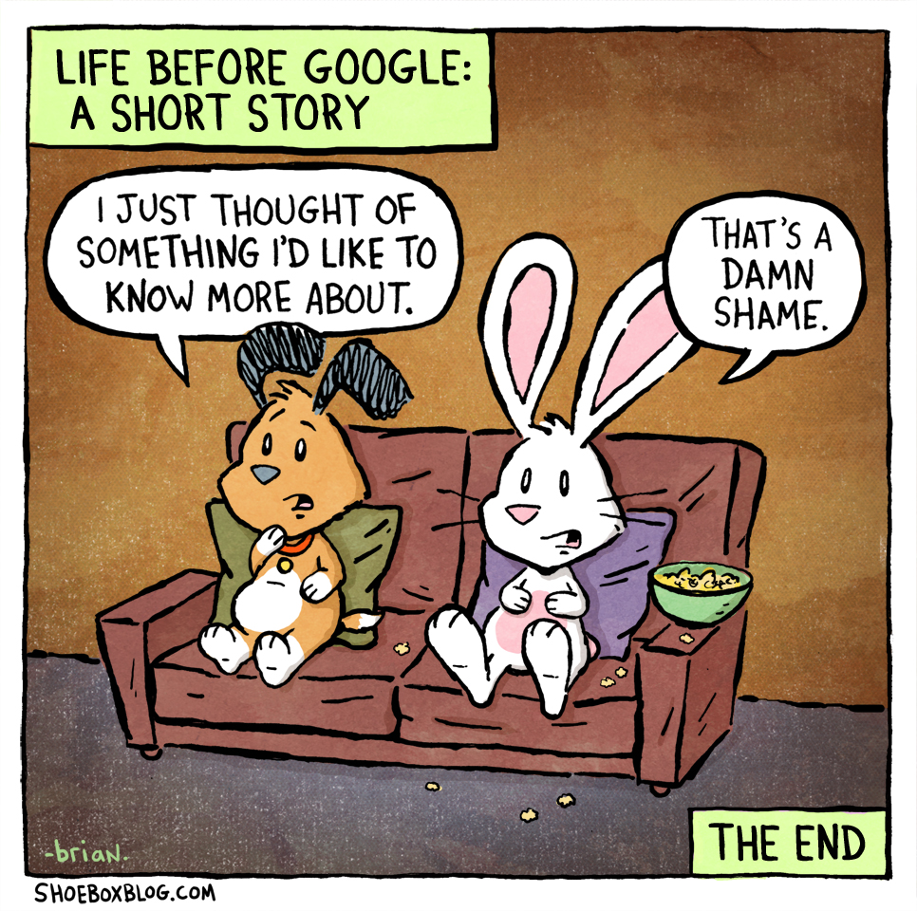
Access to External Knowledge in Soar
SoarQnA
Data chunking
Large working memory structures
Custom RHS functions
Custom SML

Slide 3
SoarQnA: Objectives
Efficient
Quick development/prototyping
Simple, unified agent interface independent of
Data format/source
Query type/complexity
Broadly applicable

Slide 4

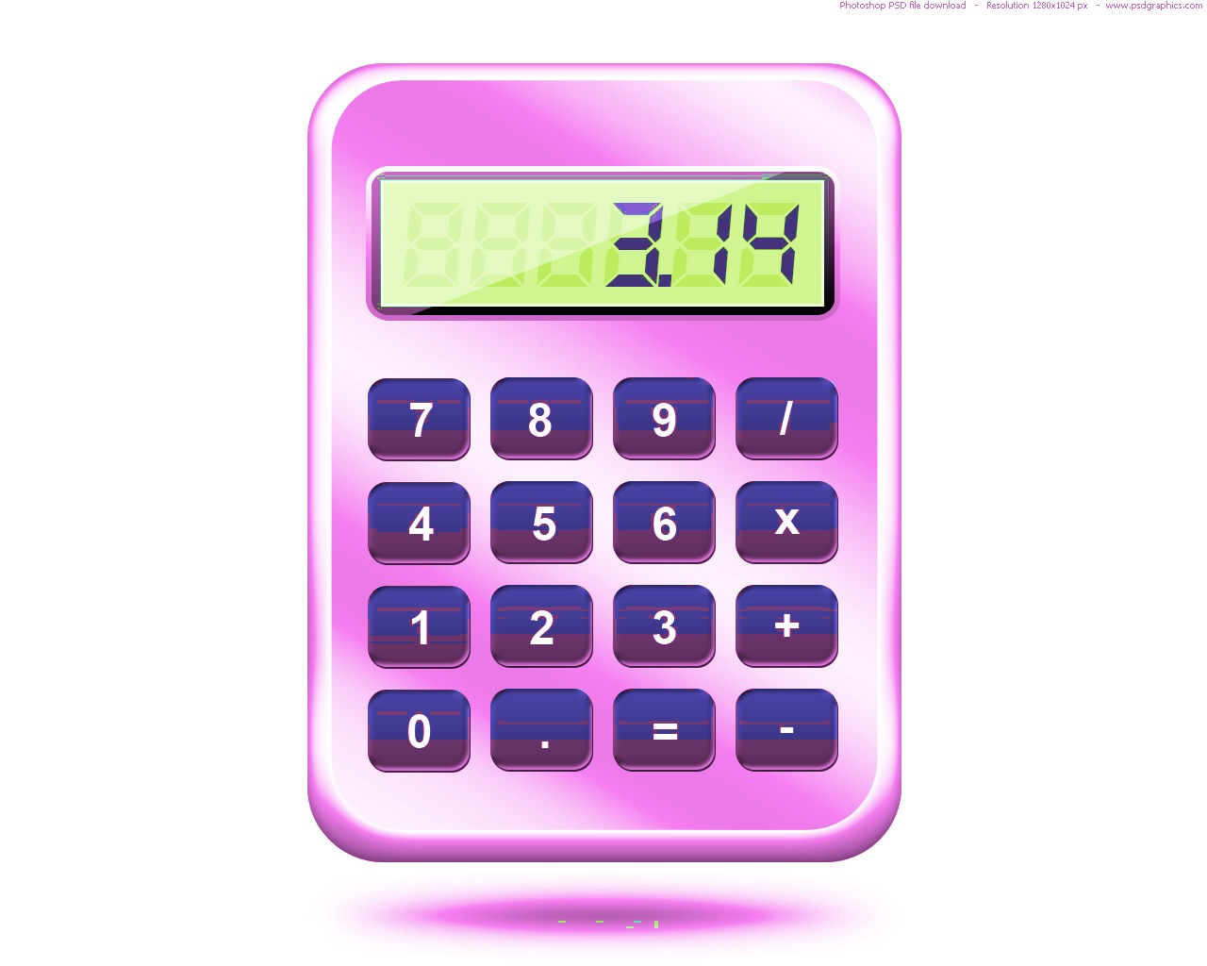
SoarQnA: Overview
Working Memory
Output
Q
A
Data Sources
DB
SoarQnA

Slide 5
SoarQnA: Components
Data source driver
Data source instance descriptor
Agent interface
IO Hooks

Slide 6
Data Source Driver
Interface
Example
Driver
Create new connections
Connection
Executes queries
QueryState
Maintains query state and provides incremental result access
Driver
Database Driver
Connection
Database Connection
QueryState
Query cursor aaaaaaaaaaaaaaaaaaaaaaaaaaaa

Slide 7
Data Source Instance Descriptor
Interface
Example
Instance name
Agent will use this
Connection information
Driver, instance parameters
Available queries
Name, definition
“my_database”
Hi
“host=localhost, port=…”
Hi
“all=select * from…”

Slide 8
Agent Interface
Input
Output
qna-registry
^|instance name|
^query |query name|
qna-query
^source |instance name|
^query |query name|
^parameters
^name value
^results << all incremental >>
^status
^id #
^result
^num #
^features
^name value
^next
qna-next
^id #
^status

Slide 9
IO Hooks
Listens for qna- output commands, provides feedback during input-phase
Executable can run with any existing SML client with no modification
Exposes library calls for more direct programmatic control

Slide 10
Included with Soar 9.3.1
Documentation
Data Source Drivers
Math. Most Soar RHS functions
Dice. Liar’s dice probability calculations
DB. JDBC wrapper
Example agent
SQLite performance evaluation

Slide 11
SQLite Performance Evaluation Large Result Set Exhaustion

Slide 12

SoarQnA: Objectives Revisited
Efficient
Quick development/prototyping
Simple, unified agent interface independent of
Data format/source
Query type/complexity
Broadly applicable

Slide 13
Pragmatic Development Comparison
 | Semantic Memory | SoarQnA
Implementation | C++, Kernel | Java, SML
Knowledge Representation | Directed graph via symbolic triples | Fixed per data source instance
Query Semantics | Fixed in architecture | Fixed per query
Query Composition | Dynamic | Parameterized
Retrieval Biases | Fixed in architecture | Fixed per query
Query Frequency | 1 per state per decision | Arbitrary number per decision
Query Time | Generally << 1msec | Dependent upon data source instance, query
Store Dynamics | Fixed in architecture (user can only add new knowledge) | Fixed per data source instance (could include arbitrary user modification)
Learning | Integrated within architecture | Deliberate via rules

Slide 14
Evaluation
Nuggets
Coal
Objectives achieved
In use for Liar’s dice
Included in Soar 9.3.1
Small data source driver set
Currently read-only
Limited performance evaluation
Query execution is synchronous with agent execution, which may impede reactivity
CSoar only
Notes:
NO JSOAR

