Slide 1
Robust parsing and LGSoar
Deryle Lonsdale and Tory Anderson

Slide 2

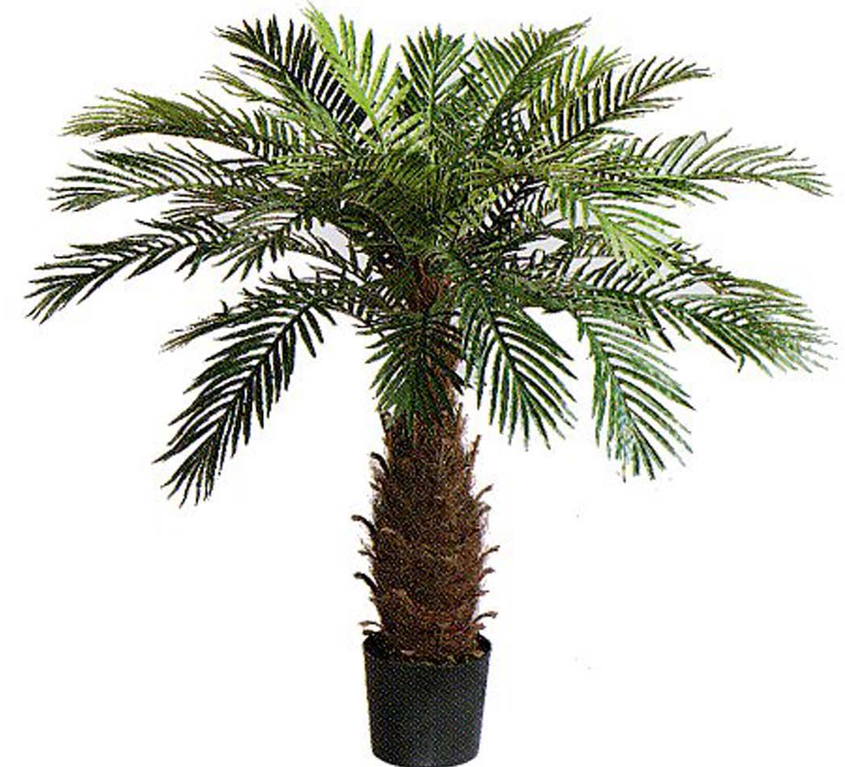
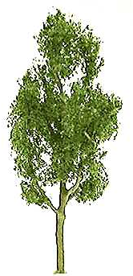
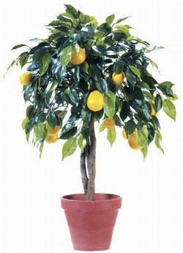
Different types of trees

Slide 3


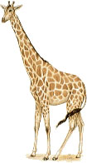
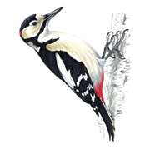



Ways of viewing a tree

Slide 4
Parsing
Start with text (e.g. sentence)
Label each of the elements (e.g. words)
Diagram the relationships between elements: parse tree
Why?
Shows constituency
Visual representation of content
Useful for future reference (e.g. treebanks)

Slide 5
Linguistic theories and parsing
LFG (KANT)
GB/P&P (NL-Soar)
Minimalist Program (XNL-Soar)
SFG (NIGEL)
HPSG (Verbmobil)
Categorial grammar (ALE)
RST (PENMAN)
TAG (XTAG)
STATISTICS (CANDIDE)
etc. etc.

Slide 6
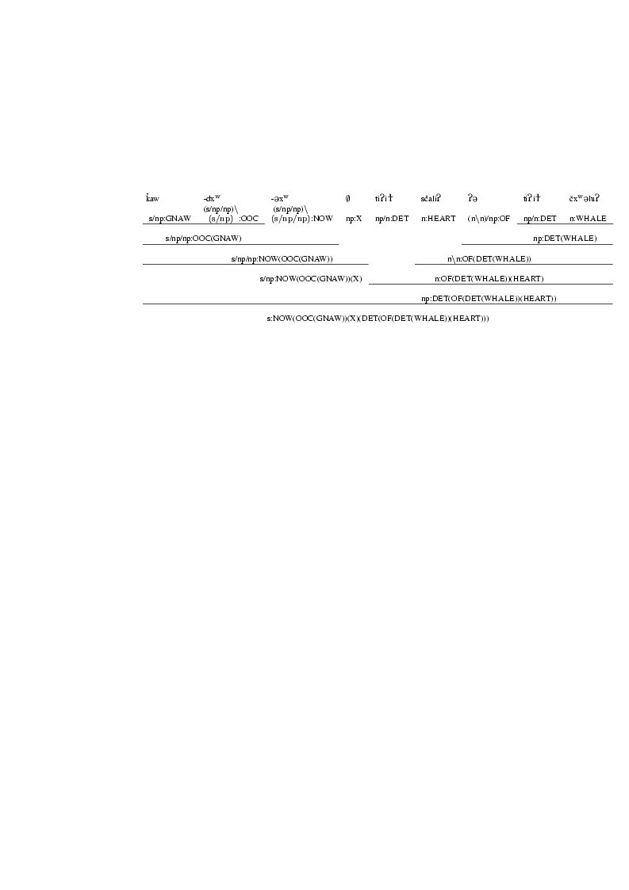
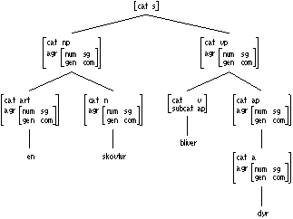
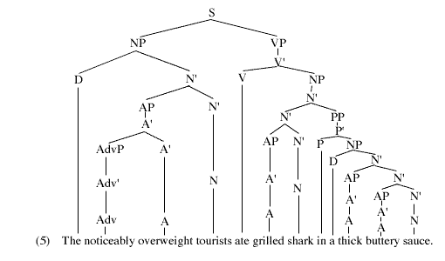
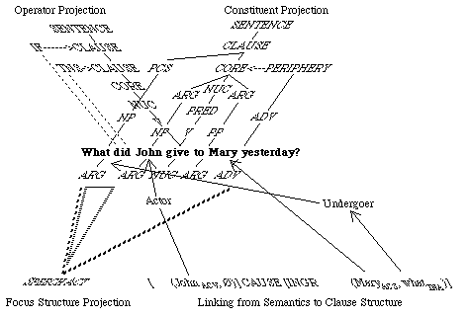
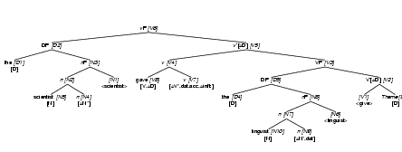
Different kinds of parse trees

Slide 7
Robust parsing
Most parsers based on linguistic theory
Linguistic theories assume grammatical input
Much of language use not entirely grammatical
L2 English
Spoken language
Controlled language / sublanguage
Headlines
PowerPoint slide bullets
Traditional parsers don’t handle these types of language well

Slide 8
The LG parser
Freely available for research purposes
Robust (e.g. information retrieval, MT)
Calculates simple, explicit relations
Fast
Written in C
Not based on any linguistic theory
More appropriate for some tasks than traditional phrase-structure parsers

Slide 9
Link Grammar
What is a link?
Shows a relationship between pairs of words
Subject + verb
Verb + object
Preposition + object
Adjective + adverbial modifier
Auxiliary + main verb
Labels each relationship accordingly
Potential link types are specified by technical rules
Possible to score linkages, penalize links

Slide 10
LG example parses
Linkage 1, cost vector = (UNUSED=0 DIS=2 AND=0 LEN=23)
+-----------------------------------------Xp----------------------------------------+
| +-----------------------MVp-----------------------+ |
| +---------------MVp--------------+ | |
| | +-------Jp-------+ +----Js---+ | |
+--Wd--+Sp*+-PPf-+--Pg*b--+--MVp-+ +----AN----+ | +---D--+ +-Js+ |
| | | | | | | | | | | | | |
LEFT-WALL I.p 've been.v majoring.v in Material engineering.n at my University in Korea .
Linkage 1, cost vector = (UNUSED=0 DIS=2 AND=0 LEN=27)
+----------------------------------------------Xp----------------------------------------------+
| +-----------Wdc-----------+ +------------------Opt-----------------+ |
| | +--------CO--------+ | +--------------AN-------------+ |
| | | +-----D*u----+-------Ss------+ | +-------AN-------+ |
+--Wc--+ | +--La-+ +--Mp--+--J-+ | | | +----AN---+ |
| | | | | | | | | | | | | |
LEFT-WALL but probably the best.a class.n for.p me was.v medicine.n and first.n aid.n principles.n .

Slide 11
Previous LG applications
Grading EFL essays
Extracting biographic facts from genealogical documents
Analyzing newspaper headlines
Clinical trial records and patient data matching
Other languages (Farsi, Arabic, Lushootseed)

Slide 12
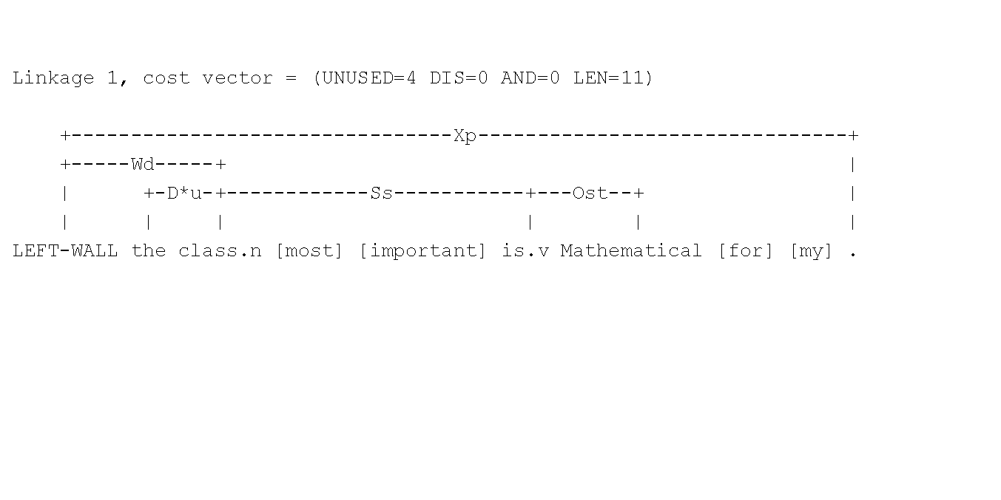
Ill-formed sentence

Slide 13
Skipping problematic words
Mary married I think, 23 November 1661, Samuel Gay.
No complete linkages found.
+-------------------------Xc------------------------+
+-----------------------Osn----------------------+ |
+------------------Xc------------------+ | |
+-------------MVp------------+ | | |
+--Ss--+ +--TM-+--TY--+ | +--G-+ |
| | | | | | | | |
Mary married.v [I] [think] [,] 23 November 1661 , Samuel Gay .

Slide 14
Parsing Persian with LG
<tu midAni kh mn mirum> “you know that I am going”
+------------C-----------+
+--------Spn2-------+ | +-------Spn1-------+
| +-VMdur+-VMP-+--SUB-+ | +VMdur+-VMP-+-RW+
| | | | | | | | | |
tu.pn mi.vmd dAn.vs i.vmp kh.sub mn.pn mi.vmd ru.vp m.vmp .

Slide 15
Parsing Lushootseed
linkparser> bE+ Lil +t +Eb +ExW ?ElgWE? ?E ti?E? bE+ ?Es+ istE?.
++++Time 0.07 seconds (0.20 total)
Found 2 linkages (2 had no P.P. violations)
Linkage 1, cost vector = (UNUSED=0 DIS=2 AND=0 LEN=28)
+----------------------------Xp---------------------------+
| +-----------EM----------+ |
| +--------PA-------+ +---------P--------+ |
| +----ASP----+ | | +------DT------+ |
+----Wd----+--MD--+ | | | | +----AD---+ |
| +-AD+-TX+ | | | | | | +-STV+ |
| | | | | | | | | | | | |
LEFT-WALL bE+ Lil +t +Eb +ExW ?ElgWE? ?E ti?E? bE+ ?Es+ istE? .

Slide 16
Sample link specifications
<pref-asp1>: {(PRF- or STV- or PRG-)};
<pref-asp2>: {HAB-} & {DUB-} & {AD-};
<predprefs>: {NZ-} & {<pref-asp1>} & {SX-} & {<pref-asp2>} & {(FUT- or PT-)};
<root-main>: <predprefs> & {DT-} & {LX+} & {BNF+} & {TX+} & {TC+} & {ACH+} & {TC+} & {TX+} & {ASP+};
<main-args>: {P-} & {GEN-} & {WH-} & {SOs+} & {MV+};
<root-ditrx>: <predprefs> & {DT-} & {LX+} & {BNF+} & TX+ & {TC+} & {ACH+} & {TC+} & {TX+} & {ASP+};
<ditrx-args>: {P-} & {GEN-} & {WH-} & {SOs+} & {EX+} & {SOo+} & {MV+};
<root-middle>: <predprefs> & {DT-} & {LX+} & {BNF+} & {TX+} & {TC+} & MD+ & {ACH+} & {TC+} & {TX+} & {ASP+};
<middle-args>: {P-} & {GEN-} & {WH-} & (({PA+} & {EM+}) or ({EM+} & {PA+})) & {MV+};
<pred1>: ((<root-main> & <main-args>) or
(<root-middle> & <middle-args>) or
(<root-ditrx> & <ditrx-args>)
) & {Wd-};

Slide 17
LG-Soar: LG + Soar + DRT
Parse input via LG parser
Input words, links into Soar
Productions to identify and infer:
Entities: discourse referents
Attributes: properties of entities
Actions, states
Other relationships: spatial, temporal
Anaphor, deixis, other pragmatic content

Slide 18
Discourse Representation Theory
Discourse Representation Structure
Discourse referents:
Variables, representing objects; anything that can serve as the antecedent for an anaphor
Conditions:
Represent properties and relationships
Examples:
Thomas(u)
v married w

Slide 19
Predicate logic equivalent
Thomas Smith, Haverhill, married at Andover 6 January 1659, Unice Singletary of Salisbury.
u v w x m n o y z a
Unice(y), Singletary(z), prep(“at”, x), verbal(“married”, v, x)
propername=uv
modifier=“Haverhill”
Thomas(u), Smith(v), Haverhill(w), Andover(x), 6(m), January(n),
propername=yz
time(day m, month n), 1659(o), time(month n, year o), Salisbury(a),
modifier=“January”
modifier=“Andover”

Slide 20
LG-Soar current status
Most complete running system in Soar 7
Conversion to Soar 9 underway
Most of code updated to Soar 9 (finally!)
DRS output format needs updating (currently Tcl)
Newer version of LG parser released, need to update

Slide 21
Conclusions
Coal
Nuggets
Not as useful when linguistics required
No cognitive modeling: Soar is just a program-ming environment
Linguistic grammar development very opaque
Robust parsing
Flexible: various applications
Soar 9.3 underway, largely complete
Interest growing

