Slide 1
The XNL-Soar Sandbox
Deryle Lonsdale, Jeremiah McGhee,
Nathan Glenn, and Tory Anderson

Slide 2
Why?
Language involves interesting cognition
Language/task integrations compelling
Lots of theories, microtheories
Linguists aren’t always grounded
Gives students experience
Carrying forward prior work
Little CL/NLP interaction with modeling

Slide 3
From NL-Soar…
NL-Soar: language modeling system
Natural language parsing: syntax
Problematic and difficult structures
Semantics (lexical conceptual structure)
Generation (concepts → text)
Discourse (discourse recipes)
Language translation (English←→French)
Task integrations
WordNet

Slide 4
…
NL-Soar versions
Soar 6: mid/late 1990’s
Soar 7: early 2000’s
Soar 8: late 2000’s
Extensive chunking
Extremely deep stacks
Many different operators
Soar 8: ran in Soar 7 mode

Slide 5
… to XNL-Soar
XNL-Soar: upgrade, re-do NL-Soar
More current syntax (Minimalist Program)
Soar 9 architecture (finally!)
Soar 9.3

Slide 6
Migrating WordNet
Reduction of total # productions by an order of magnitude
C interface
Tcl /C interface
Java interface (JAWS interface)
Several intermediate versions (1.6-3.0)
SMem version too

Slide 7
Graphing the parses
X-windows code
Low-level, tightly integrated with agent
CLIG: computational linguistics interactive grapher
Nice primitives, good export capability
Not well maintained/disseminated, Tcl
GraphViz
Very versatile
Various output formats

Slide 8
Benefits from the rewrite
Several thousand productions to a few hundred
Updated syntax
Soar architectural improvements
Easier system installation
Eclipse, SVN
Students writing code

Slide 9
Semantic memory
Ambiguity is pervasive in natural language; need to:
Avoid it when possible (strategies)
Detect it when present
Disambiguate it when necessary
Two types of ambiguity
PP attachment
Present participle / gerund

Slide 10
PP attachment ambiguity
I saw a man with a moustache. (N attach)
I saw a man with my own eyes. (V attach)
I saw a man with a telescope. (N/V attach)
Training: corpus of WSJ PP attachments
Test: annotated Brown Corpus sentences
6 different strategies
SMem boosts, generalizes

Slide 11
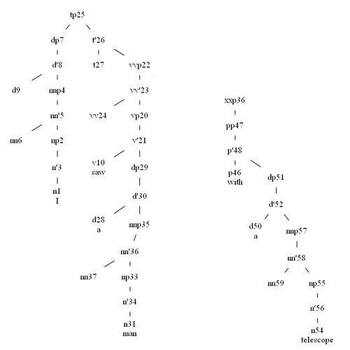
?

Slide 12
Participle/gerund ambiguity
My favorite cousin was singing. (participle)
My favorite activity was singing. (gerund)
His business is advertising. (both possible)
Exemplars mined from Penn treebank
SMem helps, need more semantics

Slide 13
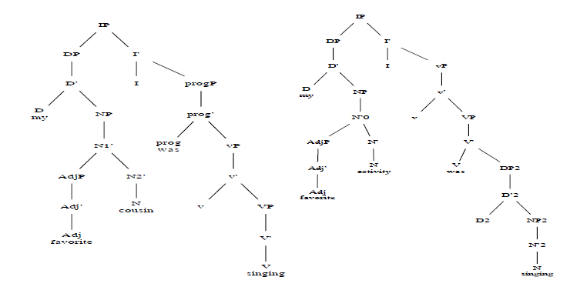

Slide 14
Underway
Snips: undo erroneous hypotheses
Semantics
Semsnips: semantic snips
Finish semantic graphing
French
Japanese

Slide 15
Why sandbox?
No learning/chunking
Walled off from other tasks
Learning how to code Soar
Getting used to Soar 9

Slide 16
To do
Translation
Discourse
Generation
Chunking?

Slide 17
Conclusions
Coal
Nuggets
Still not public-ready
Some more linguistics to implement
No chunking yet
No activation, decay
Up-to-date after years
More easily deployable
SMem and EpMem
More streamlined tools
Evaluation with real-language use cases
Hundreds of sentences parsed

