Slide 1
Learning To Use Memory
Nick Gorski & John Laird
Soar Workshop 2011

Slide 2
Memory & Learning
Agent
Environment
action
Memory
observations
reward

Slide 3
Actions, Internal & External
Agent
Environment
action
{go left, go right, eat food, bid 5 5s, pick a flower}
Memory
observations
action
reward
{store, retrieve, maintain}

Slide 4
Internal Actions Over Memory
Internal actions are deliberate or automatic
Automatic actions are in the background
Architectural and always happen
Ex: storage to episodic memory
Deliberate actions are in the foreground
Procedural knowledge and cognitive
Ex: storage to working memory
Notes:
Don’t need to decide to store knowledge of an experience
Also can’t prevent memories from forming, even if they’re unpleasant

Slide 5
Internal Reinforcement Learning
Agent
Environment
Memory
Action Selection
action
observations
Reinforcement
Learning
reward

Slide 6
Assumptions
Custom framework, not using Soar
Simple memory models
Simple tasks

Slide 7
Learning to Use Memory
Research Question:
When can agents learn to use memory?
Idea:
Investigate dynamics of memory and environment independently
Need:
Simple, parameterized task

Slide 8
An Interactive TMaze
LEFT
(observation)
{forward}
(avail. actions)

Slide 9
An Interactive TMaze
DECIDE
(observation)
{left, right}
(avail. actions)

Slide 10
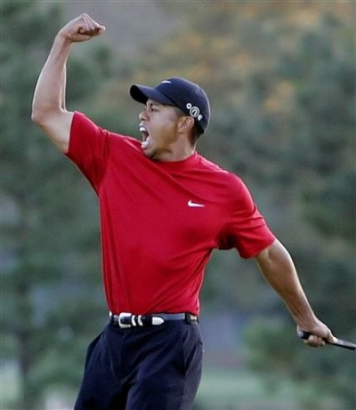
An Interactive TMaze
+1
(reward)
Notes:
Add a smiley face

Slide 11
TMaze
Base TMaze
C
A/B
Question: how much knowledge is needed to perform this task?

Slide 12
Parameterized TMazes
Base TMaze
Temporal Delay
# Dependent Actions
C
C
C
D
D
A/B
A/B
Concurrent Knowledge
Amt. of Knowledge
2nd Order Knowledge
C
C
C
A/B X/Y
A B W X Y Z
A/B

Slide 13
Two Working Memory Models
Bit memory
Gated WM
1
0
A/B
toggle
gate
Internal action toggles between memory states
Less expressive
Ungrounded knowledge
Internal action stores current observation
More expressive
Grounded knowledge

Slide 14
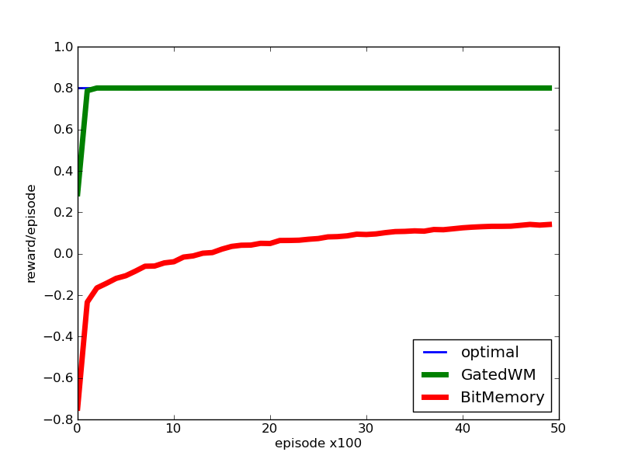
TMaze
Base TMaze
C
A/B

Slide 15
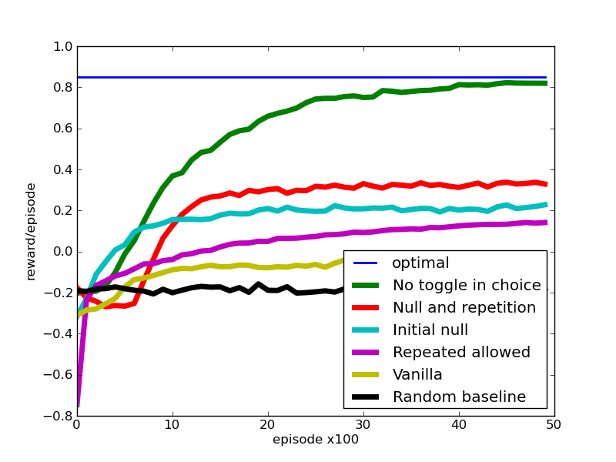
Bit Memory & TMaze
Methodology:
Modify memory to attribute blame
Interfering behavior in choice location
Doesn’t manifest with GWM

Slide 16


State Diagram: Bit Memory TMaze
STARTING STATES
true
percept
mem
toggle
true
percept
mem
true
percept
mem
toggle
true
percept
mem
L
L
1
L
L
0
R
R
1
R
R
0
up
up
up
up
true
percept
mem
true
percept
mem
L
C
1
R
C
1
left
right
toggle
left
right
toggle
true
percept
mem
true
percept
mem
L
C
0
R
C
0
left
right
left
right

Slide 17
State Diagram: GWM TMaze
STARTING STATES
true
percept
mem
gate
true
percept
mem
true
percept
mem
gate
true
percept
mem
L
L
L
L
L
R
R
R
R
R
up
up
up
up
true
percept
mem
true
percept
mem
true
percept
mem
true
percept
mem
L
C
L
L
C
R
C
R
C
R
left
right
gate
gate
gate
gate
left
right
true
percept
mem
true
percept
mem
L
C
C
R
C
C
left
right
left
right

Slide 18
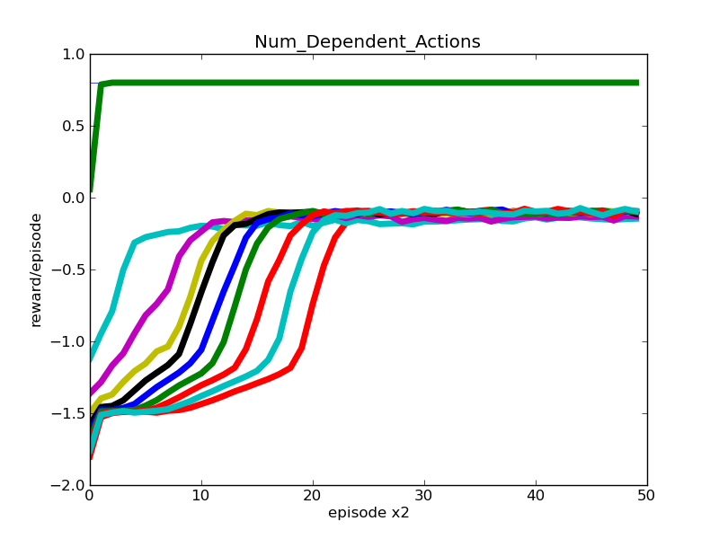
Number of Dependent Actions
# Dependent Actions
C
D
D

Slide 19
What We’ve Learned
Our machine learning intuition is often wrong (and yours probably is, too!)
Chicken & Egg Problem
State ambiguity is very problematic to learning
Notes:
One worry early on is that all of these things would be really easy to learn and there wouldn’t be any interesting results

Slide 20
Chicken & Egg Problem
Prospective uses of memory are hard
Case study: bit memory & TMazes
Bit memory
Base TMaze
Chicken & Egg Problem:
Must learn an association between 1 & 0 and A & B
Must learn an association between 1 & 0 and left & right
To be effective, can’t self- interfere with memory in C!
1/0
C
A/B
Endemic across memory models

Slide 21
Implications for Soar
Soar natively supports learning internal acts.
Next step: learning to use Soar’s memories
Learning alongside hand-coded procedural knowledge is potentially strong approach
Soar got the WM model right
RL will never be a magic bullet

Slide 22
Nuggets & Coal
Nearly finished!
Better understanding of RL + memory, and thus Soar 9
Parameterized, empirical evaluations of RL gaining traction
Optimality not only metric of performance
Not quite finished!
Qualitative results, but no closed form results yet
No recent results for long term memories
Not immediately applicable to Soar

