Slide 1
Language and Soar
Peter Lindes
Soar Workshop
29 May 2024

Slide 2
What is Language?
Give a simple definition

Slide 3
What is Language?
Whatever GPT-4 says it is ?
A set of formal rules for syntax and semantics ?
A means to convey meaning ?
A system for encoding and decoding meaning ?
None of the above ? Then what ?

Slide 4
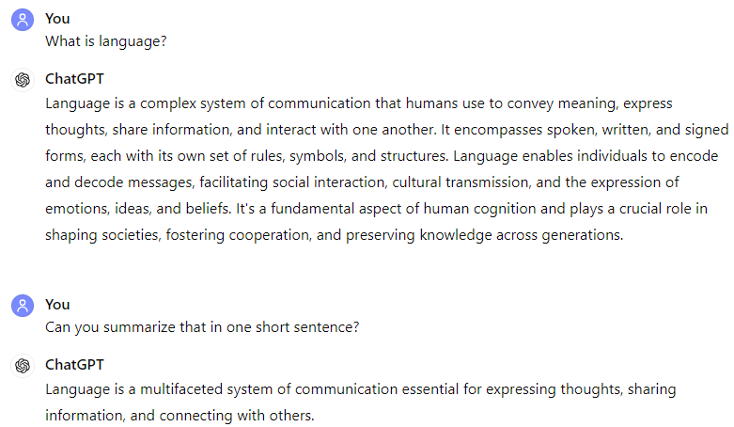
Whatever GPT says it is ?

Slide 5
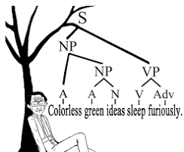
Formal rules for syntax and semantics ?
LLMs show this is not true.

Slide 6
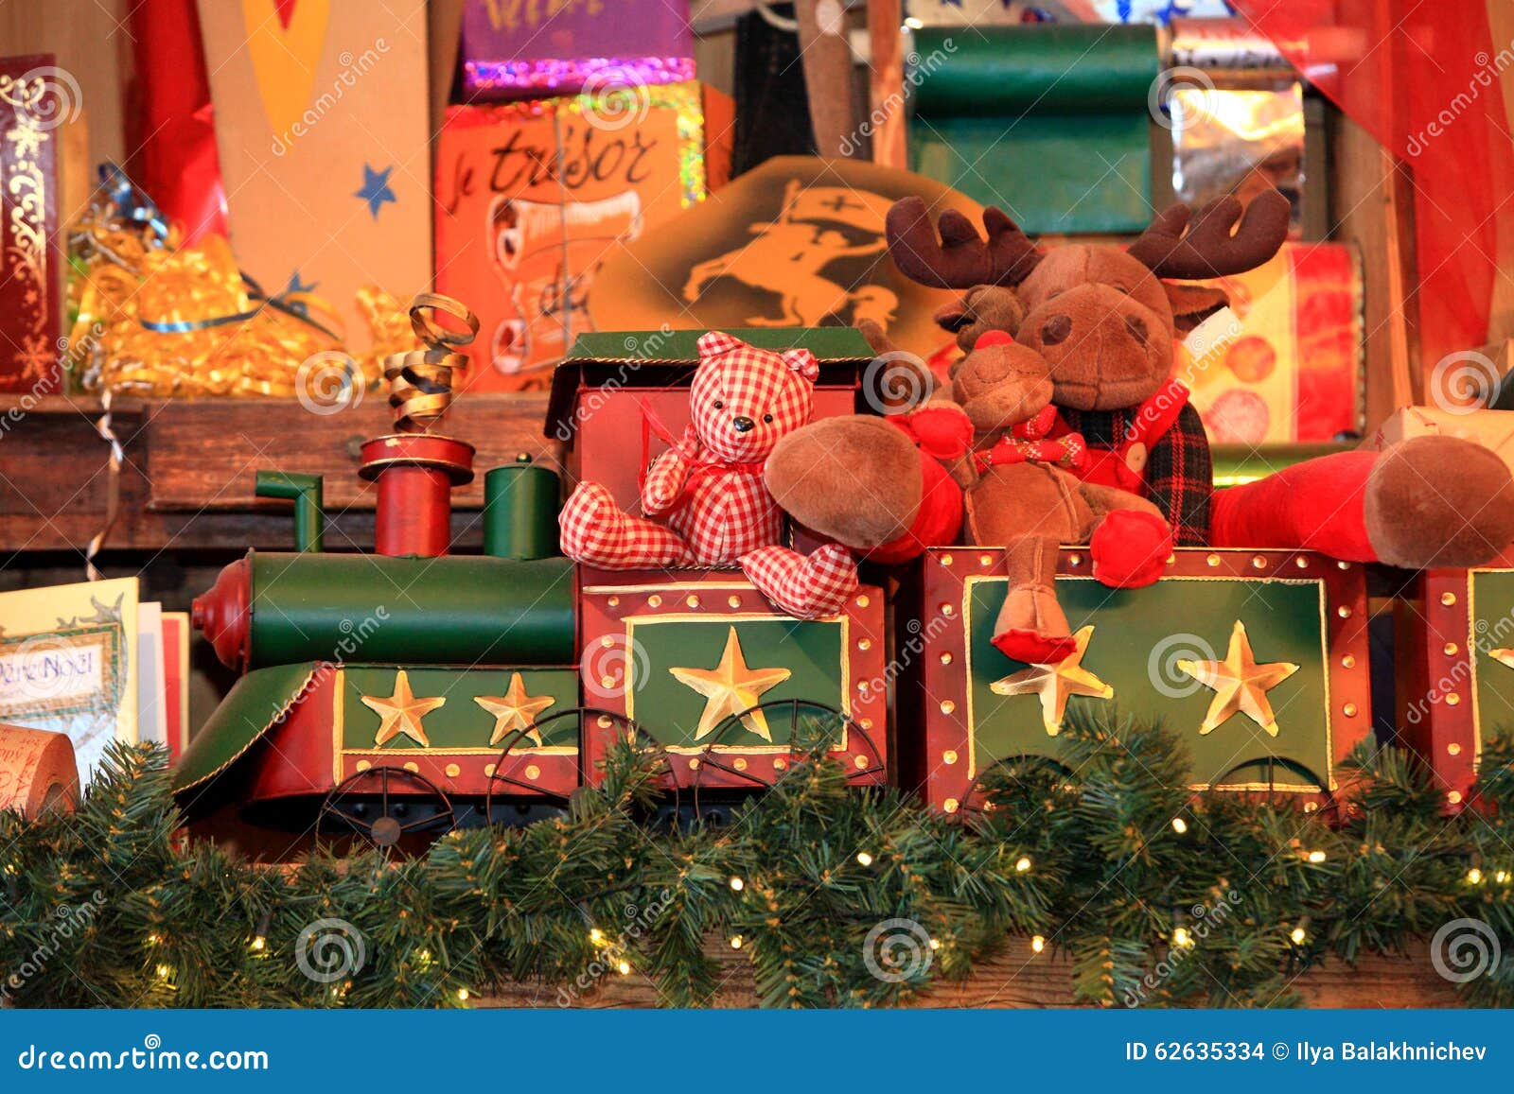
A means to convey meaning ?

Slide 7

Encoding and decoding meaning ?
He’s going to drown!
He needs help!
I’m going to drown!
Help!
construct meaning
symbolize meaning
SOS
SOS
encoding
decoding
● ● ● ꟷ ꟷ ꟷ ● ● ●

Slide 8
Language evokes meaning !
Meaning includes images, concepts, experiences, etc.
A speaker generates symbols intended to evoke meaning
Those symbols are represented by a spoken or written code
The code is decoded into internal symbols by the hearer
The hearer constructs a meaning based on those symbols
The result is approximate
The result is in the hearer’s terms

Slide 9
The Problem
Autonomous agents that can learn through collaboration with humans

Slide 10
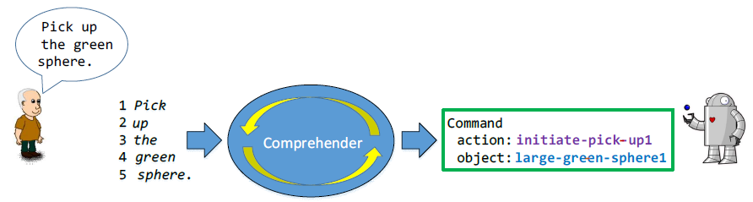
How to make a robot use language?
The robot needs a means to construct internal messages that it can act on from each input sentence.
How can it grow its knowledge of language from experience?

Slide 11
Computational Models of Language
Winograd 1972 – SHRDLU
Anderson 1974, 1978 – LAS
Langley 1981 – AMBER
Lewis 1993 – NL-Soar
Chang, Mok 2008 – ECG
Steels and Hild 2012 – FCG
Ball 2011 – Double R
Jones 2020 – Sentence processing in ACT-R
Lindes 2022 – Lucia
Human-like?
Acquiring language?

Slide 12
Desiderata
An autonomous agent whose knowledge grows from experience
Learn from experience based on how humans do it

Slide 13
Human Acquisition of Language and Concepts

Slide 14
Human Acquisition
Input hypothesis – Krashen 1985, 2003
Aggregation, clustering, characterization, storage – Langley 1986
Stages of development – Tomasello 2003
Key experiences – Chang 2008
Propose but verify – Trueswell et al. 2013
Statistical entrenchment – Goldberg 2019
Integrated with real-time automatic comprehension – Lindes 2022
Time scales: 100s of msecs, seconds, years

Slide 15
Modeling Acquisition
Developmental stages:
Pre-verbal
Immediate
Abstract
Integration with modeling comprehension
Overlapping phases of acquisition events:
Understanding an input episode
Generalizing to semantic memory
Converting to automatic skill

Slide 16
A Computational Model of Human Acquisition

Slide 17
Human-like Language Acquisition
Integrated with comprehension using modular structures of composable elements
Piecemeal: acquire one new composable element at a time
Incremental: learns from one experience at a time
Guided by previously learned knowledge
Rapid acquisition from few experiences
Langley, Pat (2022). The Computational Gauntlet of Human-Like Learning. Proceedings of the AAAI Conference on Artificial Intelligence, 36(11), 12268-12273.

Slide 18
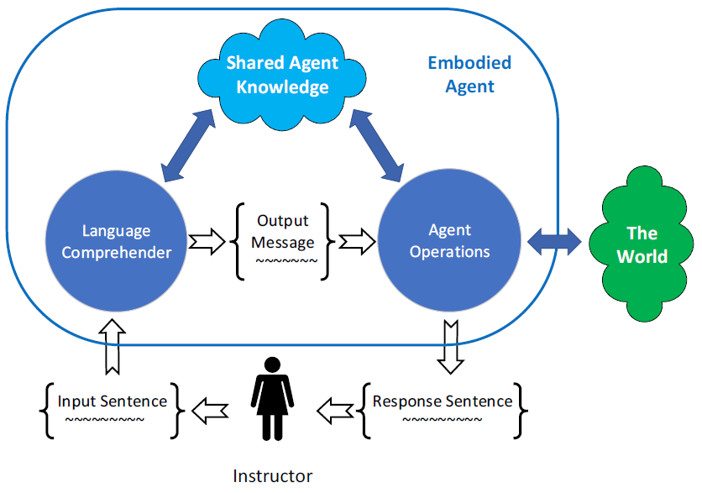
Strategy: Use a Cognitive Model

Slide 19
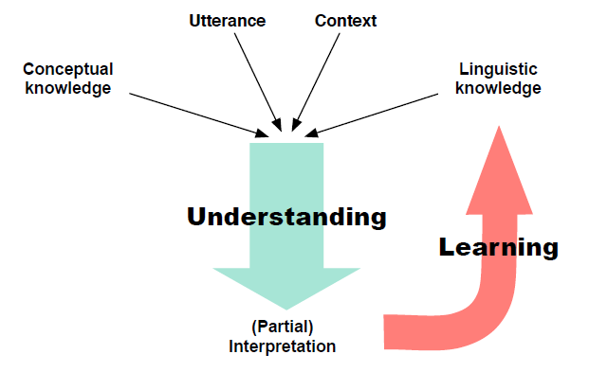
An Acquisition Event
Chang, Nancy (2008). A computational model of the emergence of early constructions. PhD dissertation, UC Berkeley.

Slide 20
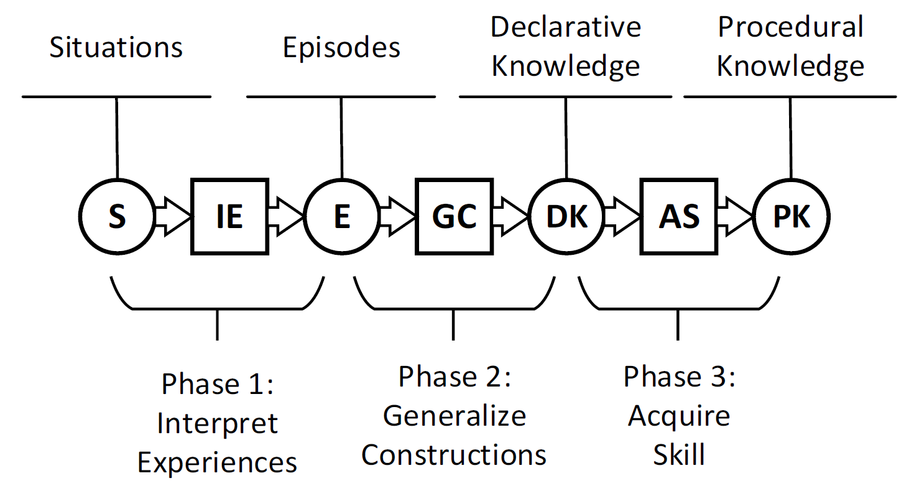
Overlapping Phases of Acquisition
How can we do that?
Lindes, Peter (2022). Constructing Meaning, Piece by Piece: A Computational Cognitive Model of the Human Sentence Comprehension. PhD dissertation, University of Michigan.

Slide 21
Prior Research
Things we have already done that we can build on

Slide 22
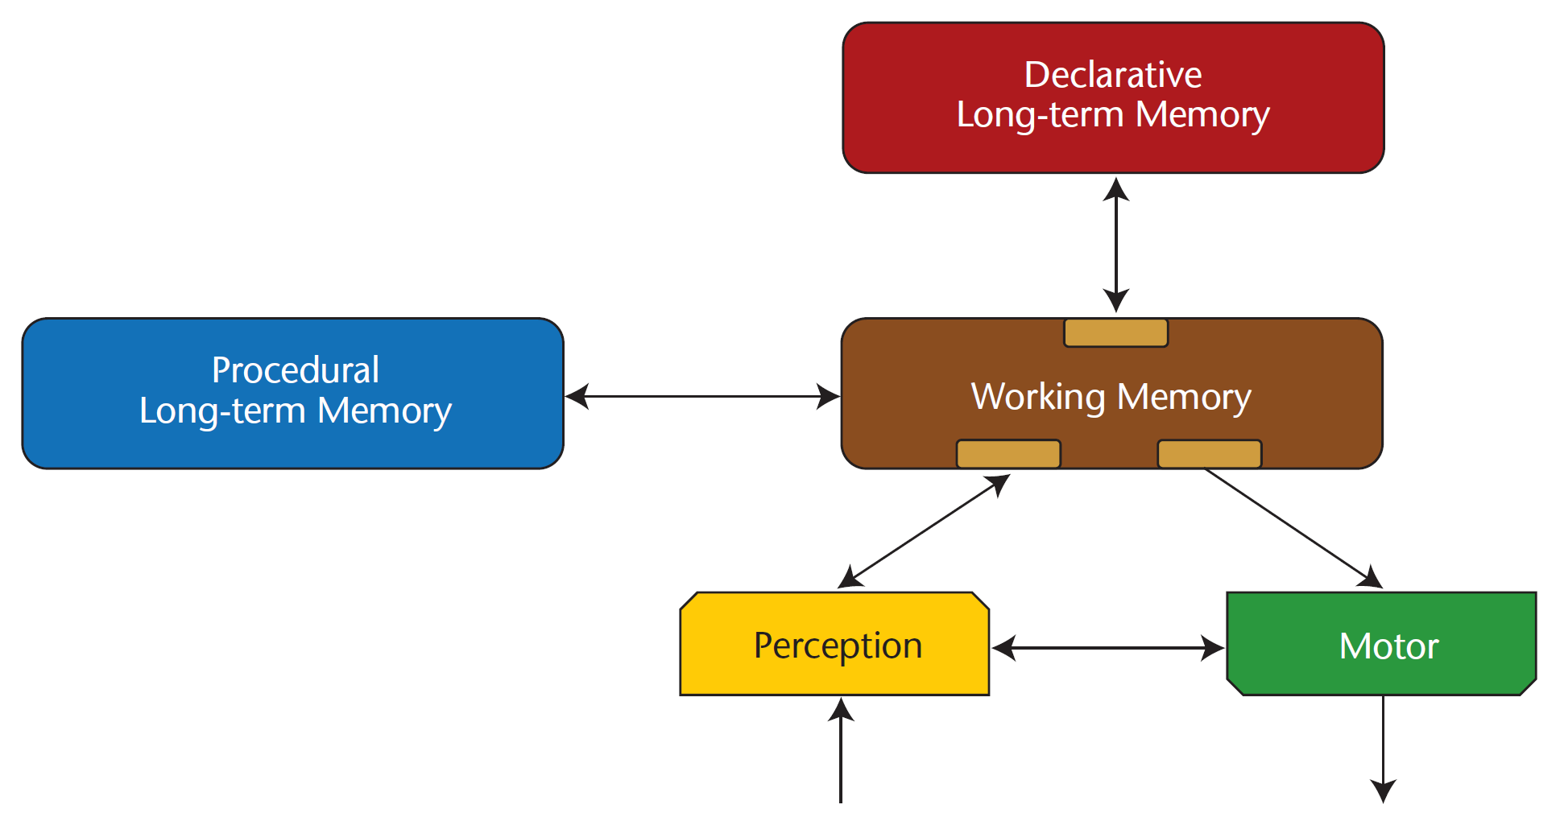
Common Model of Cognition
Laird, J. E.; Lebiere, C.; and Rosenbloom, (2017). A standard model of the mind: Toward a common computational framework across artificial intelligence, cognitive science, neuroscience, and robotics. AI Magazine, 38(4): 13–26.

Slide 23
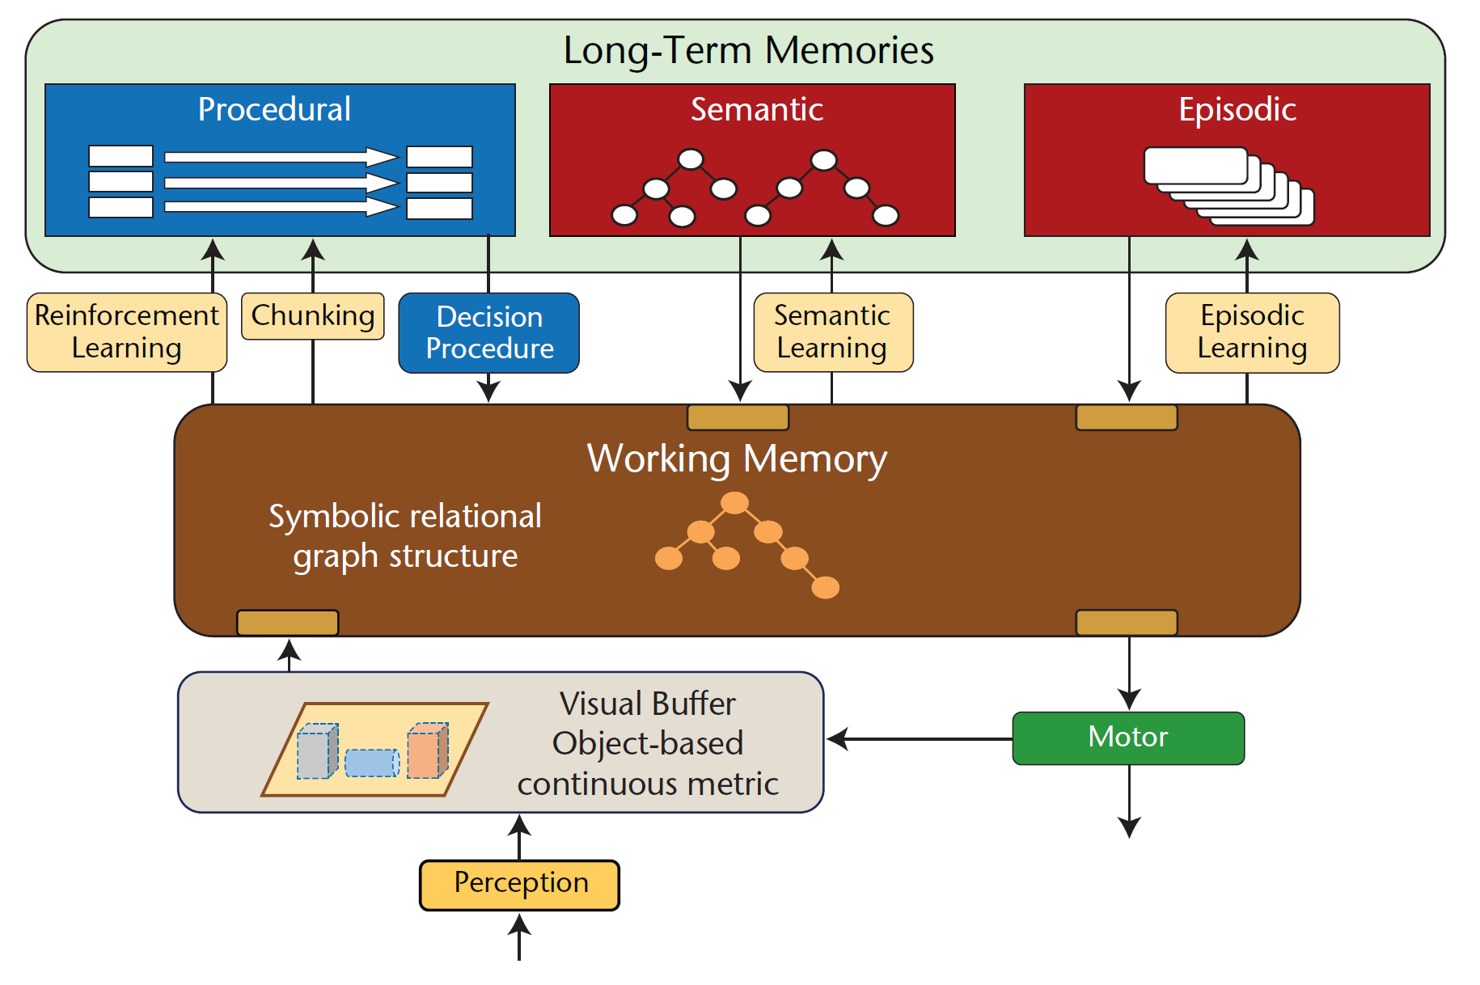
The Soar Cognitive Architecture
Laird, J. E (2012). The Soar Cognitive Architecture. MIT Press.

Slide 24
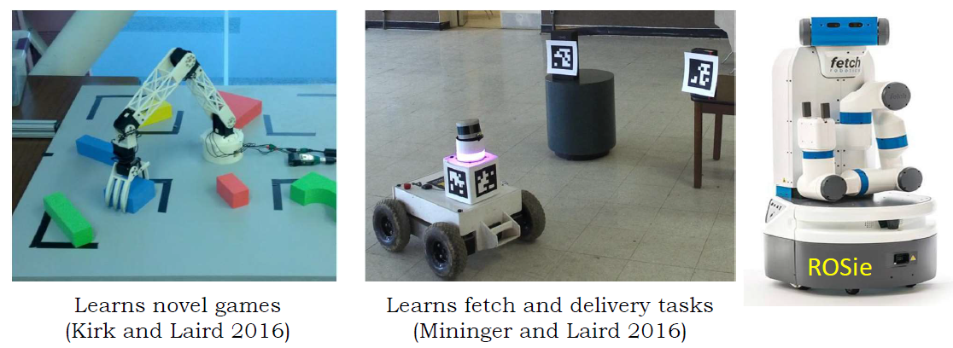
Interactive Task Learning - Rosie

Slide 25
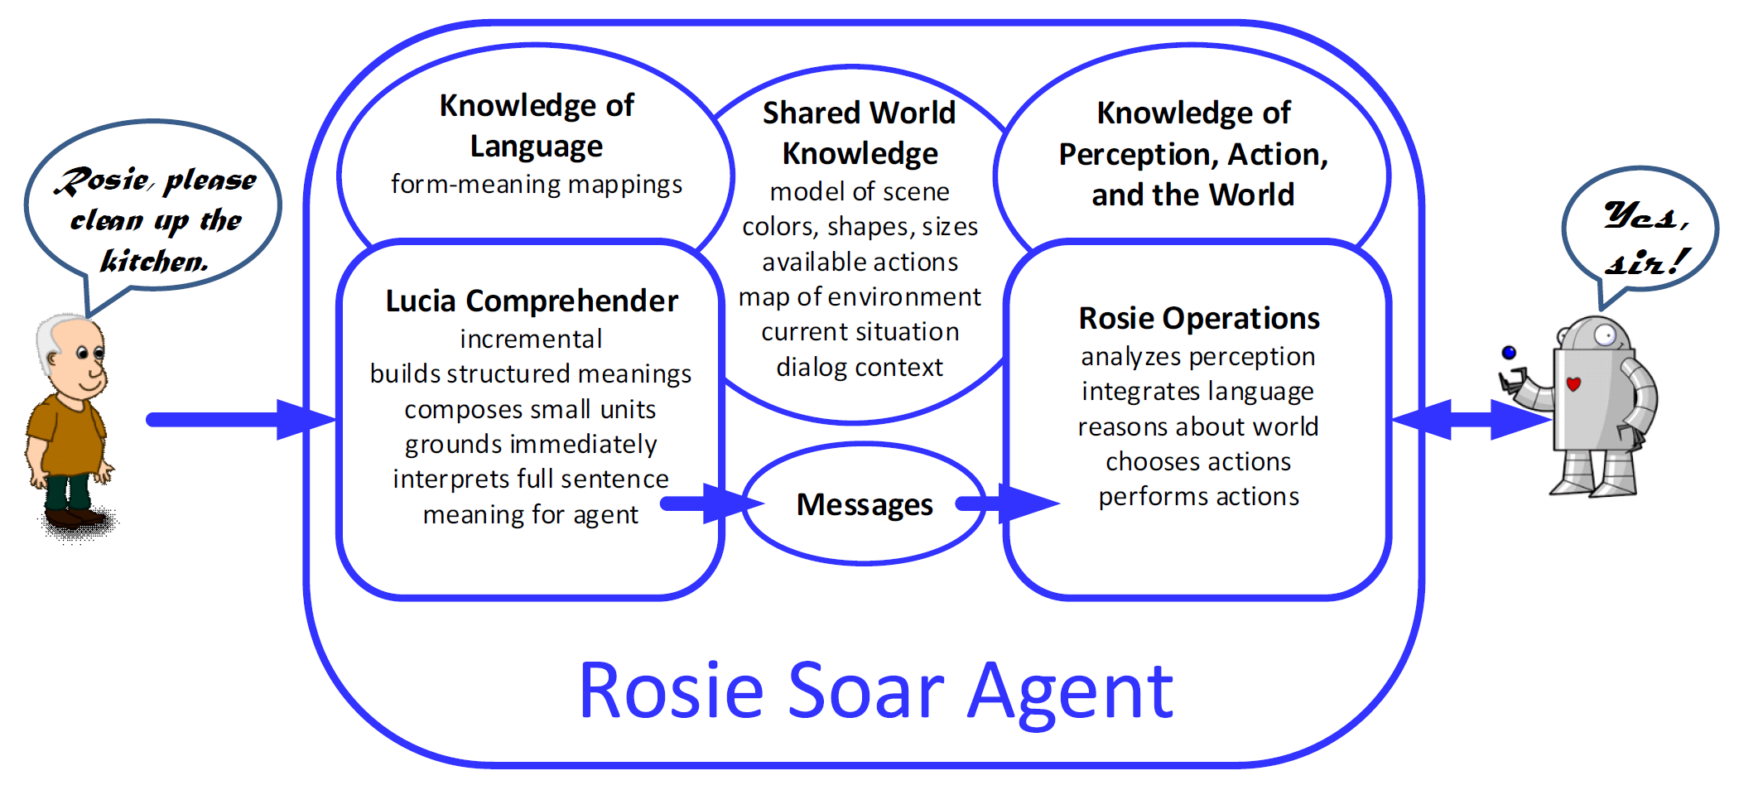
Integrated Language Comprehension
Knowledge that must grow

Slide 26
Evaluating the Model: An AI Benchmark

Slide 27
Evaluation with a Benchmark
ALFRED:
8,055 expert demonstrations
Goals and plans
Human language
Stages:
Learn concepts from demonstrations, no language
Learn simple language derived from goals and plans
Expand to the human language
Expectation:
Mastery from a small subset
High task performance

Slide 28
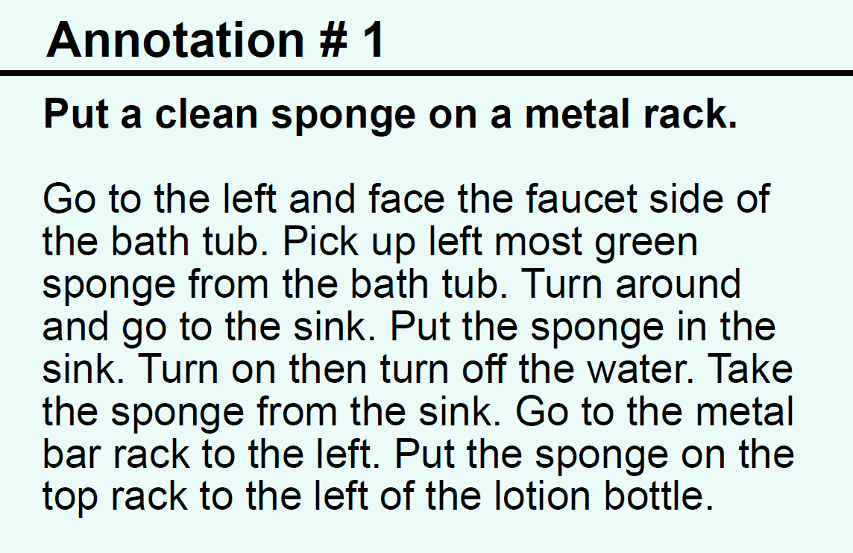
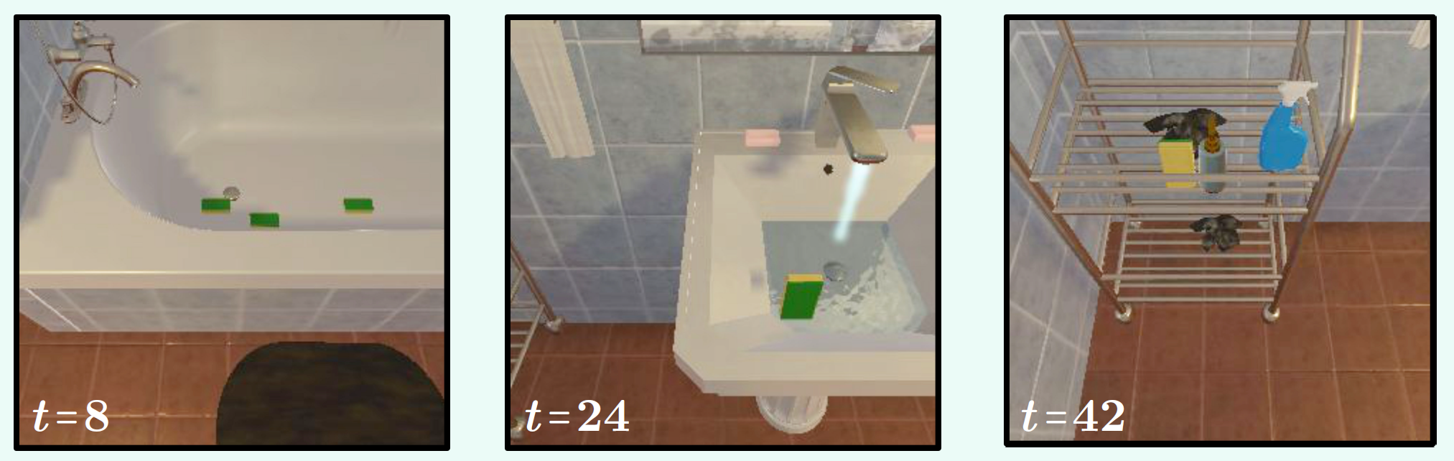
An ALFRED Task in AI2-THOR
Task Description
Clean a dish sponge and put it in the drying rack.
Goal Description
The goal is that a dish sponge is clean and it is in the drying rack.
Steps as Action Descriptions
Steps as Sentences
GotoLocation(bathtubbasin)
PickupObject(dishsponge)
GotoLocation(sinkbasin)
CleanObject(dishsponge)
GotoLocation(dryingrack)
PutObject(dishsponge,
dryingrack)
Go to the bathtub basin.
Pick up the dish sponge.
Go to the sink basin.
Clean the dish sponge.
Go to the countertop.
Put the dish sponge
in the drying rack.

Slide 29
Pre-verbal Learning
Action Models
Object Categories
ALFRED Demos
THOR-Soar++
AI2-Thor

Slide 30
Learning Immediate Language
ECG-like Grammar
Action Models
Object Categories
ALFRED Demos
Language
Scripts
Lucia++
THOR-Soar++
AI2-Thor
Tasks

Slide 31

Learning Complex Language
Acquisition
Algorithm
ECG-like Grammar
Action Models
Object Categories
ALFRED Demos
LLM
ALFRED AMT Scripts
Lucia++
THOR-Soar++
AI2-Thor
Language
Scripts
Tasks

Slide 32


Nuggets
Coal
A roadmap to growing language
Based on human-like learning
Built on existing research
Potential for high performance on an AI benchmark
Many details to work out
Limited manpower
No funding

