Slide 1
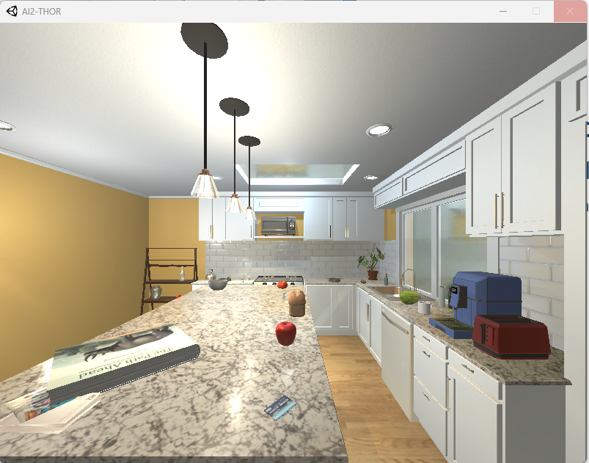
Thor-Soar Project
John Laird and CIC Center for Integrated Cognition
https://integratedcognition.ai May 2024
For everything, list meta-issues, evaluation for design decisions, etc.

Slide 2
AI2-Thor
https://ai2thor.allenai.org/ithor
Allen Institute for Artificial Intelligence (2017: still supporting)
Implemented on top of the Unity graphics and physics engine
Interactive object manipulation: pick up, move, pour, clean, cook,, …
Lots of objects
Some dynamic physics: mass, friction, bouncing, …
State changes: clean/dirty, uncooked/cooked, …
Multi-agent
Lots of rooms/scenarios
Photo-realistic scenes (eye-candy); extensions:
ProcThor that generates environments automatically for testing.
Actively used in agent community: 180 Publications, Alfred dataset

Slide 3
Thor-Soar Goals
Reference Embodied Soar Agent in Dynamic Environments
Standardize agent development
Core agent: instantiate with state rep. and declarative operator rep.
Platform for Future Soar Agent Research
Support Multiple Approaches for Integrating Language Processing
Native Soar (Lucia: P. Lindes); LLM; Lucia + learning(LLM + ITL)
Next Iteration of Interactive Task Learning (ITL) Agent for Soar
Unify ITL and non-ITL agent designs
Exploit lessons learned from Rosie and expand capabilities
Support Broader Integration of Generative Models (LLMs)
Beyond ITL agent-LLM integration
Beyond language processing

Slide 4
Rules, Knowledge Bases, Tools, and Evaluation
Generic reasoning modules
Standardized Smem and Epmem access
Standardize SVS access, …
Word / Knowledge bases
Google Books (1.6M), Human Brain Cloud (231K), SWOWEN (38K)
WordNet…
Development tools
Convert from PDDL+ and HTN languages into Soar
???
Evaluation of minimal viable agent using existing benchmarks
Alfred?
Volunteers Welcome!

Slide 5
Phased Development
Integrate of Soar and AI2-Thor:
Nathan Glenn, Jim Beyer, James Kirk
Thor-Soar agent initial development
John Laird
Integrate with Lucia for command execution (not ITL)
Peter Lindes
Redesign agent – iterate on conventions and support of ITL
John Laird, James Kirk, Peter Lindes, Steven Jones, Bob Wray
Integrate with existing ITL infrastructure (maybe)
James Kirk, John Laird
Rewrite ITL infrastructure to integrate with the agent
James Kirk, John Laird, Peter Lindes
Research on incorporating other cognitive capabilities
Behavioral Constraints, Metacognition, …
Explore a range of generative model integrations
Notes:
Line of minimal viable agent.
Design tools
Evaluation of minimal viable agent. Possibly with Alfred.

Slide 6
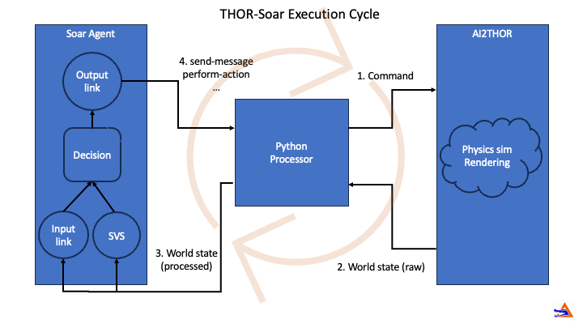
Thor-Soar Execution Cycle

Slide 7
Current Agent Progress
Agent that supports different reasoning in combination
Direct execution (with preferences)
Iterative deepening look-ahead search (finds shortest path of operators)
Means-ends analysis
Hierarchical operators
Chunking
Subgoals as unordered set or linked list
No reinforcement learning (no use cases yet)
No exploitation of semantic or episodic memory (no use cases yet)
Next step – full code review and more conventions
Demo: Cook Potato, Close Microwave Door, Put Potato on Counter
With Chunking

Slide 8
Reference Embodied Soar Agent: Conventions
Visual Soar agent organization
File organization; upgrades to Visual Soar
State representations
Conventions for flags, constants, …
Conventions for representing properties, relations, …
Operator representations that support combinations of reasoning
Message interface between natural language to agent internal representation
Extending Abstract Meaning Representation (AMR)

Slide 9
State Representation Design
Exploring, Analyzing, and Evaluating Alternative Designs
Dimensions of Analysis
Efficiency for execution and encoding
Correctness and generality with chunking
Ease of human comprehension – locality of object data
Ease of extension with new state features and new operator
Accessibility/translation with language processing
Example Convention: State object representation alternatives
Object centered: all features and relations are off an object structure
Issues with copying and chunking
Separate mutable features/relations from immutable features/relations
Shallow copy and good chunking, but no locality of object data
Rosie: separate representations for multi-object relations and uni-object features
Fixed-depth copy (2-3) and should be ok with chunking

Slide 10
Operator Representations
Support many types of reasoning
Direct execution (implemented in proposal, preference, and application rules)
Planning/Look-ahead search (substates using internal models of operators)
Means-ends analysis (substates to achieve preconditions)
Operator implementation (substates to apply operator actions)
Chunking without tears (should work out of the box)
Reinforcement learning (less important)
Combinations:
Look-ahead over operator implementation
Means-ends that switches to operator implementation when preconditions are met
Potentially off-line compilation of declarative representations of an operator (PDDLish) into multiple rules (and Visual Soar file/directory?)

Slide 11
Means-Ends Analysis: General Problem Solver (GPS) The Ends do Justify the Means
Operator are proposed only when their actions will achieve part of the goal
If an operator is selected and preconditions aren’t met,
then, there is an operator no-change substate
In substate, use the same problem space
Same state and same set of operators
In substate, preconditions become subgoals to be achieved
When preconditions are achieved, operator implementation rules fire
Can have a huge impact on the search branching factor
Key idea for Soar: make pre-condition satisfaction explicit
Critical for knowing when MEA is done, and operator implementation takes over

Slide 12
Operator Proposals Rules: Open-Container Example
Standard Operator Proposal: all preconditions achieved in current state
If thor-world problem-space and
next to a closed container that can be turned on and it is turned off
then
propose operator to open that container and mark pre-conditions satisfied
If thor-world problem-space and
next to a closed container that cannot be turned on
then
propose operator to open that container and mark pre-conditions satisfied

Slide 13
Operator MEA Proposal Rules: Open-Container
MEA Operator Proposal – only when there is a relevant desired (goal):
If thor-world problem-space and
there is a closed container that can be turned on and
there is a desired to have it open
then
propose operator open container and
create desireds to be next-to container and it turned off ← preconditions
If thor-world problem-space and
there is a closed container that cannot be turned on and
there is a desired to have it open
then
propose operator open container and
create desired to be next-to container ← precondition

Slide 14
Operator Application Rules
Internal Application – used for look-ahead and pure internal testing
If executing internal action and
operator open container for an object is selected and
next to that object and preconditions are satisfied
then
change state of container from closed to open.
External Application – used for acting in the world
If executing external action and
operator open container for an object is selected and
next to that object and preconditions are satisfied
then
perform-action open on container

Slide 15
Operator Proposals Rules: Close-Container Example
Standard Operator Proposal: all preconditions achieved in current state
If problem-space is thor-world and
next to an opened container
then
propose operator to close that container and mark pre-conditions satisfied
sp {thor-soar*propose*close-container
(state <s> ^problem-space.name thor-world
^flags.mea-operator-selection false
^world <world>)
(<world> ^open-container <open-container-object>
^next-to-object <open-container-object>)
-->
(<s> ^operator <operator> +)
(<operator> ^name close-container
^transformative false
^close-container <open-container-object>
^pre-conditions-satisfied true)}

Slide 16
Operator MEA Proposal Rules: Close-Container
MEA Operator Proposal: only when there is a relevant desired (goal):
If problem-space is thor-world and
there is an open container and
there is a desired to have it closed ← goal
then
propose operator close container for that container and
create desireds to be next-to container ← precondition
sp {thor-soar*propose*close-container*mea
(state <s> ^problem-space.name thor-world
^flags.mea-operator-selection true
^world.open-container <open-container-object>
^desireds.desired.closed-container.handle <open-container-handle>)
(<open-container-object> ^handle <open-container-handle>)
-->
(<s> ^operator <operator> +)
(<operator> ^name close-container
^transformative false
^close-container <open-container-object>
^desireds <desireds>)
(<desireds> ^count 1
^desired.next-to-object.handle <open-container-handle>)}
← goal
← precondition

Slide 17
Operator Application Rules
Internal Application: used for look-ahead and pure internal testing
If executing internal action and
operator closed container for a container is selected and
preconditions are satisfied
then
change state of container from open to closed.
External Application – used for acting in the world
If executing external action and
operator close container for a container is selected and
preconditions are satisfied
then
perform-action close on container

Slide 18
Supporting Rules and Conventions
If a desired predicate matches a state predicate, then mark the desired achieved.
Multiple rules. Need different ones for properties and relations. Worrisome.
If a desired predicate no longer matches a state predicate, then mark the desired achieved.
Multiple rules: Cannot depend on elaborations across substates (?). Worrisome
If all of an operator’s desireds are achieved and mark operator pre-conditions achieved.
If all pre-conditions of a superoperator where are achieved, make problem space be superoperator implementation.
If there is a superoperator where not all pre-conditions are achieved, make the problem space the same as above. [operator subgoal]
Copy unachieved desired from superoperator to substate.

Slide 19
Supporting Rules and Conventions
If a desired predicate matches a state predicate,
then mark the desired achieved.
If an operator’s desireds are all achieved,
then mark operator pre-conditions achieved.
If the superoperator’s pre-conditions are all achieved,
then problem space is superoperator implementation.
If the superoperator’s pre-conditions are not all achieved,
then the problem space is the same as above. [operator subgoal]
Copy all unachieved superoperator desireds to substate.

Slide 20
Kitchen Environment for Thor-Soar
Demo Task [Unordered]
Cook a Potato, Put Potato on the Counter, Close Microwave Door
Physical Actions (13)
Break-object, close-container, empty-object, fill-object, get-object, go-to, open-container, put-in, put-on, slice-object, toggle-object, turn-off, turn-on
Objects (77)
Counter tops, cabinets (6), microwave, tomato, toaster, stoveburner(8), stool(2), statue(2), spoon, spatula, soap bottle, sink(2), shelving unit, bottle, vase (3), potato, pot, plate, peppershaker, paper towel roll, pan mug, lightswitch, lettuce, knife, kettle, houseplant, floor, faucet, egg, drawer (6), wine bottle, window,

Slide 21
Some Experiments…
Cook a Potato, Put Potato on the Counter, Close Microwave Door
13 actions required in sequence
With no attention/search control: Branching factor at least 77
~77¹³ = 3.34 *10²⁴
Attention-filtered objects: in goal or have a relation with an object in goal:
Countertp19; Microwave43; Potato50; CounterTop1
~4¹³ = ~67M
Problem-solving approaches
Iterative deepening: assures minimal # of operators
No Means-ends Analysis: propose all operators that have satisfied preconditions
Means-ends Analysis: only propose operators that help achieve a desired
Search control: prefer transformative actions (cooking) to non-transformative (go)
Sequenced desireds: Cook Potato, then Put Potato on Counter, then Close Micro

Slide 22
Post-Chunking, No MEA, No Order Cook a Potato, Put Potato on the Counter, Close Door
14: O: O91 (go-to) CounterTop17
15: O: O95 (get-object) Potato
16: O: O92 (go-to) Microwave
17: O: O97 (open-container)
18: O: O100 (put-in) Potato
19: O: O99 (close-container) Microwave
20: O: O103 (cook)
21: ==>S: S6 (operator no-change)
22: O: O105 (turn-on-microwave)
23: O: O106 (turn-off-microwave)
24: O: O107 (open-container) Microwave
25: O: O108 (get-object) Potato
26: O: O109 (close-container) Microwave
27: O: O112 (put-on) Potato CounterTop19

Slide 23
Post-Chunking Trace of Ordered Desireds: Cook Potato
11: O: 89 (cook) #Potato [Desireds: achieved; unachieved]
12: ==>S: S5 (operator no-change) [next-to micro; potato->micro; door closed]
13: O: O90 (put-in) #Microwave
14: ==>S: S6 (operator no-change) [next-to micro; holding potato; micro open]
15: O: O94 (get-object) #Potato
16: ==>S: S7 (operator no-change) [desired: next-to potato]
17: O: O96 (go-to) #Potato Moves to Potato
18: ==>S: S8 (state no-change) Gets Potato
19: O: O92 (go-to) #Microwave Moves to Microwave
20: O: O90 (put-in) #Potato in Micro
21: ==>S: S9 (operator no-change) [next-to micro; holding potato; micro open]
22: O: O98 (open-container) Opens Microwave
23: ==>S: S10 (operator no-change) Puts potato in Micro
24: ==>S: S11 (operator no-change) [next-to micro; potato->micro; door closed]
25: O: O101 (close-container) Closes Microwave
26: ==>S: S12 (operator no-change) Switches to operator implementation
27: O: O106 (turn-on-microwave) Turns on Microwave
28: O: O107 (turn-off-microwave) Turns off Microwave
29: O: 0108 (next-desireds) New desireds: Put Potato on Counter
Red(3): learns a chunk to select. Black(5): the only choice with MEA
Notes:
Some odd aspects because of order it found a solution

Slide 24
Post-Chunking MEA Trace of Cook Potato in Microwave
[Desireds: unachieved; achieved]
11: O: 89 (cook) Potato [next-to micro; potato - micro; door closed]
12: ==>S: S5 (operator no-change)
13: O: O90 (put-in) Microwave [next-to micro; holding potato; micro open]
14: ==>S: S6 (operator no-change)
15: O: O94 (get-object) Potato [next-to potato]
16: ==>S: S7 (operator no-change)
17: O: O96 (go-to) Potato Moves to Potato
18: ==>S: S8 (state no-change) Gets Potato
19: O: O92 (go-to) Microwave Moves to Microwave
20: O: O90 (put-in) Microwave [next-to micro; holding potato; micro open]
21: ==>S: S9 (operator no-change)
22: O: O98 (open-container) Opens Microwave
23: ==>S: S10 (operator no-change) Puts potato in Microwave
24: ==>S: S11 (operator no-change) [next-to micro; potato - micro; door closed]
25: O: O101 (close-container) Closes Microwave
26: ==>S: S12 (operator no-change) Switches to operator implementation
27: O: O106 (turn-on-microwave) Turns on Microwave
28: O: O107 (turn-off-microwave) Turns off Microwave
Notes:
Some odd aspects because of order it found a solution

Slide 25
Decision Data for Iterative Deepening Look-ahead Cook Potato, Close Microwave Door, Put Potato on Counter
No MEA: Unordered subgoals and no search control
MEA: Unordered subgoals and no search control
Graph-search size; ~4¹³ = ~67M, ~3¹³ = ~1.6M
12.2M
7.16M
117K
4.3K
27
40
~50x slower with debugger
~1 hour
~1 hour
~2 sec
~40 sec
~4 sec
~2 sec

Slide 26
Decision Data for Iterative Deepening Look-ahead Cook Potato, Close Microwave Door, Put Potato on Counter
Basic MEA: Unordered subgoals and no search control
Minimal search control (smaller branching factor: prefer transformative ops.)
Ordered subgoals (no search required for subgoal ordering)
33-2 seconds real-time (robot movement included but no debugger)
117K
4.3K
2.8K
2.8K
649
545
40
42
41

Slide 27
English to Message Processing Pipeline
Extend Abstract Meaning Representation (AMR) as the message format interface between language processing and agent interpretation
Existing English to AMR tools (LLMs) are incomplete
Throws away critical information (tense, plurals) and doesn’t ground.
Current plan
Use Lucia (Lindes Thesis - ECG inspired) in short term
Lucia + LLM; Fine-tune LLM for AMR (trained from Lucia data?)
Open issue where grounding occurs – matching language to context
During language processing (Lucia)
During message interpretation
English Sentences
AMR-style
Thor-Soar Messages
Agent
knowledge, intent, …
Lucia + LLM?
Agent Interpretation
LLM?
Grounding?
Grounding?

Slide 28
Example Message Format
The goal is that a dish sponge is clean and it is on the countertop.
(<g> ^instance-of goal-description
^ARG1 <a>)
(<a> ^instance-of conjunction
^op1 <c>
^op2 <b>)
(<c> ^instance-of state-description
^ARG1 <c1>
^ARG2 <c2>)
(<c1> ^instance-of reference-description
^category sponge
^modifier dish)
(<c2> ^instance-of object-state
^ARG1 clean-04)
(<b> ^instance-of relation
^ARG0 located-at ^ARG1 <c1> ^ARG2 <b1>)
(<b1> ^instance-of reference-description
^category countertop)

Slide 29
Adding Grounding
The goal is that a dish sponge is clean and it is on the countertop.
(<g> ^instance-of goal-description
^ARG1 <a> )
(<a> ^instance-of conjunction
^op1 <c>
^op2 <b>)
(<c> ^instance-of state-description
^ARG1 <c1>
^ARG2 <c2>)
(<c1> ^instance-of reference-description
^category sponge
^modifier dish
^groundings <c1g>) # Note: the images show three dish sponges in the bathtub
(<c1g> ^grounding <c1g1> <c1g2> <c1g3>)
(<c1g1> ^category sponge
^handle sponge-45)
(<c1g1> ^category sponge
^handle sponge-53)
(<c1g1> ^category sponge
^handle sponge-27)
…

Slide 30
Another Example
Go to the bathtub basin.
(<g> ^instance-of go-to-command
^classes <g1>
^action <g0>
^ARG4 <b>)
(<g1> ^class go-to-command
^class command)
(<g0> ^instance-of action
^handle go-to-1)
(<b> ^instance-of reference-description
^category basin
^part-of <b2>
^groundings <b1g>)
(<b1g> ^grounding <b1g1>
(<b1g1> ^category basin
^part-of <b2>
^handle basin-22)
(<b2> ^instance-of reference-description
^category bathtub
^groundings <b2g>)
(<b2g> ^grounding <b2g1>
(<b2g1> ^category bathtub
^handle bathtub-04)

Slide 31
Current Progress
Handwritten rules added to an agent that process “cook the potato”
Hardwires in using the microwave and where to put the cooked potato.
Takes language input, creates a message, interprets, and performs task

Slide 32
Thor-Soar Goals
Reference Embodied Soar Agent in Dynamic Environments
Standardize agent development
Core agent: instantiate with state rep. and declarative operator rep.
Platform for Future Soar Agent Research
Support Multiple Approaches for Integrating Language Processing
Native Soar (Lucia: P. Lindes); LLM; Lucia + learning(LLM + ITL)
Next Iteration of Interactive Task Learning (ITL) Agent for Soar
Unify ITL and non-ITL agent designs
Exploit lessons learned from Rosiand expand capabilities
Support Broader Integration of Generative Models (LLMs)
Beyond ITL agent-LLM integration
Beyond language processing

