Slide 1


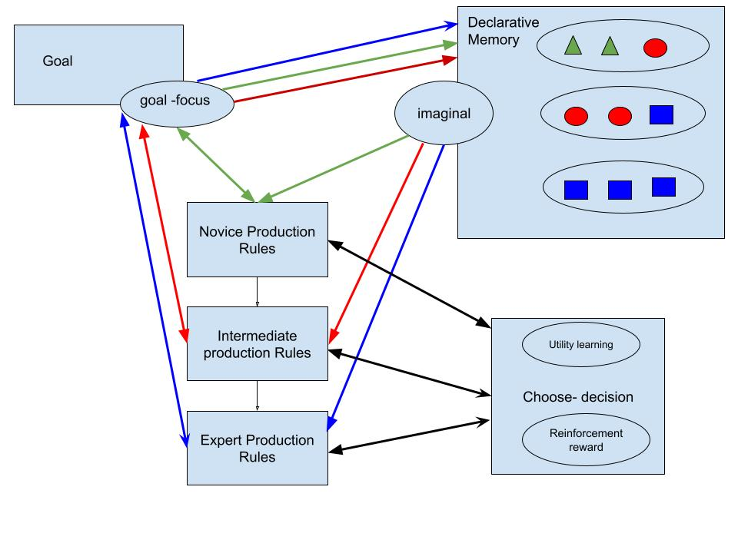
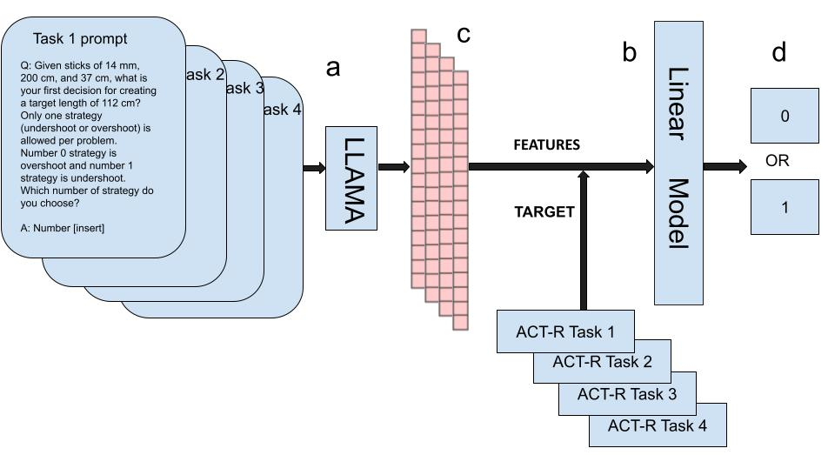
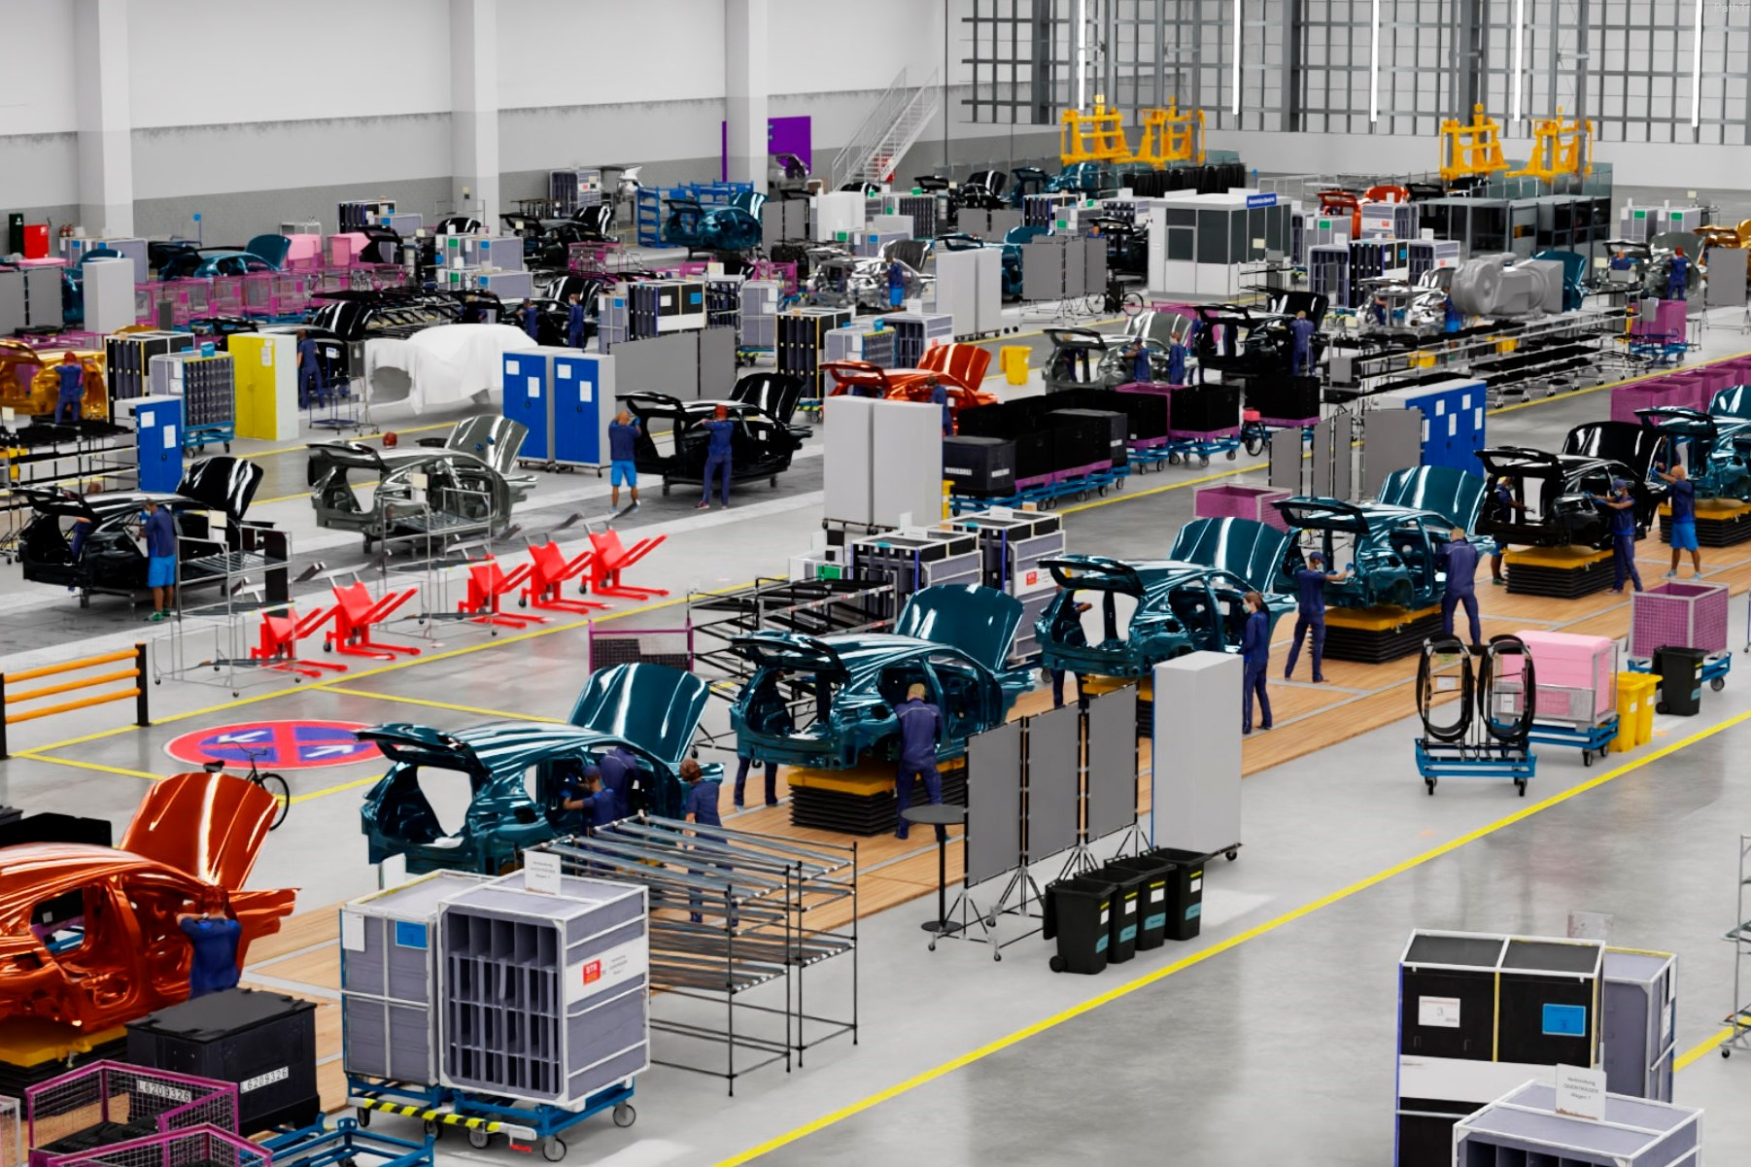
LLAMA-ACT-R: Use Neuro-Symbolic Architecture (ACT-R) for LLM Decision Making in Manufacturing
Siyu Wu
Soar Workshop 2024

Slide 2
Reference
🟨 Binz, M., & Schulz, E.(2024) Turning large language models into cognitive models, ICLR.
🟨 Ritter, F. E., Tehranchi, F., & Oury, J. D. (2019). ACT-R: A cognitive architecture for modeling cognition. Wiley Interdisciplinary Reviews: Cognitive Science, 10(3), Paper e1488.
📘 Wu, S., Bagherzadeh, A., Ritter, F., Tehranchi, F. (2023, Sep) Cognition Models Bake-off: Lessons Learned from Creating Long-Running Cognitive Models. Poster in proceedings 16th International Conference on Social Computing, Behavioral-Cultural Modeling & Prediction and Behavior Representation in Modeling and Simulation (SBP-BRIMs)
📘 Wu, S., Giles, C. L., & Ritter, F. E.(2024) LLAMA-ACT-R, a neuro-symbolic architecture (ACT-R) for LLM decision making. In Poster presented in Annual Ethical AI Symposium. University of Michigan Institute for Data Science.

Slide 3
Introduction
LLMs tend to use shortcuts and cannot remember past interactions. Limit their ability to improve over time unlike humans
Decision-Making in the Era of Industry 4.0: Complex and Challenging
Language models in domain-specific decision-making Q&A suffer from:
Inaccurate and irrelevant context.
No memory, leading to inconsistent and unhuman like responses trajectory
Notes:
LLMs learn from very large amounts of data to make predictions and decisions. But they tend to use shortcuts and cannot remember past interactions, which limits their ability to improve over time unlike humans
Decision-Making in the Era of Industry 4.0: Complex and Challenging
When using a language model as a tool to assist in this domain-specific decision-making, which presents two issues:
The responses are often incorrect and lack contextual relevance.
There is a lack of human behavior resonance; the answers to calls across different prompts are not related to each other. The language model is stateless and does not show any traces of learning or improvement across calls.

Slide 4
Proposed Solution
Using Cognitive Architecture to Model Levels of Human Decision-Making Behaviors for Enhanced Production Efficiency
LLAMA-ACT-R Framework: Employing Neuro-Symbolic Architecture for LLM Decision-Making

Slide 5
Related Work
Use ACT-R model to simulate human behavior, behavior variance, learning, and error-making.
📘 Wu, S., Bagherzadeh, A., Ritter, F., Tehranchi, F. (2023, Sep) Cognition Models Bake-off: Lessons Learned from Creating Long-Running Cognitive Models. Poster in proceedings 16th International Conference on Social Computing, Behavioral-Cultural Modeling & Prediction and Behavior Representation in Modeling and Simulation (SBP-BRIMs)

Slide 6
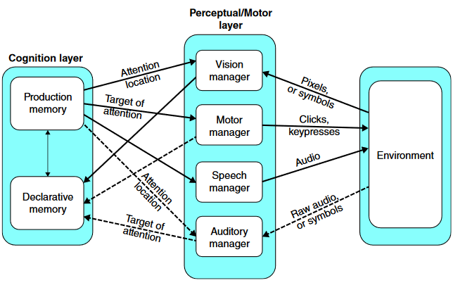
ACT-R
Image adapted from: Ritter, F. E., Tehranchi, F., & Oury, J. D. (2019). ACT-R: A cognitive architecture for modeling cognition. Wiley Interdisciplinary Reviews: Cognitive Science, 10(3), Paper e1488.
http://acs.ist.psu.edu/papers/ritterTOip.pdf
Cognitive architecture
Modules to implement the fixed mechanisms of cognition
Core
Productions, if-then rules, actionable memory
Unmodified
Chunks,
factual memory, slot-value pairs
Modified
Notes:
Go through quickly. Using a cognitive architecture, because if we weren’t we wouldn’t be here… This figure depicts the core cognitive components of ACT-R, other modules exist. Central to the functioning of the architecture are the procedural and declarative modules (implementing procedural and declarative memory respectively). The procedural module uses productions to encode memory about actions. They can query the buffers manage by other modules and inspect chunks. The declarative module uses chunks (a collection of slot/key value pairings) to implement factual memory. The motor system depicted is ACT-R (now part of the current ACT-R standard), developed by Mike Byrne. It adds modules to manage perception (visual and auditory), motor control, and speech. Those modules can parse the screen of applications written in AGI (ACT-R GUI Interface). They provide a great mechanism for making models that use special interfaces, but are poorly equipped to working with native interfaces (“in the wild”).
For more see Anderson; Ritter, Tehranchi, & Oury. Use figs from papers frank sent. http://acs.ist.psu.edu/papers/ritterTOip.pdf
acs.ist.psu.edu/papers/ritterTO19.pdf

Slide 7
Feature Extraction of Open-source Large Language Models for Behavioral Science
Passing text input through an openly accessible LLM and capturing the resulting final embeddings. These embeddings capture both the content and context within the prompts, offering the least information loss for further analysis.
🟨 Binz, M., & Schulz, E. (2024) Turning large language models into cognitive models, ICLR.

Slide 8
Schema of LLAMA-ACT-R
ACT-R Model Create and Setup
LLAMA-ACT-R

Slide 9
Schema of LLAMA-ACT-R

Slide 10
Proposed Contribution
Fine-tuned language model predicts human decisions and offers learning insights, overcoming limitations of previous work by Binz & Schulz (2024) for broader task application.

Slide 11
A USE CASE: VSM-ACT-R
Using Cognitive Architecture to Model Levels of Human Decision-Making Behaviors for Enhanced Production Efficiency: This approach integrates CAs to simulate and model levels of decision-making processes in manufacturing (production line), encompassing error generation, learning, and strategy optimization.

Slide 12
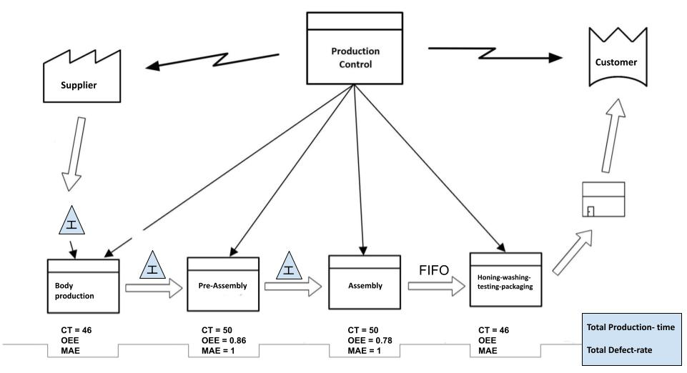
Value Stream Map

Slide 13
Process
Defining divisions of efficiency sectors using Value Stream Map.
Establishing constraints on production line efficiency and abstract domain centered decision-making problem.
Employing a human-centered approach to model various levels of decision-making using ACT-R.
Testing and tuning the model to mimic human learning and error-making for novice, intermediate and expert.

Slide 14
Decision-making problem abstraction and formulation
With a focus on maintaining stable output as the target for the Bosch plant and by examining the structure of the Value Stream Map (VSM), we develop a decision-making problem that balances increasing time efficiency on the assembly line with maintaining stable output.
“Our manufacturing line has two sections with potential defect sources: pre-assembly and assembly. Pre-assembly takes 40 seconds with an OEE (Overall Equipment Effectiveness) rate of 88%, while assembly takes 44 seconds with an OEE rate of 80.1%. To reduce total assembly time by 4 seconds, we need to identify which section can be shortened with minimal defect increase. There are two options: reduce pre-assembly time or reduce assembly time.”

Slide 15
Used human-centered approach to develop different expertise levels of decision-making
The process begins by interviewing plant managers at Bosch USA to understand the complex decision-making challenges they face daily.
Their insights, combined with a VSM tailored to their specific plant system, are used to enhance production time efficiency at a Bosch plant.
The model possesses capabilities across a variety of production efficiency decision-making rationales. It can perform tasks using decision-making algorithms observed from human subjects and incorporate personas representing a range of expertise levels, from novice to expert.

Slide 16
Level of Expertise Mechanism in VSM-ACT-R

Slide 17
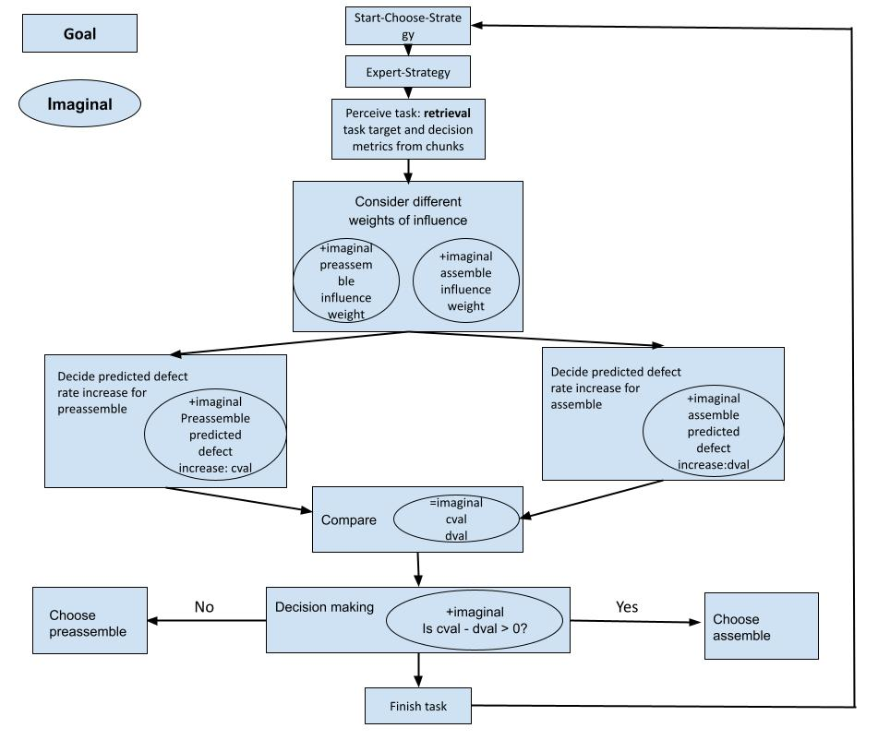
https://github.com/SiyuWu528/VSM-ACT-R

Slide 18
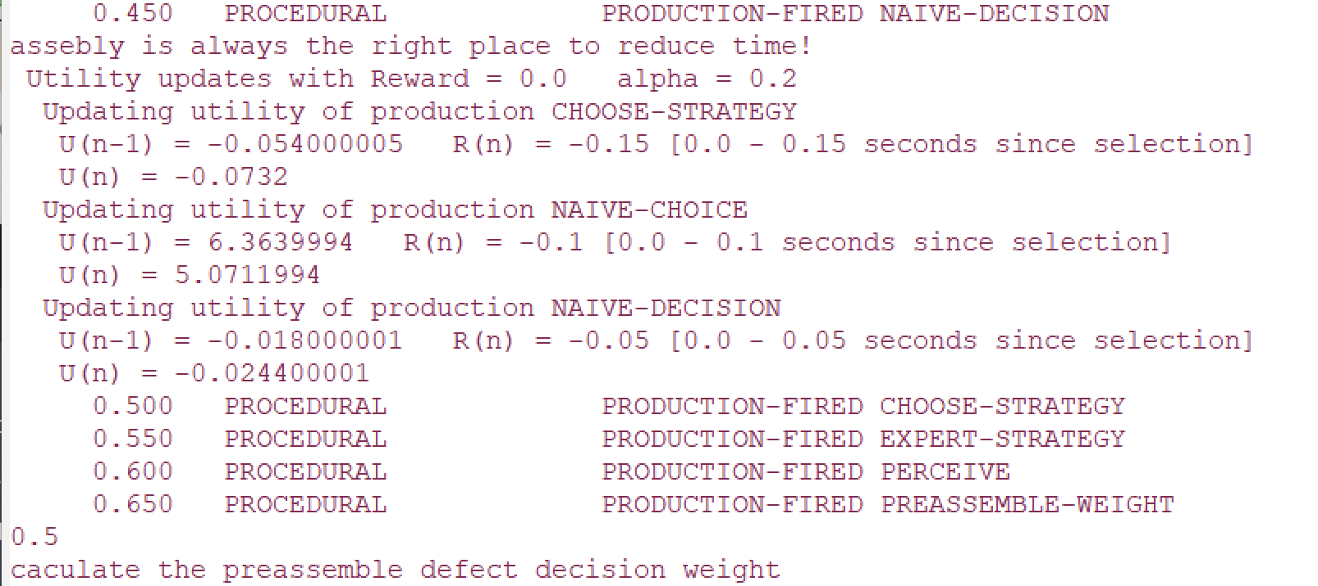
Output

Slide 19
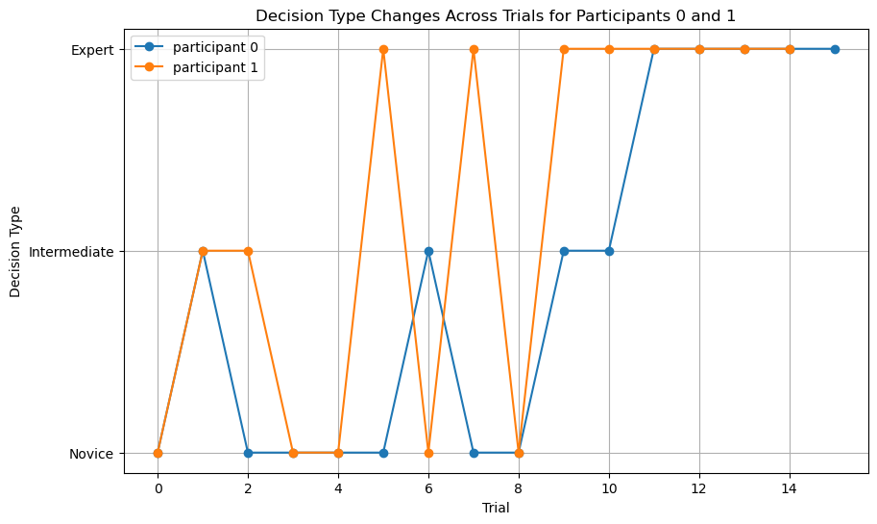
Learning Rate

Slide 20
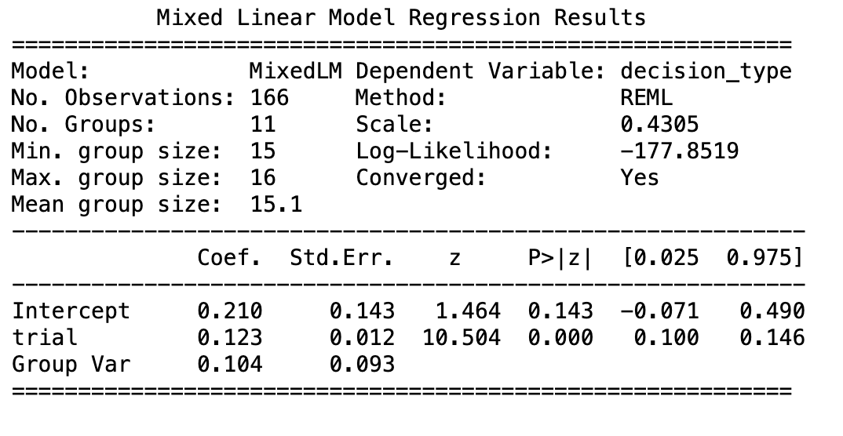
Individual Difference

Slide 21
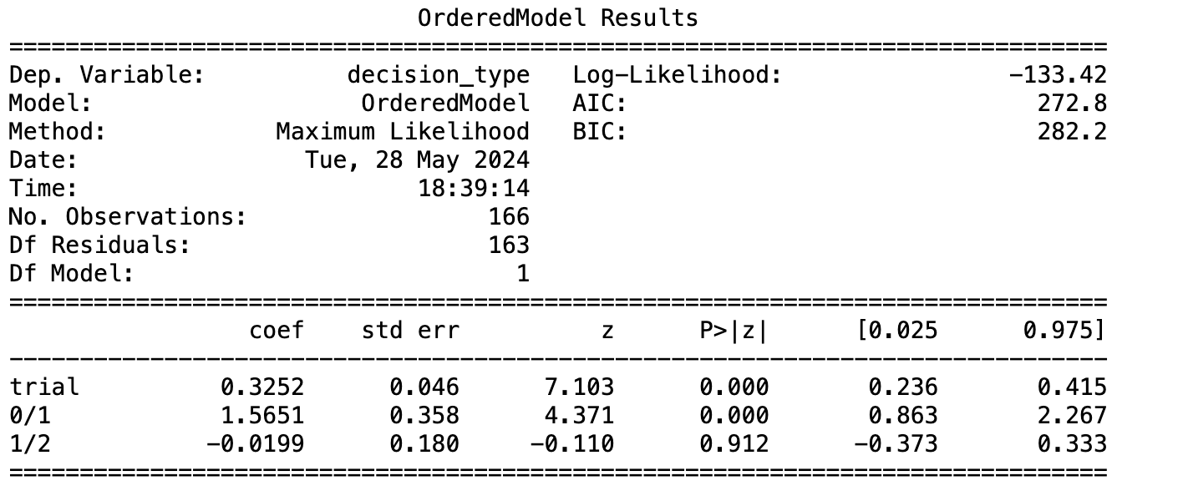
Learning progress

Slide 22
What’s next

Slide 23
Contribution
The VSM-ACT-R model is a neural-symbolic cognitive model designed to optimize time reduction in the assembly sectors of the production line.
The deployment of LLAMA-ACT-R enables LLMs to become a customized tool for plant decision-makers to request decision-making assistance, as well as a learning tool that mimics the observed learning and error-making in the same domain.

Slide 24
Further work
Completed
Data collection
Fine tune Llama
VSM-ACT-R built
Nuggets
Coal
Leverage CAs strength to build better LLMs through a novel integration strategy.
No funding after summer

Slide 25
Thank you
Dan Bothell for VSM-ACT-R help
Thank my collaborators and mentors Frank E Ritter, C Lee Giles, Alessandro Oltramari from PSU and Bosch

