Slide 1
~$ pip install soar-sml
Packaging Soar for Python - Jonathan de Jong
Notes:
(I’ll be using terminal-black, to set the mood)
Hello everyone, i’ll be sharing some thoughts and developments on packaging Soar’s SML for python
Which is something i’ve been working on the last couple of weeks

Slide 2
A Small Precap (Major Topics)
Installing Soar SML (for Python) in an easy manner
Explaining how this increases accessibility
How I want to build on this in the future
Notes:
First, a small precap of the major topics
I’ll show you how to easily install Soar SML, for Python
I’ll explain why i did this, and how this increases accessibility
And I want to show a sneak peek of how i’ll build on this in the future

Slide 3
A quick demo
Notes:
But first, a quick demo
I’ll start with an empty environment; nothing is installed here, not soar, not soar suite, only python
Then i’ll run this command, pip install soar-sml
And it is installed, soar is installed.
This is all thats necessary to install Python’s SML Bindings
This is live, you could pull up a terminal and do this yourself
The kernel is also bundled, which i’ll show you by opening a python interpreter
I’ll import this specific namespace; soar_sml
Next, i’ll create a kernel
Then an agent
And then i’ll run a CLI command on that agent; hello world
And as you can see, the command ran.
I’ll even show a print command of the state, to see that the empty agent was fully initialised.

Slide 4
What just happened?
I installed Soar via pip, a python packaging management tool
Imported a namespace soar_sml into python
I ran a simple echo command that just said “hello world”
I ran a command that printed the top-level state
Or; I just quickly got a soar kernel up and running with only a few simple steps
Notes:
What just happened?
Well, I installed soar via pip, python’s packaging management tool
Then i imported the soar_sml namespace
I ran a simple echo command to show off it works
And a print command to emphasize that
All of this was without installing soar suite, or building it locally, all of it was real-time, with these simple commands

Slide 5
A Small Primer on Python Packaging - Wheels
‘pip’ is considered the standard way of packaging python libraries.
With pypi.org being the standard package index.
It can distribute a “pre-compiled” variant of a library.
By matching crucial denominators; OS, CPU Architecture, Python (ABI) Version, etc.
These distributions are called “wheels”
‘pip’ will match the right variant of a wheel, and install it directly.
No local building necessary, immediately able to be imported.
Notes:
Next, i’ll explain the inner workings of this, by giving a quick primer on python packaging
External libraries have binary distributions that’re called “wheels”, they’re tagged with specific attributions that are relevant for the machine they’ll be installed to, such as CPU architecture, and operating system
When pip wants to install a package, it goes through the index, and installs the right wheel variant for the machine
While pip *can* do local builds, wheels bypass this process, and basically give python the dynamic libraries it needs to directly import the module, with the right compatibility

Slide 6
How ‘soar-sml’ takes advantage of python wheels
Wheels are built in CI (On Github)
For all major operating systems;
MacOS >=10.9 (x86 & ARM)
Linux with GLIB >=2.17 (x86 32-bit & 64-bit)
Oldest versions: Debian 8, Ubuntu 14, Fedora 20, RHEL 7, etc.
Windows >=7 (64-bit)
For Python >=3.5 on all the above OSes
SoarSuite not required, version can be specified when running pip:
pip install soar-sml>=9.6
Notes:
I worked together with Nathan on getting Soar to build python wheels for its SML Bindings
Soar github CI now uploads wheels for Python’s SML bindings, and makes them available on Windows, MacOS, and Linux, for all python versions above 3.5, like magic
This means that you dont need to install soar suite, and can just run the pip install command on any of those operating systems, to run a simple python script which uses Soar SML
You’ll get an error message if pip cannot find a compatible wheel, so its all-or-nothing.
This library will follow the same versioning of soar itself, so you can specify the version you want with the above, and pin it to a specific version if you want.

Slide 7
Why: Increasing accessibility to the Soar Project
Lowering the threshold
Increasing the chances for someone to try out soar, and get interested
Quick turnaround / impulse response to “trying out” (and messing around)
Creating interfaces via SML should be easy
Developing testing input and output models
Python is a language made for speed and ease of development
pip is a natural extension of this, and the expected path
Notes:
So why did I do this?
Well, I wanted to make sure more people could easily access Soar, when i first started researching it myself, i found most documentation and practices have a high threshold for someone who’s new to soar, and autonomous agents in general
So, to contribute, i basically turned my use-case into a goal; make it easy to install soar, make it easy to learn by experimenting, trying, and “messing around”
Furthermore, i find that having an agent interact with the environment is much more interesting than internal juggling, which made me want to make setting up such an interface with the world easy
Example: something that interacts with a smart home’s sensors and buttons, which can be done with HTTP APIs
Python itself is perfect for ease of development and prototyping, a lot of the ecosystem is based around “it should be simple”, and pip is no exception, which is why i chose that to handle first

Slide 8
A comparison; before and now
Before:
Either: Download SoarSuite, or Build Manually
Friction: For low-energy-investment/cursory glances, most would give up at this step, or not be able to find instructions for it in the first place
Add line to script that pivots the import to this specific folder
sys.path.append('/home/user/SoarSuite/bin')
Friction: Non-”pythonic”, fragile, and makes scripts non-portable without manual editing
Import using Python_sml_ClientInterface
Now:
pip install soar-sml
import soar_sml
Notes:
I’ll show the comparison with a before-and-after, and how previous friction is now removed from the project
Whereas before, you’d have to;
grab soarsuite or build it manually
At the start the python script, run the specific path.append function inbetween importing
to add the soar suite (or local build output) to the path
And then import using that long and case-mixed namespace
Now;
you’d only have to run one specific command
and import one standardized namespace
(More slander):
Most of this is unorthodox to the python community, which means that it doesn’t hook onto existing practices, which means that it is already a ton of friction to surpass that, just for a project they might have encountered out of nowhere.
With that high of a threshold, most wouldn’t really look at the project again, seeing no easy way to poke at it
You could compare this with the likes of chatGPT, where it is today as easy as downloading an app, or going to a website, and then start talking to the model without even needing to pay

Slide 9
Backwards Compatibility
Now everything is under the namespace soar_sml
Small package that adds backwards compatibility for existing scripts: soar-compat
Just re-exports everything under soar_sml to Python_sml_ClientInterface
No manual path editing required, all existing scripts become portable.
Everything that uses ‘import Python_sml_ClientInterface’ will “just work”
sys.path.append not required
Installable via soar-compat, or soar-sml[compat]
pip install soar-sml soar-compat
or; pip install "soar-sml[compat]"
Notes:
So what about backwards compatibility? Everything’s now under the namespace soar_sml
Well… its easily fixable, i added a simple package that just re-exports soar_sml to python-sml-clientinterface, since its basically just the same package, just uploaded with a different name
If you download that package, this also means that all your existing python scripts immediately become portable across machines
you can remove that path.append function if you want to, or keep it, it’ll be redundant
You can install it via soar-compat, or (even easier) via an “extra” in brackets after soar-sml, by adding “compat” there
Do put quotes around them, some terminals interpret the brackets as something specific

Slide 10
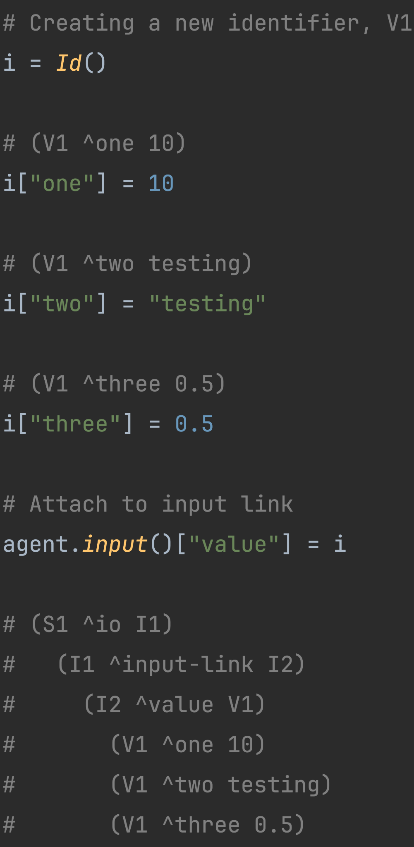
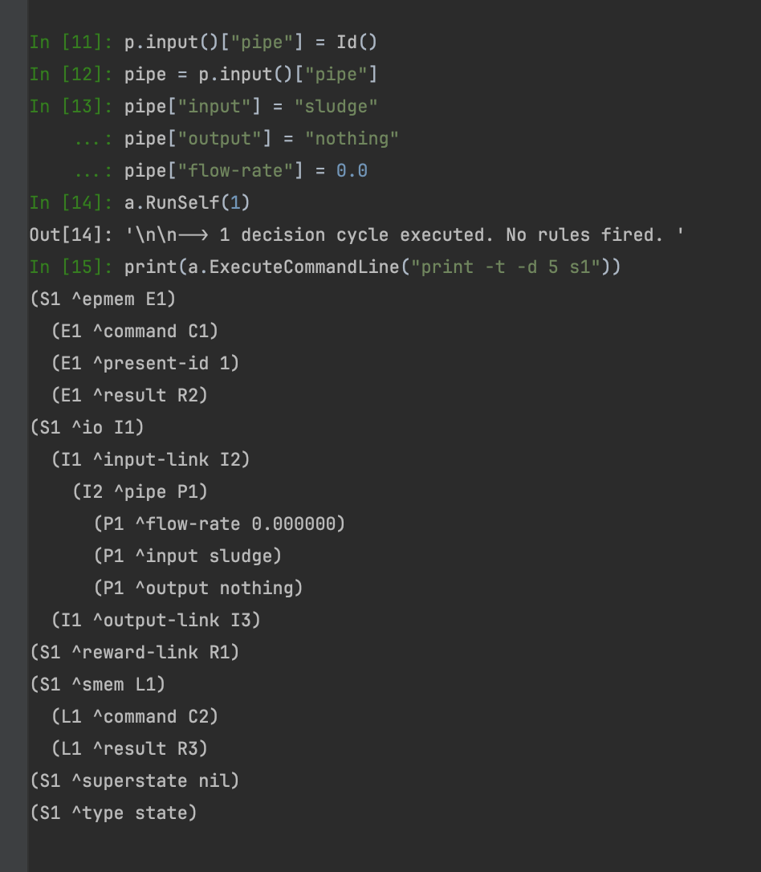
Future: Pythonic Soar I/O
Notes:
So, now, what do i want to do with this? / What will i do with this?
Well, here's something I've been working on, a library that builds on top of soar-sml, that lowers the threshold even more, which makes IO very easy to manipulate
These images are then impressions of the kind of code i want to enable, they’ll probably be a little different from what i’ll eventually release, but the impression of ease of development is what i wanted to portray
As you can see on the left side, I'm adding attributes to an identifier with key-value setting, using the key as attribute
^one, ^two, ^three
Integer, string, float
With this, behind the scenes, I'm adding WMEs that represent these pairs, which you can see as comments above the statements
At the end, I add the identifier to the input link also via key-value setting, with the attribute “^value”, and the structure gets added as a whole, represented in the comments at the bottom
On the right you see a more elaborate example
The agent gets added input-link elements that add a “feel” for sensors in a specific pipe it needs to monitor

Slide 11
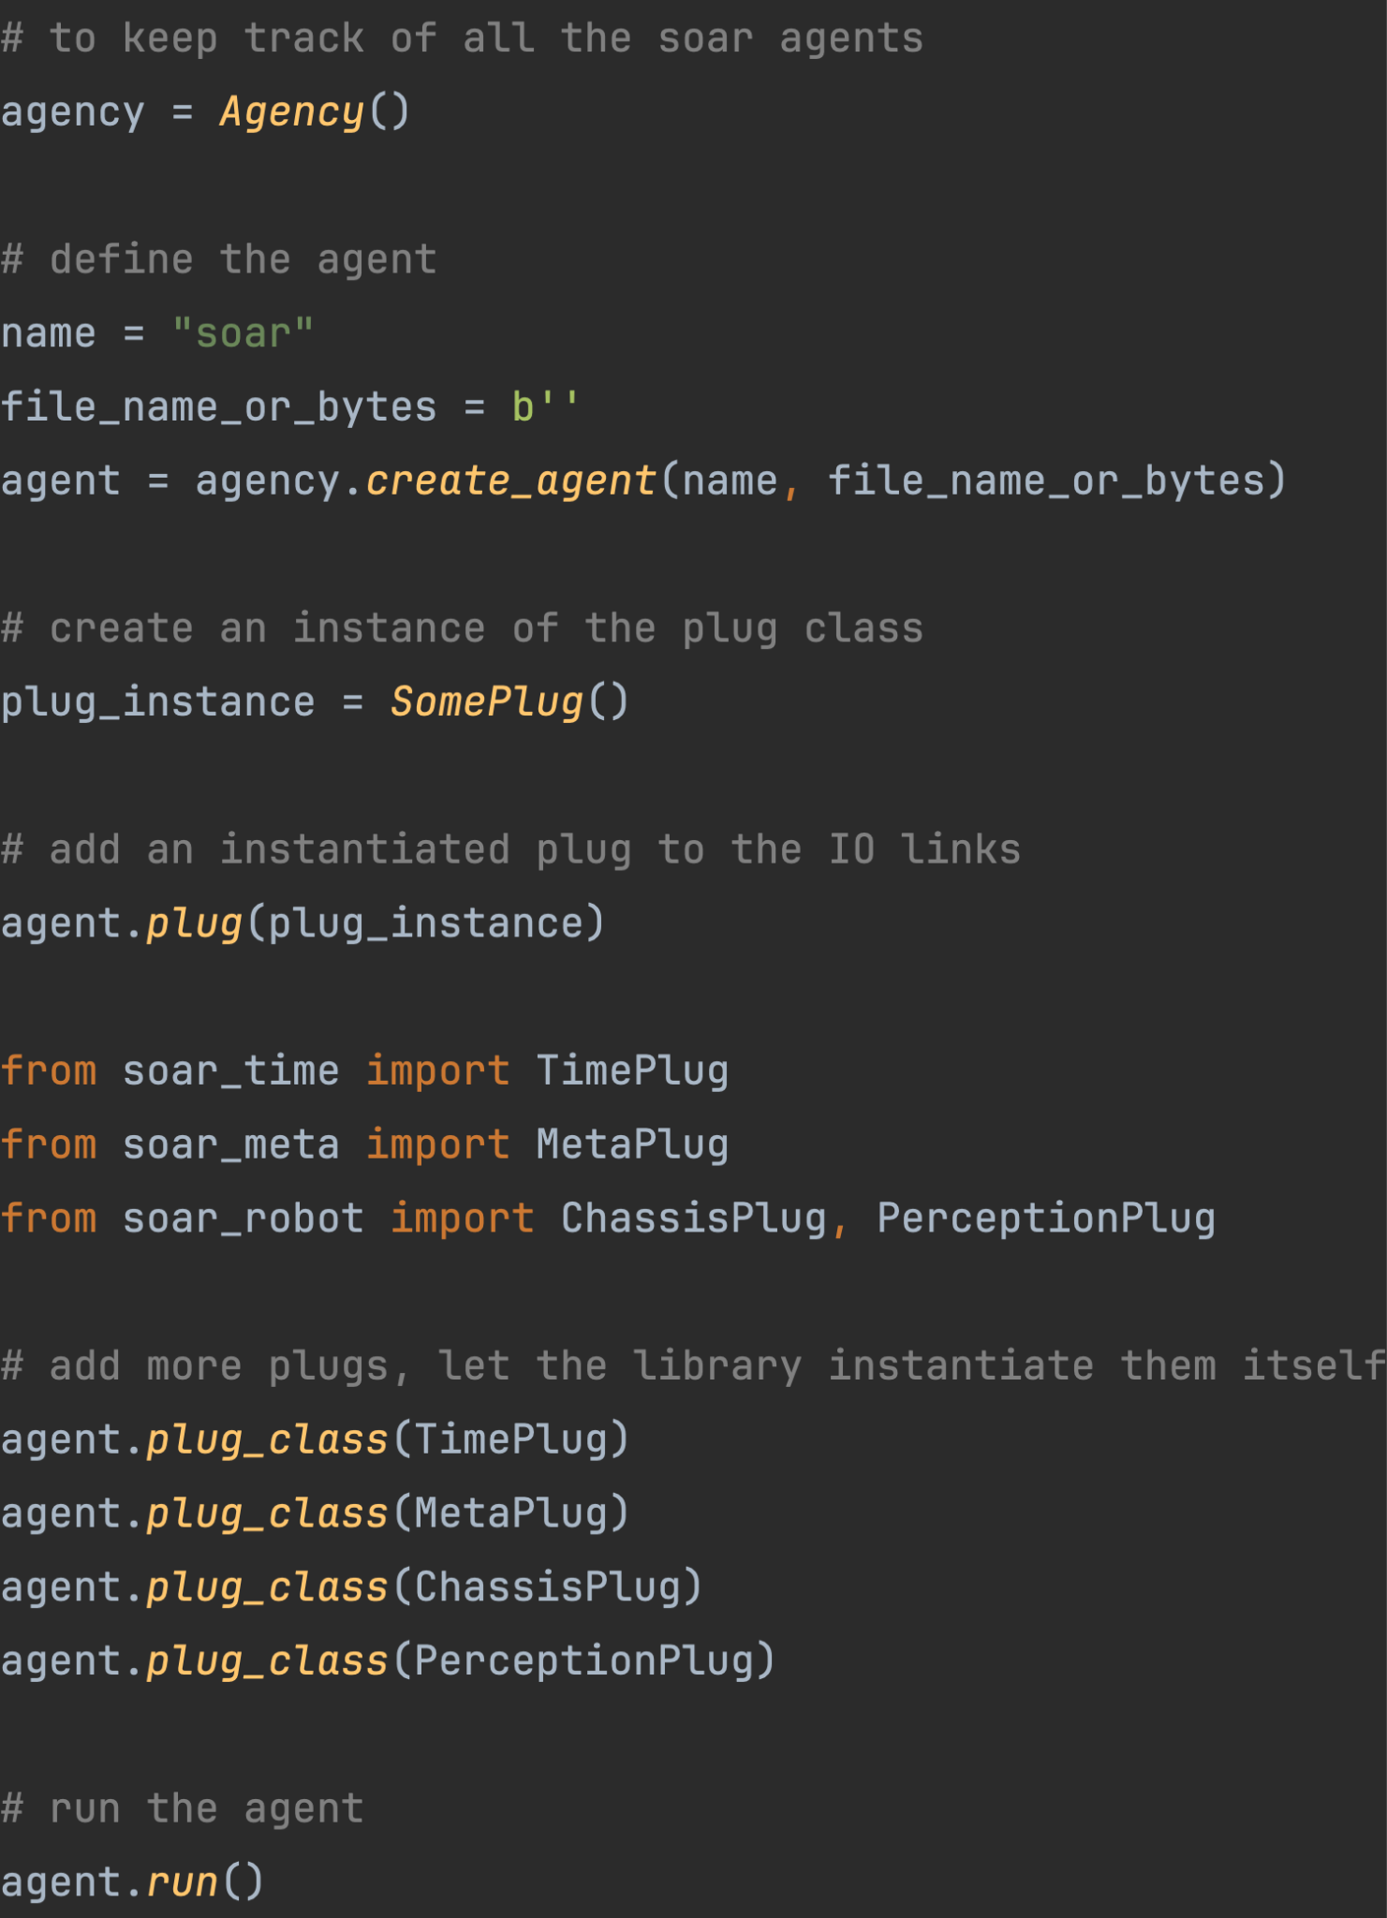
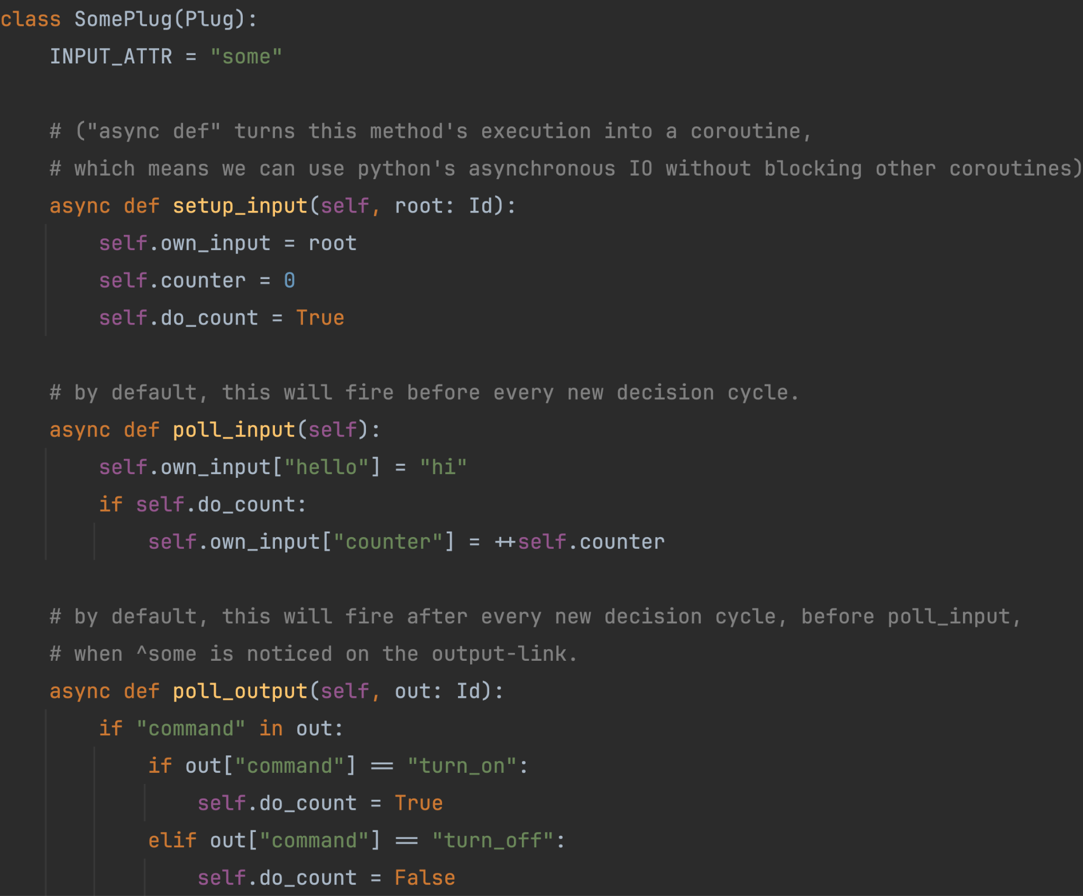
Future: Soar Pluggable I/O
Notes:
But i’m not done yet
the previous part was only a foundation for this part, where i want to make interfaces self-contained, and easily distributable.
See on the left, where I make a python class defining an input poll function, and an output poll function
The input function runs before every decision cycle, and sets the WMEs on the input link that the agent needs
Then the output function runs after every decision cycle, and only if the library notices a command on the output link, which is then processed
Here it has a little counter that the agent could turn on and off, adding a number for every cycle
On the right, you can see how this spans out, where it is possible to pull plug classes from multiple packages, external or local
such as a fictitious “soar_robot” library, importing a “Chassis” plug, and a “Perception” plug, containing all the IO the agent would need to properly interface with such a robot
And its just added to the agent like that, with all the necessary input and output loops
we even add a “Meta” plug, where an agent could control the importing of extra IO-plug packages itself, and maybe even make its own

Slide 12
Recap
Installing Soar SML via pip install soar-sml
To lower the threshold for curious students/researchers
Future: Creating a “pythonic” development kit for pluggable IO interfaces
Notes:
So, just a recap, and this is the end of my presentation;
I helped package Soar SML for python, installable via pip
To lower the accessibility threshold
And in the future: Making a development kit for pluggable IO interfaces

Slide 13
(Last Slide)
(S13 ^impasse no-state ^attribute operator)
Notes:
That was my Talk, thank you.

Slide 14
(Last Last Slide)
Notes:
That was my Talk, thank you.

