Slide 1
2024 Soar Update
9.6.1 – 9.6.3 and beyond
Nathan Glenn
Notes:
Prepare by opening a browser to soar.eecs.umich.edu.

Slide 2

About me
BYU undergrad, worked on XNL-Soar
Software Engineer since 2007
Previous post at trivago, N.V. (Düsseldorf, Germany)
With CIC for the past year
Notes:
On the right is my gravatar. You’ll see this on GitHub

Slide 3
Timeline
9.6.0: July 2017
9.6.1: December 2022
9.6.2: March 2024
9.6.3: Soon!
Notes:
Mazin Assanie was the major maintainer through 9.6.0
9.6.1 also included much of his work. He moved on, CIC was formed, and we finished it off with lots of infrastructure changes and various maintenance tasks and bug fixes
9.6.1, 2, and 3 are all maintenance releases. No major breakage or backwards-incompatibilities. Bug fixes, V-S and debugger updates, lots of infrastructure, build updates, cleanups, etc.

Slide 4
RHS Functions
tcl
string
JSoar compatibility:
set-{count, sum, multiply, min, max, range, mean, stdev, mac}
Automatically call exec for unknown functions
Notes:
Larger changes were made for JSoar compatibility
Also:
from-st-xml
Please don’t use this unless you’re super sure. It will cause issues in some settings. It’s just there for JSoar compatibility.

Slide 5
Language
sp { no-op
(state <s> ^superstate nil)
-->
}
🟢
sp { no-op
(<s> ^results <any>)
-->
}
Warning: On the LHS of production no-op, identifier <s> is not connected to any goal or impasse.
⚠️
sp { no-op
(state <s>)
-->
}
Error: Expected attribute-value test after state/impasse test. Did you forget to add "^type state" or "^superstate nil"?
🚨
Notes:
Soar now properly detects ungrounded (LHS not connected to a state) productions, refuses to source them, and tells the user how to fix them.
I wish that warning were an error instead, but this is what we have for now.
Previously that last production would automatically produce a wildcard match over all attributes and values on <s>, leading to I think 6 matches
Not grounding your production can crash Soar under certain circumstances, so this needed fixing!
Generally improved weird production-related warnings

Slide 6
Language
automatically-create-singletons on by default (9.6.3)
Notes:
Decided after much experimentation with chunking that this is a better default.
This is technically a breaking change, but we think it is highly unlikely to actually break anything in the wild.

Slide 7
SML Libraries
Stopped exporting internal classes
SWIG autodoc adds docstrings with function/argument types to Python bindings
Python bindings now usable for Python 3.5+ (thank you Jonathan de Jong!)
Notes:
TODO: hide this slide?
Python bindings used to require same minor version of Python (3.11, 3.12, etc.) as Soar was compiled against, which was very annoying

Slide 8
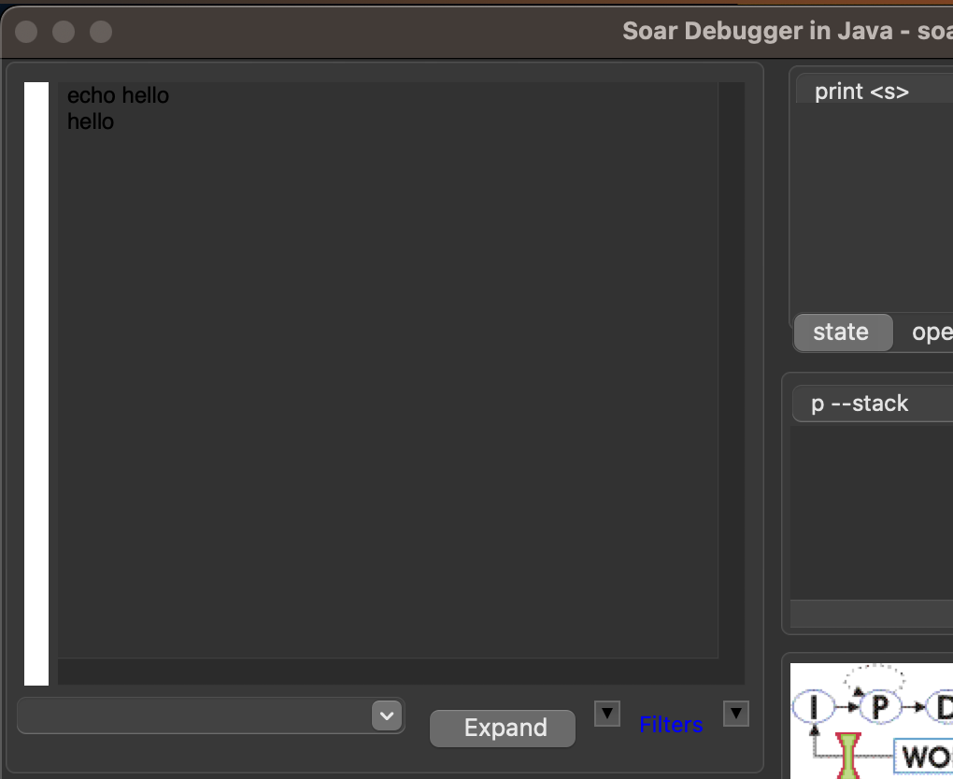
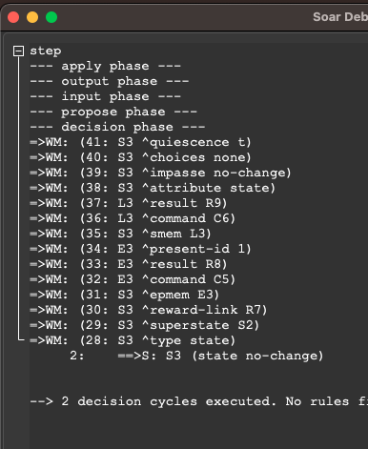
Debugger
Before
After
Notes:
proper dark mode text display on Mac
Also fixed shortcut key to be CMD instead of CTRL- fixed strange scrolling behavior instabilities
- Shortcuts for increasing/decreasing text size

Slide 9
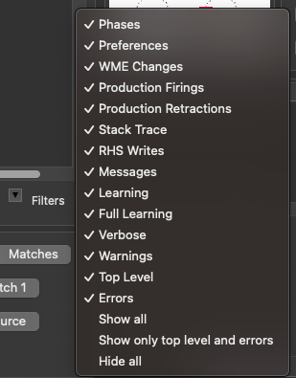

Debugger
Notes:
- More output filtering options in the debugger. All 14 output types are toggleable, with convenient shortcuts for common desired combinations (hide all and show only errors and top-level).

Slide 10
Debugger
Notes:
- The "collapse" button in the debugger will now collapse existing traces instead of only collapsing traces output later.

Slide 11
Debugger
Notes:
- CMD/CTRL = or - to make text bigger or smaller

Slide 12

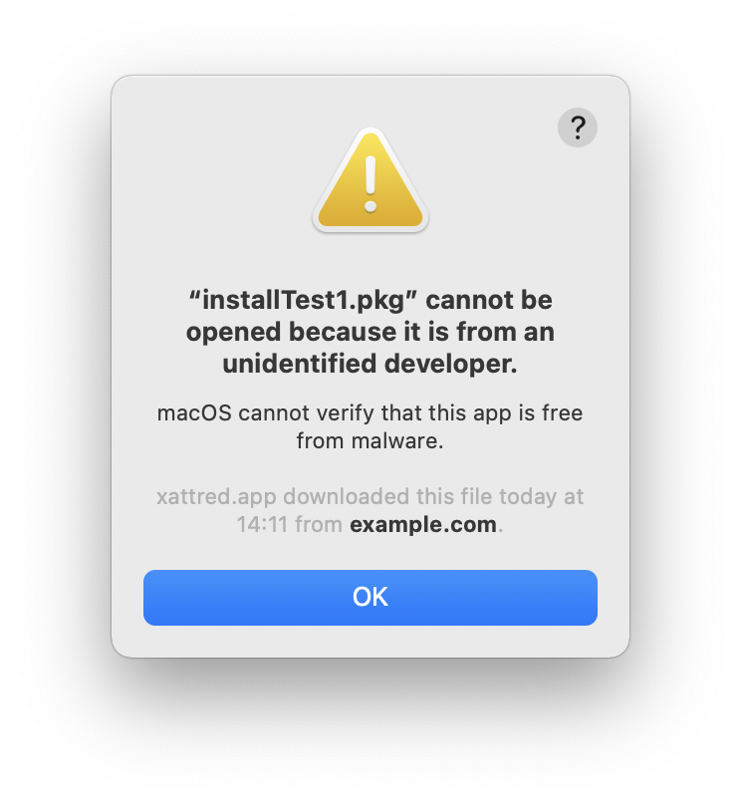
Setup
Dedicated setup scripts
Unquarantine on Mac
Soar CLI exits on EOF
Pip install option exists, too!
Thanks to Jonathan de Jong
Notes:
Noticed that first-time setup logic was being copied for other applications, so extracted it for re-use
We explicitly unquarantine our binaries on mac so they can be opened without issue (see graphic)
SoarCLI now exits on EOF, meaning that it is possible to automatically test that it works by piping data to it or using the expect utility (also exits gracefully on CTRL-D like a normal program)
- Generally speaking, we probably need to re-think the installation process. If anyone wanted to volunteer to make proper installers for Soar, that would be grand!

Slide 13
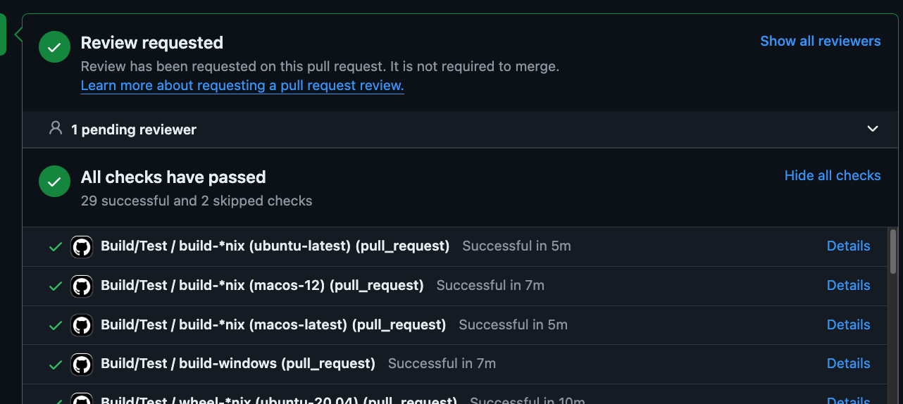
Build/Infrastructure
Automated building and testing with GitHub Actions
Updated platforms in distribution
Notes:
Every time we push to GitHub, we get notifications if the code could not be built or if unit tests fail
We run performance tests as well, but we’re not graphing them anywhere
We dropped 32-bit platforms from the distribution but added M-series Macs
Lots of work on fixing build warnings, but we can’t yet build with strictest compiler settings

Slide 14
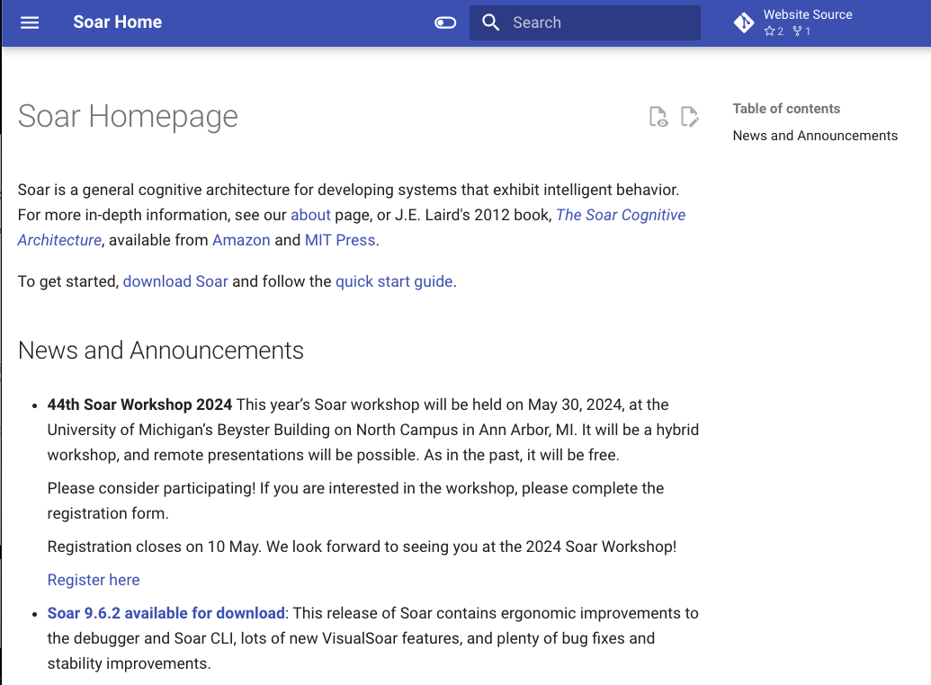
New Website
http://soar.eecs.umich.edu/
Thanks to Moritz Schmidt!
Based on mkdocs
Tutorial and manual
Full text search
Responsive
Notes:
soar.eecs.umich.edu
Open and show it
Works well at different sizes
notice we have tutorial and manual tabs; these need full review and fix for figures
exec vs "exec" search
some pages not ported yet
entire site is on GitHub, generated from markdown files

Slide 15
Thank you to Soar contributors!
Mazin Assanie
Johnathan de Jong
Bob Marinier
Moritz Schmidt
Bryan Stearns
And more! Sorry for not mentioning you! You are appreciated!
Would love more contributions to core Soar, documentation, website, issue discussions, tutorials, etc.
Notes:
Outside contributing is how I got into my current role. Please, contributions are welcome, technical or otherwise!

Slide 16
The Future
Largest requested features
Snapshotting
Fix 100X debugger slowdown
Ergonomics and beginner-friendliness
Productivity tools
Stability
Build and distribution
Documentation
Notes:
No actual roadmap; Soar is being developed as needed for CIC projects, includingTHOR-Soar, DroneSoar (seen in previous presentations)
Snapshotting: DroneSoar scenario takes an hour to run, John wants to iterate on something that happens at the 30 minute mark. Currently very difficult to edit and re-run, which is terrible.
Ergonomics and beginner-friendliness: helpful warnings, automated guidance on proper Soar usage
Productivity tools: debugger functionality like profiling, visual exploration of WM, etc. LLM assistant?! LSP with datamap support!
Sky is the limit here.
Stability: -Wall and /W4, address/memory/undefined behavior sanitizers, fuzz-testing
Build and distribution: finish adding all tests to CI, also build and distribute SVS viewer (or switch to alternative like a Java application). Reorganize or re-do install process
Documentation: finish website, online tutorial/manual, publish SML docs there, more tutorials, etc.

Slide 17


Nuggets and Coal
New website
New contributors
New projects
New build infrastructure
Improved stability
Improved debugger
No dedicated funding for Soar
Release process still complex
Long road to clean build with -Wall, /W4, sanitizers, etc.

Slide 18
Thank you!
Questions and comments are welcome

