Slide 1
Representing Ontologies in Soar
Peter Lindes
Soar Workshop
29 May 2024

Slide 2
The Problem
How to represent, easily, large amounts of knowledge in Soar

Slide 3
Kinds of Knowledge in a Soar Agent
Objects:
Categories
Properties
Affordances
Actions
Tasks
Language
Constructions
Meaning schemas
Messages
Many of these are built by hand.
How could we make that easier?
This would reduce the entry cost.

Slide 4
What is Ontology?
What theory and technologies are available for knowledge representation?

Slide 5
What is ontology? (Philosophy)
Ontology: The branch of metaphysics … is concerned with identifying, in the most general terms, the kinds of things that actually exist.
https://www.webpages.uidaho.edu/engl257/classical/ontology_and_epistemology.htm
… ontology is the study of what there is.
https://plato.stanford.edu/entries/logic-ontology/

Slide 6
What is ontology? (Computer Science)
… ontology is the study of what there is.
https://plato.stanford.edu/entries/logic-ontology/
An ontology refers to the systematic mapping of data to meaningful semantic concepts.
https://blog.palantir.com/ontology-finding-meaning-in-data-palantir-rfx-blog-series-1-399bd1a5971b

Slide 7
Ontology Technologies
Much research has been done and technologies are available

Slide 8
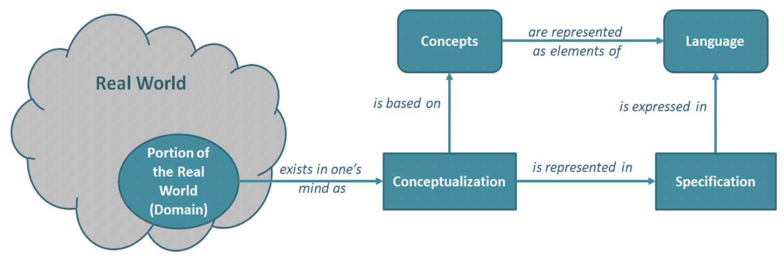
OWL: Web Ontology Language
The Web Ontology Language (OWL) is a family of knowledge representation languages for authoring ontologies.
https://en.wikipedia.org/wiki/Web_Ontology_Language
https://cambridgesemantics.com/blog/semantic-university/learn-owl-rdfs/owl-101/

Slide 9
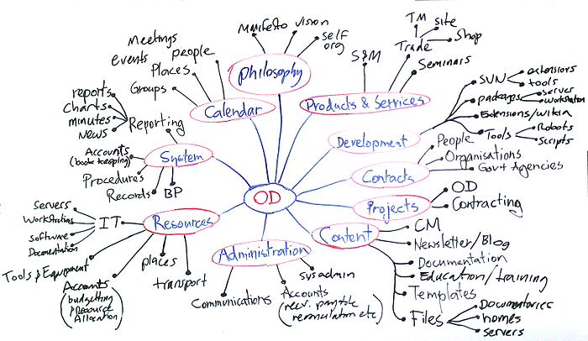
Ontology Generation and Visualization with Protégé
… an ontology is a description (like a formal specification of a program) of the concepts and relationships that can exist for an agent or a community of agents.
https://medium.com/@vindulajayawardana/ontology-generation-and-visualization-with-prot%C3%A9g%C3%A9-6df0af9955e0

Slide 10
Soar Ontologies
How can we represent knowledge in a Soar agent?

Slide 11
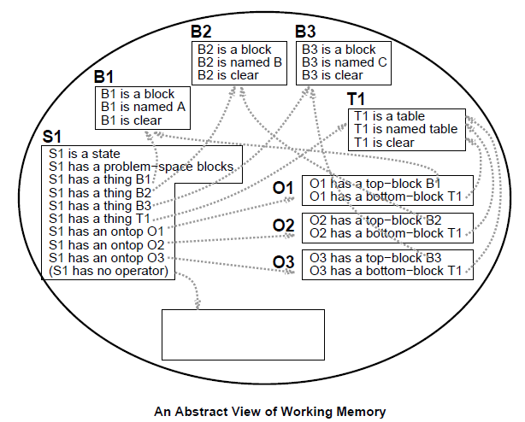
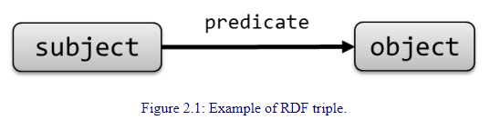
Ontologies in Soar
https://book.validatingrdf.com/bookHtml008.html
Soar Manual, Figure 2.3, p. 9

Slide 12
A Soar Top-Level Ontology (classes)
Thing
Object
Relation
Location
Concept
Language
Grabbable
Action
Building
Color, …
Word
Container
Room
Task
Composition
Operator
Surface
Goal
Schema

Slide 13
A Soar Top-Level Ontology (instances)
S1
Go to the kitchen.
Objects
World
Object
Relations
Map
Language
Word senses
Compositions
Schemas
Messages
Concepts
Color, shape, size
Tasks
Goals
Actions
Operators
world
sentence
text
W1
S2
relations
objects
parse
meaning
self
R1
on
O3
R9
S4
M17
R2
O23
P4
instance
1
O24
R14
relation
I7
2
object
in
O25
W1
W2
W3
W4
R3
1
O26
Go
to
the
kitchen
instance
2
I8

Slide 14
Rosie’s Object Ontology
template category _HANDLE_ _WORD_ _SUPER_ _AFFORDANCE_* {
entity1 entity none1
object object entity1
obstacle1 obstacle object
block block object grabbable1
kitchenware1 kitchenware object grabbable1
utensil1 utensil kitchenware1
fork1 fork utensil1
knife1 knife utensil1
spoon1 spoon utensil1
mug1 mug kitchenware1 fillable1
cup1 cup kitchenware1 fillable1
pitcher1 pitcher kitchenware1 fillable1 dispenser1
carton1 carton kitchenware1 fillable1 dispenser1
plate1 plate kitchenware1
}
template color _HANDLE_ _WORD_* {
red1 red
orange1 orange
yellow1 yellow
green1 green
blue1 blue
purple1 purple
black1 black
brown1 brown
white1 white
gray1 gray
}

Slide 15
Lucia’s ECG Grammar
construction TransitiveCommand
subcase of Imperative
constructional
constituents
verb: ActionVerb
object: RefExpr
meaning: ActOnIt
constraints
self.m.action <--> verb.m
self.m.object <--> object.m
schema Action
roles
action
direction
location
modifier
schema ActOnIt
subcase of Action
roles
object

Slide 16
Representing Soar Ontologies
What tools could we develop to make this easy?

Slide 17
Named Data Types
Primitive types: string, integer, float, boolean
Named constant types:
Structured types (schemas):
Finger [1-5] # An integer whose values should be in this range
Speed [0.0-120.0] # A float with values in this range
Color [red, green, blue] # A string which contains one of these specific values
Block { color: Color, shape: Shape, size: Size, clear: boolean }
Color [red, green, blue]
Shape[sphere, rectangle, square, triangle]
Size [small, medium, large]
World { objects: ObjectSet, relations: WorldRelationSet, self: ObjectRepresentation}

Slide 18
Sets
ObjectSet { object*: ObjectRepresentation, pointed~: ObjectRepresentation }
WorldRelationSet { relation*: WorldRelation }
WorldRelation { type: RelationType, instances: RelInstanceSet }
RelationType [in, on, left-of, ... ]
RelInstanceSet { instance+: RelInstance }
RelInstance { 1: ObjectRepresentation, 2: ObjectRepresentation }
* = 0 to max integer
+ = 1 to max integer
~ = 0 or 1, nil if 0 (the attribute is always there)
? = present or not (optional)

Slide 19
Class Hierarchy
Object { handle: string, grabbable: boolean }
Block { color: Color, shape: Shape, size: Size, clear: boolean }
Receptacle { openable: boolean }
Surface { ... }
Kichenware { material: Material, ... }
Utensil { grabbable <-- true }
Fork { ... }
Knife { ... }
Spoon { ... }
Plate { ... }
CeramicPlate { material <-- ceramic }
PaperPlate { material <-- paper }
Bowl { }
Material [ ceramic, metal, paper, plastic ]

Slide 20
Messages
Message { }
Command { action: Action }
GoToCommand { action.handle <- go-to-1, ARG1: ReferenceDescription }
TransitiveCommand { ARG1: ReferenceDescription }
PickupCommand { action.handle <- pick-up1 }
PutDownCommand { action.handle <- put-down1, ARG2: Relation }
ObjectDescription { }
GoalDescription { ARG0: Assertion }
Action { handle: ActionHandle }
ActionHandle [clean-01, go-to-1, pick-up1, put-down1, ...]
Assertion { }
StateDescription { ARG1: ReferenceDescription, ARG2: ObjectState }
RelationAssertion { ARG0: Relation }
AndAssertion { op1: Assertion, op2: Assertion }

Slide 21
A Message In Working Memory
# ::snt Pick up a dish sponge.
(<p> ^instance-of pick-up-command ^classes <p0>
^action <pa> ^ARG1 <s>
^text |Pick up a dish sponge.|)
(<p0> ^class pick-up-command transitive-command command message)
(<pa> ^instance-of action ^handle pick-up1 ^text |Pick up|)
(<s> ^instance-of reference-description
^category <s1> ^givenness indefinite ^modifier <d> ^groundings <s1g>
^text |a dish sponge|)
(<s1> ^handle sponge ^type grabbable)
(<d> ^instance-of object-modifier ^handle dish ^type usage
^text |dish|)
# Note: the images show three dish sponges in the bathtub
(<s1g> ^grounding <s1g1> <s1g2> <s1g3>)
(<s1g1> ^category sponge ^modifier <d> ^handle DishSponge21)
(<s1g2> ^category sponge ^modifier <d> ^handle DishSponge22)
(<s1g3> ^category sponge ^modifier <d> ^handle DishSponge23)

Slide 22
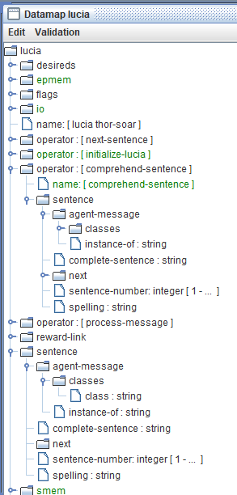
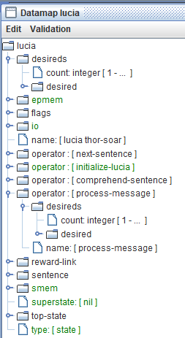
Visual Soar

Slide 23


Nuggets
Coal
A simple declarative notation
Many types of knowledge
Maps to Soar structures
Tools to translate to Soar
Simple knowledge engineering
Eases entry into Soar world
Proven approach
Unfamiliar to Soar developers
Much work to do:
Define representations
Build translation tools
Integrate with agent code
Lots of debugging

