Slide 1
A Proposal for Extending the Common Model of Cognition to Emotion
Paul S. Rosenbloom¹, John E. Laird², Christian Lebiere³, Andrea Stocco⁴, Richard H. Granger⁵ & Christian Huyck⁶
¹Institute for Creative Technologies & Thomas Lord Dept. of Computer Science, University of Southern California
²Center for Integrated Cognition, IQMRI
³Department of Psychology, Carnegie Mellon University
⁴Department of Psychology, University of Washington
⁵Department of Psychological and Brain Sciences, Dartmouth University
⁶Department of Computer Science, Middlesex University
Notes:
This is a talk to be presented at the upcoming International Conference on Cognitive Modelling
It reflects a true interdisciplinary partnership
Will start with a quick review of the Common Model of Cognition
before moving on to the proposed extension to emotion

Slide 2
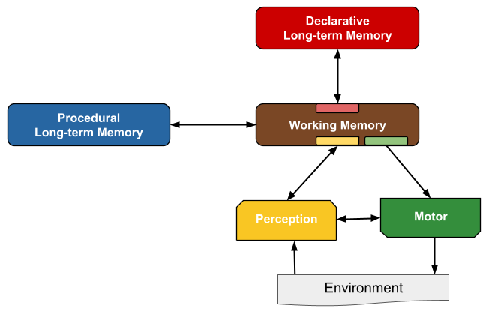
Common Model of Cognition
A developing consensus about what is required in a cognitive architecture
In particular, for humanlike minds
Human minds and
Other natural and artificial minds modellable in same manner at suitable level of abstraction
Consensus developed from:
Existing cognitive architectures
Researchers who study/develop cognitive architectures
Results relevant to cognitive architectures
Abstract, radically incomplete, and not directly executable
Includes what the community can reach a consensus on concerning necessity
Based on polling
Sufficiency only relevant to what topics are considered for consensus building
Notes:
Don't consider it a cognitive architecture itself

Slide 3
Structure of the Common Model of Cognition
Sixteen initial assumptions
Structure and processing
Significant parallelism both within and across modules and content
Sequential behavior from cognitive cycle
~50 msec in humans
Memory and content
LTMs contain symbolic data with associated quantitative metadata
Learning
Incremental, as a side effect of performance
Perception and motor control
Laird, J. E., Lebiere, C. & Rosenbloom, P. S. (2017). A Standard Model of the Mind: Toward a Common Computational Framework across Artificial Intelligence, Cognitive Science, Neuroscience, and Robotics. AI Magazine, 38, 13-26.
3
Notes:
Procedural and declarative long-term memories
Perception and motor modules that interact with an external environment
All interact through working memory
All but PM limited to accessing and modifying buffers
Example assumptions
Explicitly hybrid
Although you can structure performance so as to influence what is learned

Slide 4
Common Model of Cognition
A developing consensus about what is required in a cognitive architecture
In particular, for humanlike minds
Human minds and
Other natural and artificial minds modellable in same manner at suitable level of abstraction
Consensus developed from:
Existing cognitive architectures
Researchers who study/develop cognitive architectures
Results relevant to cognitive architectures
Abstract, radically incomplete, and not directly executable
Includes what the community can reach a consensus on concerning necessity
Based on polling
Sufficiency only relevant to what topics are considered for consensus building
Notes:
Goal of this work is to partially ameliorate this incompleteness

Slide 5
Extending the Common Model to Emotion
Emotion is essential to surviving and thriving in challenging physical and social domains
Wisdom of evolution
Proposal here is far from a full model of emotion
Only architectural aspects of how emotional states arise and affect cognition
Abstracts over details of appraisal and dimensional models
Avoids such topics as how emotional states are reflected in external expressions
Doesn’t include deliberate reasoning about emotion
Although leaves room for it in cognitive system
Proposal grew out of:
Earlier analysis of emotion and the Common Model (Larue et al., 2018)
June 2022 virtual workshop on the topic
Larue, O., West​, R., Rosenbloom, P. S., Dancy, C. L., Samsonovich, A. V., Petters, D., & Juvina, I. (2018). Emotion in the Common Model of Cognition. Procedia Computer Science, 145, 730-739.
Notes:
Not just a human quirk.

Slide 6
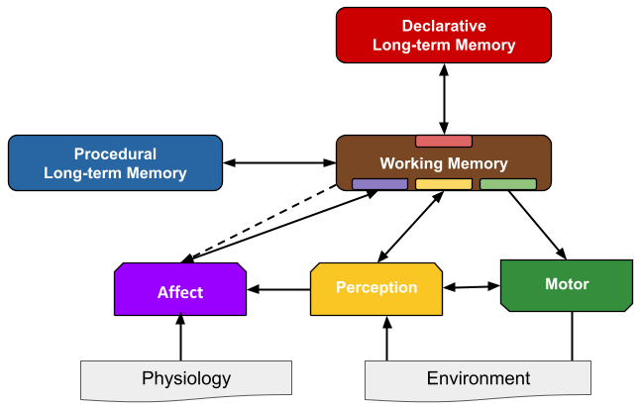
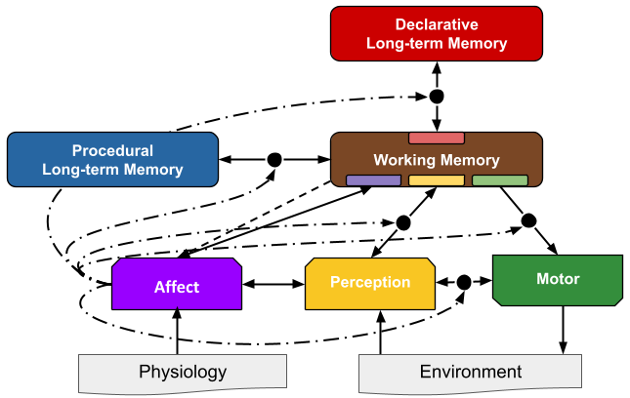
Initial Synthesis From Workshop
Add an Affect module to the Common Model
Receives input from:
Physiology: to react to bodily state
Perception: for immediate reactions to the state of the world
WM buffer: for reactions to the state of the cognitive system
WM more broadly: to set the context for affective processing
Affects remainder of Common Model:
Provides input to WM buffer to support cognitive reasoning
Filters communications between other modules and WM
Directly affects Perception
Notes:
Reasoning about emotion – i.e., the ”cold” aspects – is presumed to occur via standard cognitive processing within the original modules of the Common Model.
The higher-level aspects of appraisal theory would thus fit here.
The “hot” aspects of emotion are presumed to be the province of the physiological system that provides input to the affect module.
What was termed the “warm” aspects of emotion at the workshop are the architectural facets of emotion processing.
Model proposed inclusion of affect module but did not delve into its internals.
Filtering can affect what shows up in WM and at what level of detail.
Can also affect what is learned/acted-on in the other direction.

Slide 7
Coming out of Workshop
Sense of consensus with respect to something like this synthesis
But it reflected only a few days' work by a subset of the community
And only came together at the final session
It thus did not seem right to consider it as an official consensus
It was furthermore still quite minimal in coverage
Subgroup decided to push model further before going back to the community to see if a more thorough consensus was reachable
The proposal here is the product of these deliberations

Slide 8
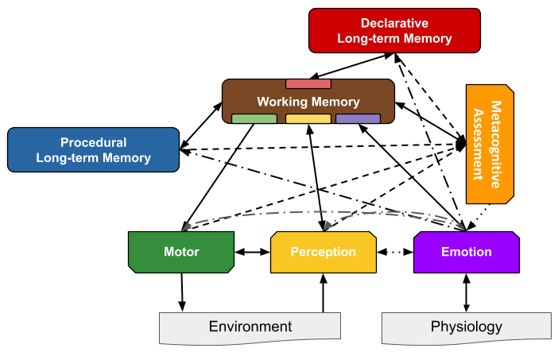
Refined CMC+Emotion Synthesis
Relabeled Affect module as Emotion
Role is to generate emotional vectors
But with no commitment to size or contents
Appraisals act as inputs to creation of vectors
High-level cognitive appraisals come from WM
Metacognitive Assessment module added
Observes modules and traffic among them
Generates low-level appraisals
Transmits results to emotion module
Emotion may affect module operation
E.g., extensive evidence indicates emotions can influence memory storage and retrieval
Notes:
Emotional vectors: E.g., <valence, arousal> or more extended vectors used in dimensional models.
E.g., generation of large vectors by assigning one slot to each appraisal
E.g., generation of intensity and valence pairs by aggregating over the values of all appraisals for the former and differentially over positive and negative appraisals for the latter.
Affecting module operation is in addition to filtering communication
Examples of affecting module operation: May yield rewards for RL in PM or somatic markers in DM.
State-dependent memory and clinical effects such as post-event emotional and traumatic responses directly mediated via cortico-amygdala loops.
New modules analogous to Perception & Motor
Although internally facing

Slide 9
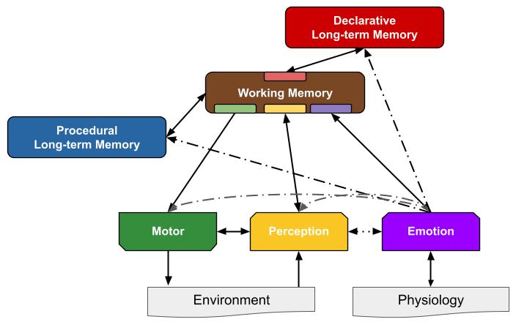
Emotion Module
Added connection from Emotion down to physiology
For emotion vectors to affect physiology
Dot-dash arrows from Emotion point to junctions
Filter communication and modify module operation
Retains bidirectional connection Emotion ⬌ WM
Supports high-level cognition-emotion interactions
Retains bidirectional connection Emotion ⬌ Perception
Although back arrow may be redundant with dot-dash arrow
Notes:
Eliminated MA module and connections from figure to focus on emotion module
Example for down to physiology: when a cognitively identified threat – such as a verbal threat – requires the body to prepare to respond.
Examples for modifying module operation: alters how PM selects actions to execute and how DM determines what knowledge to retrieve.

Slide 10
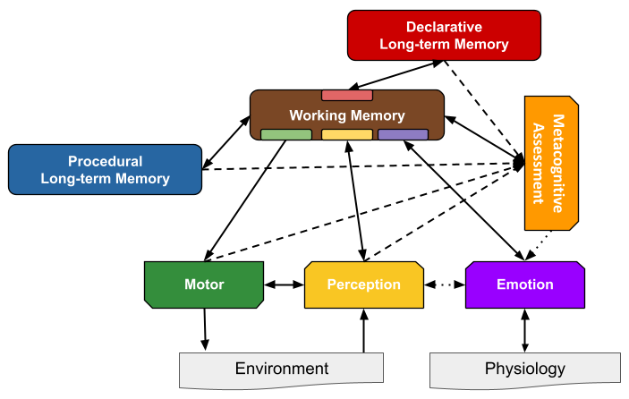
metacognitive assessment Module
Modeling appraisals generically as aspects of metacognition
Large-scale topic of its own but with no existing Common Model consensus
Although Kralik et al. (2018) did begin exploring this topic
Low-level appraisals provided by Metacognitive Assessment
Fixed architectural sensing at junctions between modules and links to WM
Can sense communication with WM and internal operation
Surprise appraisal becomes akin to things like feeling of knowing
High-level appraisals assumed to be cognitive in nature
Whether via same cognitive system or a distinct metacognitive system
No arrows back from metacognitive assessment to other modules
Do not appear necessary for emotional metacognitive assessment
Feedback instead goes through Emotion
A module itself versus distributed across junctions(?)
Shown as a module to leave open possibility of across-module appraisals
Kralik, J. D., Lee, J. H., Rosenbloom, P. S., Jackson, P. C., Epstein, S. L., Romero, O. J., Sanz, R., Larue, O., Schmidtke, H. R., Lee, S. W. & McGreggor, K. (2018). Metacognition for a Common Model of Cognition. Procedia Computer Science, 145, 740-746.
Notes:
Eliminated dot-dash arrows from emotion module to focus on MA module
As one simple example of MA for emotion, both surprise and familiarity are computed architecturally in Sigma based on monitoring its learning process.
An example of across-module appraisal is Sigma’s computation of attention based on both surprise and desirability.
However, the necessity of such a possibility remains an open question.

Slide 11
Status of Consensus
Attempted to determine if a consensus was reachable around this refinement
Two separate emails sent to workshop attendees requesting input
One informal, as free text, and one structured more formally as a questionnaire
Proved insufficient to yield a consensus even among the workshop attendees
So, no attempt has yet been made at achieving a broader community consensus
Instead presented here as a proposal for further consideration
Rather than as an agreed-upon extension to the Common Model
But integrated additional concurring workshop attendees in as co-authors of this paper
Still incomplete in many ways with respect to a full model of emotion
Shares the Common Model’s natural abstraction and incompleteness
Although here only for what might become a consensus
Hope provides basis for a wider discussion of extending Common Model to emotion

