Slide 1
Learning to “Soar”
Creating families of models to support training
Bob Wray, Randy Jones
8 Jun 2017
Copyright © 2017 Soar Technology, Inc.

Slide 2
Questions
What are good (fast, cheap, reliable/robust) methods of developing/learning low-level robotic controller in Soar?
What are good (fast, cheap, effective) methods for developing a family of Soar models?

Slide 3
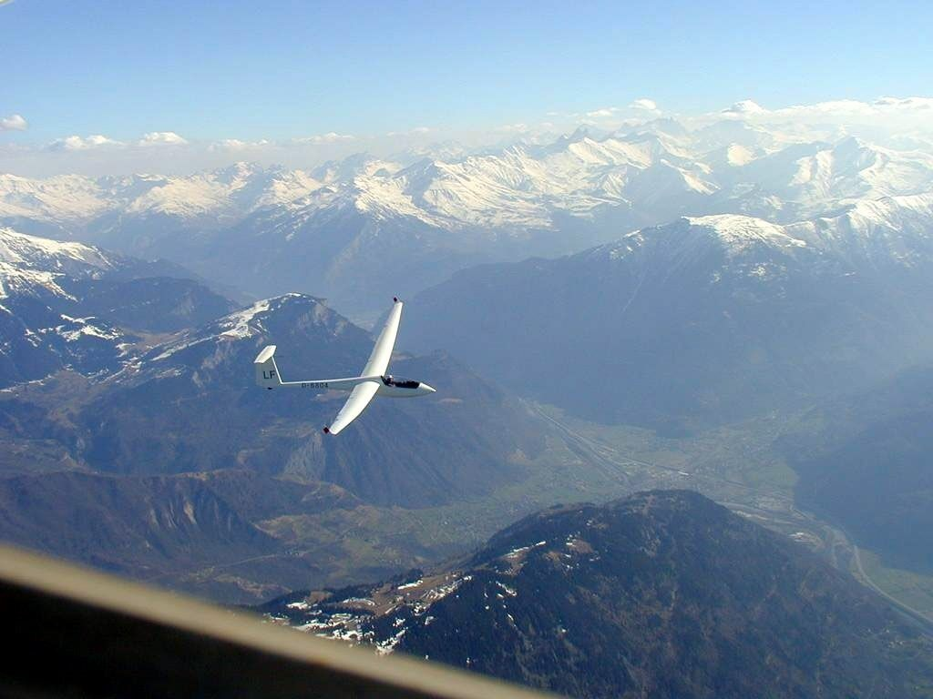
Illustrative Problem Domain

Slide 4
Application Requirements
Goal:
Train an individual (“instructor”) who needs to interact with pilots with various skill levels
Key aspects of training:
Recognizing learner mistakes (e.g., control over-compensation)
Learning when (and when not) to guide the learner explicitly
Recognizing if the learner’s reactions to guidance are effective
Requirements:
Realistic flight (stick level control of aircraft)
Generation of many different kinds of learner behaviors
Interactive (responsive to instructor guidance)

Slide 5
Initial System Architecture

Slide 6
Question 1
What are good (fast, cheap, reliable/robust) methods of developing/learning low-level robotic controller in Soar?
Generic joystick controller, rudder (slider)
Obvious solution: Learn a “perfect” solution with RL?
Computable, optimal flight paths enable straightforward formulation of policy for RL
Examples of others who have used RL to learn low-level controllers?
Are there other established ways to approach learning a robotic controller in Soar?

Slide 7
Question 2
What are good (fast, cheap, effective) methods for developing a family of Soar models?
Does a traditional goal formulation + the RL policy result in learning that looks human like?
Do flight paths generated by the system during RL look similar to human pilots along a similar learning path?
Does variability in pilot performance arise from alternative goal decompositions?
Are there ways to (easily) formulate “policies” for non-optimal flight paths?

Slide 8
System Architecture Questions

Slide 9
Conclusions
Questions
What are good (fast, cheap, reliable/robust) methods of developing/learning low-level robotic controller in Soar?
What are good (fast, cheap, effective) methods for developing a family of Soar models?
Nuggets
Somewhat rare opportunity to build a Soar model of humans performing a complex perceptual/motor/decision task
Opportunity to explore the trajectory of learning
Coal
Just getting started. Research, technology, and integration challenges ahead.

