Slide 1

Update from the
Deryle Lonsdale
Brigham Young University

Slide 2
Background
NL-Soar: the original system
XNL-Soar: new, improved lex/syn/sem
LG-Soar
Different dependency-like parser (Link Grammar)
No deployments outside of BYU (except pre-Rosie versions of LG-Soar for BOLT)

Slide 3
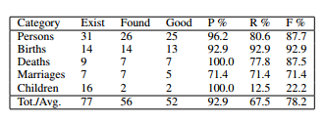
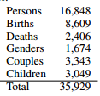
Recent (1)
OntoSoar: ontology-directed information extraction (see Lindes 2014)
Read 860-page book, extracted:
Presented at AAAI 2015 (Cognitive Systems)
Adding more targeted relationships for extraction

Slide 4
Recent (2)
Lewis’s dissertation: link/snip regime for resolving/failure on problematic structures
English focus but mentions possible extensions to other languages
This year: German
No implementation (yet)
Presented at GLAC 2015

Slide 5
Summary
Coal
Nuggets
Vanishing support/interest
Looming sunset for NL-Soar
Haven’t yet transitioned core functionality (generation, mapping, discourse)
Scale mismatch with Big Data era of NLP
OntoSoar and ECG
EpMem and garden paths
SMem and lexical semantics
More cross-linguistic work
Still keeping up with Soar versions
Eclipse, NetBeans

