Slide 1
NL-Soar tutorial
Deryle Lonsdale and Mike Manookin
Soar Workshop 2003

Slide 2
Acknowledgements
The Soar research community
The CMU NL-Soar research group
The BYU NL-Soar research group humanities.byu.edu/nlsoar/homepage.html

Slide 3
Tutorial purpose/goals
Present the system and necessary background
Discuss applications (past, present and possible future)
Show how the system works
Dialogue about how best to disseminate/support the system

Slide 4
What is NL-Soar?
Soar-based cognitive modeling system
Natural-language focus: comprehension, production, learning
Used specifically to model language tasks: acquisition, translation, simultaneous inter-pretation, parsing difficulties, etc.
Also used to integrate language performance with other modeled tasks

Slide 5
How we use language
Speech
Language acquisition
Reading
Listening
Monolingual/bilingual language
Discourse/conversational settings

Slide 6
Why model language?
Can be insightful into properties of language
Understand interplay between language and other cognitive processes (memory, attention, tasks, etc.)
Has NLP applications

Slide 7
Language modeling
Concise, modular formalisms for language processing
Language: learning, situated use
Rules, lexicon, parsing, deficits, error production, task interference, etc.
Machine learning, cognitive strategies, etc.
Various architectures: TiMBL, Ripper, SNoW
Very active research area; theory + practice
Various applications: bitext, speech, MT, IE

Slide 8
How to model language
Statistical/probabilistic
  Hidden Markov Models
Cognition-based
  NL-Soar
  ACT-R
Non-rule-based
  Analogical Modeling
  Genetic algorithms
  Neural nets

Slide 9
The larger context: UTC’s (Newell ’90)
Develop a general theory of the mind in terms of a single system (unified model)
Cognition: language, action, performance
Encompass all human cognitive capabilities
Observable mechanisms, time course of behaviors, deliberation
Knowledge levels and their use
Synthesize and apply cognition studies
Match theory with experim. psych. results
Instantiate model as a computational system

Slide 10
From Soar to NL-Soar
Unified theory of cognition
+
Cognitive modeling system
+
Language-related components
≅
Unified framework for overall cognition including natural language (NL-Soar)

Slide 11
A little bit of history (1)
UTC doesn’t address language directly:
  “Language should be approached with caution and circumspection. A unified theory of cognition must deal with it, but I will take it as something to be approached later rather than sooner.” (Newell 1990, p.16)

Slide 12
A little bit of history (2)
CMU group starts NL-Soar work
Rick Lewis dissertation on parsing (syntax)
Semantics, discourse enhancements
Generation
Release in 1997 (Soar 7.0.4, Tcl 7.x)
TACAIR integration
Subsequent work at BYU

Slide 13
NL-Soar applications
Parsing breakdown
NTD-Soar (shuttle pilot test director)
TacAir-Soar (fighter pilots)
ESL-Soar (language acquisition: Polish speakers learning English)
SI-Soar (simultaneous interpretation: English→French)
AML-Soar (Analogical Modeling of Language)
WNet/NL-Soar (WordNet integration)

Slide 14
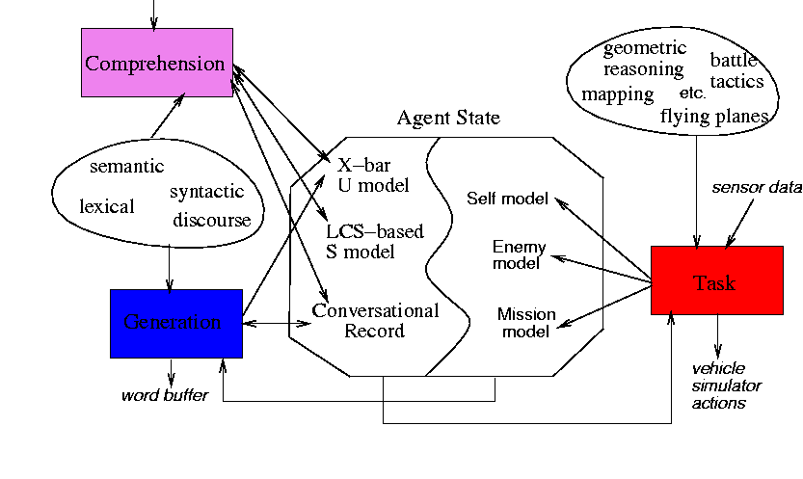
An IFOR pilot (Soar+NL-Soar)

Slide 15
NL-Soar processing modalities
Comprehension (NLC): parsing, semantic interpretation (words→structures)
Discourse (NLD): track how conversation unfolds
Generation (NLG): realize a set of related concepts verbally
Mapping: converting from one semantic representation to another
Integration with other tasks

Slide 16
From pilot-speak to language
1997 release’s vocabulary was very limited
Lexical productions were hand-coded as sp’s (several very complex sp’s per lexical item)
Needed a more systematic, principled way to represent lexical information
WordNet was the answer

Slide 17
Integration with WordNet
Before:
Severely limited, ad-hoc vocabulary
No morphological processing
No systematic knowledge of syntactic properties
Only gross semantic categorizations
After:
Wide-coverage English vocabulary
A morphological interface (Morphy)
Subcategorization information
Word senses and lexical concept hierarchy

Slide 18
What is WordNet?
Lexical database with wide range of information
Developed by Princeton CogSci lab
Freely distributed
Widely used in NLP, ML applications
Command line interface, web, data files
www.princeton.cogsci.edu/~wn

Slide 19
WordNet as a lexicon
Wide-coverage English dictionary
  Extensive lexical, concept (word sense) inventory
  Syncategorematic information (frames etc.)
Principled organization
  Hierarchical relations with links between concepts
  Different structures for different parts of speech
  Hand-checked for reliability
Utility
  Designed to be used with other systems
  Machine-readable database
  Used as a base/standard by most NLP researchers

Slide 20
Hierarchical lexical relations
Hypernymy, hyponymy
  Animal ←→ dog ←→ beagle
  Dog is a hyponym (specialization) of the concept animal
  Animal is a hypernym (generalization) of the concept dog
Meronymy
  Carburetor <--> engine <--> vehicle

Slide 21
Hierarchical relationships
dog, domestic dog, Canis familiaris -- (a member of the genus Canis (probably descended from the common wolf) that has been domesticated by man since prehistoric times; occurs in many breeds; "the dog
=> canine, canid -- (any of various fissiped mammals with nonretractile claws and typically long muzzl
=> carnivore -- (terrestrial or aquatic flesh-eating mammal; terrestrial carnivores have four or five clawed digits on each limb)
=> placental, placental mammal, eutherian, eutherian mammal -- (mammals having a placenta; all mammals except monotremes and marsupials)
=> mammal -- (any warm-blooded vertebrate having the skin more or less covered with hair; young are born alive except for the small subclass of monotremes)
=> vertebrate, craniate -- (animals having a bony or cartilaginous skeleton with a segmented spinal column and a large brain enclosed in a skull or cranium)
=> chordate -- (any animal of the phylum Chordata having a notochord or spinal column)
=> animal, animate being, beast, brute, creature, fauna -- (a living organism characterized by voluntary movement)
=> organism, being -- (a living thing that has (or can develop) the ability to act or function independently)
=> living thing, animate thing -- (a living (or once living) entity)
=> object, physical object -- (a tangible and visible entity; an entity that can cast a shadow; "it was full of rackets, balls and other objects")
=> entity, physical thing -- (that which is perceived or known or inferred to have its own physical existence (living or nonliving)

Slide 22
WordNet coals / nuggets
Complexity
Granularity
Coverage
Widely used
Usable information
Coverage
you’ll see...

Slide 23
Sample WordNet ambiguity
head 30
line 29
point 24
cut 19
case 18
base 17
center 17
place 17
play 17
shot 17
stock 17
field 16
lead 16
pass 16
break 15
charge 15
form 15
light 15
position 15
roll 15
slip 15
break 63
make 48
give 45
run 42
cut 41
take 41
carry 38
get 37
hold 36
draw 33
fall 32
go 30
play 29
catch 28
raise 27
call 26
check 26
cover 26
charge 25
pass 25
clear 24

Slide 24
Back to NL-Soar
Basic assumptions / approach
NLC: syntax and semantics (Mike)
NLD: Deryle
NLG: Deryle

Slide 25
Basic assumptions
Operators
Subgoaling
Learning/chunking

Slide 26
NL-Soar comprehension op’s
Lexical access
  Retrieve from a lexicon all information about a word’s morpho/syntactic/semantic properties
Comprehension
  Convert an incoming sentence into two representations
  Utterance-model constructors: syntactic
  Situation-model constructors: semantic

Slide 27
Sample NL-Soar operator types
Attach a subject to its predicate
Attach a preposition and its noun phrase object together
NTD: move eye, attend to message, acknowledge
IFOR: report bogey
Attach an action with its agent

Slide 28
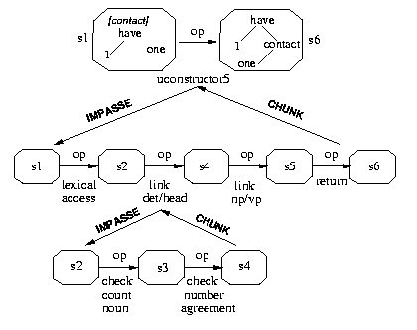
A top-level NL-Soar operator

Slide 29
Subgoaling in NL-Soar (1)

Slide 30
Subgoaling in NL-Soar (2)

Slide 31
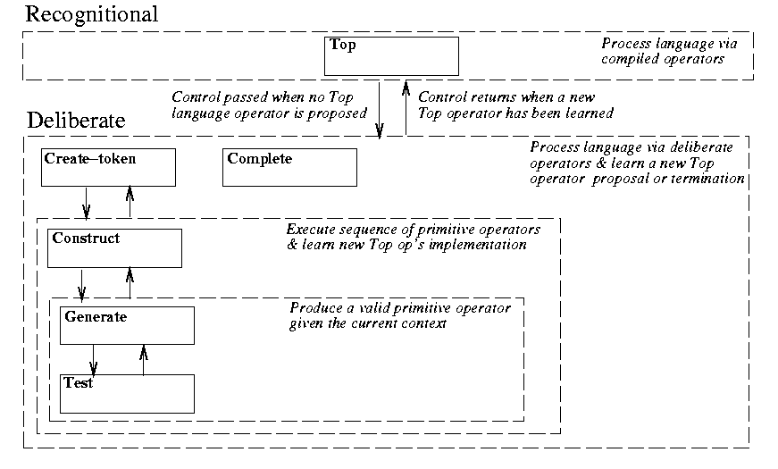
The basic learning process (1)

Slide 32
The basic learning process (2)

Slide 33
The basic learning process (3)

Slide 34
Lexical access processing
Performed on incoming words
Attended to from decay-prone phono buffer
Relevant properties retrieved
  Morphological
  Syntactic
  Semantic
Basic syn/sem categories projected
Provides information for later syn/sem processing

Slide 35
Morphology in NL-Soar
Previous versions: fully inflected lexical entries via productions
Now: TSI code to interface directly with WordNet data structures
Morphy: subcomponent of WordNet to return baseform of any word
Had to do some post-hoc refinement

Slide 36


Slide 37
Comprehension

Slide 38
NL-Soar Comprehension
Overview of topics:
Lexical Access
Morphology
Syntax
Semantics

Slide 39
How NL-Soar comprehends
Words are input into the system 1 at a time
The agent receives words in an input buffer
After a certain amount of time the words decay (disappear) if not attended to
Each word is processed in turn; “processed” means attended to (recognized, taken into working memory) and incorporated into relevant linguistic structures
Processing units: operators, decision cycles

Slide 40
NL-Soar comprehension op’s
Lexical access
  retrieve from a lexicon all information about a word’s morpho/syntactic/semantic properties
Comprehension
  convert an incoming sentence into two representations
  Utterance-model constructors: syntactic
  Situation-model constructors: semantic

Slide 41
Lexical Access
Word Insertion: Words are read into NL-Soar one at a time.
Lexical Access: After a word is read into NL-Soar, the word frame is accessed from WordNet.
WordNet: An online database that provides information about words such as their part of speech, morphology, subcategorization frame, and word senses.

Slide 42
Shared architecture
Exactly same infrastructure used for syntactic comprehension and generation
  Syntactic u-model
  Semantic s-model
  Lexicon, lexical access operators
  Syntactic u-cstr operators
  Decay-prone buffers
Generation leverages comprehension
Learning can be bootstrapped across modalities

Slide 43
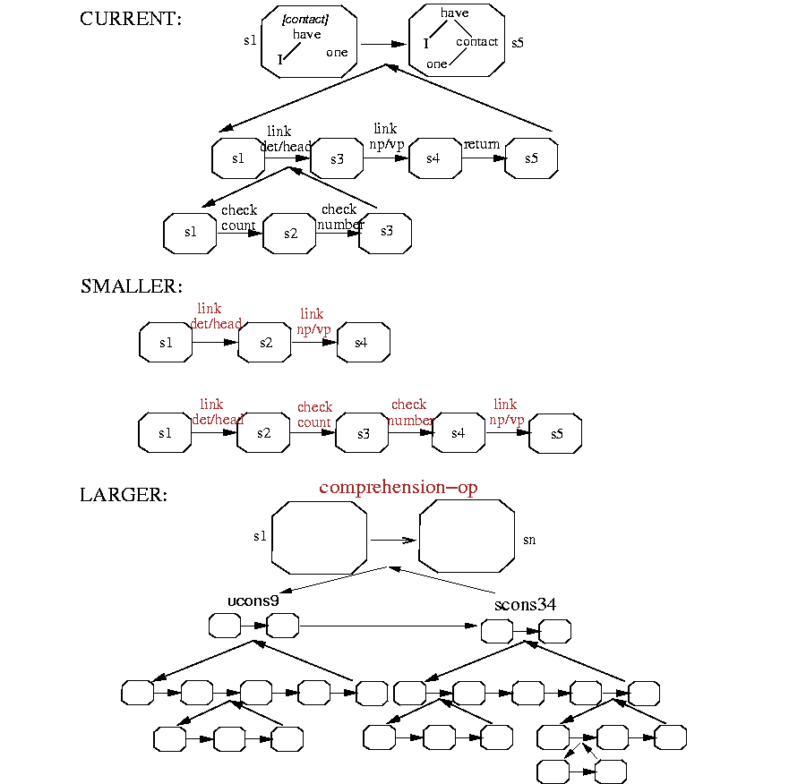
How much should an op do?

Slide 44
Memory & Attention
Word enter the system one at a time.
If a word is not processed quickly enough, then it decays from the buffer and is lost.

Slide 45
Assumptions
Interpretive Semantics (syntax is prior)
Yet there is some evidence that this is not the whole story
Other computational alternatives exist (tandem)
We hope to be able to relax this assumption eventually

Slide 46
Syntax

Slide 47
NL-Soar Syntax (overview)
Representing Syntax (parsing, X-bar)
Subcategorization & WordNet
Sample Sentences
U-cstrs (constraint checking)
Snips
Ambiguity

Slide 48
Linguistic models
Syntactic model: X-bar syntax, basic lexical properties (verb subcategorization, part-of-speech info, features, etc.)
Semantic model: lexical-conceptual structure (LCS) that is leveraged from the syntactic nodes and lexicon-based semantic properties
Assigner/receiver (A/R) sets: keep track of which constituents can combine with which other ones
I/O buffers

Slide 49
Syntactic phrases
One or more words that are “related” syntactically
Form a constituent
Have a head (most important part)
Have a category (derived from the head)
Have specific order, distribution, cooccurrence patterns (in English)

Slide 50
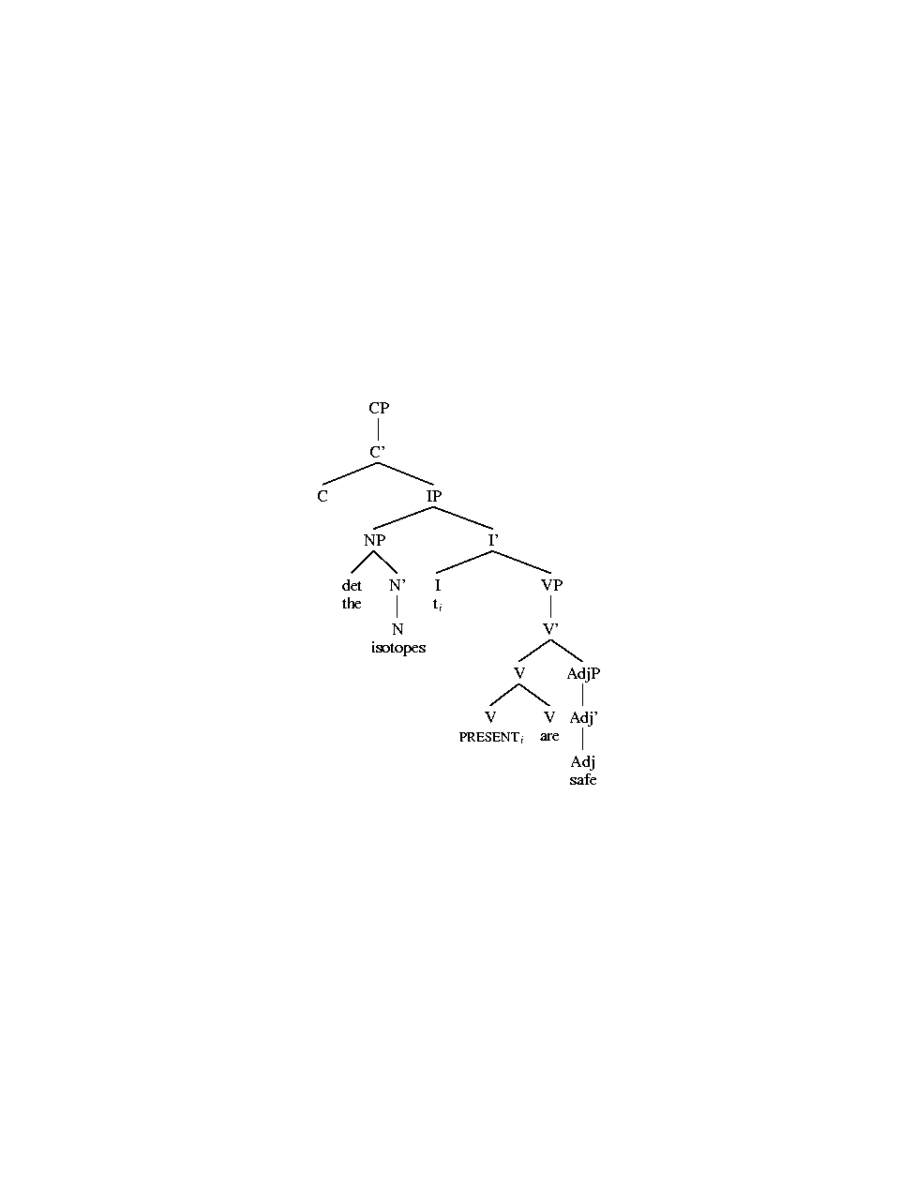
English parse tree
are

Slide 51
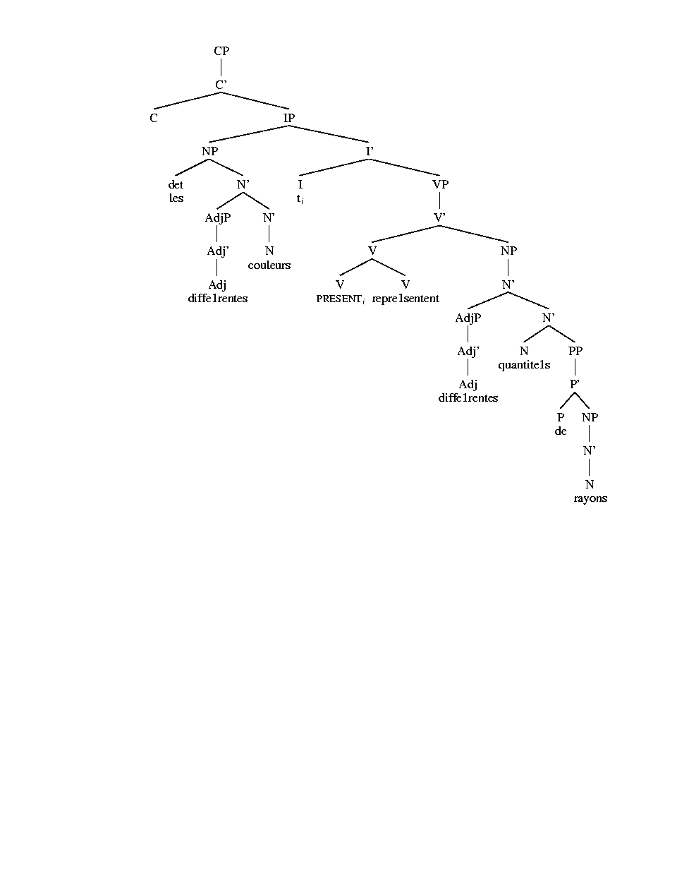
French parse tree

Slide 52
Some tree terminology
Tree: diagram of syntactic structure (also called a phrase-marker)
Node: position in a tree where branches come together or leave
  Terminal: very bottom of the tree (also called a leaf node)
  Nonterminal: node inside the tree (also called a non-leaf node)
  Sister, daughter, mother, etc. for relative position

Slide 53
Phrase structure
The positions:
  Specifier
  Head
  Complement
The levels:
  Zero-level
  Bar-level
  Phrase-level

Slide 54
Diagramming syntax (phrases)
phrase structure follows a basic template
words have a category, project to a phrase
head: most important word, lowest level, basic building-block of phrases; P, A, N, V
specifier: qualifies, precedes the head (Eng.)
  spec(NP) = determiner
  spec(V) = adverb
  spec(A) = adverb
  spec(P) = adverb

Slide 55
Diagramming syntax (phrases)
complement: completes (modifies) the head; follows the head in English
  compl(V) = PP or NP or ...
  compl(P) = NP or PP
  compl(NP) = PP or clause or …

Slide 56
Noun phrases
NP
NP
s
h
s
h
Det
the
N’
NP
Det
my
N’
c
h
h
h
N
N’
N
dogs
h
dogs
across the
fence
N
dogs

Slide 57
Verb phrases
VP
VP
s
h
s
h
Qual
never
V’
Qual
never
V’
c
VP
h
h
h
V
V
barked
V’
barked
h
at the mailman
V
barked

Slide 58
Prepositional phrases
PP
PP
s
h
s
h
Deg
just
P’
PP
Deg
just
P’
c
h
h
h
P
P’
P
across
h
across
the street
P
across

Slide 59
Adjective phrases
AP
AP
s
h
s
h
Deg
quite
A’
Deg
quite
A’
c
AP
h
h
h
A
A
proud
A’
proud
h
of their child
A
proud

Slide 60
The basic phrase template
NP
PP
s
h
s
h
N’
P’
c
c
h
h
AP
VP
N
P
s
h
s
h
A’
V’
c
c
h
h
A
V

Slide 61
The basic X’ template
XP
s
h
X’
c
h
X
where X is any category

Slide 62
Why X’?
Generative semantics: generate syntactic surface forms from same underlying semantic representation
End of 1960’s, Chomsky argues for interpretive semantics
  Crux of argument: nominalization (Remarks on Nominalization)

Slide 63
The I category
IP
s
h
I’
c
NP
VP
h
h
I
h
N’
(past)
V’
h
h
N
V
zebras
sneeze

Slide 64
An example of a CP complement
CP
h
C’
IP
h
C
why
I’
VP
I
we
work

Slide 65
Subcategorization
What types of complements a word requires/allows/forbids
  vanish: ø The book vanished ___.
  prove: NP He proved the theorem.
  spare: NP NP
  send: NP PP
  proof: CP
  curious: PP or CP
  toward: NP
Information not available in most dictionaries (at least not explicitly)

Slide 66
WordNet subcat frames
1 Something ----s
2 Somebody ----s
3 It is ----ing
4 Something is ----ing PP
5 Something ----s something Adjective/Noun
6 Something ----s Adjective/Noun
7 Somebody ----s Adjective
8 Somebody ----s something
9 Somebody ----s somebody
10 Something ----s somebody
11 Something ----s something
12 Something ----s to somebody
13 Somebody ----s on something
14 Somebody ----s somebody something
15 Somebody ----s something to somebody
16 Somebody ----s something from somebody
17 Somebody ----s somebody with something
18 Somebody ----s somebody of something
19 Somebody ----s something on somebody
20 Somebody ----s somebody PP
21 Somebody ----s something PP
22 Somebody ----s PP
23 Somebody's (body part) ----s
24 Somebody ----s somebody to INFINITIVE
25 Somebody ----s somebody INFINITIVE
26 Somebody ----s that CLAUSE
27 Somebody ----s to somebody
28 Somebody ----s to INFINITIVE
29 Somebody ----s whether INFINITIVE
30 Somebody ----s somebody into V-ing something
31 Somebody ----s something with something
32 Somebody ----s INFINITIVE
33 Somebody ----s VERB-ing
34 It ----s that CLAUSE
35 Something ----s INFINITIVE

Slide 67
WordNet semantic classes
26 Noun classes
15 Verb classes
  verb.body
  verb.change
  verb.cognition
  verb.communication
  verb.competition
  verb.consumption
  verb.contact
  verb.creation
  verb.emotion
  verb.motion
  verb.perception
  verb.possession
  verb.social
  verb.stative
  verb.weather
  (noun.Tops)
  noun.act
  noun.animal
  noun.artifact
  noun.attribute
  noun.body
  noun.cognition
  noun.communication
  noun.event
  noun.feeling
  noun.food
  noun.location
  noun.group
  noun.motive
  noun.object
  noun.person
  noun.phenomenon
  noun.plant
  noun.possession
  noun.process
  noun.quantity
  noun.relation
  noun.shape
  noun.state
  noun.substance
  noun.time
Notes:
This is to give you an idea of the classes WordNet uses.
(??They were originally designed around collocation tendencies of various word senses.)

Slide 68
Lexical information
Sample sentence: “Dogs chew leashes.”
dogs: N[pl], V[3sg]
chew: N[sg], V[~3sg]
leashes: N[pl], V[3sg]
dogs: n-animal, n-artifact, n-person, v-motion
chew: n-act, v-consumpt, n-food
leashes: n-artifact, v-contact, n-quantity

Slide 69
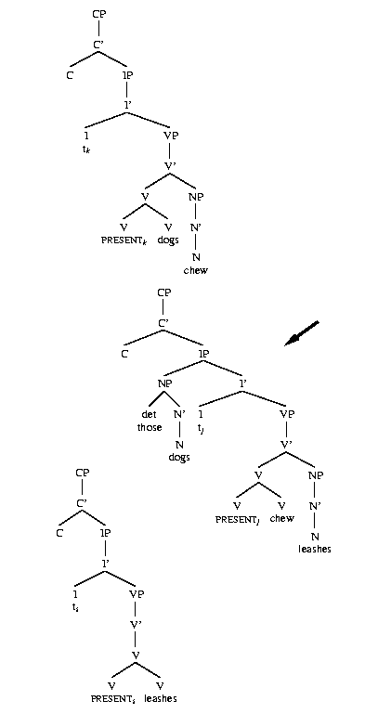
Completed sentence parse
Most complete model consistent with lexical properties, syntactic principles
Non-productive partial structures are later discarded
Input for semantic processing


Slide 70
Syntactic Snips
Pritchett (1988), Gibson (1991), and others justify syntactic reevaluation.
Also called ‘garden path’ sentences.
‘I saw the man with the beard/telescope.’

Slide 71
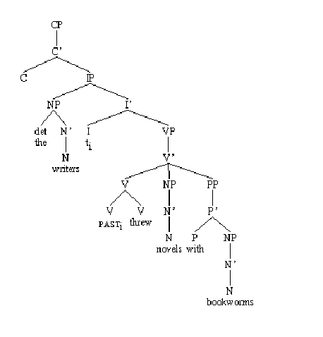
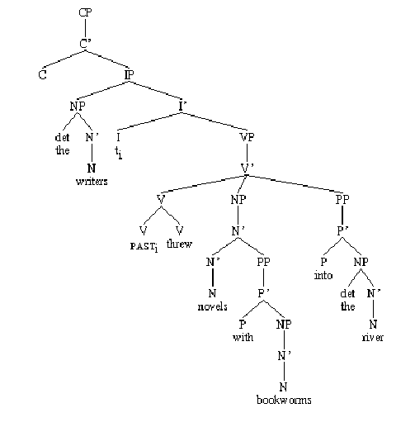
Syntactic Snip Example

Slide 72
Attachment ambiguity (2)
Hindle/Rooth: mutual information
  Baseline via unambiguous instances
  “Easy” ambiguities: use model
  “Hard” ambiguities: thresholded partitioning
Other factors
  More context than just the triple
  Intervening constituents
  Nominal compounding is similar in structure/ complexity (but sparseness a worse problem)
  Indeterminate attachment:
  We signed an agreement with them.

Slide 73
Ambiguity
A sentence has multiple meanings
Lexical ambiguity
  Different meanings, same syntactic structure; differences at word level only
  e.g. bat (flying mammal, sports device)
    Yesterday I found a bat.
Morphological ambiguity
  Different meanings, different morphological structure; differences in morphology
  e.g. axes (axe+s, axis+s)
  Pay attention to these axes.

Slide 74
Syntactic ambiguity
Sentence has multiple meanings based on constituent structure alone
Frequent phenomena:
  PP-phrase attachment
    I saw the man with a beard. (not ambiguous)
    I saw the man with a telescope. (ambiguous)
  Nominal compound structure
    He works for a small computer company.

Slide 75
Syntactic ambiguity (cont.)
Frequent phenomena (cont.)
  Modals/main verbs
    We can peaches. (not ambiguous)
    We can fish. (ambiguous)
  Possessives/pronouns
    We saw his duck. (not ambiguous)
    We saw her duck. (ambiguous)
  Coordination
    I like raw fish and onions.
    The price includes soup and salad or fries.

Slide 76
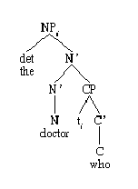
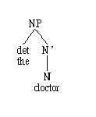

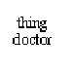
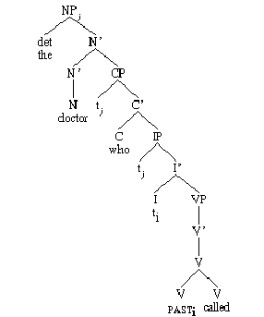
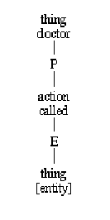
Parsing a sample sentence (1)
doctor
who
called

Slide 77
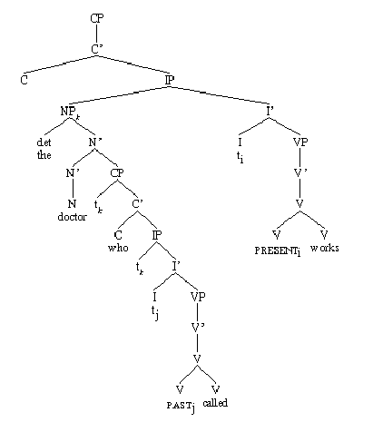
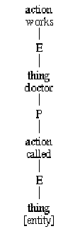
Parsing a sample sentence (2)
works

Slide 78
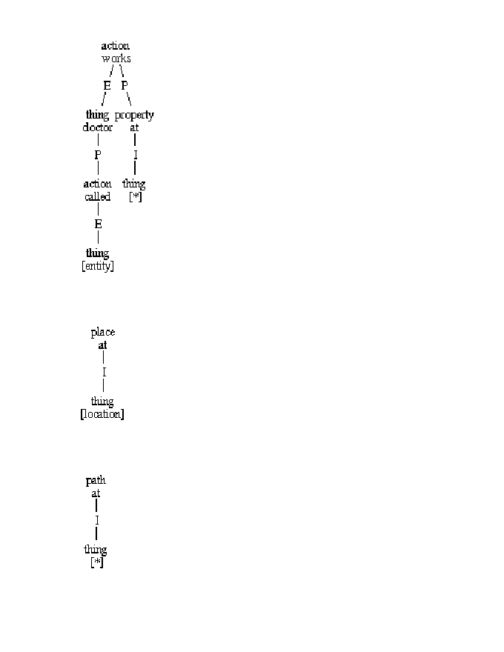
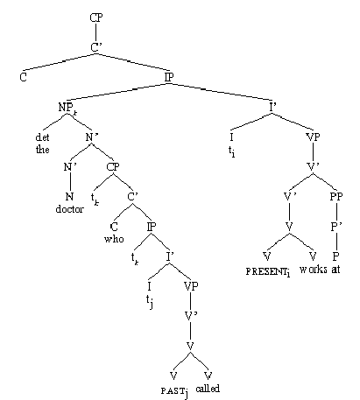
Parsing a sample sentence (3)
at

Slide 79
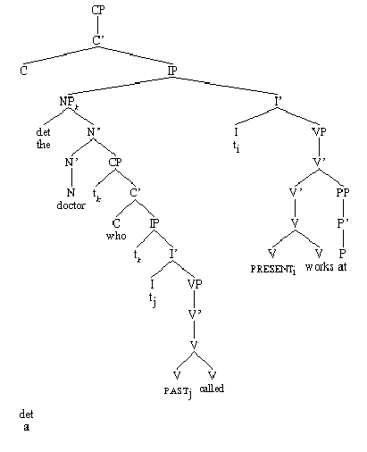
Parsing a sample sentence (4)
a

Slide 80
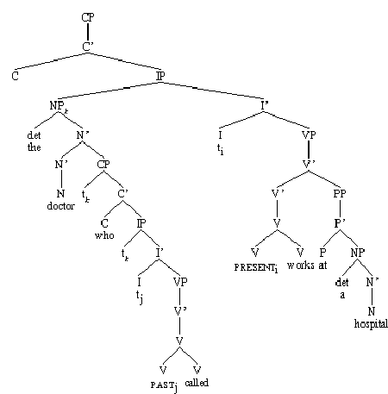
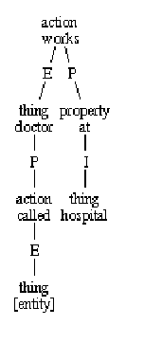
Parsing a sample sentence (5)
hospital

Slide 81
U-model constructors (u-cstrs)
Link in a word/phrase into the ongoing u-model
Checks for compatibility (subject-verb agreement, article-head number agreement, gender compatibility, word order, etc.)
Tries out all possibilities in a hypothesis space, determines when successful, returns result, then actually performs the operation

Slide 82
English parse tree
?
are

Slide 83
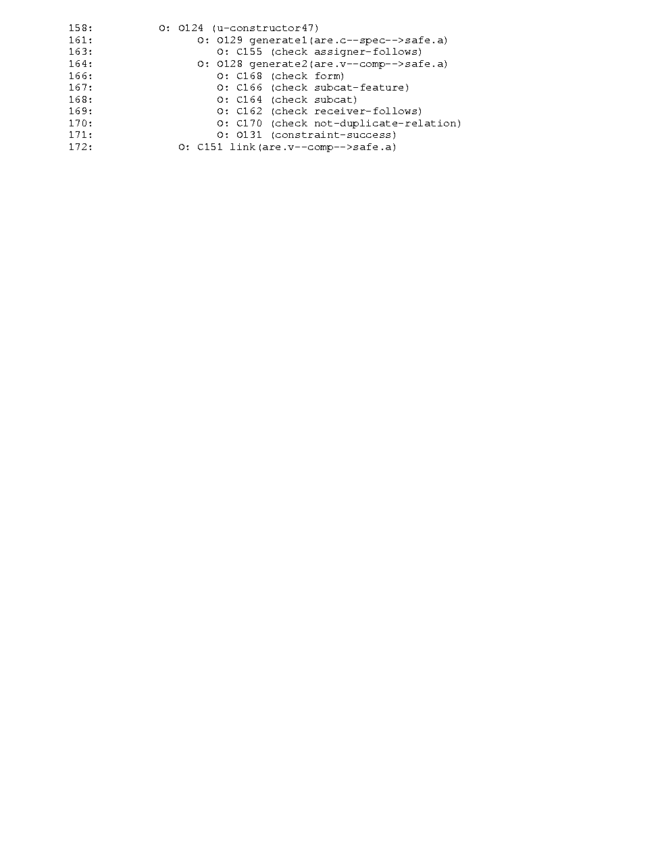
Learning a u-constructor

Slide 84
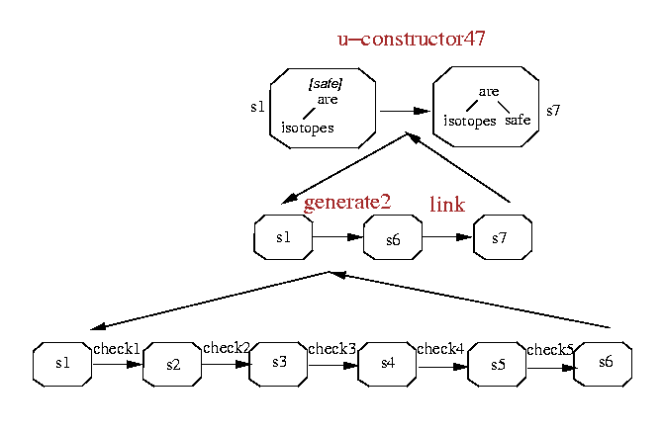
Composition of u-cstr op’s

Slide 85
Deliberation vs. Recognition
Learning is (debatably) the most interesting aspect of (NL-)Soar
Deliberation: goal-directed behavior using knowledge, but having to “figure out” everything along the way; don’t know what to do
Recognitional: chunked-up knowledge, skill, automaticity, expertise, cognitively cruising; already know how to solve the problem

Slide 86
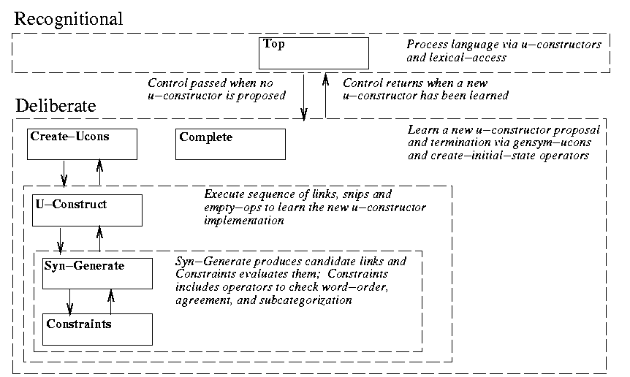
Syntactic building blocks

Slide 87
Deliberation (vs. recognition)
“The isotopes are safe.”
  196 decision cycles (vs. 146)
  24 msec/dc avg. (vs. 14)
  18 waits (vs. 132)
  4975 production firings (vs. 1016)
  12,371 wm changes (vs. 2,153)
  Wm size: 951 avg, 1691 max (vs. 497, 835)
  CPU time: 4.7 sec (vs. 2.1)

Slide 88
Syntax (review)
NL-Soar syntax: incremental, accesses properties from WordNet
The syntactic operator, the ‘u-cstr,’ takes finds ways to place each word sense into the ongoing syntactic tree.
It uses constraints such as subcategorization, word sense, number, gender, case, etc.
Failed proposals lead to new proposals.

Slide 89
Syntax review (2)
When all constraints are not satisfied or no possible actions remain, the sentence is deemed ungrammatical.
The result of this process is that NL-Soar syntactic processing actively discriminates between possible word senses.
Once the current word’s operator has succeeded, the process begins on the next word heard.
The X-bar syntactic structure in NL-Soar is thus built up incrementally, and is interruptable at the word level.
Subgoaling/learning happens and is necessary.

Slide 90
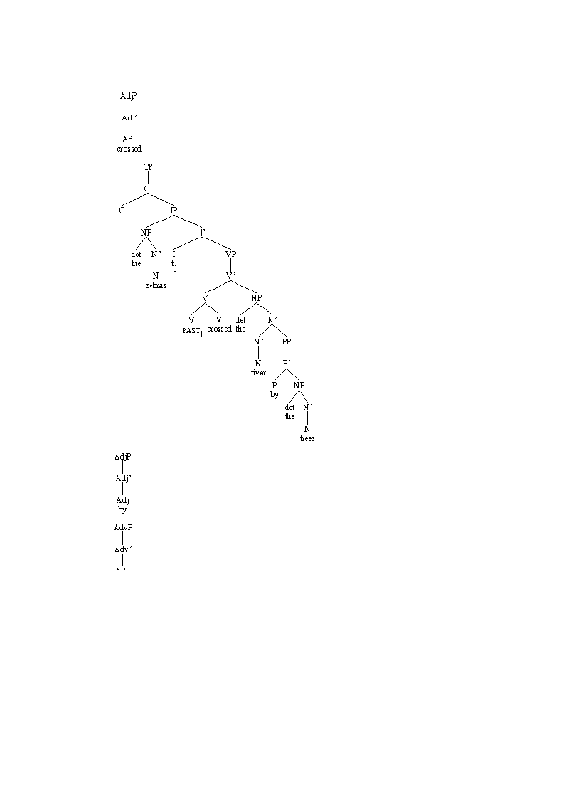
Example phrase structure tree
“The zebras crossed the river by the trees.”

Slide 91
Discourse/dialogue
NLD running in 7.3
Work with TrindiKit
  Possible inspiration, crossover, influence
WordNet integration
  Adapt NLD discourse interpretation for WordNet output
More dialogue plans (beyond TACAIR)

Slide 92
Semantics

Slide 93
Semantics (overview)
Representing Semantics
Semclass Information
Sample Sentences
S-cstrs (constraint checking)
Semantic Snips
Semantic Ambiguity

Slide 94
Basic assumptions
Syntax, semantics are different modules
They are (somehow) related
  Knowing about one helps knowing about another
They involve divergent representations
Both are necessary for a thorough treatment of language

Slide 95
Sample sentence syn/sem

Slide 96
Semantics
What components of linguistic processing contribute to meaning?
Characterization of the meaning of (parts of) utterances (word/phrase/clause/sentence)
To what extent can the meaning be derived (compositionally)? How is it ambiguous?
Formalisms: networks, models, scripts, schemas, logic(s)
Non-literal use of language (metaphors, exaggeration, irony, etc.)

Slide 97
Semantic representations
Ways of representing concepts
  Basic entities, actions
  Relationships between them
  Compositionality of meaning
Some are very formal, some very informal
Various linguistic theories might involve different representations

Slide 98
Lexical semantics
Word meaning
  Synonymy: youth/adolescent, filbert/hazelnut
  Antonymy: boy/girl, hot/cold
Word senses
  Polysemy: 2+ related meanings (bright, deposit)
  Homonymy: 2+ unrelated meanings (bat, file)

Slide 99
45 WordNet semantic classes
26 Noun classes
15 Verb classes
  verb.body
  verb.change
  verb.cognition
  verb.communication
  verb.competition
  verb.consumption
  verb.contact
  verb.creation
  verb.emotion
  verb.motion
  verb.perception
  verb.possession
  verb.social
  verb.stative
  verb.weather
  (noun.Tops)
  noun.act
  noun.animal
  noun.artifact
  noun.attribute
  noun.body
  noun.cognition
  noun.communication
  noun.event
  noun.feeling
  noun.food
  noun.location
  noun.group
  noun.motive
  noun.object
  noun.person
  noun.phenomenon
  noun.plant
  noun.possession
  noun.process
  noun.quantity
  noun.relation
  noun.shape
  noun.state
  noun.substance
  noun.time

Slide 100
LCS
One theory for representing semantics
Focuses on words and their lexical properties
Widely used in NLP applications (IR, summarization, MT, speech understanding)
It displays the relationships which exist between the argument(s) and the predicate (verb) of an utterance.
Two categories of arguments: external (outside the scope of the verb) and internal (an argument residing within the verb’s scope).
An LCS shows the relationships between qualities and arguments.

Slide 101
LCS and NL-Soar
NL-Soar’s uses LCS’s for its semantic representation.
  Others have been used in the past; others could be used in the future.
Built incrementally, word-by-word.
Pre-WordNet: 7 classes: action, process, state, event, property, person, thing
Now: WordNet-defined semantic classes
Discussed at Soar-20

Slide 102
Interpretive semantics
Map:
  NP’s → entities, individuals
  VP’s → functions
  S’s → T values
Relate objects in the semantic domain via syntactic relationships

Slide 103
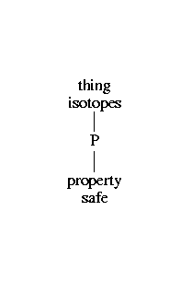
Parsing (NL-Soar)
The isotopes are safe.

Slide 104
Modeling semantic processing
Also done on word-by-word basis
Uses lexical-conceptual structure
Leverages syntax
Builds linkages between concepts
Previous versions used 8 semantic primitives
  Coverage useful but inadequate
  Difficult to encode adequate distinctions
WordNet lexfile names now used as semantic categories

Slide 105
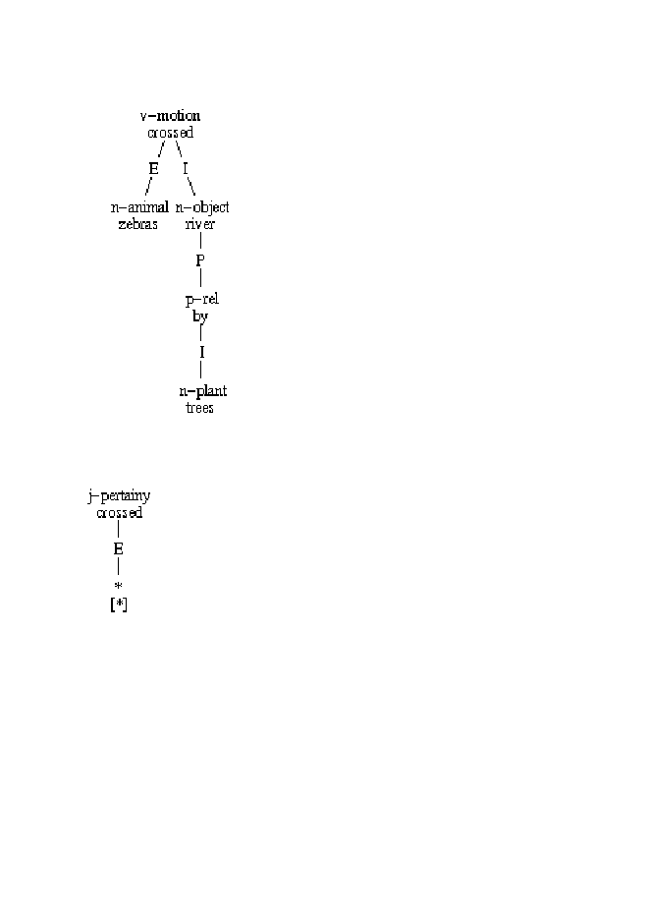
Example LCS
“The zebra crossed the river by the trees.”
The predicate in this LCS is the verb ‘crossed’ which is of the class ‘motion.’
The predicate has two arguments, an external argument, ‘zebra,’ and an internal argument, ‘river.’ Zebra is a noun of the class ‘animal,’ whereas river is a noun of the class, ‘object.’
The internal argument, ‘river,’ then has the quality of being ‘by the trees.’ This is shown as a relation between ‘river’ and ‘by’ with it’s internal argument, ‘trees,’ which is a noun of the class ‘plant.’

Slide 106
WordNet Sem Word Classes
n-act n-object j-pertainy v-stative
n-animal n-person v-body v-weather
n-artifact n-phenom v-change
n-attribute n-plant v-cognition
n-body n-possession v-communic
n-cognition n-process v-competition
n-communic n-quantity v-consumpt
n-event n-relation v-contact
n-feeling n-shape v-emotion
n-food n-state v-motion
n-group n-substance v-perception
n-location n-time v-possession
n-motive p-rel v-social

Slide 107
Selectional restrictions
Semantic constraints on arguments (the semantic counterpart to syntactic subcategorization)
Close synonymy
  Small/little
  I have little/*small money.
  This is Fred, my big/*large brother.
Animacy
  My neighbor admires my garden.
  *My car admires my garden.
  Bill frightened his dog/*hacksaw.
Implicit objects in English (e.g. I ate.)
Can be superseded (exaggeration, figurative language, etc.)
Psycholinguistic evidence

Slide 108
Lexical information
Sample sentence: “Dogs chew leashes.”
dogs: N[pl], V[3sg]
chew: N[sg], V[~3sg]
leashes: N[pl], V[3sg]
dogs: n-animal, n-artifact, n-person, v-motion
chew: n-act, v-consumpt, n-food
leashes: n-artifact, v-contact, n-quantity

Slide 109
The syntactic parse


Slide 110
WordNet Sem Word Classes
n-act n-object j-pertainy v-stative
n-animal n-person v-body v-weather
n-artifact n-phenom v-change
n-attribute n-plant v-cognition
n-body n-possession v-communic
n-cognition n-process v-competition
n-communic n-quantity v-consumpt
n-event n-relation v-contact
n-feeling n-shape v-emotion
n-food n-state v-motion
n-group n-substance v-perception
n-location n-time v-possession
n-motive p-rel v-social

Slide 111
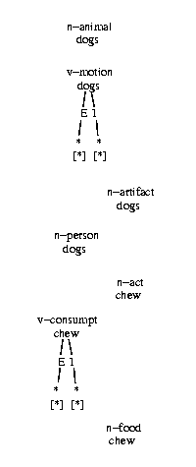
Preliminary semantic objects
Pieces of conceptual structure
Correspond to lexical/phrasal constructions in syntactic model
Compatible pieces fused together via operators

Slide 112
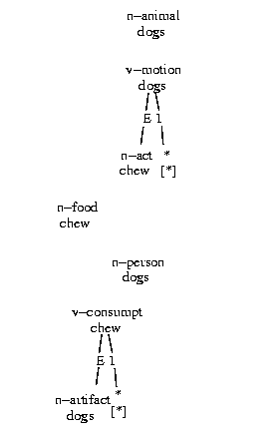
Selectional preferences
Enforce compatibility of pieces of semantic model
Reflect limited disambiguation
Based on semantic classes
Ensure proper linkages
Reject improper linkages
Implemented as preferences for potential operators

Slide 113
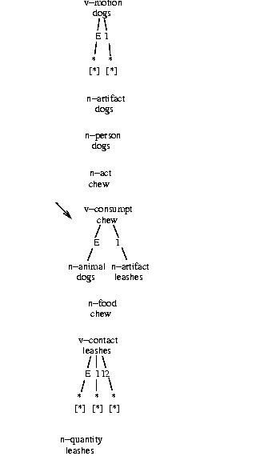
Final semantic model
Most fully connected linkage
Includes other sem-related properties not illustrated here
Serves as input for further processing (discourse/dialogue, extralinguistic task-specific functions, etc.)


Slide 114
Semantic disambiguation
Word sense
  Choosing most correct sense for a word in context
  Problem: WordNet senses too narrow (large # of senses)
    Avg. 4.74 for nouns (not a big problem)
    Avg. 8.63; high of 41 senses for verbs (a problem)
Semantic classes
  Select appropriate WordNet semantic class of word in context
  An easier, more plausible task
Notes:
Problem: Lexical entries in WordNet can dozens of different senses.
In order to make a semantic representation, we need to decide which meaning is most appropriate. This task is called Word Sense Diambiguation – but WordNet’s senses are too-fined grained to make this a plausible task for untrained native speakers, and too difficult of a task to model in one step. So we are working on an intermediate goal: Semantic Class Disambiguation.

Slide 115
Semantic class disambiguation
Select appropriate WordNet classification of word in context
Advantages
  An easier, more plausible task
    Conflates similar, easily confused senses
  Analogous with “part of speech” in syntax
    Obviates need for ad-hoc classifications
    Simpler than WordNet’s multi-level hierarchies
  Intermediate step to more fine-grained WSD
Various WordNet-derived lexical properties can be used in SCD
Notes:
NL-Soar attempts to keep syntax and semantics roughly similar – so we need a “semantic” evquivalent to part of speech to structure the semantic representation
The earlier version of NL-Soar had an eight-fold division based on Jackendoff, but each word (or word-sense) had to be hand-classified. In WordNet, this is already done for us.
We basically conflate all the word-senses which share a category, so instead of choosing between dozens of fine senses, we choose from just a few categories.
Intermediate step (and useful framework) to build on, when we do tackle more fine-grained WSD later on (using WN’s semantic hierarchies)

Slide 116
Sem constraint for #29 v-body
Most frequent verbs in class:
wear, sneeze, yawn, wake up
(most frequent) Subjects:
  People
  Animals
  Groups
Direct Objects:
  Body Parts
  Artifacts
Indirect Objects: none
Subject Constraint
sp {top*access*body*external
(state <g> ^top-state <ts> ^op <o>)
(<o> ^name access)
(<ts> ^sentence <word>)
(<word> ^word-id.word-name <wordname>)
(<word> ^wndata.vals.sense.lxf v-body)
-->
(<word> ^semprofile <sempro> + &)
(<sempro> ^category v-body ^annotation verbclass + & ^psense <wordname> ^external <subject>)
(<subject> ^category *
^semcat n-animal + &
^semcat n-person + &
^psense * ^internal *empty*) }

Slide 117
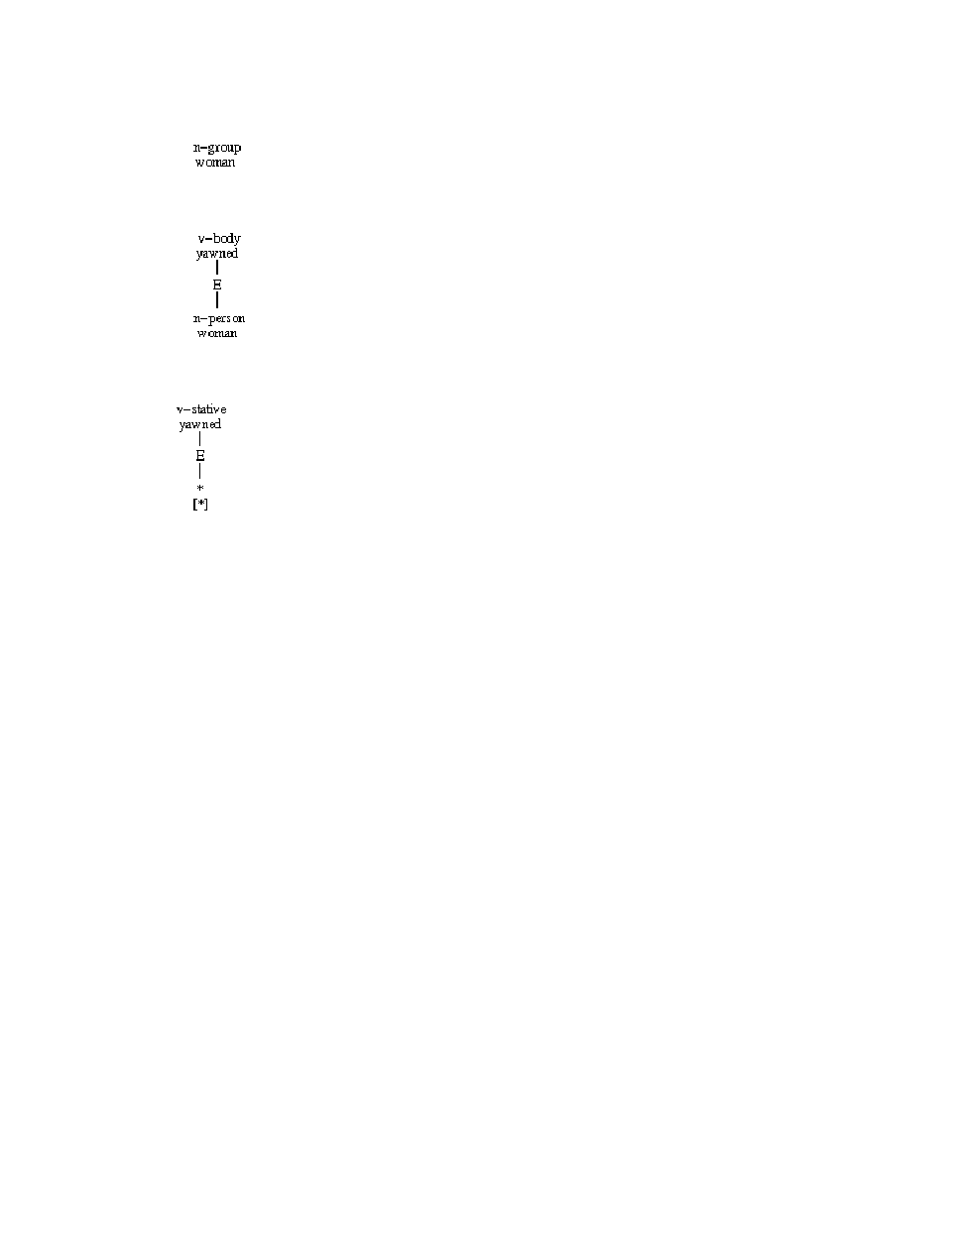
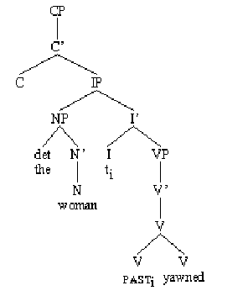
Sample sentence: the woman yawned
(basic case: most frequent senses succeed.)
Syntax:
  first tree works.
Semantics:
  v-body & n-person match.
  v-stative never tried.
Notes:
(This is the basic case: most frequent senses succeed.)
This sentence is unambiguous syntactically.
So there’s only one part of speech combination to consider.
noun(“woman”) – verb(“yawn”)
The most common sense of yawned is v-body,
And most common sense of woman is n-person,
So they get tried first.
V-body allows n-person as a subject, so it passes constraint.
And we get the parse on the right.

Slide 118
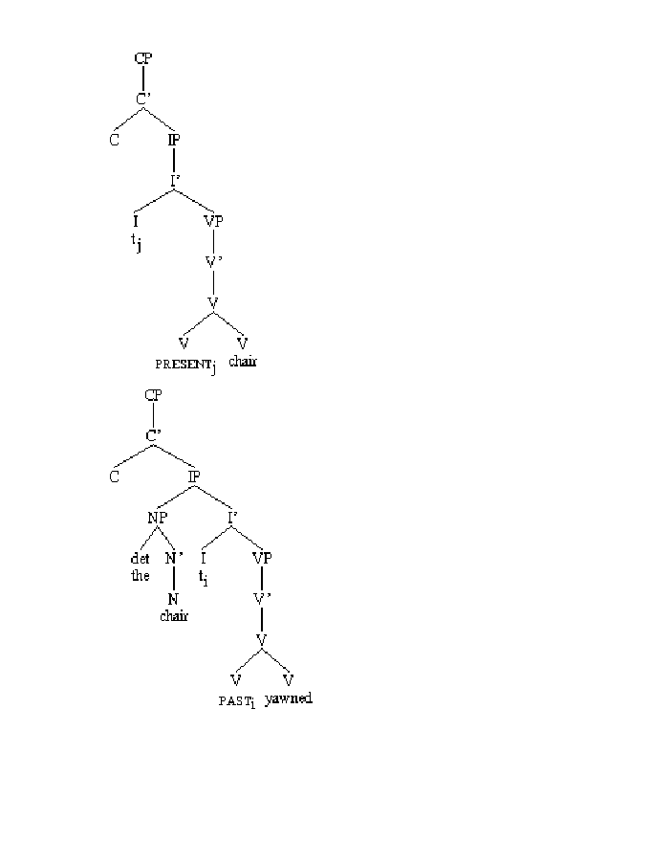
Example #2: The chair yawned
(most frequent noun sense inappropriate)
Semantics:
  chair_{verb} senses rejected
  n-artifact incompatible w/ v-body
  n-person accepted
Syntax:
  chair_{verb} rejected
  chair_{noun} accepted
v-social
chair
|
E
|
*
|*|
v-body
yawn
|
E
|
n-person
chair
v-body
yawn
|
E
|
n-artifact
chair
Notes:
(Most frequent noun sense inappropriate)
“Chair” is morphologically ambiguous –
can be either a noun or a verb. NL-Soar tries both trees,
But the syntax module rejects “chair” as a verb (green X on left).
This causes semantic module to throw out all the verb-classes which include a sense of the word “chair” (green X on right through v-social)
This still leaves two noun-classes: n-artifact and n-person.
N-artifact is more common, and is tried first.
But v-body rejects n-artifact as a subject, so it fails constraint.
NL-Soar then tries n-person (e.g., dept. chair), which succeeds.

Slide 119

Example #3: The crevasse yawned.
(most frequent verb sense inappropriate)
Semantics:
  all noun senses incompatible w/ v-body
  n-object matches with v-stative
Syntax:
  first tree works
v-body
yawn
|
E
|
n-object
crevasse
v-stative
yawn
|
E
|
n-object
crevasse
Notes:
Example #3: The crevasse yawned.
(Most frequent verb sense inappropriate)
There is only one sense for crevasse in WordNet, and it belongs to n-object. This doesn’t work as a subject of body verbs, so the verb sense fails (matching with no subjects and failing to fill its external role).
There is another sense of yawn (“be open, gape, yaw”) which does fit with natural objects, and this sense matches.

Slide 120
Attachment ambiguity
PP-attachment: one of the hugest NLP problems
Lexical preferences are obvious device:
I saw a man with a beard/telescope.
Co-occurrence statistics can help
But there are strong syntactic factors as well (low attachments)

Slide 121
Semantics
Once an appropriate syntactic constituent has been built, semantic interpretation begins.
As with syntax, an utterance’s semantics is constructed one word at a time via operators.
This operator, called the s-constructors, takes each word and one by one fits them into the LCS.
In order to associate semantic concepts correctly, the operators execute constraint checks before linking them in the LCS.

Slide 122
Semantics Continued
Semantic constraints check such things as word senses, categories, adjacency, and duplication of reference and fusion.
They also refer back to syntax to ensure that the two are compatible.
Successful semantic links are graphed out in the semantic LCS.
If the proposed parse does not pass through the constraints successfully then it is abandoned and other options for linking the arguments are pursued.

Slide 123
S-model constructor (s-cstr)
Fuses a concept into the ongoing s-model
Checks for compatibility (thematic role, semfeat agreement, feature consistency, syntax-semantics interpretability, word order, etc.)
Tries out all possibilities in a hypothesis space, determines when successful, returns result, then actually performs the operation

Slide 124
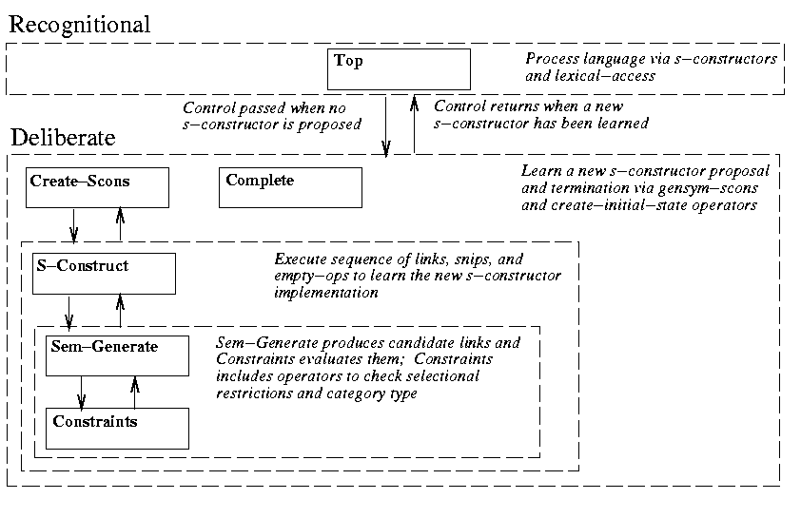
Semantic building blocks

Slide 125
French syntactic model

Slide 126
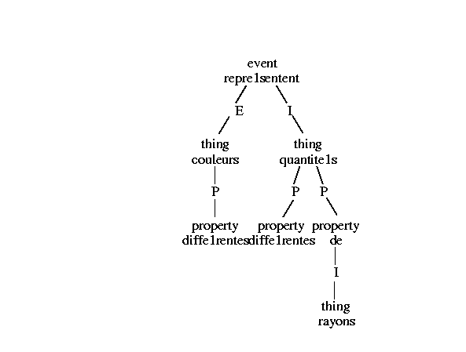
French semantic model

Slide 128
Semantic complexity
WordNet word-sense complexity is astounding
Has resulted in severe performance problems in NL-Soar
  Some (simple!) sentences not possible
New: user-selectable threshold
Result: possible to avoid bogging down of system

Slide 129
Discourse/Pragmatics
Discourse
  Involves language at a level above individual utterances.
    Issues
      Turn-taking, entailment, deixis, participants’ knowledge
  Previous work has been done (not much at BYU)
Pragmatics
  Concerned with the meanings that sentences have in particular contexts in which they are uttered.
    NL-Soar is able to process limited pragmatic information
      Prepositional phrase attachment
      Correct complementizer attachment

Slide 130
Pragmatic Representation
Why representation?
  Ambiguities abound
    BYU panel discusses war with Iraq
    Sisters reunited after 18 years in checkout counter
    Everybody loves somebody
Different types of representation
  LCS – Lexical Conceptual Structures
  Predicate Logic
    The dog ate the food.
      ate(dog,food).
  Discourse Representation Theory

Slide 131
NL-Soar discourse operators
Manage models of discourse referents and participants
Model of given/new information (common ground)
Model of conversational strategies, speech acts
Anaphor/coreference: discourse centering theory
Same building-block approach to learning

Slide 132
Discourse/dialogue
NLD running in 7.3
Work with TrindiKit
  Possible inspiration, crossover, influence
WordNet integration
  Adapt NLD discourse interpretation for WordNet output
More dialogue plans (beyond TACAIR)

Slide 133
NL-Soar generation process
Input: a Lexical-Conceptual Structure semantic representation
Semantics → Syntax mapping (lexical access, lexical selection, structure determination)
Intermediate structure: an X-bar syntactic phrase-structure model
Traverse syntax tree, collecting leaf nodes
Output: an utterance placed in decay-prone buffer

Slide 134
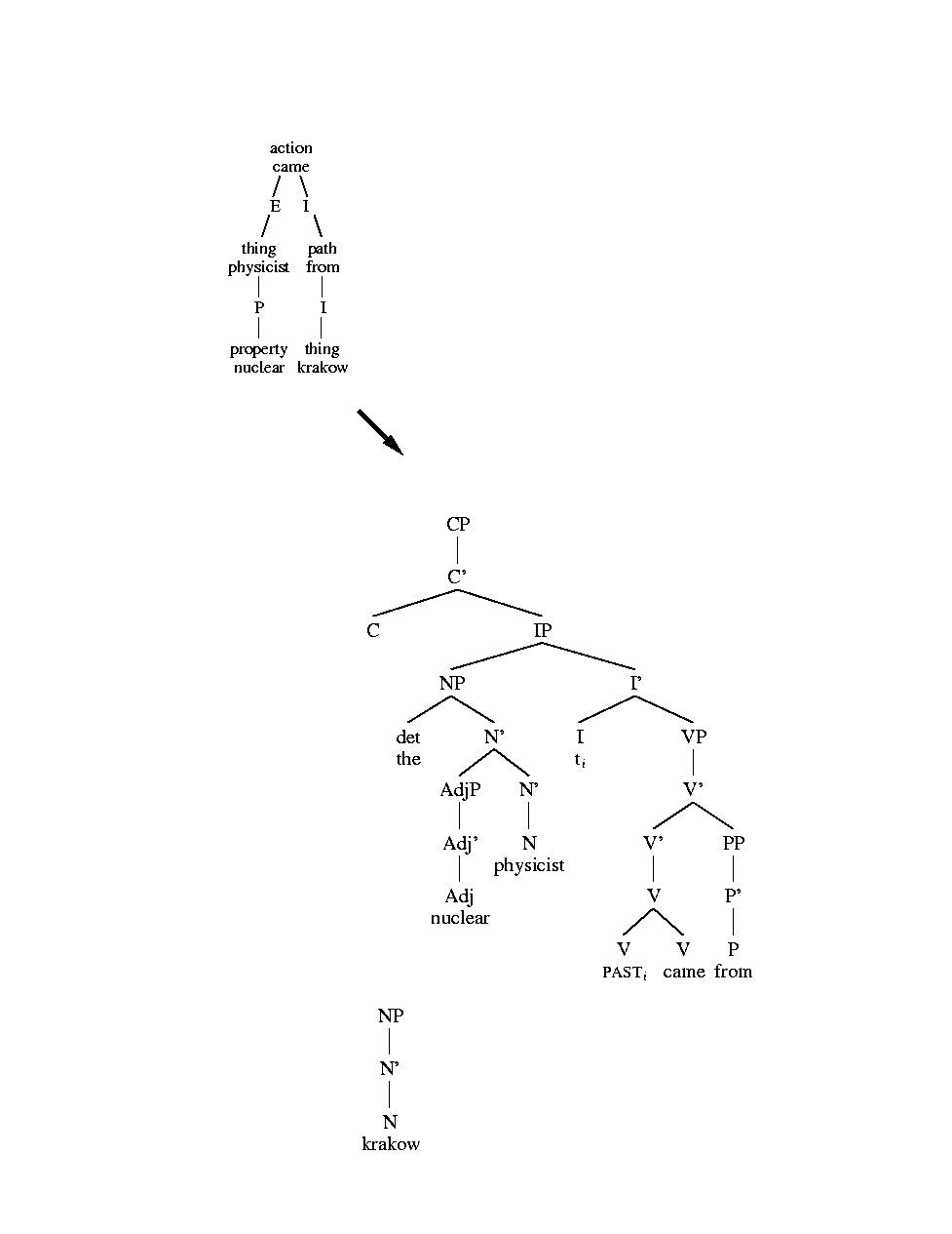
NL-Soar generation

Slide 135
NL-Soar generation

Slide 136
NL-Soar generation

Slide 137
NL-Soar generation
OP39
OP12
OP27
OP44

Slide 138
Generation
NLG running in 7.3
Wider repertoire of lexical selection operators
WordNet integration
Serious investigation into chunking behavior

Slide 139
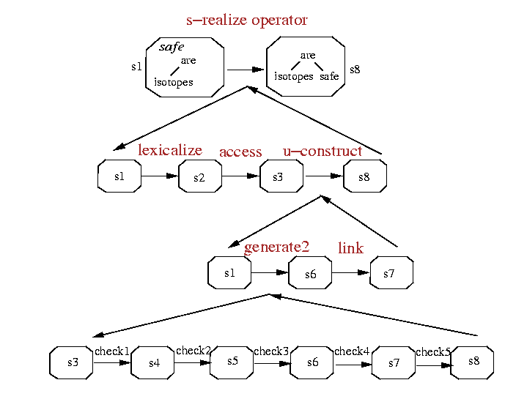
NLS generation operator (1)

Slide 140
NLS generation operator (2)

Slide 141
NLS generation operator (3)

Slide 142
NLS generation operator (4)

Slide 143
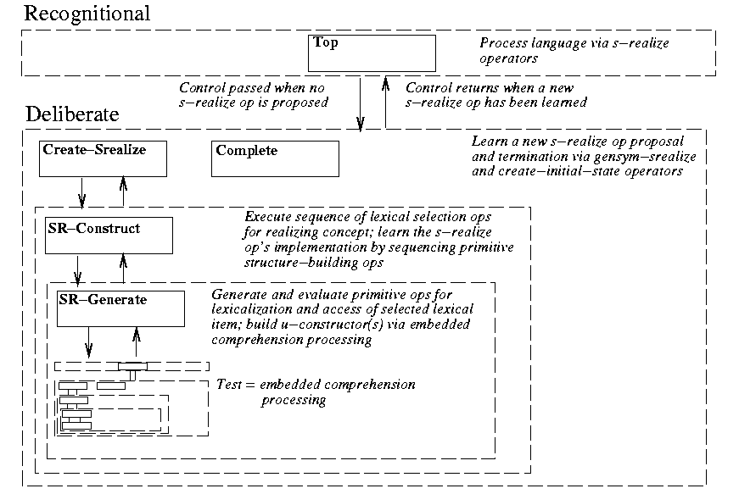
Generation building blocks

Slide 144
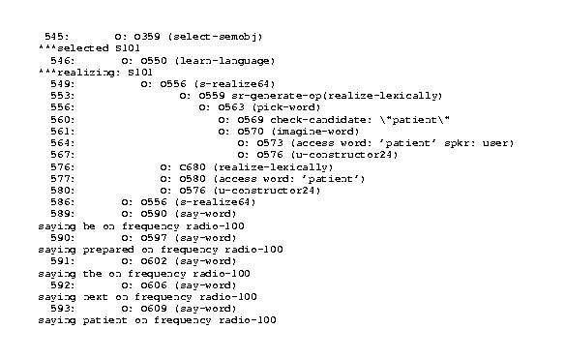

Partial generation trace

Slide 145
NL-Soar generation status
English, French
Shared architecture with comprehension
  Lexicon, lexical access
  Semantic models
  Syntactic models
Interleaved with comprehension, other tasks
Bootstrapping: learned operators leveraged
Not quite real-time yet; architectural issues
Needs more in text planning component
Future work: lexical selection via WordNet

Slide 146
Shared architecture
Exactly same infrastructure used for syntactic comprehension and generation
  Syntactic u-model
  Semantic s-model
  Lexical access operators
  u-cstr operators
Generation leverages comprehension
Learning can be bootstrapped across modalities!

Slide 147
French u-model

Slide 148
French s-model

Slide 149
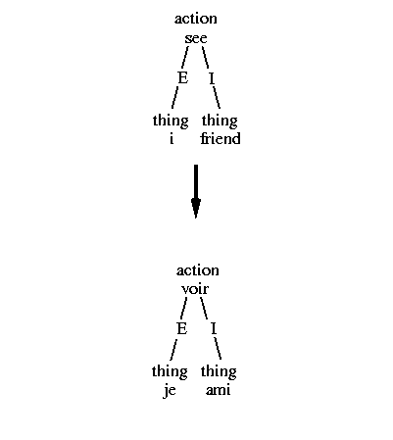
NL-Soar mapping

Slide 150
NL-Soar mapping operators
Mediate pieces of semantic structure for various tasks
  Convert between different semantic representations (fs→LCS)
  Bridge between languages for tasks such as translation
  Input: part of a situation model (semantic representation)
  Output: part of anther (type of) situation model

Slide 151
Mapping stages
Traverse the source s-model
For each concept, execute an m-cstr op
  Lexicalize the concept: evaluate all possible target words/terms that express it, choose one
  Access: perform lexical access on the word/term
  s-constructor: incorporate the word/term into the generation s-model

Slide 152
Current status
We’ve made a lot of progress, but much still remains
We have been able to carry forward all basic processing from 1997 version (Soar 7.0.4, Tcl 7.x)
It’s about ready to release to brave souls who are willing to cope

Slide 153
What works
Generally the 1997 version (backward compatibility)
  Though it hasn’t been extensively regression-tested
Sentences of middle complexity
Words without too much ambiguity
Morphology > syntax > semantics

Slide 154
What doesn’t work (yet)
Conjunctions
Some of Lewis’ garden paths
Adverbs (semantics)

Slide 155
Documentation
Website
  Bibliography (papers, presentations)

Slide 156
Distribution, support
(discussion)

Slide 157
Future work
Increasing linguistic coverage
CLIG
Newer Soar versions
Other platforms
Other linguistic structures
Other linguistic theories
Other languages

