Slide 1
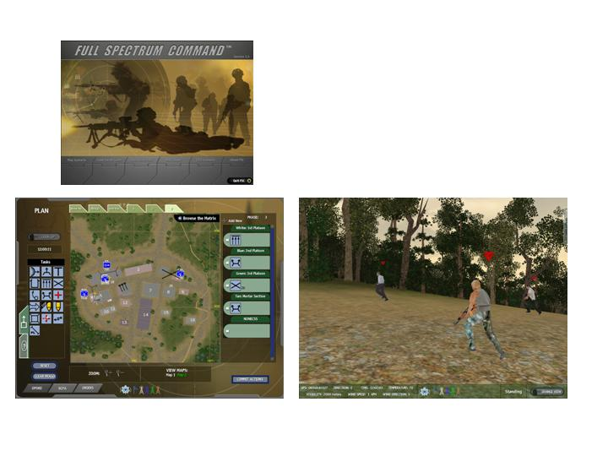
Tactical AI, Soar, and Full Spectrum Command
Paul Brobst
Ryan McAlinden
Institute for Creative Technologies
6/9/04
Soar Workshop

Slide 2
Tactical reasoning vs. Strategic reasoning
Tactical reasoning
  Small scale actions serving a larger purpose. Carried out with only a limited or immediate end in view.
  Small, sequential actions (e.g. MoveTo, FireAt) that can be aggregated to achieve a higher-level goal.
  Examples: Bounding overwatch, Suppressive fire, Follow route, Clear room
  Individual/Squad level reasoning
Strategic reasoning
  Higher-level goals consisting of sequential tactical-level actions.
  Combined to satisfy an overall goal or objective.
  Examples: Assault location, Secure town, Clear building
  Generally associated with Platoon and higher.

Slide 3
Full Spectrum Command
Real Time Strategy training aid developed for the U.S. Army
  ICT and Quicksilver Software
Focus on Company-level MOUT operations against asymmetric Opposing Force (OPFOR) threats
Currently support McKenna (Ft. Benning) and Silvy (Singapore) MOUT sites
Player typically controls Blue Force (BLUFOR); computer OPFOR
Two phases of BLUFOR training
  Planning– at the Company level issuing orders to Platoons, Squads, and Fire Teams
  Execution– planned actions that have been committed to the simulation

Slide 4
Planning Phase and Execution Phase
Planning phase
  Issue sequentially executed actions (matrix)
  Event-based
Execution phase
  First-person perspective/control
  Ability to bypass phase matrix and issue Fragos

Slide 5
Full Spectrum Command AI
Player provides the high-level plan for the BLUFOR
  All high-level plan actions have an associated AI handler function
  Most handlers contain the lower-level tactical decisions needed to carry out the action inside of them; they are not broken down into atomic actions
A minimal plan is provided by the Game for the OPFOR through the scenario (Patrol Route, Guard)
  Opposing force is very reactive. It does not adapt to player input and is geared towards a certain avenue of approach
Two levels of AI that manage these plans/actions
  Control– primarily reactive (Spotted, firedAt)
  Command– runs in a separate thread
  Both still just issue individual actions not dependent on overall game state or mission

Slide 6
Current AI
Manager Services
Map
NPC
Know
Thread 1
Thread 2
Simulation Engine
Reactive
(Control)
AI
Command
AI
Sound
Physics
Graphics

Slide 7
FSC-AI Continued
Sim Engine communicates with Command and Control AI via message passing.
Manager Services are part of the AI system, not the Sim Engine. They track NPC locations, map information etc and are updated by both the Sim Engine and the AI systems.
All manager updates must be preserved in order to support FSC-AI vs External-AI capabilities.
Manager services contain nearly everything an external AI system will need.

Slide 8
ICT AI Extensions to FSC
Tactical reasoning
  Soar interface to FSC-- bypass existing AI and use Soar for tactical-level decision making for both BLUFOR and OPFOR
  Ability for OPFOR (and BLUFOR) to be more than just reactive
    Recognize and manage game state for several decision cycles
    Input higher-level mission objectives (“clear all buildings”), which are decomposed into unit-level tasks
Strategic reasoning
  Planner interface into FSC
    Enable computer-directed Blue Force
    Enhance Opposing Force with adaptability

Slide 9
Extended AI
Manager Services
Map
NPC
Know
Update queries
Managers updated
Thread 1
Thread 2
2
6
Simulation Engine
XInterface
G
S
K
I
Soar
Executable
actions
Action
outputs
7
Sound
5
1
Decision
cycle
Physics
Graphics
3
AI Event
Queue
Event &
updates
4

Slide 10
GSKI and FSC
Statically compiled and linked in with FSC executable
Running GSKI and Soar in a separate thread from game
Use EventQueue to determine which decision cycle to launch (OnSpotted, OnFiredAt)
XInterface manages events and game updates based on events
  NPC location, health, current task
Data control and flow is working…
  still working on the rules

Slide 11
Nuggets & Coal
Nuggets
  GSKI’s thread control options– relatively easy to hook up and manage decision cycles
  FSC’s existing AI thread– simulation does not have to rely on AI output (can use existing reactive AI)
    Don’t know how Soar will perform with dozens of agents running concurrently
Coal
  FSC is not designed to be interfaced with in this way
    State Management (hard to manage where game data is at any given time)
    Codebase (parts of the AI are tightly coupled to all other parts of the game)
    Existing AI is not meant to handle more than sequential baseline unit actions (difficult for higher-level objectives)

Slide 12
Questions?

