Slide 1

Soar Emote
Bob Marinier
John Laird
University of Michigan

Slide 2
Motivation
Emotions and feelings influence behavior, so a UTC needs to model them
Emotions and feelings are influenced by processes at the biological, cognitive and social levels
Existing models only cover one or two of these levels
Notes:
So suppose John tells me that something I did needs more work. If I thought I did a good job and he uses a negative tone of voice and I’m really tired, I may get angry. On the other hand, if I didn’t particularly like what I did either, he uses a positive tone of voice and I’m energetic, then I’ll probably take the criticism much better.

Slide 3
Background
Antonio Damasio 1994, 2003
  Big picture with focus on the biological level
  Defines difference between emotions and feelings
    Emotion = body state
    Feeling = perception of emotion
  Model is descriptive
Gratch & Marsella 2004 (EMA)
  Uses appraisal theory to cover cognitive and social levels
  Describe coping mechanisms
    Problem-focused, emotion-focused
  Model is implemented in Soar rules

Slide 4

Gratch & Marsella: Appraisal Theory
“Emotion” (Feeling) | Appraisal Variables
Joy | Desirability > 0 Likelihood = 1
Hope | Desirability > 0 Likelihood < 1
Fear | Desirability < 0 Likelihood < 1
Dismay | Desirability < 0 Likelihood = 1
Anger | Desirability < 0 Blameworthy object

Slide 5
Gratch & Marsella: Coping
Emotion-focused coping
  Denial: Deny that a negative event occurred
    “He wasn’t actually angry at me.”
  Positive-reinterpretation: Increase the desirability of an event
    (after failing to qualify) “A master’s degree is more marketable than a PhD anyway.”

Slide 6
Soar Emote
A framework which combines the biological, cognitive and social levels as described by Damasio
  Maintains emotions/feelings distinction
Details on the cognitive and social levels filled in with simplified version of EMA
Emotions and feelings are influenced but not determined by knowledge
  The mechanisms which generate emotions and feelings are separate from the cognitive mechanisms

Slide 7
Evaluation Ideas
Too early to try matching human data
Goal is to show that each level in the model exerts some influence on behavior
Qualitatively, we also consider the plausibility of the behavior
To test the framework, we introduce a simple game

Slide 8
A Water Balloon Game
Two-player cooperative water balloon toss
Phases
  Throw: Thrower tosses the balloon to the catcher
  Catch: Catcher tries to catch the balloon
  Remark: Thrower remarks on result
  Remark: Catcher remarks on result
  Final: Thrower gets to consider catcher’s remark
After each round, the players switch roles

Slide 9
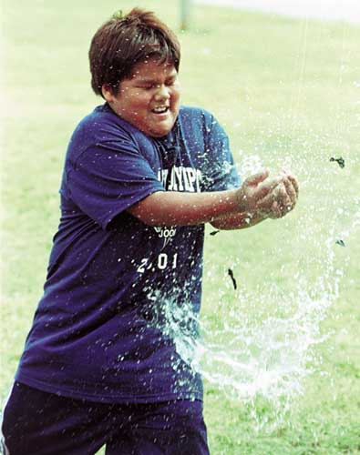

Slide 10
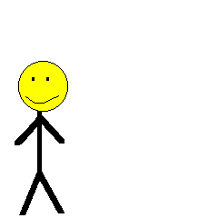
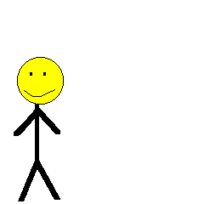
For example…
Thrower makes a bad throw
  Doesn’t have complete control
Catcher runs to catch the balloon but fails
  Catcher gets wet and is hot and tired
Thrower is angry that the catcher missed the balloon and makes a critical remark of the catcher

Slide 11
Soar Emote
Environment
Agent
Physical System
Cognitive System
(visible)
External Physiology (13)
I’m on grass
He looks angry
He made a critical remark about me
I’m hot
I’m tired
I’m not in pain
His fault catch failed
…
(Appraisals)
Appraisal Summarizer (10)
Cognitive Contribution (10, 12)
Anger, Intensity high
High body temperature
No pain
High exertion
Cognitive Appraisals (9)
Internal Physiology (2,11)
His fault catch failed
Anger, Intensity high
Angry at him
…
(Appraisals)
I’m tired +
Anger, Intensity medium
Architecture Boundary
Body Appraisal (12)
(2)
Desirability -
Working Memory (6)
Body State (2)
Emotion (13)
He looks angry
Critical remark about me
I’m on grass
Normal environmental temperature
External Stimuli
Emotion System (12)
Percepts, including feelings (5, 15)
Desirability +
I’m on grass
I’m not in pain
…
Desirability –
I’m hot
I’m tired
…
Desirability – (his fault)
He looks angry
Critical remark about me when it’s his fault
…
(Appraisal Rules)
Conclusions
He’s the reason I’m angry
…
Actions
I can engage in Denial
I can engage in Positive Reinterpretation
I can make a critical remark about him
I can say nothing
…
Cognitive Appraisals,
Actions, Coping,
Focus of Anger (8, 15)
Emotion (14)
Anger, Intensity high
(1)
Perception (3,14)
Remark critical of him
On grass
He looks angry
Critical remark about me
High body temperature
High exertion
No pain
Reflexive Output Commands (4)
Deliberate
Output Commands (16)
Long-term Memory (rules) (7)
Actions
Motor System (16)

Slide 12
Soar Emote
Environment
Agent
Physical System
Cognitive System
(visible)
External Physiology (13)
Appraisal Summarizer (10)
Cognitive Contribution (10, 12)
Internal Physiology (2,11)
Cognitive Appraisals (9)
Architecture Boundary
Body Appraisal (12)
(2)
Body State (2)
Emotion (13)
Working Memory (6)
External Stimuli
Emotion System (12)
Percepts, including feelings (5, 15)
Emotion (14)
Cognitive Appraisals,
Actions, Coping,
Focus of Anger (8, 15)
(1)
Perception (3,14)
Reflexive Output Commands (4)
Deliberate
Output Commands (16)
Long-term Memory (rules) (7)
Actions
Motor System (16)

Slide 13
Review of Influences
Level | Systems
Biological | Internal and External Physiology, Body Emotion System
Cognitive | Appraisal Rules, Cognitive Emotion System, Emotion-focused coping
Social | Problem-focused coping (remarks), Perception of External Physiology of others

Slide 14
Test Setup
Lesion various components and note the impact on behavior
  Fully affective: no lesions
  Non-biological: no physiological influence on emotions and feelings
  Non-cognitive: no cognitive appraisals, no emotion-focused coping
  Non-social: no remarking, no external physiology
100 games, 20 rounds each, both agents of same type

Slide 15
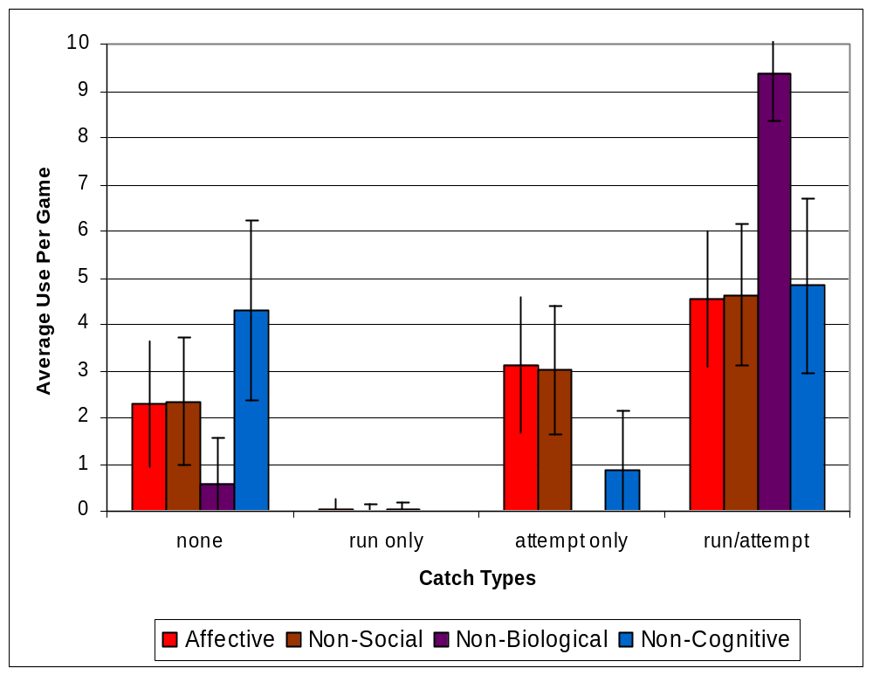
Biological Influence
Non-Biological agent
  Run/attempt significantly more than fully-affective agent
  Never chooses attempt-only

Slide 16
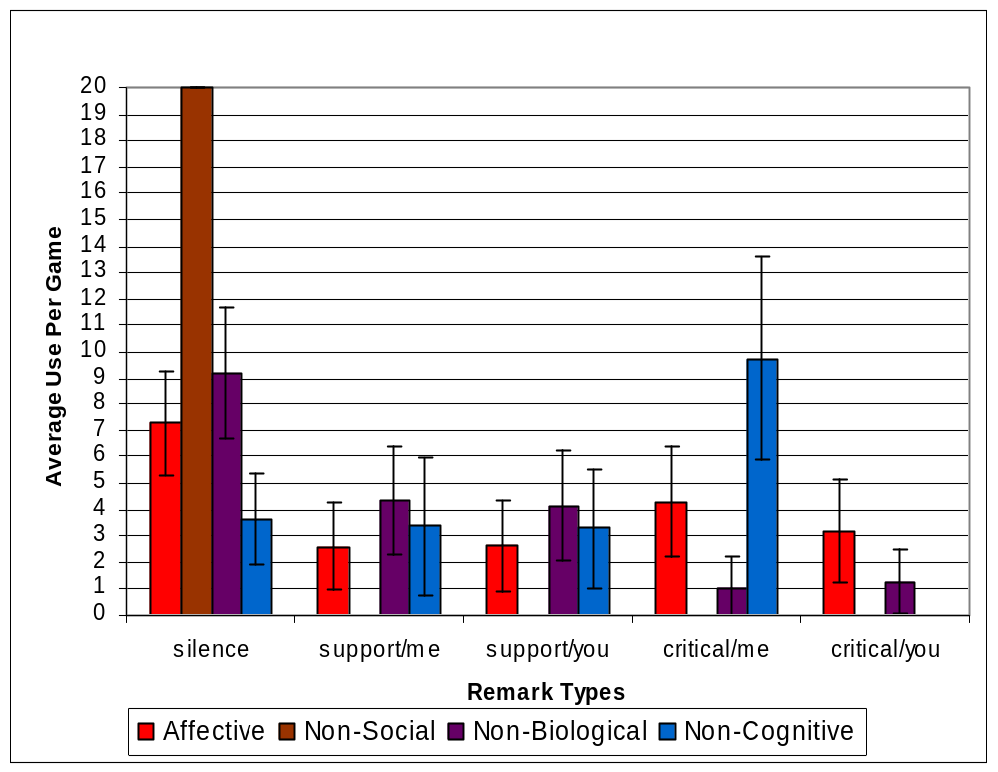
Cognitive Influence
Non-cognitive agent
  Silence significantly less than fully-affective agent
    Chooses critical/me more
  Never chooses critical/you

Slide 17

Social Influence
Non-social agent
  Always chooses silence

Slide 18
General Observations
All levels exert some influence
For this model and this task, the biological side seems to have an overall negative influence on the agent’s emotions and feelings whereas the cognitive side is more positive
Little variation in throwing behaviors

Slide 19
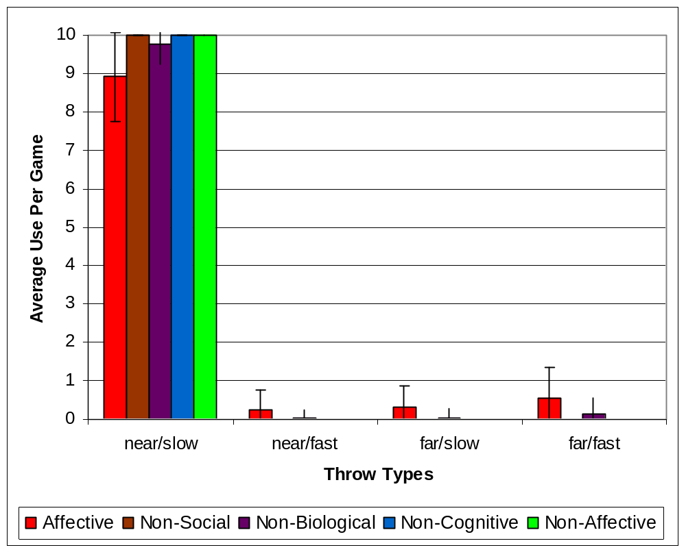
Little variation in throwing behaviors

Slide 20
The Need for History
Problem: Throwing behaviors didn’t vary much because the emotions didn’t carry over to the next round
  Agent couldn’t remember what just happened (so there wasn’t much to appraise)
Solution: Add basic history so agent can remember events between rounds
  Alternative: Emotional momentum
Expectations: Throwing behaviors especially should be more varied

Slide 21
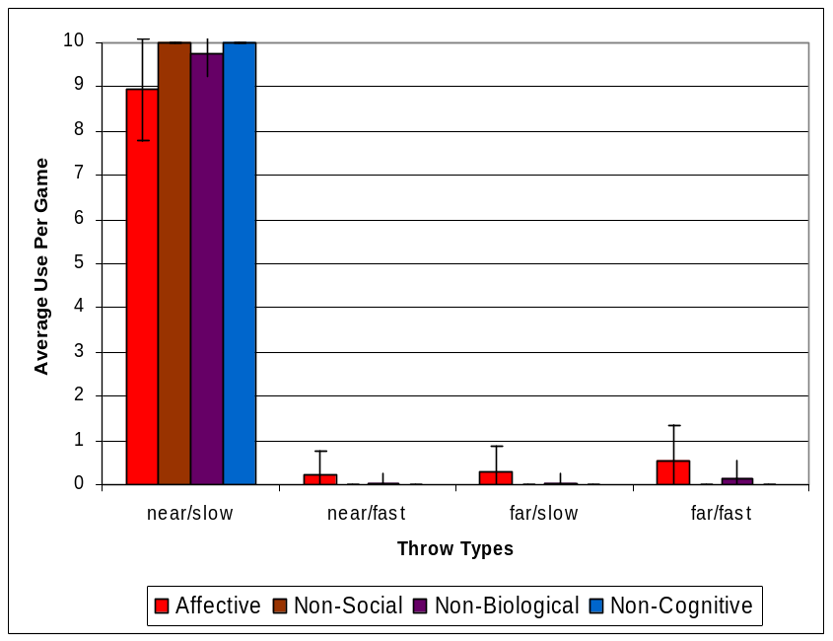
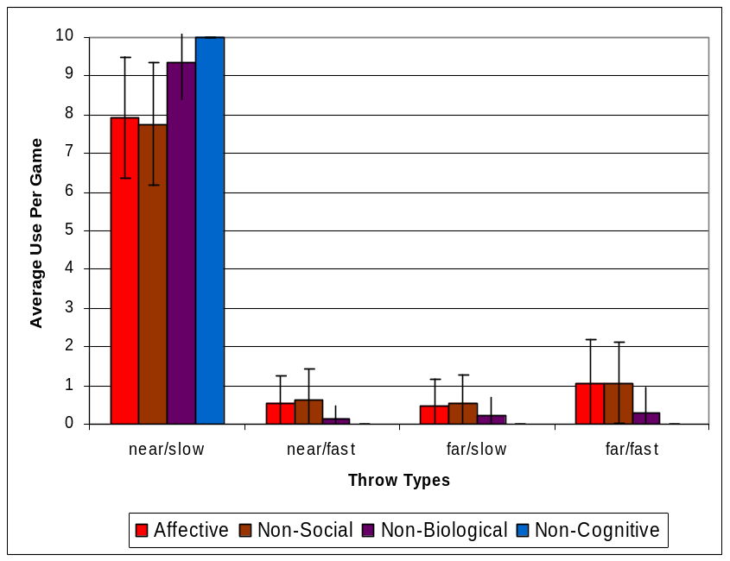
History Results
Without History
With History
In general more “bad” throws
Significant difference with Non-Social agent

Slide 22
Nuggets
  Initial results encouraging
  Able to identify and correct shortcomings
Coal
  Lots of future work left to do
  Not ready for human data

Slide 23
Future Work: Framework
Biological
  Emotional momentum
  Modification of emotional perception (as in fleeing)
Cognitive
  Moderation of emotional responses
  Modification of emotional perception (as in empathy)
  Integration with better historical model (episodic memory)
  Integration with reinforcement learning (rewards & punishments)
  Impact of emotions and feelings on architecture
    Rule matching, preferences, goals
Social
  Identify other events that have social impact
  Explore other kinds of social impact
    Culture
    Adherence to norms
All
  Appraisal theory can take place at all levels
    Explore new variables, temporal differences in variable onset
  Individual differences

Slide 24
Future Work: Evaluation
Plausibility testing
  Can test each new feature for influence
Simple case studies
  Can use to get timing data
Group data
  Can use to determine the range of plausible timings and behaviors

Slide 25
