Slide 1

Blue Bear Systems Research
Soar Agents for
Unmanned Air & Ground Vehicles
Dr Phill Smith
24th Soar Workshop
9th – 11th June 2004
Building 32, Twinwoods Business Park, Clapham, Bedfordshire MK41 6AE
Tel: 01234 212001 Email: phill@bluebearsystems.com
✓ www.bluebearsystems.com

Slide 2
Presentation Overview
Outline of project objectives, and vehicle functionality
Walkthrough slides of a typical simulation
Demonstration run
Questions
Project funded by SAIC

Slide 3
Objectives
Development of a Soar agent:
  Exercised from the Simulink simulation environment
  Controlling:
    Up to 6 unmanned ground vehicles
    Up to 4 UAV’s
  Mission
    Form up into a team
    Routine patrol through an urban area
    Dynamically re-route around blocked roads
    Investigate areas of interest

Slide 4
Conflicting Goals
The Unmanned Ground Vehicles:
  Conduct a pre-planned patrol
  Avoid blockages – dynamic route planning all done in Soar
  Seal off an area of interest, and investigate
The Unmanned Air Vehicles:
  Top priority is to provide the ground teams with comms-relay
  May conduct surveillance over:
    Road blockages
    Areas of interest

Slide 5
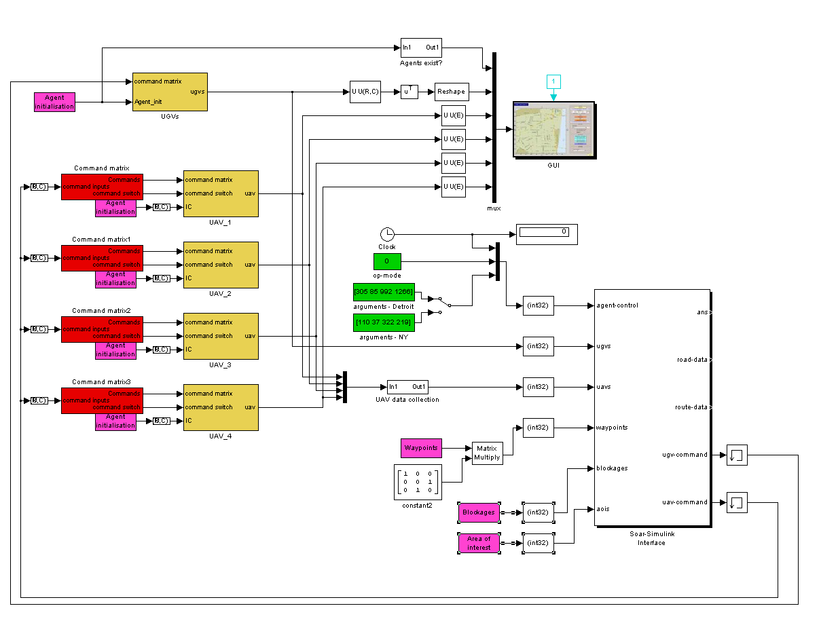
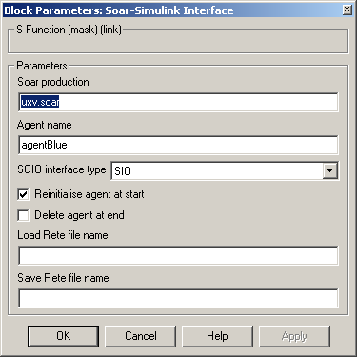
Simulink Implementation

Slide 6
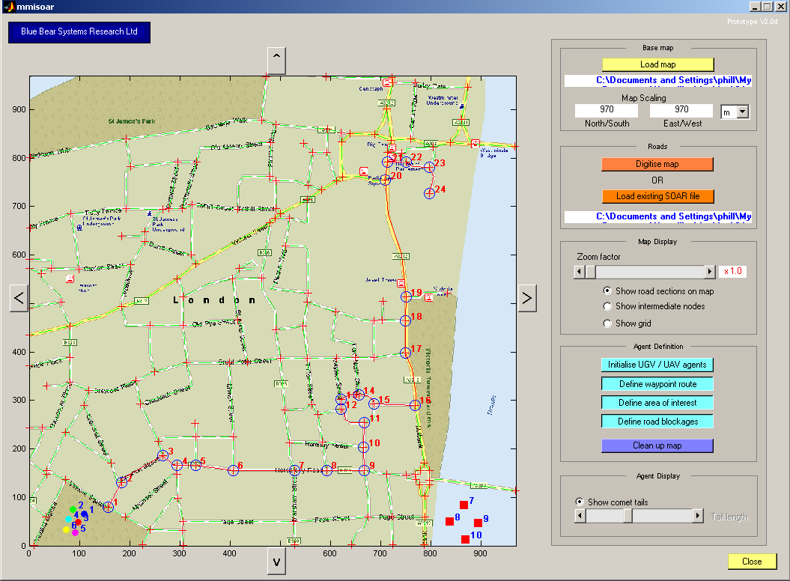
A Typical Run - 1

Slide 7
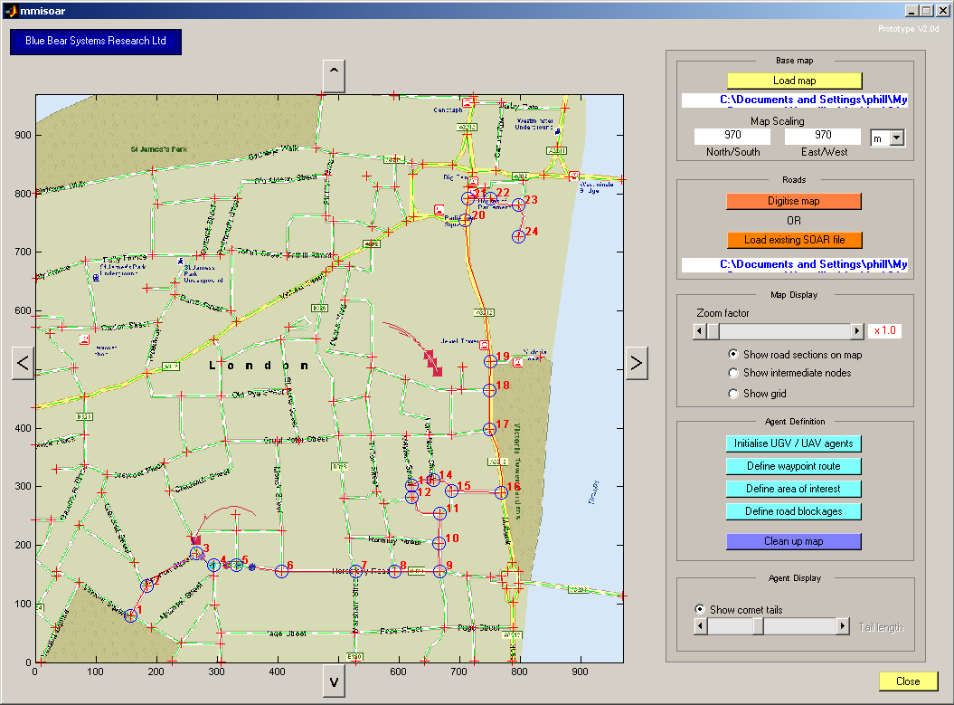
A Typical Run - 2

Slide 8

A Typical Run - 3

Slide 9
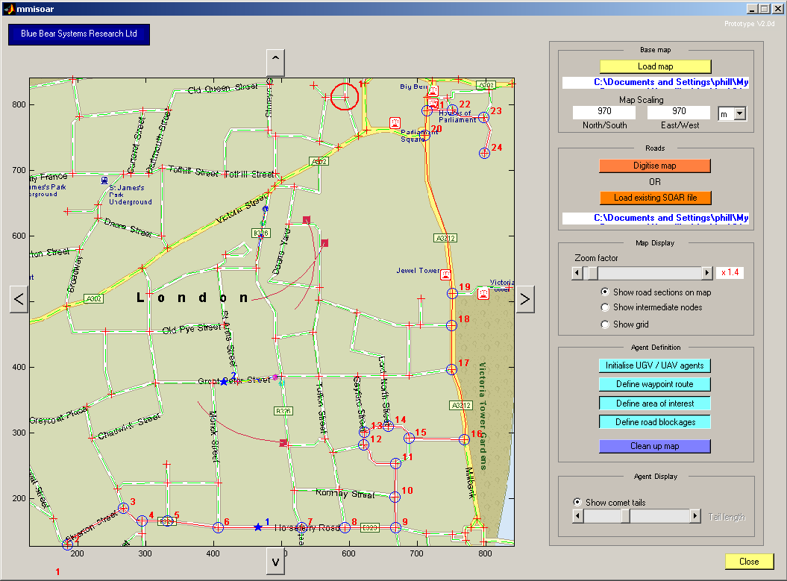
A Typical Run - 4

Slide 10
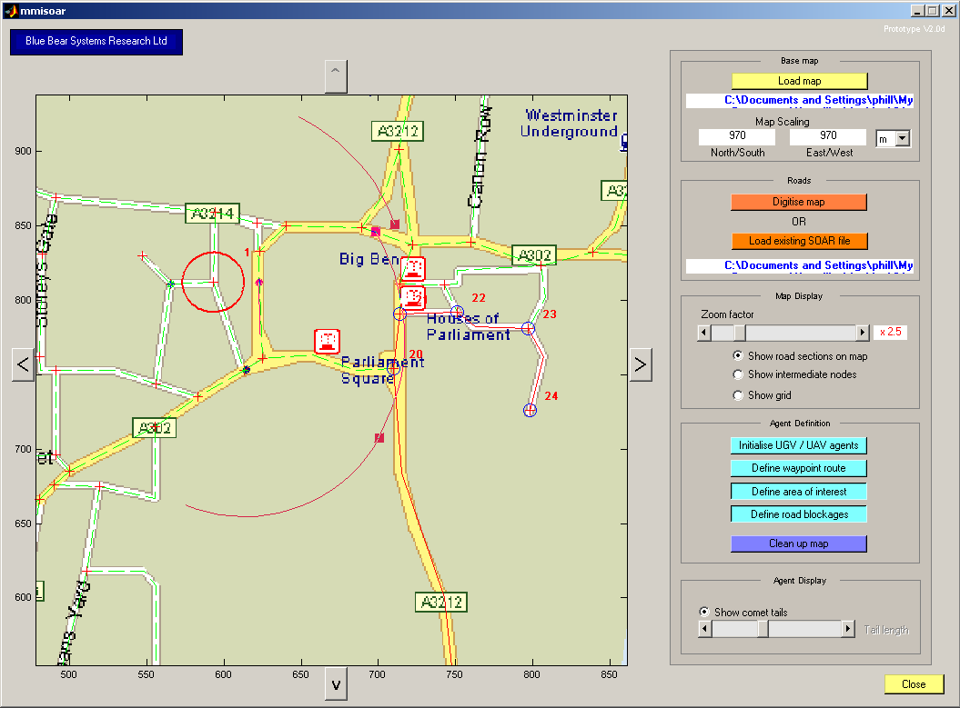
A Typical Run - 5

Slide 11
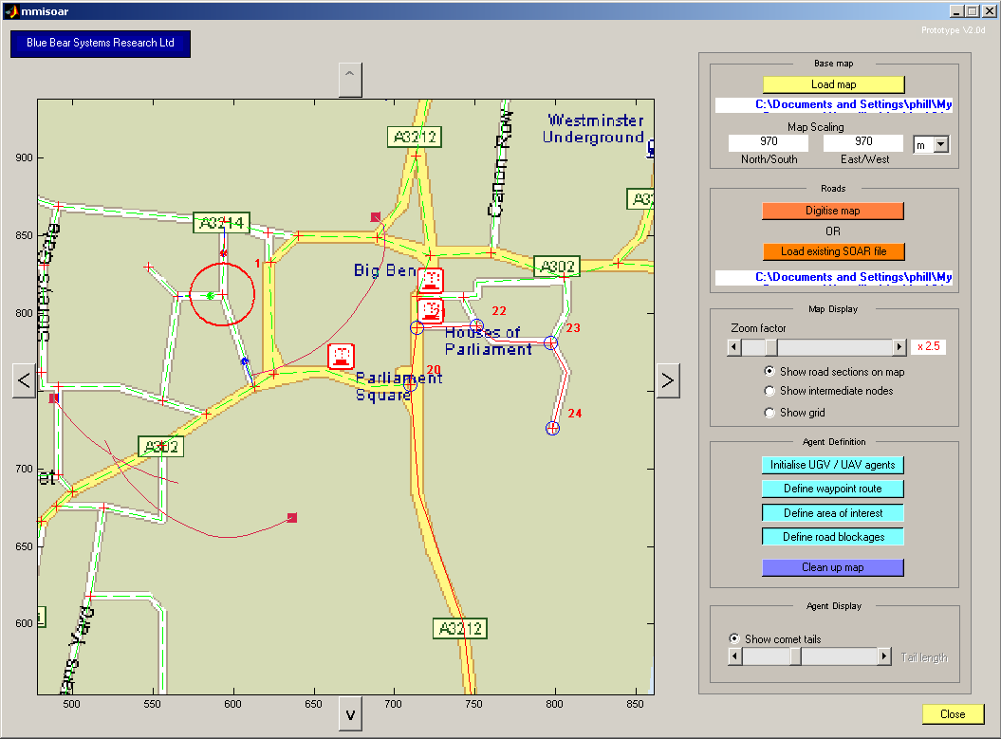
A Typical Run - 6

Slide 12
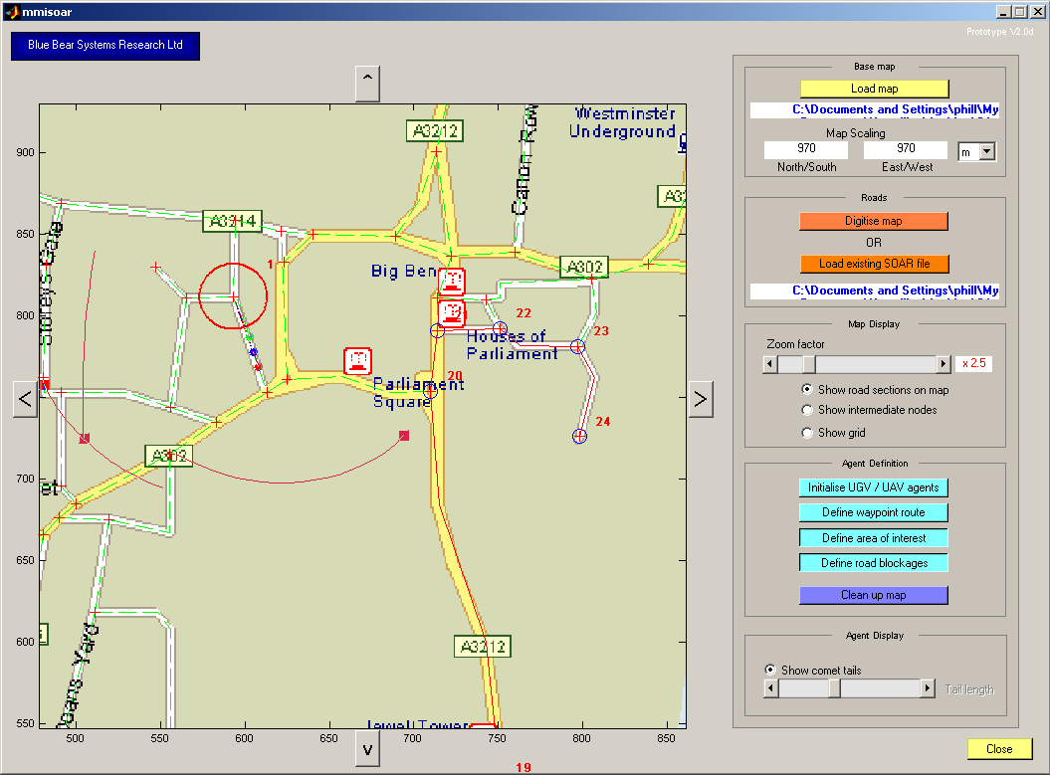
A Typical Run - 7

Slide 13
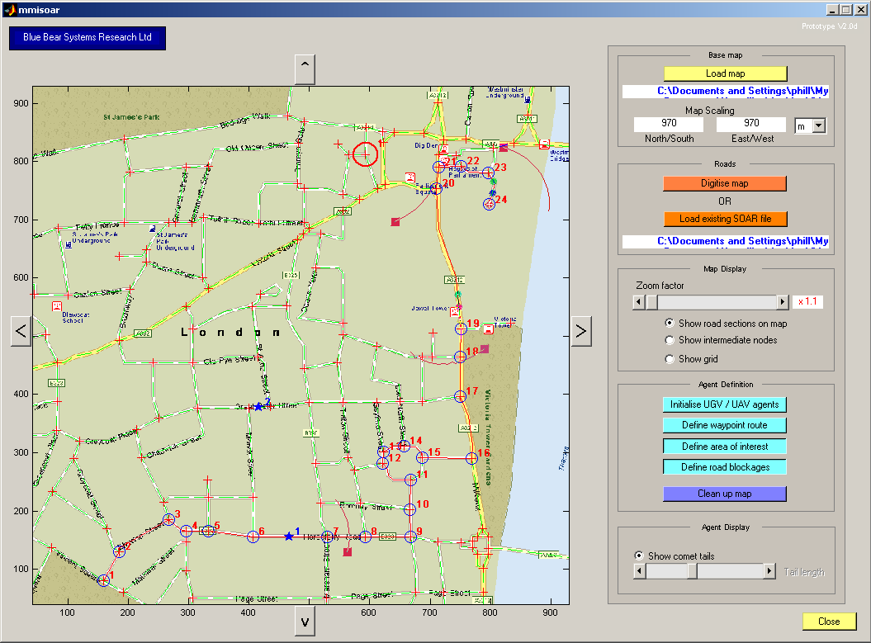
A Typical Run - 8

Slide 14
Project Next Steps
Exact detail to be determined
Moving towards hardware and experimentation
Will make use of our hardware developments
  Simon Willcox – presentation no. 12

Slide 15
Demo!

Slide 16
Conclusions
Soar is well suited to:
  Equipping vehicles with true autonomy
    Not just high level automation……
  Needs to be structured as a multi-agent system
    Lends itself to software teams, not just individuals
    Ease of code re-use
  Can be used in a vehicle systems engineering context
But….
  Software V&V issues
    Particularly with learning systems
  Certification issues for safety critical systems

