Slide 1


Soar Bugzilla
Jonathan Voigt
University of Michigan
Soar Workshop 24

Slide 2

On the Web
Interact with Soar Bugzilla using your favorite browser
https://winter.eecs.umich.edu/soar-bugzilla
Uses popular Bugzilla bug tracking software
http://www.bugzilla.org

Slide 3
What is Bugzilla?
Bugzilla is a bug and issue tracking system
Web (http) interface
Free & open source
MySQL back end
Used by many major projects
  Mozilla, Linux kernel, Gentoo, Apache, many others: http://bugzilla.org/installation-list/

Slide 4
Is Bugzilla better than SourceForge.Net Trackers?
SourceForge.Net is often slow
Bugzilla on our own server offers:
  More customization
  More control of database
  Ability to make corrections
Many other benefits

Slide 5
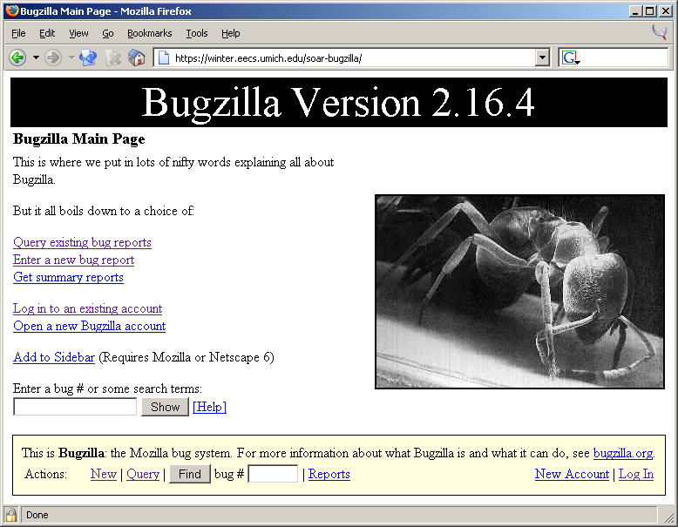

Slide 6
Using Bugzilla
Search for the bug (or desired feature/enhancement) using applicable keywords
  A Bugzilla account is not required for searching

Slide 7
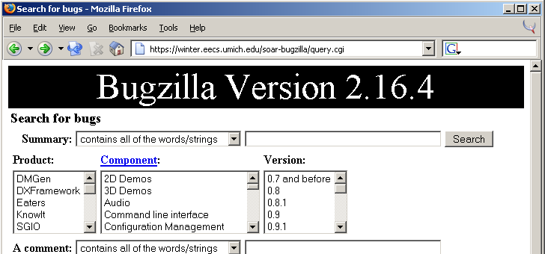
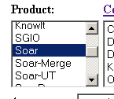


Slide 8
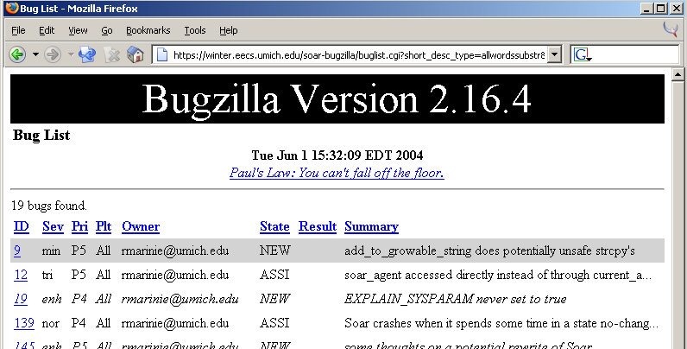

Slide 9
Entering a new bug
An account is required
Usernames are full email addresses
  Email notifications are sent when there is activity concerning the bug
Please search for the bug first
  If in doubt, enter the bug anyway

Slide 10
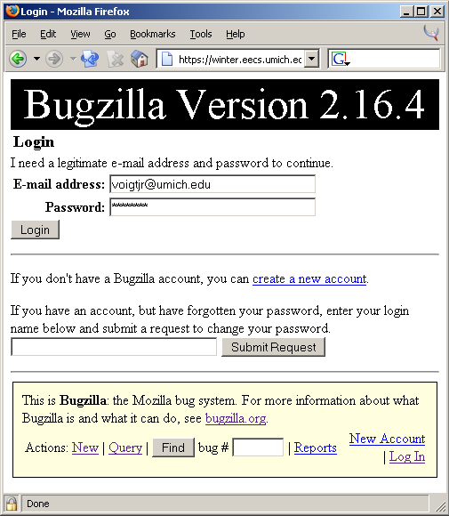

Slide 11
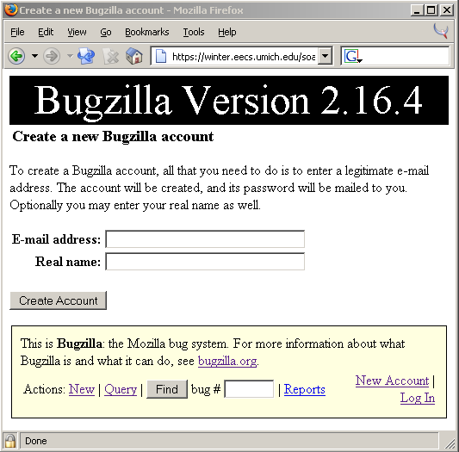

Slide 12
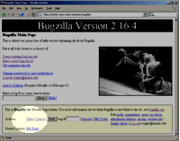
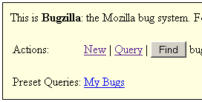
Enter New Bugs using Toolbar

Slide 13
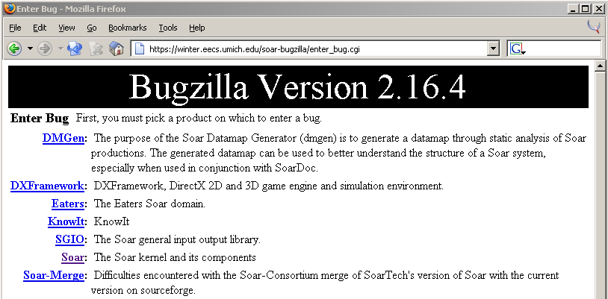

Slide 14
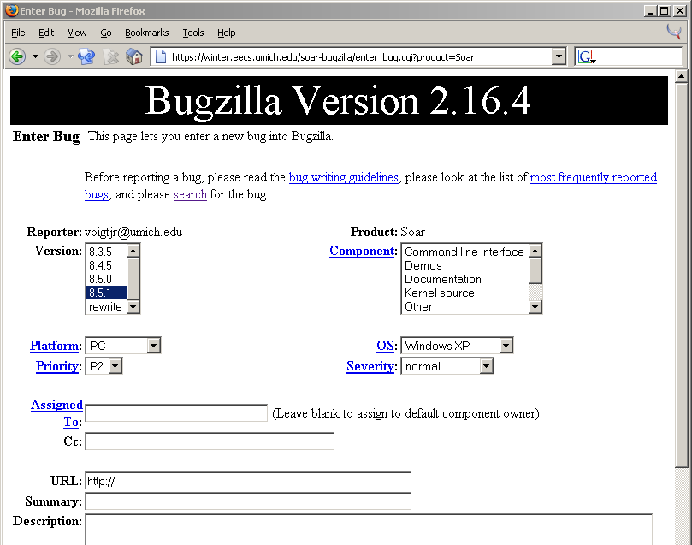

Slide 15
Each Bug/Feature/Enhancement…
Is assigned a unique ID
  Unique across all projects
  ID is the best way to refer to a bug
Is permanently archived
  Never deleted, instead enters ‘closed’ state

Slide 16
Attachments
Add attachments to bugs after the initial post
  There is no place to add them on the initial screen
Attachments are often source code, patches, and test cases but can be anything (uploaded through browser)

Slide 17
Questions
?

