Slide 1
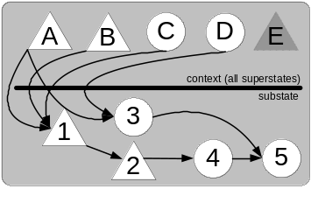
A Goal Dependency Set Primer
Robert Wray
Soar 24
10 Jun 2004

Slide 2
Why a Primer? Why now?
Covered in 1996/1997/1998/2001 Soar workshops
  Soar community changed a lot since GDS 1st conceived
  No Soar-specific documentation other than Soar 8 release notes
  Frustrated users
(draft) Soar GDS documentation now available
  Motivation for Goal Dependency Set (GDS)
  What the GDS does
  Constraints on agent design
    Memory management
    Operator elaborations
    Reentrancy
  Kernel level view
  Introduces other new (Soar 8) mechanisms

Slide 3
Terminology
I(nstantiation)-support
  Justification-based truth maintenance system
  Assertion persists only as long as it justified
    I-support: Production instantiation provides justification
  Applies to
    State elaborations
    Operator proposals (Soar 8)
    Operator elaborations (Soar 8, o-support-mode 4)
    Preference productions

Slide 4
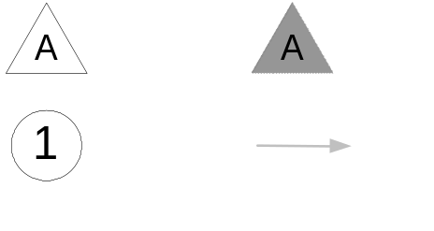
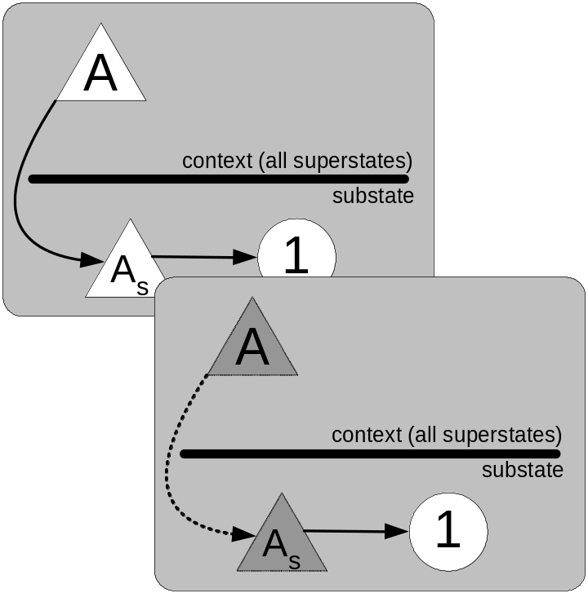
Terminology
O(perator)-support
  Operator applications
  remain in memory
  regardless of
  justification/instantiation
  New preferences are required
  to change an O-supported WME
  (e.g., reject)
  Applies to
    State elaborations
    Operator proposals (Soar 8)
    Preference productions

Slide 5
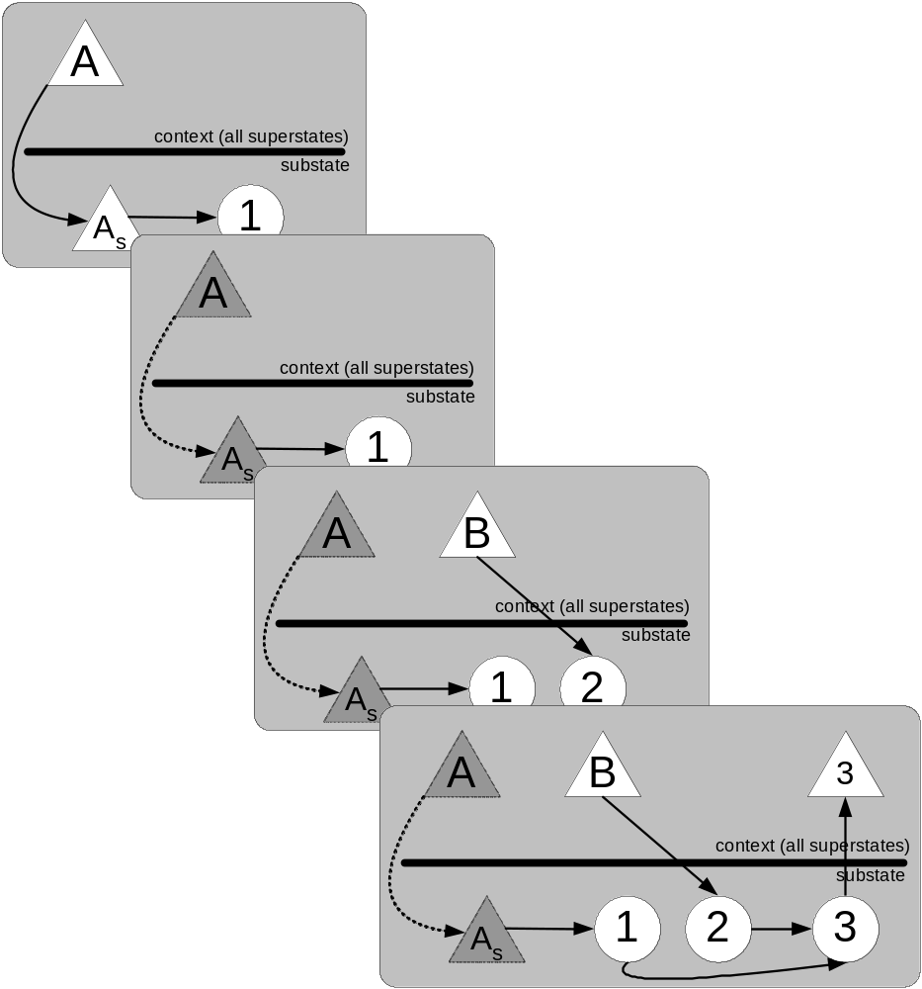
Motivation for GDS
Symbol level “quirks”
in Soar 7
  Problem space/state
  interactions with
  persistence
    Previous assertions can
    become inconsistent with
    newer information
  Non-contemporaneous constraints
  in chunks
    Learn a rule that has conditions
    that can never be simultaneously
    satisfied
Both problems require lots of low-level
knowledge design, possibly incomplete

Slide 6
GDS Solution
GDS ensures persistent WMEs within a substate are sensitive to superstate context(s)
  State, not individual element justification
  GDS := “I-support for states”
  Justification is updated dynamically as new persistent WMEs are asserted
GDS misnomers
  States, not “goals”
  GDS is the data structure, not the process
    Process: Dynamic Hierarchical Justification

Slide 7
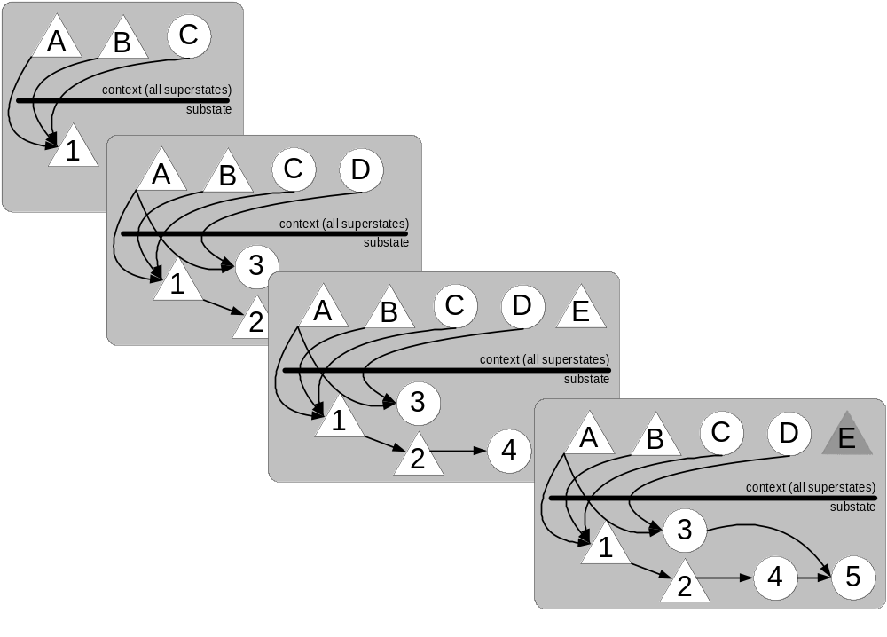
GDS Solution
GDS is NIL until/unless o-supported
elements have been asserted in the local state
GDS uses an algorithm comparable to chunking’s backtrace to establish dependencies for persistent WME
GDS is updated dynamically as new persistent assertions are created in the substate
Not every new persistent WME requires a backtrace

Slide 8
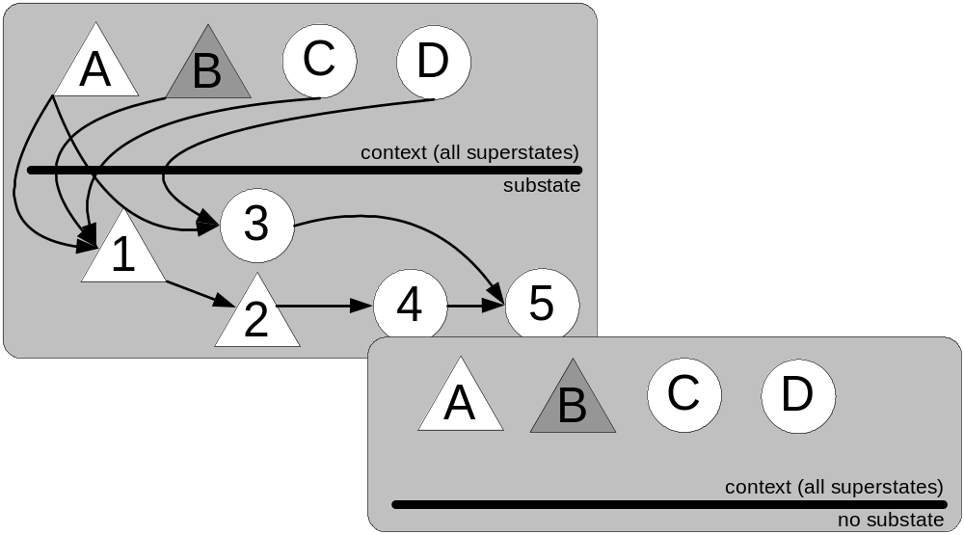
GDS Solution
Soar monitors WME changes for WMEs that appear in a state’s GDS…
When a GDS WME is retracted, Soar immediately removes the impasse state (retraction of the GDS state)

Slide 9
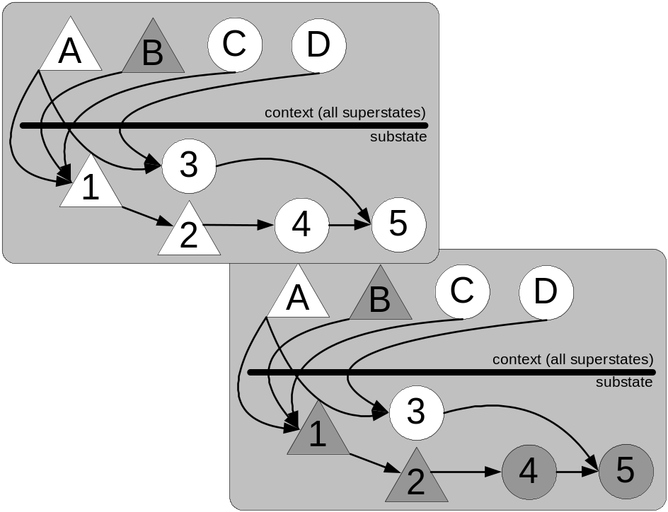
Alternative Solution
GDS assumes it is cheaper to regenerate
dependent assertions than to compute which WME changes should be associated with which persistent WMEs.
S-support retracted only dependent o-supported WMEs, rather than the entire state
S-support was potentially expensive and led to a number of technical problems

Slide 10
Impact of the GDS on agent design
Where to store o-supported assertions
  Depends on reason persistence was used
Operator elaborations
  Operator elaborations now receive I-support
  O-support-mode 4 (Soar 8.5.1)
  I-support ensures no effect on GDS
Reentrant problem spaces
  Any substate problem space can be interrupted at any time

Slide 11
Where to assert o-supported WMEs
Soar 21
Recurrent questions
  Why shouldn’t I just put all o-supported WMEs in the top state?
    Shouldn’t everything have global persistence?
  When should I return something to the top state?
    When should something have global persistence?
Answer:
  Reason for creating o-supported structures will tell you where they should be asserted

Slide 12
Categories of Persistence
Soar 21
Different reasons for using an operator to assert a WME:
Non-monotonic reasoning
Hypothetical reasoning
Remembering
Avoiding expensive computations
(see Soar 21 for specific examples of each)

Slide 13
Guidelines
Soar 21
If your o-supported WME is being created for: | It should be located in:
Non-monotonic R. Hypothetical R. | Local state Want changes in context/situation to be communicated to the local state
Remembering Avoiding Recalculation | Top state Want to be able to remember these things independent of any justification
Some combination of first group with second group | Top state Replacing an old value to be remembered (e.g., current-desired-speed) with a new one requires global persistence
Conclusions:
For most plan execution applications, all o-supported WMEs should be asserted in the top state
Inconvenient when o-support provided but not needed

Slide 14
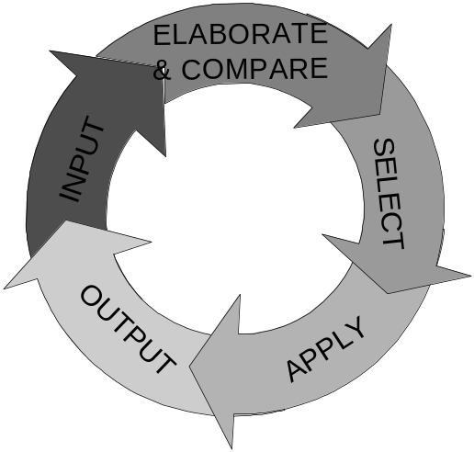
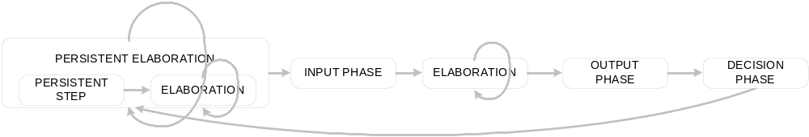
Augmenting the
GDS Solution
Soar 7 has other persistent WMEs
  context support (persistent operator selections)
    Eliminated in Soar 8/operator selections are I-supported
  “elaboration persistence” (interaction between i-support and o-support)
        Soar 8 decision cycle
        “Waterfall” (parallelism limited to prod firings w/i a goal)

Slide 15
Conclusions
GDS
+ Encourages reentrancy in design/simple, compact operator reps.
(more “Soar”-like implementations)
+ Provides a complete, architectural (reusable) solution to hierarchical inconsistencies
+ Makes it much easier to use chunking in dynamic domains
Breaks locality assumptions for most o-supported WMEs
Not well documented/understood by Soar community at-large
Not well implemented (“gradware”)
Management of top-state WMEs not well codified/explored
For Soar systems focused on plan execution in dynamic domains, most o-supported elements should be stored in the top state.
GDS seems to provide little utility and lots of frustration for non-learning systems (run-time flag?)
Function of documentation/understanding or a fundamental flaw?

Slide 16
Additional Information
GDS Primer
  http://www.speakeasy.org/~wrayre/soar/gds-primer.pdf
  Thanks to Brian Magerko, Bob Mariner, Andy Nuxoll, and Glenn Taylor for suggestions/comments on current draft
  More feedback needed/appreciated
Papers describing motivations for Soar 8 & solution specifics
  Wray, R.E. and J.E. Laird, An architectural approach to consistency in hierarchical execution. Journal of Artificial Intelligence Research, 2003. 19: p. 355-398.
  Wray, R.E. and R.M. Jones. Resolving Contentions between Initial and Learned Knowledge. in Proceedings of the 2001 International Conference on Artificial Intelligence. 2001. Las Vegas, NV.
  Wray, R.E. and J.E. Laird. Maintaining consistency in hierarchical reasoning. in Fifteenth National Conference on Artificial Intelligence. 1998. Madison, Wisconsin.
  Wray, R., Ensuring Consistency in Hierarchical Architectures, PhD Thesis in Computer Science & Engineering. 1998, University of Michigan: Ann Arbor.
  Wray, R.E., J.E. Laird, and R.M. Jones. Compilation of Non-Contemporaneous Constraints. in Proceedings of the Thirteenth National Conference on Artificial Intelligence. 1996. Portland, Oregon: AAAI Press.

