Slide 1
An Introduction to Herbal
Mark A. Cohen (1,2 ) Frank E. Ritter (2,3) Steve Haynes (3)
1 BA CS & IT Department, Lock Haven University
2 Applied Cognitive Science Lab, 3 Penn State

Slide 2
Project Goals:
Make it easier to learn how to program Soar
Promote the reuse of Soar code
Make it easier to understand running Soar models
Tools that Support these Goals:
  Herbal High-Level Language
  Herbal IDE
  Herbal Viewer

Slide 3
Herbal High-Level Language
The Herbal language is based on the definition of a Soar ontology
The language is XML based (RDF) and can be compiled directly into Soar code using XSLT
Developers can create Soar models in this language using a text editor, or with the help of the Herbal IDE

Slide 4
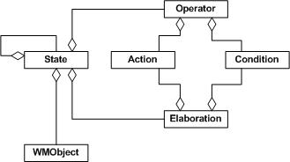
A Brief Look at the Herbal Soar Ontology

Slide 5
The Herbal IDE
Used to simplify the creation of models using the Herbal High-Level Language
Because models are written in Herbal by instantiating objects defined in an ontology, a graphical ontology editor seemed to be the best tool for the Herbal IDE -- thus Protégé was chosen for the Herbal IDE
Protégé is a free ontology editor developed by Stanford Medical Informatics that makes it possible to:
  Define a new ontology
  Import an existing ontology for reuse
  Create instances of classes in an ontology
Protégé can be extended, as needed, via custom Java plug-ins

Slide 6
Creating A Simple Model Using the Herbal IDE
Create a new project and import the Soar ontology
Define and import the classes that make up your problem domain, and instantiate initial working memory
Instantiate and import Soar objects that will define the behavior of your model
Compile into running Soar code

Slide 7
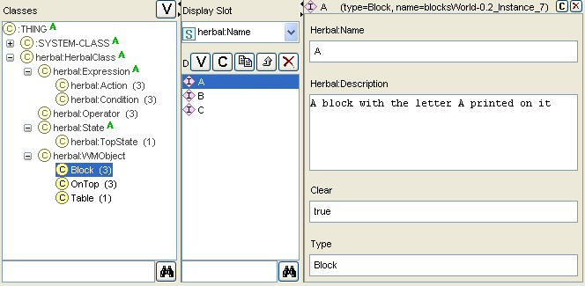
Define and Instantiate the Problem Domain

Slide 8
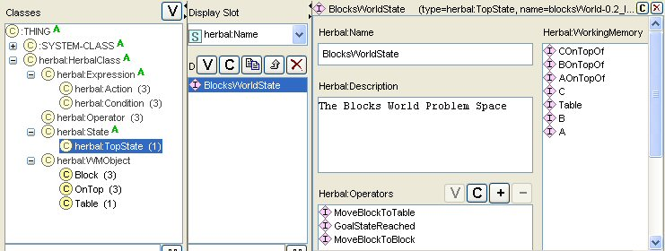
Defining Soar Objects

Slide 9
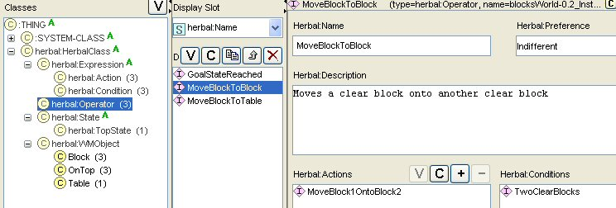
Defining Soar Objects (cont.)

Slide 10
Herbal Viewer
Generates displays of a running Soar model that will help explain the model’s behavior
Basic views work with all Soar models
More advanced views and explanations are based on model structures from the Herbal High-Level Language

Slide 11
Viewer Architecture
Herbal
Viewer
VISTA
Tcl Functions
Soar Productions
Soar
Events

Slide 12
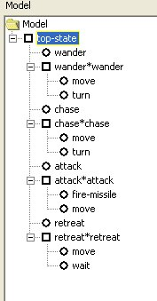
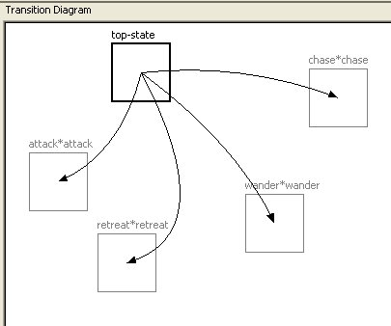
The Tree and Graph View

Slide 13
Current Status/Challenges
Language
  We have a created a simple blocks world model
  When I return we will start building slightly more complex models: dTank, ToH
IDE
  Protégé is serving its purpose -- we will be developing a few plug-ins for customization
Viewer
  Currently works for Soar models but does not yet use the language for creating better displays with more explanation
All Three Tools
  Will be used at PSU this fall for IST 402 Models of behavior
Challenges/Lumps of Coal
  The Soar ontology is a moving target: we are trying to keep it simple and at the same time identifying ways to inject information that can be used for explanation by the viewer
  Personnel changes

Slide 14
Acknowledgements/References
Acknowledgements
  Isaac Council
  Kevin Tor
  Geoff Morgan
  Urmila Kukreja
  Supported by Office of Naval Res. N00014-02-1-0021
References
  VISTA Developer’s Handbook, Soar Technology Inc. (see Glenn Taylor)
  Protégé: protégé.stanford.edu

