Slide 1

Automate: A Generalized Framework for Distributed Intelligent Process Automation
Syed Enam-ur-Rehman*
* Dept. of Computer Engineering, Sir Syed University of Engineering and Technology, Pakistan

Slide 2

Need
Complex logic
Hefty interfaces
Adding brains everywhere

Slide 3
Goals & Objectives
Generic platform for process automation
Standard hardware and software interfaces
High end intelligence
Scalable architecture
Real time process control
Easier implementation
Reusable components and services
Extendible architecture

Slide 4

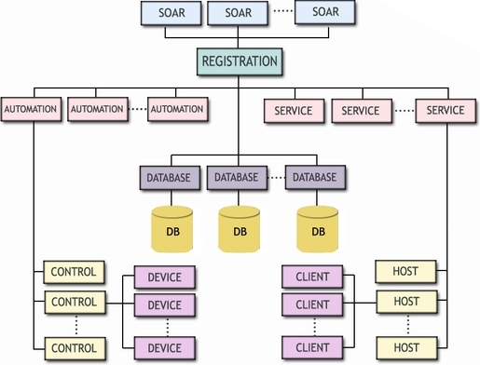
The Framework

Slide 5
System Flow
SOAR
AUTOMATION
SERVICE
DATABASE

Slide 6
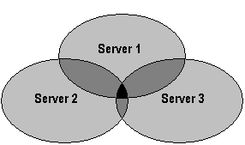
Device Philosophy

Slide 7
Device Table
Device Name
Ports
  Port Name
  Port Type
  Port Size
  Port Data / Value
Servers
  Name
Device Name
Ports
  Port Name
  Port Type
  Port Value
  Bit
    Bit #
    Pin #

Slide 8
Auto-Mate Cluster
REGISTERATION
ISCM
Server
ISCM
Client
ISCM
Client
ISCM
Client
ISCM
Client
SOAR
SERVICES
AUTOMATION
DATABASE

Slide 9
Server Table
Server name
IP address
Registration port
Command port
I/O port

Slide 10
ISCM
REG
I/O
CMD
ISCM
Auto-Mate Server
Server Table
Device Table
Other Table
User Console

Slide 11
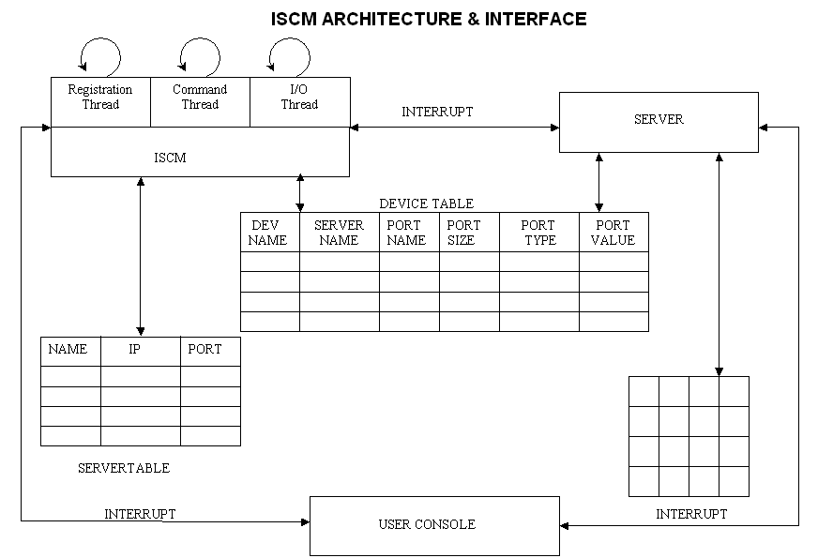

Slide 12
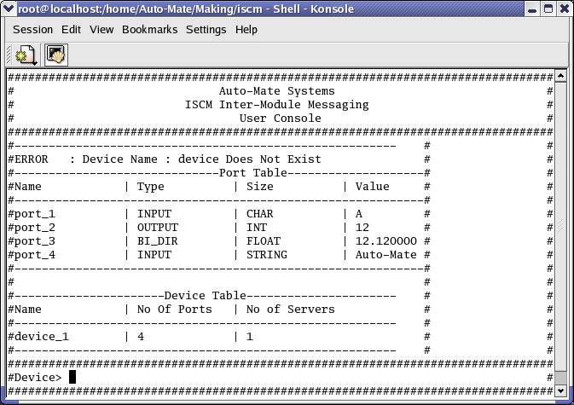
User Console

Slide 13
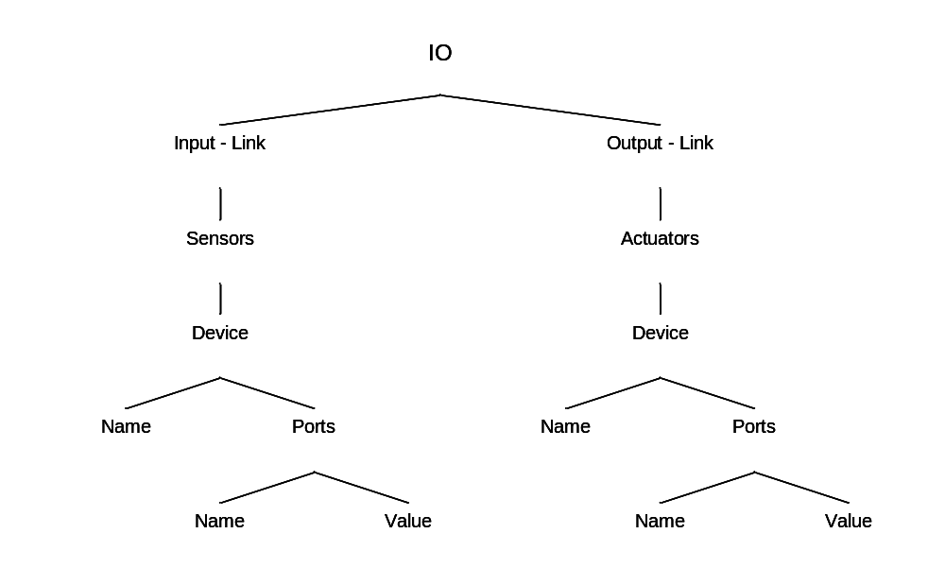
Auto-Mate Representation in Soar

Slide 14
Programmability
sp {propose*SWITCH-FAN-ON
(state <s> ^io.input-link <i>)
(<i> ^sensor <s1>)
(<s1> ^device <d1>)
(<d1> ^name THERMOMETRE
^port <p1>)
(<p1> ^name TEMP_READING
^value < 30)
-->
(<s> ^operator <o> +)
(<o> ^name output
^device <d2>)
(<d2> ^name FAN
^port <p2>)
(<p2> ^name ON_OFF
^value ON)
}
sp {apply*output
(state <s> ^operator <o1>
^io.output-link <o>)
(<o1> ^name output
^device <d1>)
-->
(<o> ^actuator <a1>)
(<a1> ^device <d1>)
}

Slide 15
Soar Server
Soar Server
Device Table
Module
Soar Module
ISCM
Soar API
Soar Kernel

Slide 16
Hardware Interconnection
PC
INTERFACE
ISA BUS
ADDRESS
DATA
IRQ
ADDRESS
DECODER
CS
INTERRUPT
HANDLER
DATA
CS
MUX
8255
(PPI)
IRQ
DATA
DRIVER
I/O
BUFFERS
DIR
BUS
CONTROLLER
DIR
MICRO CONTROLLER
DIR
INPUT
I/O
I/O
CONNECTORS
LED
DISPLAY

Slide 17
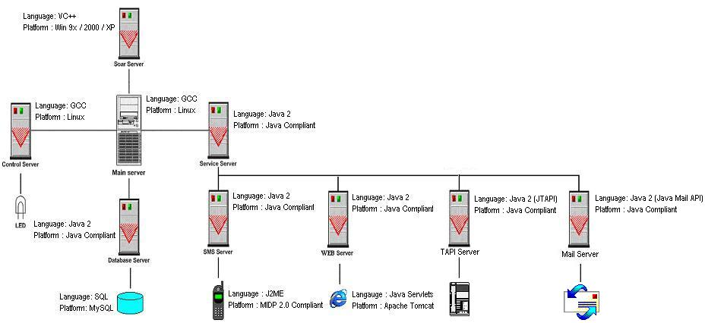
Prototype

Slide 18
Generalized Framework for Intelligent Process Automation
Single framework
Integration
Interoperability
Scalable
Extendible
Cost effective
Base for advanced research

Slide 19
Future Work
User friendly front-end
Graphical programmability
Security
Fault tolerance

Slide 20
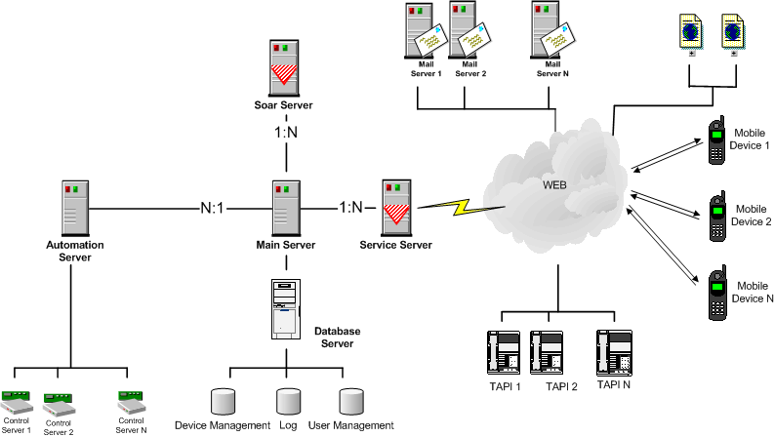
System Representation

Slide 21
senam@ieee.org auto_mate@yahoogroups.com

