Slide 1

DynaSoar
A Scalable Architecture for High Performance AI Applications
Syed Enam-ur-Rehman
Department of Computer Engineering
Sir Syed University of Engineering & Technology

Slide 2

AI Trends & Applications
Large Simulations
Behavioral / Social Modeling
Control Systems
Resource Management

Slide 3
Multi Agent Systems
Computation Intensive
Data Intensive
Communication Intensive

Slide 4
Goals & Objectives
High Performance
Transparency
Single System Image
Lower cost to performance ratio

Slide 5
The Architecture
DynaSoar Node 1
DynaSoar Node n
Utility Server
SK
SK
. . .
RA
Soar
API
Sch
RA
Soar
API
Sch
Registration
Management
Monitoring
INCM
INCM
INCM
INCM
INCM
SK Soar Kernel
RA Resource Analyzer
Sch Scheduler
INCM Inter-Node Communication Module
DSAPI Distributed Soar API
. . .
DSAPI
DSAPI
Environment
Environment
Environment
Node 1
Environment
Node n

Slide 6
Soar
Soar Kernel
  Core AI Engine
  Agent Maintenance and Execution
Soar API
  Wrapper to Soar Kernel
  Abstraction

Slide 7
Scheduler
Predective Task Scheduling
Load Balancing
Asymmetric Systems
Distributed Centralized

Slide 8
Resource Analyzer
Specifications
Availability
Usage History

Slide 9
INCM
(Inter Node Communication Module)
Gateway
Request Dispatch
Request Block
Searching
Allocation Tables & Updating
Abundant I/O Channels

Slide 10
DSAPI
(Distributed Soar API)
Interface
Utilizes INCM
Abstraction
Transparency
SSI
Agent Creation
Agent Interaction

Slide 11
Environment
User-space
Utilizes DSAPI
Single Entry Point
Distributed & Concentrated

Slide 12
Utility Server
Monitoring
Configuration
Registration
Master Allocation Table
Backup

Slide 13
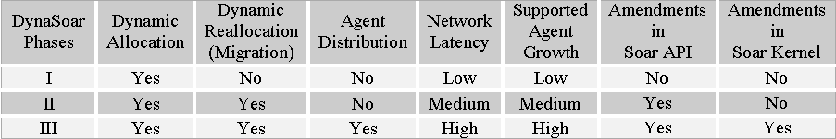
Development Phases

Slide 14
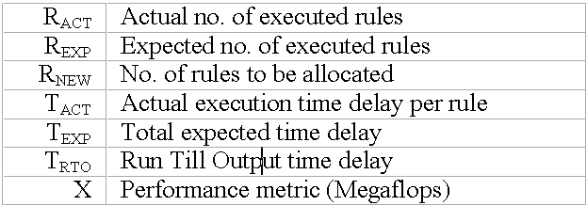
Scheduling Parameters

Slide 15
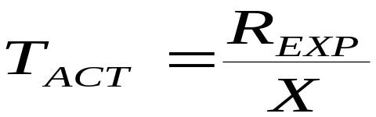
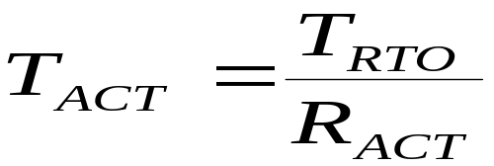
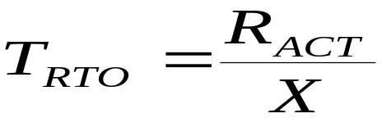
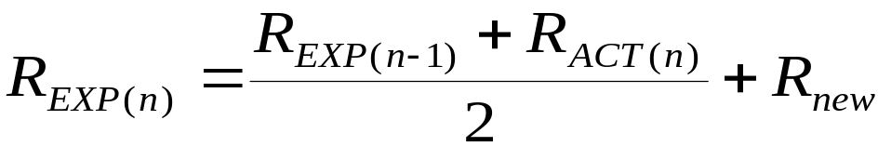

Scheduling Policy
If T_{RTO} = 0
If T_{RTO} > 0
For simulation purpose:

Slide 16
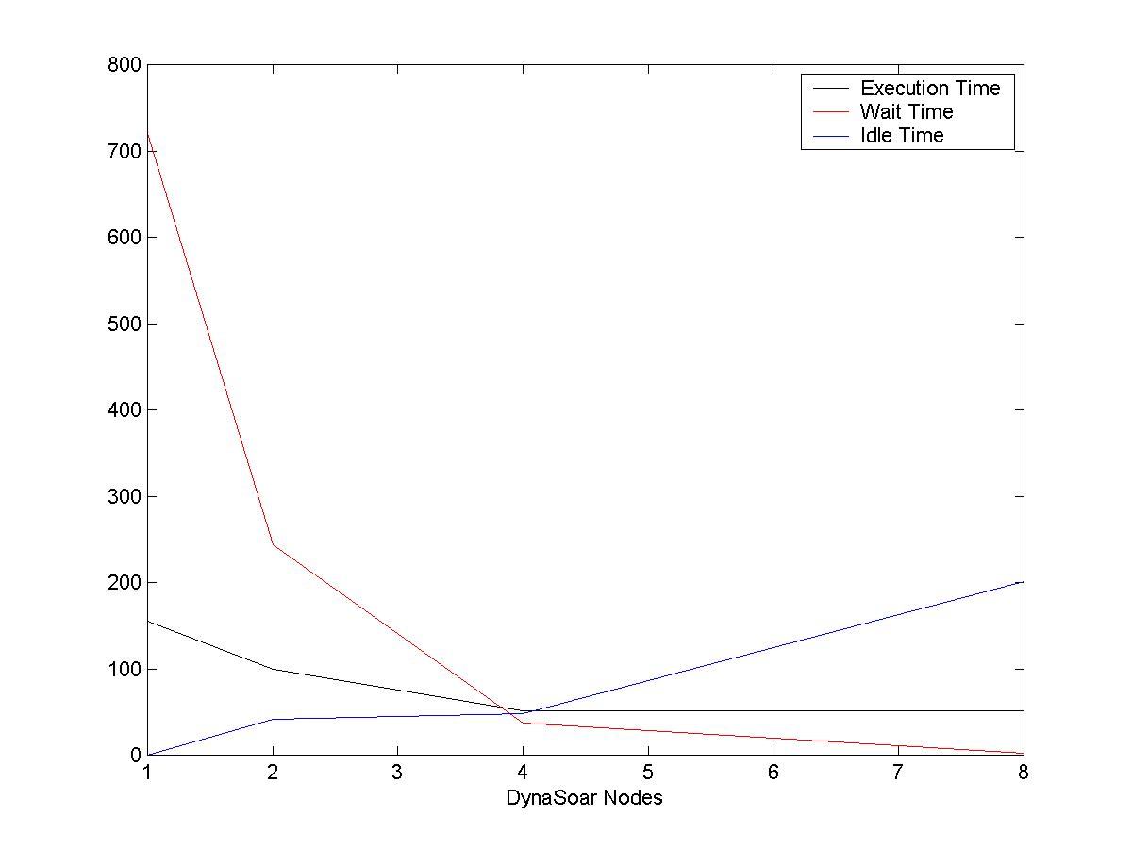
Speculation

Slide 17
Conclusion
Separate Execution of Soar & Environment
Uniform gain
Easier to implement Large AI Applications

Slide 18
Enquiries
Syed Enam-ur-Rehman (senam@ieee.org)
Usman Azeem Usmani (usman@vetolimits.com)
Nabeel Shaheen (nabeel@vetolimits.com)
Qazi Raheel Akhtar (raheel@vetolimits.com )
http://sourceforge.net/projects/dynasoar/

